Slide 1






The 22th Steering Group Meeting of the Priority Area 2
June 29, 2021, Online

Slide 2



AGENDA
10:00 Opening remarks, adoption of the agenda
10:10 Introduction of the participants (Tour de Table)
10:20 Report of the PACs: Progress since the 21th SG Meeting, plans for the next period
10:40 Recent developments and activities in EUSDR
10:55 Comparative assessment of NECPs (outcomes of the study, policy briefs, webinars)
11:15 Results of SG survey, discussion on SG mobilization and stakeholder involvement
11:40 COFFEE BREAK

Slide 3
AGENDA
12:00 Discussion: Rules of Procedure, Roadmap
12:20 Embedding, funding programs and discussion on project generation
13:00 Recent Developments in DSP
13:15 Discussion: Strategic processes/projects/flagships
13:30 Q&A, AOB, Closing words

Slide 4
Opening remarks
Ms Annamária NÁDOR, Hungarian PAC, Ministry of Foreign Affairs and Trade of Hungary
Mr. Lukáš LUKAČOVIČ, National Coordinator of the EUSDR, Office of the Government of the Czech Republic

Slide 5
Introduction of the Participants
Tour de Table

Slide 6
Report of the PACs: Progress since the 21th SG Meeting
Ms. Annamária NÁDOR, PAC (HU), Ministry of Foreign Affairs and Trade of Hungary
Ms. Zuzana SIMICOVA, Advisor (CZ), Ministry of Industry and Trade of the Czech Republic

Slide 7
Joint activities
2nd Progress Report (PAC project)
„Strategic Meetings” (monthly online consultations)
Participation at DSP workshops (e.g. Prerequisites for successful EUSDR implementation – Jan 19, Stakeholder management May 26)
Roadmap consultations with other PACs – see separate agenda point
Discussion on Working Groups – decision: postponed
Possibly Cooperation with UA on UA Presidency priorities

Slide 8
Progress on HU side
Towards an integrated National Energy and Climate Plan in the Danube Region – study, policy briefs, 2 online workshops (May 6: electricity and gas sectors, sector coupling, May 20 – RES-heating and transport) - see separate agenda point
Stakeholder database update – see separate agenda point
Update of website https://energy.danube-region.eu/category/news/2020/ - 9 news in 2021 (events, policy reports, etc.)

Slide 9
Progress on HU side
Brochure on energy storage - underground heat storage facilities – online publication
DSP „Success stories” EUSDR 10 years: (1) Energy storage, (2) Clean transport
Project support: the project partners of the Interreg Europe project, SETUP „Smart Energy Transition to Upgrade Regional Performance“, offered PA2 to take part in the 1 year continuation of the project. The main project´s objective has been the improvement of energy performance of the 6 partner regions based on an interregional exchange regarding the regional competencies on smart grids. The continuation will focus on the possible tools for balancing the power grids, mainly on battery storage and hydrogen, which became even more important during the pandemic, because of the unexpected and dramatic changes in demand and offer. The continuation is currently under approval.

Slide 10
Plans for 2021 Q3-Q4 HU side
Finalization of NECP recommendations
Progress with DESTINE interactive website – fill up missing menus + interactive map
Green district heating
Roadmap? (see discussion later)

Slide 11
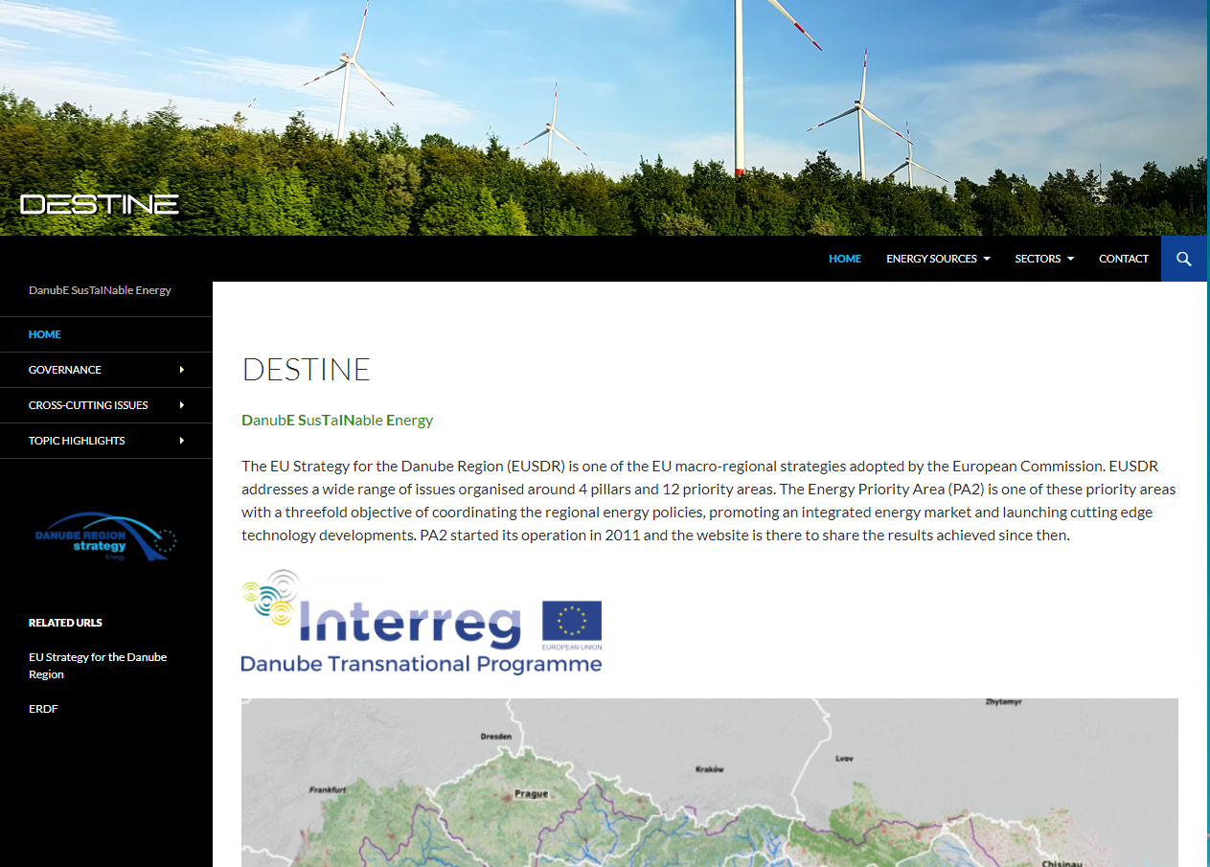
Danube Region Sustainable Energy - DESTINE
Energy sources
renewables
  geothermal
  solar
  biomass
non-renewable
  gas
alternative
  waste
  hydrogen
Sectors
electricity
heating and cooling
transport
Governance
EU
Danube Region
Country
Cross-cutting issues
Financing opportunities
Project databases
Topic highlights
market connectivity
energy storage
energy efficiency
energy poverty

Slide 12


Progress on CZ side
Support of the events: Municipal Climate Conference Baden-Württemberg 2021„ & Young Dialogue
Initiative Manifesto for young people by young people to shape the European cooperation policy
ESPON Territorial Scenarios 2050 for EUSDR & EUSAIR – TEVI 2050
Active Involvement of SG Members & Stakeholders within PA2- see agenda point

Slide 13
Plans for 2021 Q3-Q4 CZ side
Call for subcontractor of a study „Energy efficiency in buildings“- first introductory presentation at the next SG Meeting tbc
Update of RoP
Ongoging progress on actively involvement of SG Members & Stakeholders
Contribution to the ESPON Territorial Scenarios study
& Manifesto for young people
Organisation of next SG Meeting- in which form?

Slide 14
Recent Developments in EUSDR
Mr. Johan MAGNUSSON, Team Leader – Danube and Baltic Sea Regions, European Commission

Slide 15
Follow up: „Comparative Assessment of the National Energy and Climate Plans (NECPs) of the EUSDR countries “ – Policy Briefs and Webinars
Ms Katalin VARGA, Regional Centre for Energy Policy Research (REKK), Hungary

Slide 16
Presentation of the Outcomes of SG Survey
1. Participation and contribution of SG Members - on average on scale Nr. 3
2. Involvement of SG Members- proposals based on the answers given in the questionnaire
3. Thematic focus of PA2 - on average on scale Nr. 4
4. General communication between PAC´s and SG Members- well reviewed
5. Involvement of SG Members at the SG Meetings on average scale 3-4

Slide 17
Our proposals as basis for the discussion
TO MAINTAIN OUR NETWORKING
TO DO LIST FOR PA2 COORDINATION
Discussion Tour de Table at SG Meetings
More interactive Meetings in a lively and fruitable way
Promotion of EUSDR 10 years brochure among the institutions/countries
Periodic Survey before SG Meeting
To share project ideas/ conference invitiations
More Experts to the SG Meetings
Workplan for a certain period/ Roadmap
Subscription of news at the PA2 Website

Slide 18
Roundtable Discussion: SG mobilization and stakeholder involvement

Slide 19
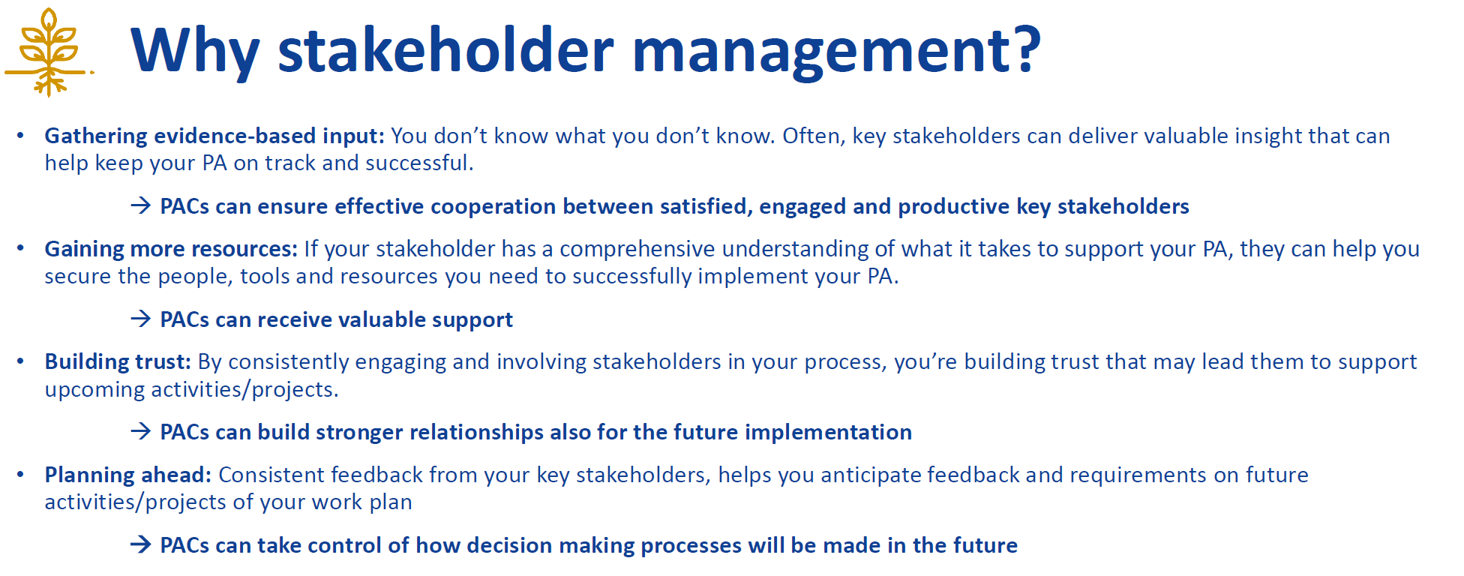
DSP workshop on Stakeholder management (May 26 – online)
Based on DSP workshop materials

Slide 20
Stakeholder involvement
Update of stakeholder list (based on PA2 request) - 2020 Q4, 2021 Q1:
Country | No of stakeholders | Update (Y/N)
AT | 6 | Y
BH | 41 | Y
BG | 2 | N
HR | 12 | N
CZ | 8 | Y
D | 27 | Y
HU | 343 | Y
MD | 1 | N
Country | No of stakeholders | Update (Y/N)
MNG | 0 | N
RO | 9 | N
SRB | 5 | Y
SK | 5 | N
SI | 4 | N
UA | 2 | N
INT | 29 | Y
SUM | 494 / 151
Also asked: Type, Profil

Slide 21

Priority Area 2- EU Strategy for the Danube Region
Sustainable Energy

Slide 22
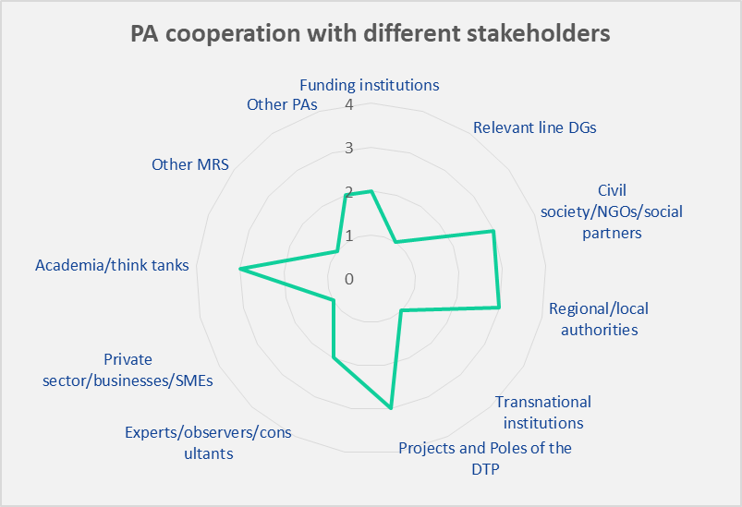
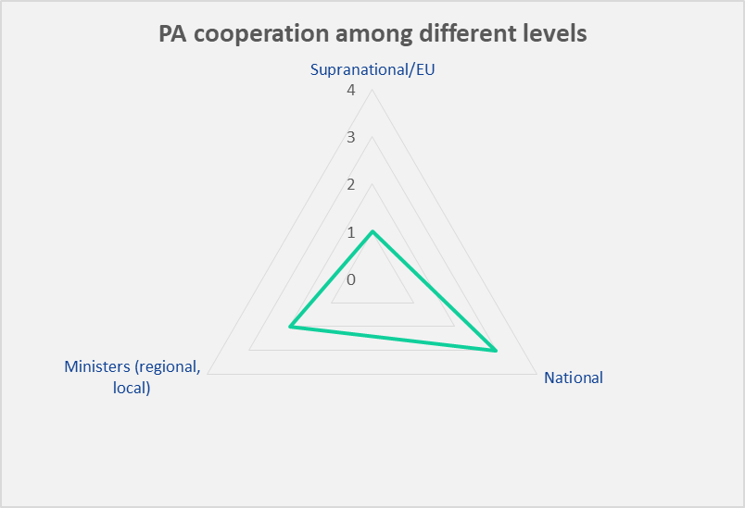

Slide 23
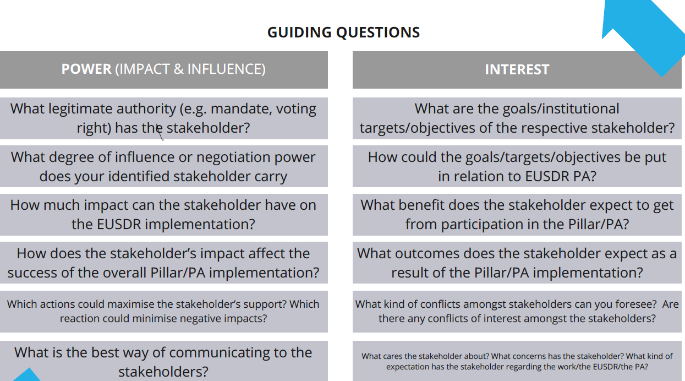
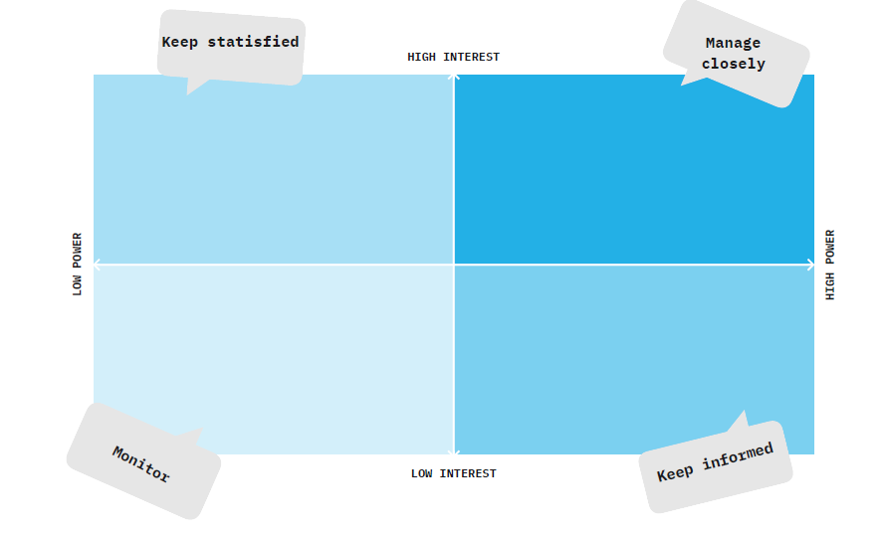
Way forward
Power-interest grid

Slide 24
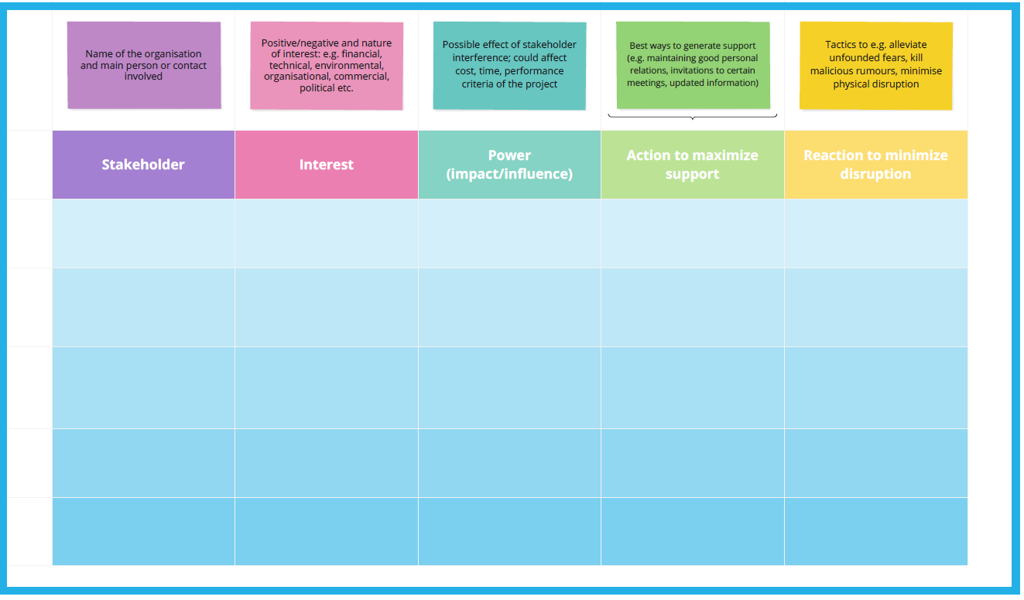

Slide 25
Roundtable Discussion: Stakeholder involvement
Feedbacks?
2nd round to update stakeholder list? (Stakeholder mapping)
Steps from Stakeholder mapping to stakeholder management
How to assess? DSP methods?
Start with selected groups? Which ones?

Slide 26

Coffee Break

Slide 27
Revision of Rules of Procedures (RoP) and Roadmap
Aim of the RoP
maintain rules by organizing SG Meetings and establishing WG´s
update our needs and wishes accordingly
launch a smooth structure of PA2 and encourage decision making powers of SG Members
Next steps: CZ side will prepare a draft autumn/winter 2021
!ROP WILL BE UP TO US!

Slide 28
Roadmap
Online meeting, March 30, 2021 (PACs) : joint position on the update of Roadmaps
Preparation and regular update of Roadmaps is set out in the EUSDR Governance Paper of the Danube Region Strategy
Roadmap: PA’s „internal” tool to monitor the progress of the implementation of the Action Plan, however no extra monitoring or reporting is foreseen
Long term ≠ Performance of the 3 years PAC projects!
Principle requirement: Roadmaps should be closely tied to the EUSDR Action Plan

Slide 29
Roadmap
Online meeting. March 30, 2021(PAC-s) : joint position on the update of Roadmaps
Aims of a Roadmap:
a functional EUSDR governance, cooperation between EUSDR NCs and PACs;
using Roadmaps as background documents for future DTP PAC projects from 2023 onwards (~ 7 years);
mid-term planning of PA activities;
a harmonised approach among the PAs (taking into account PA related specificities) for future updates, the embedding process and the future monitoring

Slide 30
Roadmaps – state of art
No roadmaps available so far (open for roadmaps in consultation with SGs): PA 1b, PA 2, PA 3, PA 7, PA 8, PA 10
Roadmap (partially) available for old AP: PA 1a, PA 4, PA 5, PA 6, (PA 9), (PA 11)
Roadmaps available or working on/considering new AP: PA 1a, PA 4, PA 5, PA 6, (PA 11)

Slide 31
Roadmaps – discussion
Very diverse views of PAC-s (50% for, 50% against: extra administration, no added value, etc.)
Roadmaps are considered highly individual in each Priority Area.
Due to the diverse PA structures and modes of implementation of the Action Plan, a high degree of flexibility is needed.
Many PAs already use Roadmaps, however under different names and different modi. Therefore, individual solutions for each PA, flexible and tailor-shaped, seem to be the best way to approach the Roadmaps. A unified approach throughout all PAs does not seem feasible at this stage.

Slide 32


Slide 33
Roadmaps – discussion
Does PA2 need a roadmap? - VOTE (now, or in written form after the meeting)
Format? (presented table or another?)
If yes – draft to be presented at the next SG (Nov-Dec 2021)

Slide 34
Presentation of funding programs, discussion on project generation
Ms Annamária NÁDOR, Hungarian PAC, Ministry of Foreign Affairs and Trade of Hungary
WHY? AP, ACT. 9: To encourage project generation related to the energy field
Target: to generate 15 successful proposals, making use of all relevant funds and programmes, in the next programming period (until 2027)

Slide 35
Actualities of the Danube Strategy Point
Ms Katharina LENZ, Pillar Officer, Danube Strategy Point

Slide 36
Discussion: Strategic projects, processes, flagships
Ms Katharina LENZ, Pillar Officer, Danube Strategy Point

Slide 37
AOB, Q&A

Slide 38
Closing words
Ms Zuzana SIMICOVA, Advisor (CZ), Ministry of Industry and Trade of the Czech Republic
Ms Annamária NÁDOR, PAC (HU), Ministry of Foreign Affairs and Trade of Hungary

Slide 39

Thank you for your time and valuable inputs!

