Slide 1

National Energy and climate plans in the danube region
Katalin Varga
program director
REKK Foundation
22nd Steering Group Meeting of the Priority Area 2
June 29, 2021

Slide 2
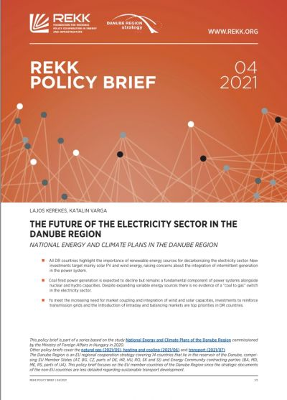
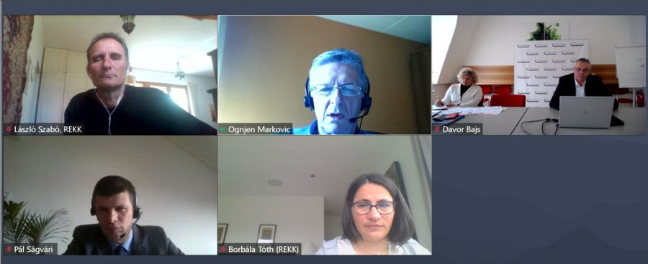
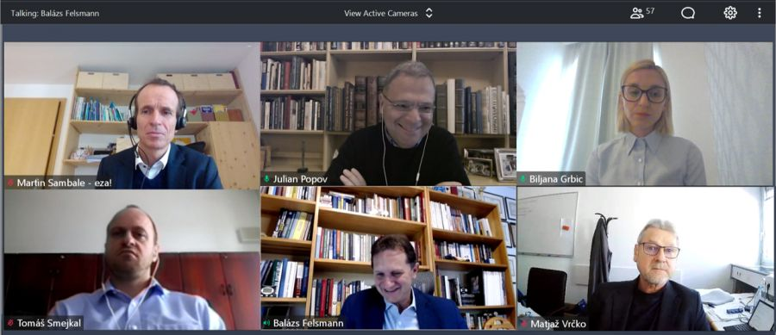
Outline
Quick summary of the long study „National Energy and Climate Plans in the Danube Region”
Further activities
  Policy briefs
  Webinars
Take-aways from the project

Slide 3
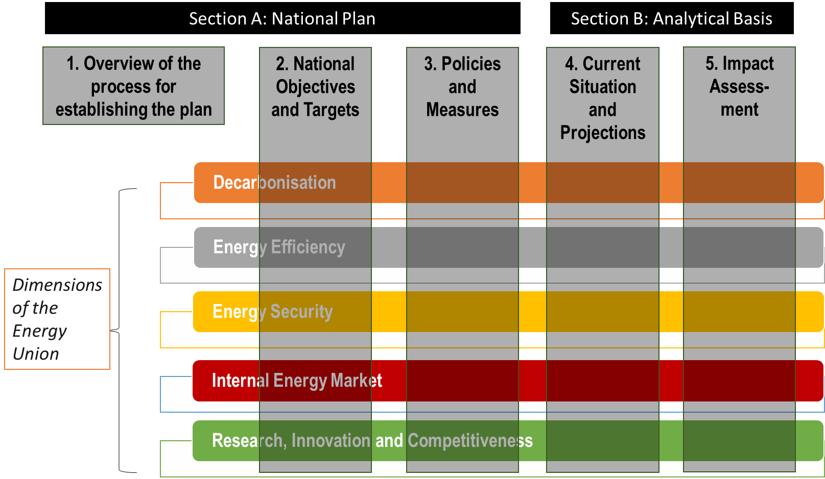
Summary of the study
Structure of the NECPs
Structure of the study
INTRODUCTION
1 Climate policy goals and status of interim target achievement
1.1 Climate policy goals of the European union
1.2 Status of 2020 target achievement
1.3 Factors hindering target achievement
2 The structure and required content of NECPs
2.1 The role of National Energy and Climate Plans
2.2 Structure and required content
3 Overview of NECPs by policy areas
3.1 Decarbonisation, GHG emissions
3.2 Renewable electricity
3.3 Renewable heating and cooling
- Use of biomass
3.4 Transport
3.5 Energy efficiency of buildings
3.6 Industry decarbonisation
3.7 Natural gas
- The role of Hydrogen and synthetic gas
3.9 Electricity
- System flexibility
3.11 Sector coupling
4 Possible impacts of policies on other member states and regional cooperation
SUMMARY, CONCLUSIONS, RECOMMENDATIONS
Objectives
Measures
Impacts

Slide 4
Policy briefs

Slide 5
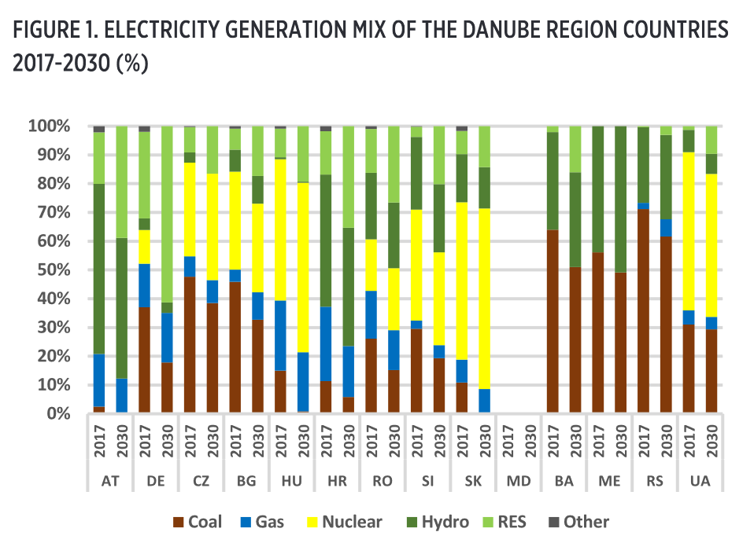
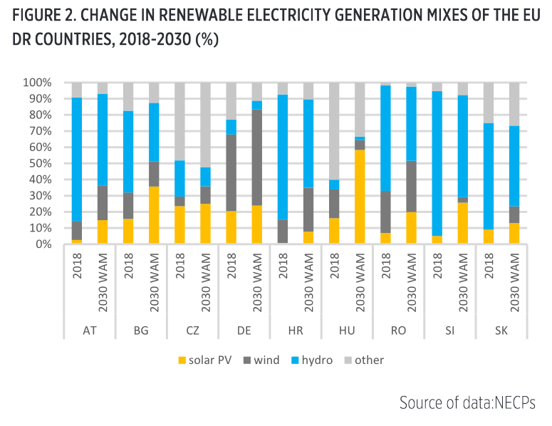
1) The future of the electricity sector in the Danube Region
Main messages
DR countries appear committed to taking steps toward decarbonizing their electricity sectors and increasing the role of renewable energy, however ambitions and development differ markedly.
Coal-based power generation will be diminished but remain an important source in several EU and the non-EU DR countries. This seems to neglect the exposure to increasing CO2 prices and the compromised economic viability of coal and lignite-based generation.
Several NECPs refer to gas as a transitional fuel that will replace aging coal-fired power plants, but there is no evidence of the “coal to gas” switch in the electricity sector.
While the current DR renewable energy capacity mix is predominately hydro-based, growth in the next decade will mainly be driven by solar PV and onshore wind energy raising concerns on integrating intermittent generation.
The policy brief is available at the PA2 website here.

Slide 6
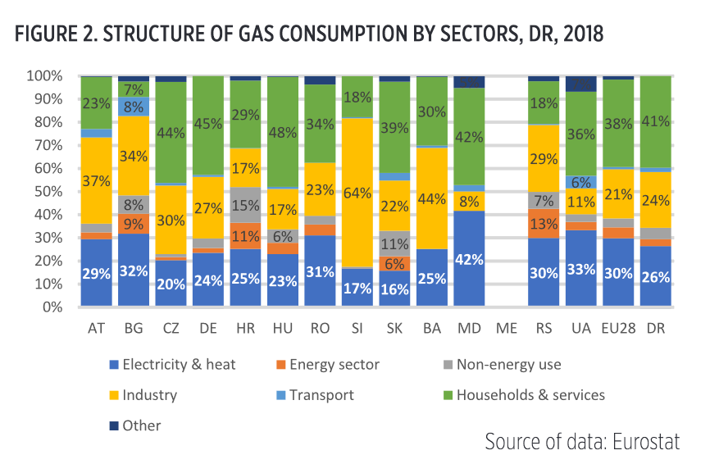
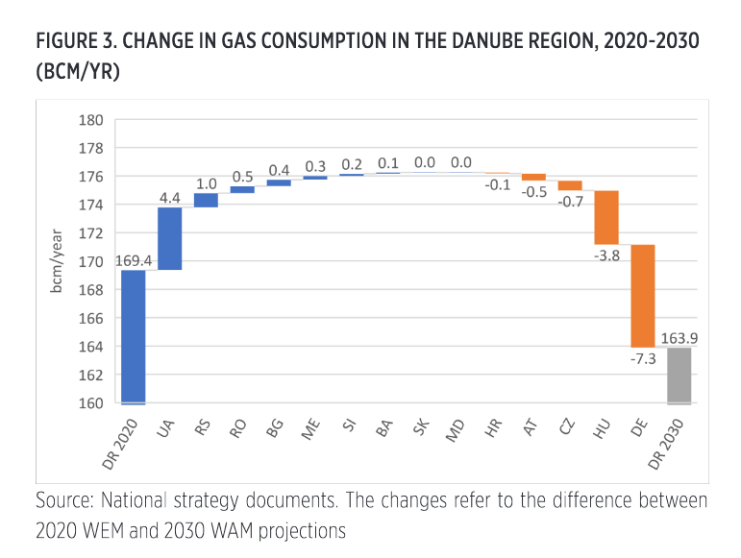
2) The future of natural gas in the Danube Region
Recommendations
No subsidies shall be provided to fossil fuels and those in operation should be phased out.
A clear signal should be sent to project promoters not to invest into assets that will be unprofitable after 10-15 years.
A tailor-made plan is needed to provide decarbonized alternative heating at affordable prices for low-income consumers.
Energy efficiency and building renovation plans must be supported through training and education of skilled workers and by setting up reliable and independent advisory service transparently.
Introducing natural gas to new markets should not be supported. Coal, biomass and other fuels should be switched to direct electrification and renewable solutions. Gas can be a bridging fuel where the infrastructure already exists, mostly in the power sector, but in new markets renewable solutions should be the way forward.
The policy brief is available at the PA2 website here.

Slide 7
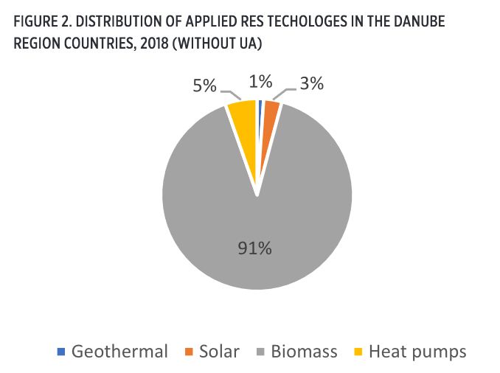
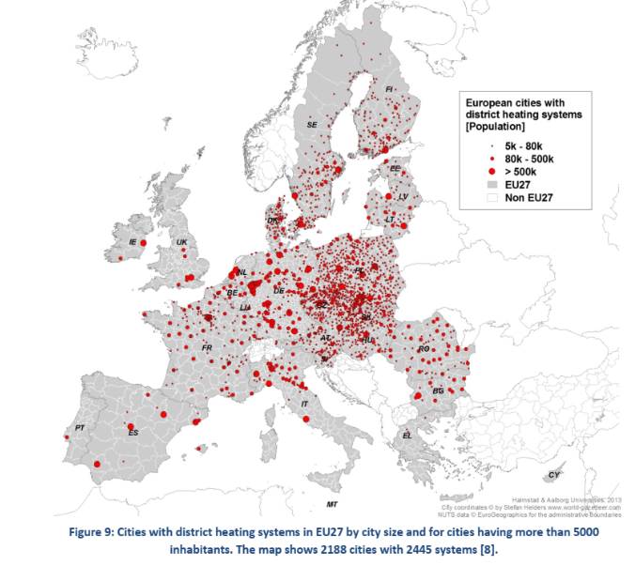
3) The development of renewable heating and cooling in the Danube Region
Recommendations
Stable and predictable support for modern renewable H&C systems to create a level playing field for biomass alternatives in the district heating and household heating sectors.
The potential for geothermal energy needs to become a higher priority where it can be exploited at a reasonable cost. Modern individual and collective heating systems shall be positioned to replace fossil-fuel-based heating, including the use of natural gas.
Household firing of biomass in old, outdated stoves should be phased-out with support for modern heating devices and energy efficiency improvements.
Climate and energy related strategies should consider the huge potential of the LULUCF sector to cheaply sequester and store carbon through the introduction of policy instruments that reward its economic value.
The policy brief is available at the PA2 website here.

Slide 8
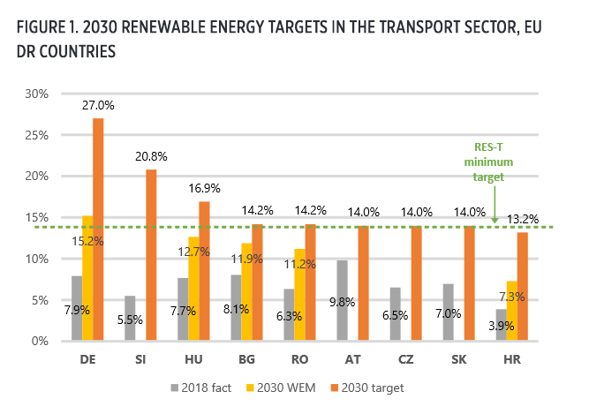
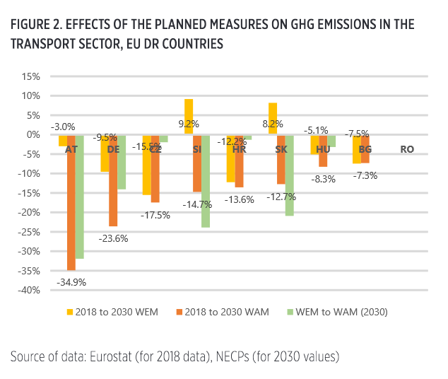
4) Renewable targets and policies in the transport sector of the Danube Region
Recommendations
Incentivizing modal-shift to less CO₂-intensive transport modes should be more essential part of the plans.
The development plans for non-motorised transport modes could also cover pedestrian infrastructure.
CO₂-based taxation and pricing (tolls and fees) should replace tax allowance and subsidy systems.
Implement support schemes for advanced biofuels and related blending requirements.
Consumer awareness campaigns should be widespread and fundamental to sustainable mobility strategies.
The policy brief is available at the PA2 website here.

Slide 9
Webinars

Slide 10
NATIONAL ENERGY AND CLIMATE PLANS OF DANUBE REGION COUNTRIES - Electricity and Gas Markets
May 6
Discussion:
Challenges of phasing out coal-fired power plants
The role of natural gas as a bridge fuel (pros and cons)
Can a shift to renewables be affordable?
Panelists:
Pál Ságvári, Vice President for International Affairs, Hungarian Energy and Public Utility Regulatory Authority (HU)
Karolina Cegir, Gas Expert, Energy Community Secretariat
Davor Bajs, Infrastructure Expert, Energy Community Secretariat
Ognjen Markovic, Project Expert, Regional Cooperation Council (BiH)
Number of participants: 88
The presentations and a summary is available at www.rekk.org/events.

Slide 11
NATIONAL ENERGY AND CLIMATE PLANS OF DANUBE REGION COUNTRIES - Renewable Heating & Transport
May 20
Discussion:
Differences in the way biomass is used in Western DR countries and CEE/SEE countries, the problem of energy poverty
Initiatives in district heating
Major mobility revolution is happening, which is not reflected by the NECPs.
Panelists:
Biljana Grbić, Advisor, Energy Community Secretariat
Julian Popov, Fellow, European Climate Foundation
Tomas Smejkal, Head of the Strategy Unit, Ministry of Industry and Trade (CZ)
Martin Sambale, Expert, EZA - Energie- und Umweltzentrum Allgäu (DE)
Matjaž Vrčko, Head of Public Transportation Division, Ministry of Infrastructure (SI)
Number of participants: 59
The presentations and a summary is available at www.rekk.org/events.

Slide 12
Take-aways

Slide 13
Take-aways
EU Danube Region countries put big effort in preparing their NECPs.
The insights and recommendations might provide useful assistance for the preparation of the upcoming NECPs of the non-EU Danube Region countries.
Insights and recommendations can also be taken into consideration for the following updates/revisions of NECPs of EU member states.
The decarbonisation of our economies must happen fast, we share a huge responsibility to avoid traps and lock-ins.

Slide 14
Thank you for your attention
Katalin Varga
katalin.varga@rekk.hu
www.rekk.hu

