Slide 1


EEA along the Danube

Slide 2
Project title: "EEA along the Danube”
Project funding: State Ministry of Baden- Württemberg
Project budget: approx. 190.000 € total budget (currently under revision)
Project duration: 01.02.2022 - 31.08.2024

Slide 3



Project and Cooperation partner:
Danube Office Ulm/ Neu- Ulm
(Application and coordinating partner)
Association European Energy Award AISBL
(European coordination)
KEA Climate Protection and Energy Agency Baden- Württemberg GmbH
(technical expertise EEA)

Slide 4
Target group:
representatives of the national (ministerial) level,
representatives of the municipal (e.g. mayor) level,
relevant (local) stakeholders (e.g. energy agencies, NGOs), who will coordinate the programme in the future (e.g. training and supervision of eea advisors and auditors).

Slide 5
The aim of the project "EEA along the Danube“:
to make the European Energy Award (EEA) better known in the Danube Region and thus to promote its distribution and application in the Danube Region.
Interested partners from the Danube Region will be introduced to a quality management and certification procedure that is already established in the European reference framework and offers a practice-oriented approach to the topics of climate protection and Green Deal at the local level.

Slide 6
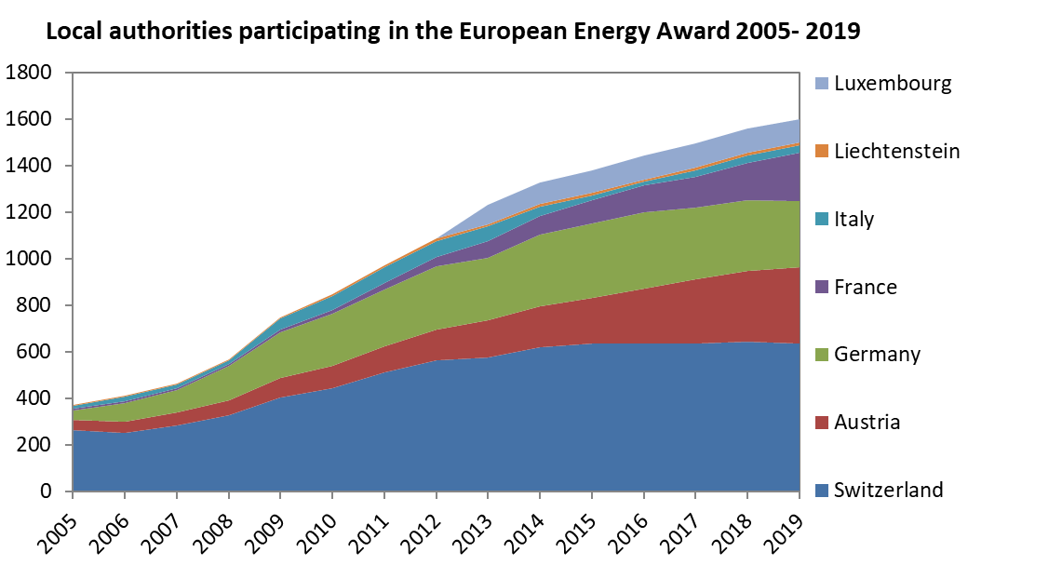

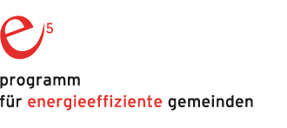




The European Energy Award Who we are
Non-profit international Association (as umbrella organization), seat in Brussels 18 European countries, 1700 local authorities
Constant growth in countries and local authorities since 30 years
European Union Strategy for Danube Region,
PA 2 „to encourage more sustainable energy“

Slide 7

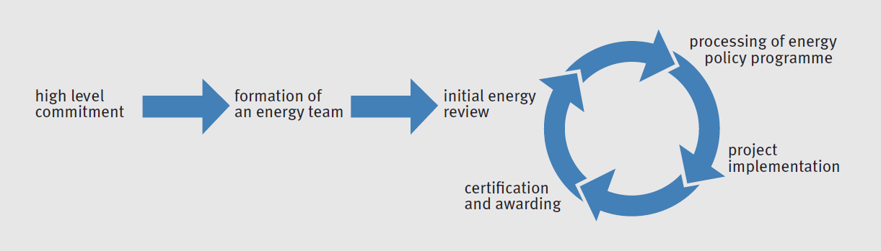





The European Energy Award A quality management and awarding system
eea catalogue of 60 measures > IDEAS / BEST PRACTICES BENCHMARKING / NATIONAL PRIORITIES
Internal, interdepartemental team > EFFICIENCY AND EFFICACITY
External, accredited eea advisor > IDEAS / KNOW-HOW / QUALITY
> MOTIVATION
External audit every 4 years
> QUALITY ASSURANCE
Yearly internal audit
> REGULAR FOLLOW-UP
European Union Strategy for Danube Region,
PA 2 „to encourage more sustainable energy“

Slide 8
The European Energy Award Relevant areas of local action
climate adaptation, air quality circular economy, smart city aspects
European Union Strategy for Danube Region,
PA 2 „to encourage more sustainable energy“

Slide 9



The eea along the Danube Existing partnerships
Long-term countries with national programmes Austria (e5), Germany (eea)
Pilot countries (and corresponding pilot partners and projects)
Croatia (REGEA North West Croatia Regional Energy Agency)
Bulgaria (EnEffect Center for Energy Efficiency) Slovenia (KSSENA Energy Agency of Savinjska, Šaleška and Carinthia) Romania (RoGBC Romanian Green Building Council)
Ukraine (MinRegion, EECU Energy Efficient Cities of Ukraine)
Serbia
European Union Strategy for Danube Region,
PA 2 „to encourage more sustainable energy“

Slide 10
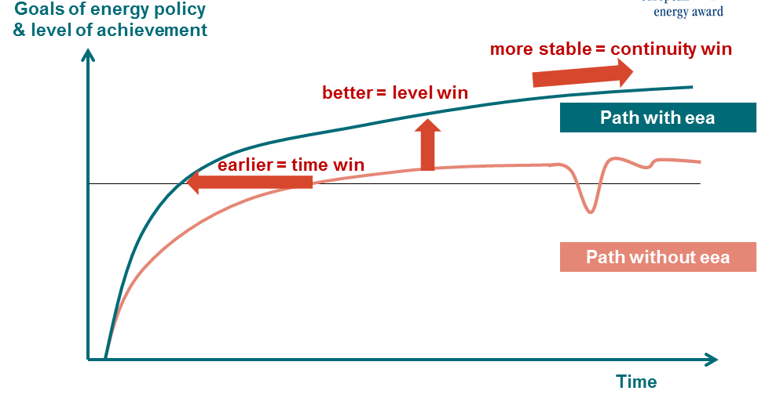
The European Energy Award Conclusion – Benefits of the eea for the national level
Translate international and national goals into local policy recommendations
Support municipalities in reaching their climate targets and improve performance with national climate targets (break-down national targets to local level)
Offer guidance to municipalities, create a praxis-oriented network of local authorities
Access to and involvement in international tools and processes, exchange of experiences
Access to innovation topics, like climate adaptation, smart cities, circular economy), international network, EU projects
International and national benchmark
European Union Strategy for Danube Region,
PA 2 „to encourage more sustainable energy“

Slide 11
Project objectives:
to publicize and promote the EEA in the Danube Region
Capacity building of local authorities, partners and institutions with regard to the EEA and the implementation of local climate protection measures
Initiate structural development in the participating regions/municipalities; find partners and possible implementers.
European Union Strategy for Danube Region,
PA 2 „to encourage more sustainable energy“

Slide 12
Identify pilot countries/regions/municipalities to prepare for independent implementation of the EEA (possibly in a follow-up project).
Contribution of the selected regions/municipalities to the achievement of the European climate goals
Contribution to sustainability and environmental protection in the Danube Region
EEA serves as an instrument for the practical establishment of national and local structures for climate protection
Within the project there will be no certification of EEA- advisers and EEA- auditors.
European Union Strategy for Danube Region,
PA 2 „to encourage more sustainable energy“

Slide 13
Project Content
Module 1: research and analysis
Module 2: information and networking
Module 3: preparation phase and capacity building
Module 4: presentation and public relations
European Union Strategy for Danube Region,
PA 2 „to encourage more sustainable energy“

Slide 14
Project Content
Analysis (study) of the status quo of the EEA-relevant criteria in the Danube region
strategy planning (acquisition municipalities and regions)
a. o. Online information and launch event
online mid-term conference
final conference and securing of results at the International Danube Festival 2024, Ulm
Module 1: research and analysis
Module 2: information and networking
European Union Strategy for Danube Region,
PA 2 „to encourage more sustainable energy“

Slide 15
Project Content
workshops in the selected regions/municipalities
exchange with existing pilot regions in the Danube region
initiation of the development of the required structures and preparation of the implementation phase
presentations and professional exchange to strengthen the network.
e. g. Study Visit in Germany with participants from the pilot regions
Integration into the EEA network/ EEA events
Module 3: preparation phase and capacity building
Module 4: presentation and public relations
European Union Strategy for Danube Region,
PA 2 „to encourage more sustainable energy“

Slide 16
Thank you for your attention

Slide 17
Contacts
Ms. Rapp
Danube Office Ulm/ Neu- Ulm
n.rapp@donaubuero.de
Tel.: +49 (0)731 880306 – 18
Mr. Graf
eea Office
valentin.graf@european-energy-award.org
Tel.: +41 (0)44 21310 - 22
Notes:
Ms Simicova will forward the presentation to you. If you are interested, you will find more detailed information on the planned project content in the appendix. Furthermore, we provide you with a presentation with more detailed information on the EEA for your further information.
We are pleased if we have raised your interest and look forward to answering your questions.

Slide 18
>more detailed information on the modules of the project
(further information on the EEA can be found in a separate presentation)
European Union Strategy for Danube Region,
PA 2 „to encourage more sustainable energy“

Slide 19
Module 1: research and analysis
Analysis of the current situation in the Danube region (status report/study) and strategy planning (acquisition municipalities and regions).
Objectives Module 1:
To obtain an overview as comprehensive as possible of the status quo of the EEA-relevant criteria (including relevant stakeholders, administrative structures, municipal options for action etc.) in the Danube region.
In addition, the acquisition phase of as many interested partners as possible in the Danube region should be completed by the end of Module 1.
European Union Strategy for Danube Region,
PA 2 „to encourage more sustainable energy“

Slide 20
Module 2: information and networking
Online information and launch event on the project and the EEA; presentation of the status report; online mid-term conference on the interim status of the project; final conference and securing of results for the International Danube Festival 2024.
Objectives Module 2 :
to have informed as many of the existing contacts as possible about municipal possibilities for action in the field of climate protection and the EEA as an instrument
to have identified (a maximum of) four pilot regions
to have promoted information and networking on the EEA in the Danube Region (establishment of an "information network").
European Union Strategy for Danube Region,
PA 2 „to encourage more sustainable energy“

Slide 21
Module 3: preparation phase and capacity building
In-depth workshops in the selected regions/municipalities; exchange with existing pilot regions in the Danube region; initiation of the development of the required structures in the selected regions and preparation of the implementation phase.
Objective Module 3:
Each pilot region has developed an individual roadmap for the introduction of the EEA (responsibilities, possible financing, next steps, network and contact persons, acquisition of pilot municipalities etc.) and has it available.
European Union Strategy for Danube Region,
PA 2 „to encourage more sustainable energy“

Slide 22
Module 4: presentation and public relations
The entire project implementation is continuously accompanied by public relations work, presentations and opportunities for professional exchange to strengthen the network.
European Union Strategy for Danube Region,
PA 2 „to encourage more sustainable energy“

Slide 23
Module 4: presentation and public relations
Planned activities and events are:
Promotion campaign for the International Danube Festival 2022
Presentation at the Annual Forum of the EUSDR 2022 is planned.
Study Visit in Germany or Austria with participants from the pilot regions
Project participants will be integrated into the EEA network and can participate in EEA events
Promotion of the project accompanying the final conference at the International Danube Festival 2024
European Union Strategy for Danube Region,
PA 2 „to encourage more sustainable energy“

