Slide 1
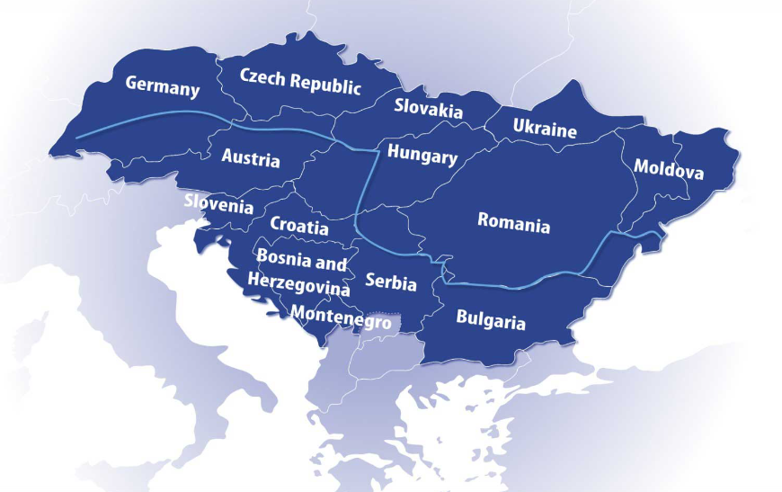
Possibilities for reducing Russian gas dependency of the Danube Region
Péter Kotek
Gábor Horváth
24 June 2022
24th Steering Group Meeting of the Priority Area 2

Slide 2
Content
Project introduction
aim
timeline
methodology
Country fact sheets
Current state of play on Russian gas dependency in the Danube Region
Annexes: detailed description of indicator data sources and calculation methodology

Slide 3
Aim of the project and methodology
Gas dependency status of DR countries
Country fact sheets, easy-to digest indicators and infographics
Methodology: Statistics, data analysis
Effects of phasing out Russian gas in DR by scenario analysis
Methodology: Modelling with EGMM (price effects, changing flow patterns, need for curtailment, supply structure)
Supply side: modelling infrastructure additions / LNG
Demand side: Reduction potential of power, industry and building sector on the short and mid term (2030)
Estimating gas demand reduction potential in DR countries
Identification of short (2022/2023 winter) and longer term options
Power&heat, Industry, Buildings potential
Methodology: literature based estimate and statistics
Collecting DR policies and actions to phase out gas and curb demand, list best practices
Methodology: news, interviews (by the end of July)
Formulating proposals for DRS cooperation

Slide 4

Timeline
Task | Description | Due date | Deliverable
Task 1-2 | State of pay and modelling (DR countries) | May-June 2022 | First interim report
DR meeting | Presenting and finalising Country Fact Sheet concept Identifying select DR countries to analyse | 24.06.2022.
Task 3 | Sectoral gas saving potential and possibilities (4-5 countries) | 31.07.2022 | Second interim report
Dissemination | Short policy brief | 31.08.2022 | Policy brief
Dissemination | Presenting second interim report, gas saving potential and possibilities of DR countries | 19.09.2022. | EUSEW Workshop
Task 4-5 | Gas phase out plans and actions, possibilities for DR cooperation | 15.09.2022 | Final study (Policy brief + country fact sheets)
Dissemination | Presenting final study | By end of 2022

Slide 5
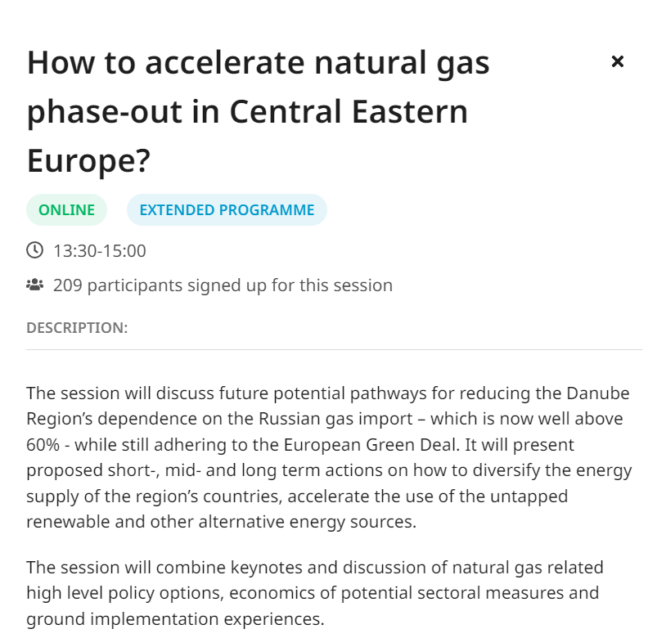
European Sustainable Energy Week - Workshop
Speakers
Annamária Nádor, Priority area coordinator, EUSDR
Georg Zachmann, Senior fellow
Andreas Graf, Senior Associate EU Energy Policy Agora Energiewende (Brussels Office)
Christian Egenhofer, Associate senior research fellow
Representative of Daikin Europe TBC
Tamas Medgyes, Chief operations officer
EUSEW Extended Programme week 19 Sept 2022 13:30-15:00
Register here

Slide 6
Country factsheets

Slide 7
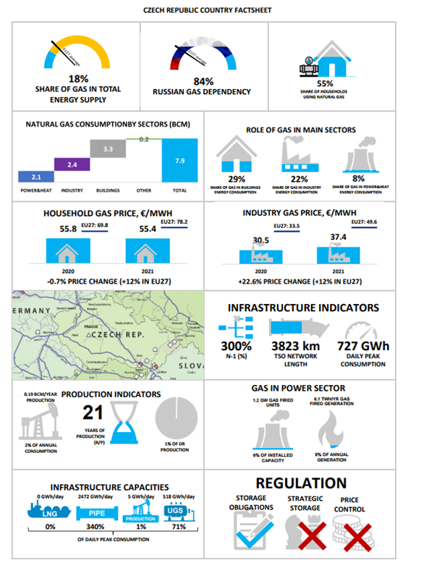
General information related to the factsheets
For each country, the factsheet contains a total of 22 indicators in 12 boxes and a network map.
During the selection of the indicators and the infographics prepared for them, we tried to give a comprehensive picture of the countries' gas dependence and Russian gas dependence.
The first part of the indicators is related to the gas consumption side, while the second part shows the different dimensions of the natural gas infrastructure.
The infographics basically show the conditions of 2019-2020, as COVID has changed the already country-specific values ​​in many ways (for example: consumption in the industrial sector). Where this problem did not exist, we displayed the most recent data available.
We used public databases that provide information about multiple countries and allow for comparability between countries. (For example: Eurostat, ACER, ENTSO-G, ENTSO-E)

Slide 8
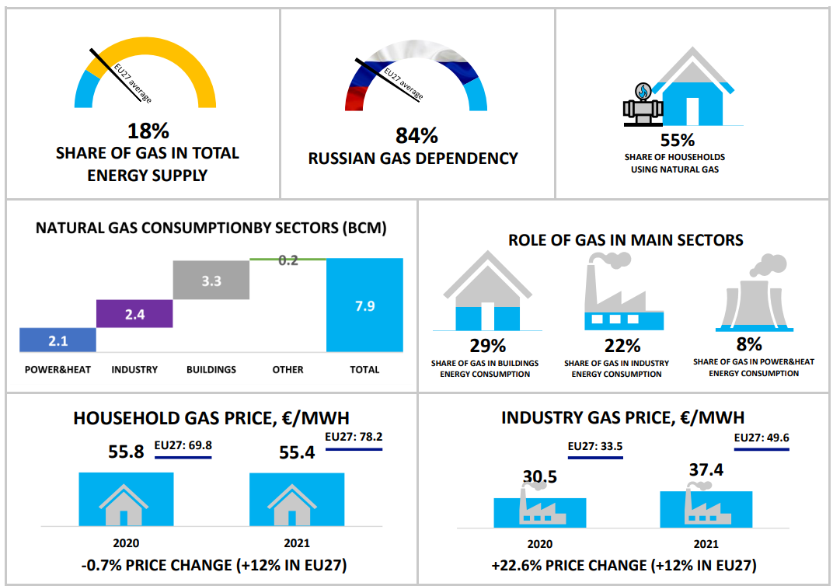
Natural gas consumption in numbers
Share of natural gas in total energy supply
Russian gas dependency
Share of households using natural gas
Natural gas consumption by sectors
Role of gas in main sectors
Household gas price change
Industry gas price change
Example: Indicators from the Czech Republic factsheet

Slide 9
Natural gas consumption in numbers
Share of natural gas in total energy supply: shows 2019 status; besides the country’s own percent, the clockwise shows the EU average
Russian gas dependency: Share of Russian gas re-calculated based on neighboring country supply mix. For this reason, share of RU gas is higher than ACER data.
Share of households using natural gas: shows the Total number of household gas consumers devided by the total number of households
Natural gas consumption by sectors: Gross inland consumption divided up to four main categories: power&heat; industry; buildings and other
Role of gas in main sectors: shows the share of natural gas supply by sector in the total enegy supply by the sector (GWh) for 2019.
Household gas price: shows the changes between the second half of 2020 and 2021 in the country and also the chhanges in the EU
Industry gas price: shows the changes between the second half of 2020 and 2021 in the country and also the chhanges in the EU

Slide 10
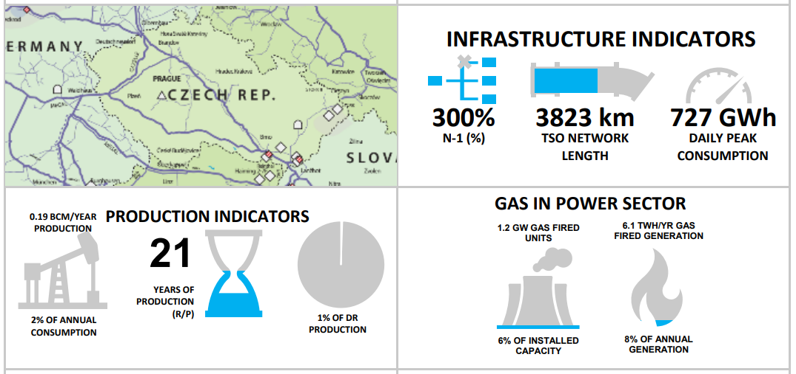
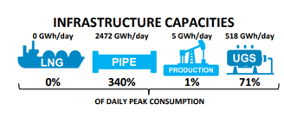
Natural gas infrastructure in numbers
Network map
N-1 ratio
TSO Network length
Daily peak consumption
Production/Annual consumption
R/P value
Share in DR production
Infrastructure capacities compared to daily peak consumption
Example: Indicators from the Czech Republic factsheet

Slide 11
Natural gas infrastructure in numbers
Network map: from ENTSO-G The European Natural Gas Network Map
N-1 ratio: shows the percentage of total demand that can be satisfied if the largest item of gas supply infrastructure is disrupted.
TSO Network length: in combination with other indicators it can show the state of development of the system
Daily peak consumption: the value is an estimation from the ENTSOG Winter Supply Outlook 2021/2022; estimates the highest daily consumption
Production/Annual consumption rate: shows shows the country's self-sufficiency on an annual basis
R/P ratio: means reserves/production ratio; it shows how many years the current level of production can be maintained.
Share in DR production: shows the proportion of that country within the total production of the DR
Infrastructure capacities compared to daily peak consumption: shows how much of the maximum daily consumption can be received through a given type of infrastructure (LNG, pipeline, Storage, Production)

Slide 12
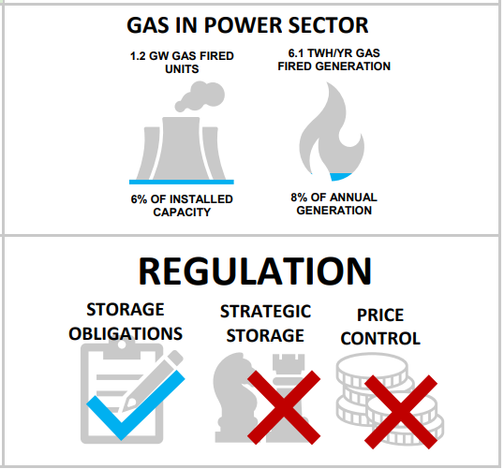
Other indicators
Gas in power sector: these indicators shows the importance of natural gas in the power sector from the aspect of capacity and generation
Gas fired units compared to total installed capacity
Gas fired generation compared to total generation:
Regulation: The infographics show if there is a restriction on natural gas in the following areas.
Storage obligation
Strategic storage
Price control
Example: Indicators from the Czech Republic factsheet

Slide 13
Main questions related to the factsheets
Should we deviate from the commonly used calculation method if a country suggests a different value? We recommend to use the uniformly calculated values ​​and indicate the value given by the country in a footnote.
Are there any indicators that would be worth adding to the list?
Are there any indicators that we should leave out?

Slide 14
Regional outlook on the current state of play on Russian gas dependency in the Danube Region

Slide 15
Goal of indicator-based assessment
Collect easy-to digest indicators and create fact-sheets of DR countries.
Supply side indicators
N-1
Production, Pipeline, LNG, storage infrastrucure
Demand side indicators
Role of gas in Power&heat, industry, buildins
Russian dependency
Households connected to gas network
Summarize the indicators and highlight risk-groups with similar problems
List DR countries actions to ease Russian gas dependency
Future work:
List gas saving potential of DR countries by sector and measure
Show the options of DR countries for alternative supply
Room for cooperation

Slide 16
Gas dependency in the DR - how to assess?
Two-tier approach
How important is natural gas in the energy consumption of the country? Indicator: Gas in Total energy supply (TES quantity of energy necessary to satisfy inland consumption )
How important is Russian gas in the mix? Calculated based on relative shares published by ACER, (https://aegis.acer.europa.eu/chest/dataitems/214/view)
Role of gas in TES is is identical with the EU27 (24%), but share of RU gas is 50% for DR and 29% in EU27. > DR is more dependent on RU gas
Share of RU gas is
Over 90% in BA, BG, MD
Over 80% AT, CZ, HU, RS, SK, SI
Limited role in HR, RO, UA due to domestic sources or LNG
Notes:
As many DR countries noted their sourcing to originate from another European country, in some cases the dependency of Russian gas indicated by ACER might be lower that the actual value. To illustrate this effect: Austria reported 64% Russian gas, 32% Germany and 4% domestic production. Based on this figure, one could argue that Austrian dependency is 64% from Russia. In fact, gas of German origin is made up of 49% Russian gas, therfore to estimate the correct share of Russian gas in Austria, the appropriate weighting of German gas was performed. This results in 80% of Russian gas in the total Austrian mix. The same calculation for performed for all DR countries. Share of Russian gas reported in the study therefore may be higher than the one reported by ACER.

Slide 17
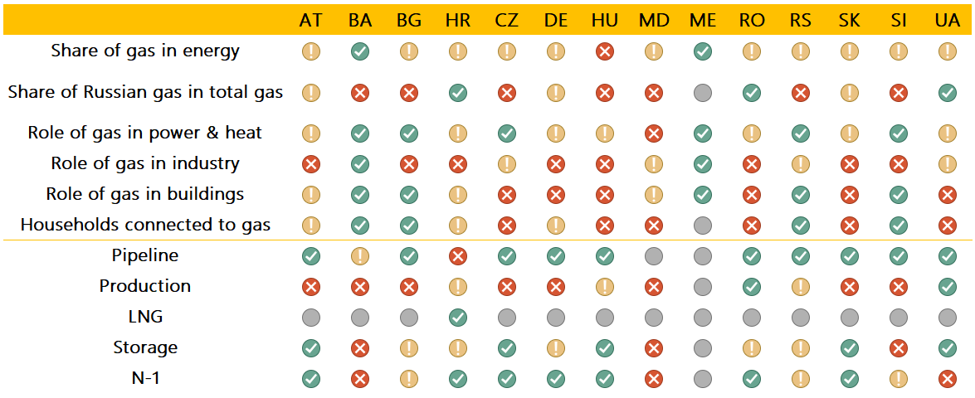
Summary of dependency indicators

Slide 18
Tresholds for indicator-based assessment
NOT APPLICABLE
MIGHT BE AN ISSUE
NOT AN ISSUE
PROBLEMATIC

Slide 19
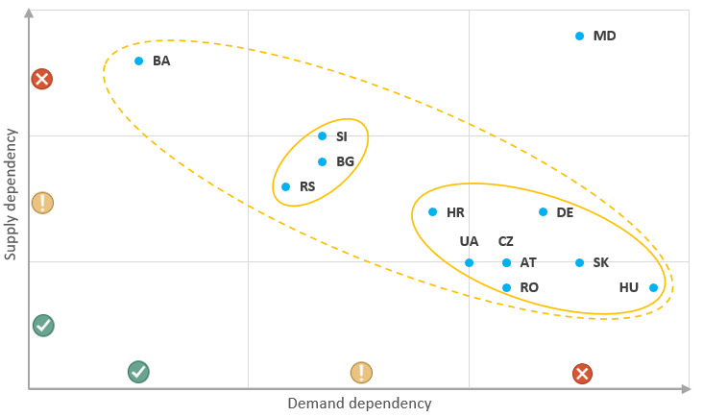
Composite indicator- what have we learnt?
Strong negative relationship between the demand-side and the supply-side dependencies
Those countries that rely heavily on gas have taken significant efforts to ensure the security of supply by adequate infrastructure capacities
Highly gas dependent with limited supply options: MD
Highly gas-dependent countries with mostly sufficient supply options: AT, DE, CZ, HR, HU, SK, UA
Moderately gas-dependent countries with weaker supply options: BG, RS, SI
Not gas-dependent but have very limited options to find alternative supply sources: BA
ME not on graph due to no gas consumption and no dependency

Slide 20
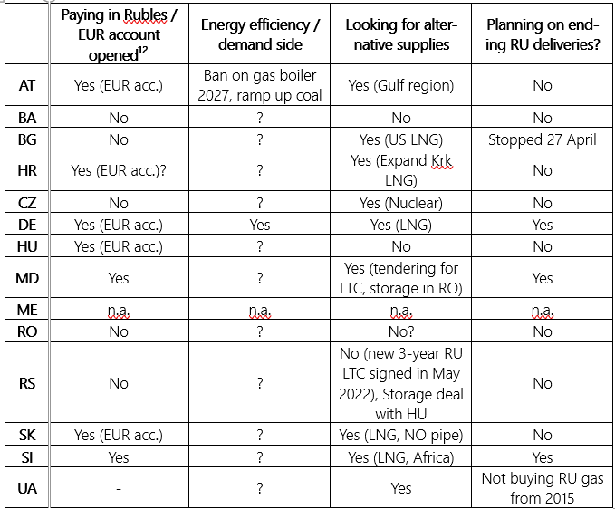
DR countries actions to replace RU gas
Attitude towards paying in Rubles
Paying in Rubles: MD?
Opened an account, paying in Euros and this is converted to Rubles: AT, DE, HU, SK and SI
Not paying in Rubles, no account opened: BG, RS, BA, CZ, RO, UA
Looking for alternatives for Russian gas supplies
Ramping up RES gases:?
Ramping up own production: UA, RO
Looking for alternative supplier:AT, BG, MD, DE, SK, SI, UA
Energy efficiency initiatives: ?
Planning to end Russian gas deliveries
No Russian imports: UA, BG
Statement to end Russian imports: DE, MD
No plan to phase out Russian gas: BA, RS, RO, HU

Slide 21
Next steps
Country fact sheets content approval
Comments on the regional status description
For the next steps: please indicate your (or any of your colleagues or experts) availability for a 1 hour online interview on the specific measures related to reducing gas dependency of your country during the summer to: borbala.toth@rekk.hu and peter.kotek@rekk.hu by possibly 7 July.

Slide 22
Thank you for your attention
peter.kotek@rekk.hu and gabor.horvath@rekk.hu
Visit: rekk.hu

Slide 23
ANNEX A
County fact sheet legend

Slide 24
Box 1: Share of gas in total energy supply
Data name: Share of gas in total energy supply
Data source: Eurostat Simplified energy balances [nrg_bal_s] 2019
Calculation/methodology: Total energy supply natural gas / Total energy supply Total (GWh)

Slide 25
Box 2: Russian gas dependency
Data name: Russian gas dependency
Data source: ACER Estimated number and diversity of supply sources 2020
Calculation/methodology: Share of Russian gas re-calculated based on neighboring country supply mix. For this reason, share of RU gas is higher than ACER data.
As many DR countries noted their sourcing to originate from another European country, in some cases the dependency of Russian gas indicated by ACER might be lower that the actual value. To illustrate this effect: Austria reported 64% Russian gas, 32% Germany and 4% domestic production. Based on this figure, one could argue that Austrian dependency is 64% from Russia. In fact, gas of German origin is made up of 49% Russian gas, therfore to estimate the correct share of Russian gas in Austria, the appropriate weighting of German gas was performed. This results in 80% of Russian gas in the total Austrian mix. The same calculation for performed for all DR countries. Share of Russian gas reported in the study therefore may be higher than the one reported by ACER.

Slide 26
Box 3: Share of households using natural gas
Data name: Share of households using natural gas
Data source: National reporting for MMR (ACER – CEER), Eurostat Number of private households by household composition [lfst_hhnhtych] 2019
Calculation/methodology: Total number of household gas consumers / Total number of households

Slide 27
Box 4: Natural gas consumption by sectors
Data name: Natural gas consumption by sectors
Data source: Eurostat Simplified energy balances [nrg_bal_s]
Calculation/methodology: Gross inland consumption divided up to power&heat= transformation input-transformation output+distribution losses+energy sector energy use; industry= final consumption non-energy use+final consumption industry energy use; buildings=commercial and public services energy use+households energy use for 2019.
Note: Conversion from GWh to bcm using 10.5 TWh/bcm

Slide 28
Box 5: Role of gas in main sectors
Data name: Share of gas in sectors total energy consumption
Data source: Eurostat Simplified energy balances [nrg_bal_s]
Calculation/methodology: Total energy supply natural gas by sector / Total energy supply Total by sector (GWh) for 2019.

Slide 29
Box 6: Household gas price
Data name: Household gas price
Data source: Eurostat [nrg_pc_202]
Calculation/methodology: Consumption band D2 : 20 GJ < Consumption < 200 GJ in EUR/MWh with all taxes and levies included for the second half 2020 and 2021. Change indicates the relative increase/decrease from 2020 July-December to 2021 July-December.

Slide 30
Box 7: Industry gas price
Data name: Industry gas price
Data source: Eurostat [nrg_pc_202]
Calculation/methodology: Consumption Band I3 : 10 000 GJ < Consumption < 100 000 GJ in EUR/MWh with all taxes and levies included for the second half 2020 and 2021. Change indicates the relative increase/decrease from 2020 July-December to 2021 July-December.

Slide 31
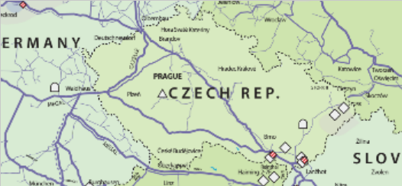
Box 8: Natural gas network map
Data name: Gas infrastructure map by country
Data source: ENTSO-G The European Natural Gas Network
Calculation/methodology: -

Slide 32
Box 9: Infrastructure indicators
Data name: N-1
Data source: Energy Union indicators
Calculation/methodology: % of total demand that can be satisfied if the largest item of gas supply infrastructure is disrupted.
Data name: Network length
Data source: ENTSOG TYNDP 2020 infrastructure report and TSO websites
Calculation/methodology: Length of natural gas transmission network, km. Distribution network not included.
Data name: Peak consumption
Data source: ENTSOG winter supply outlook 2021/2022
Calculation/methodology: Daily maximum gas consumption, in Cold Winter scenario, DC (GWh/day), pg 45 Table 9.

Slide 33
Box 10: Production indicators
Data name: Gas production
Data source: BP statistical review and Eurostat [nrg_bal_s]
Calculation/methodology: Total gas production per year / Total primary energy supply (gas)
Data name: R/P ratio
Data source: BP statistical review and Eurostat [nrg_bal_s]
Calculation/methodology: R/P (Reserves/production) = annual gas production / Total gas reserves. Denotes for how many years production may continue at the current rate.
Data name: Share in DR production
Data source: BP statistical review and Eurostat Simplified energy balances [nrg_bal_s]
Calculation/methodology: Country gas production / total DR gas production

Slide 34
Box 11: Gas in power sector
Data name: Gas-fired power plant capacities
Data source: ENTSO-E Transparency platform, Installed capacity per production type in 2021
Calculation/methodology: Capacity of gas-fired power plants / Capacity of all power plants (MW)
Data name: Gas-fired power generation
Data source: ENTSO-E Transparency platform, Generation per production type in 2021
Calculation/methodology: generation of gas-fired power plants / generation of all power plants (TWh)

Slide 35
Box 12: Infrastructure capacities
Data name: Technical capacities of the gas transmission system
Data source: ENTSOG Capacity map
Calculation/methodology:
LNG: total LNG entry capacity to the national transmission system, GWh/day; (ENTSOG)
Pipe: total pipeline entry capacity, GWh/day; (ENTSOG)
Production: daily gas production, GWh/day;
Storage: daily technical withdrawal capacity, GWh/day (AGSI+)

Slide 36
Box 13: Regulation
Data name: Regulations related to natural gas storage and price by country
Data source: Storage obligation and Strategic storage: Report on Gas Storage Regulation and Indicators – ACER; Price control: CEER database 2021
Calculation/methodology:

Slide 37
ANNEX B
Regional comparison of supply and demand indicators of the DR countries

Slide 38
Natural gas consumption by sectors
Three main consuming sectors
Power&heat
Industry
Buildings
DR structure is similar to EU27, slightly more building heated with gas and power sector is using less
High share (over 40%) of building heating in DR

Slide 39
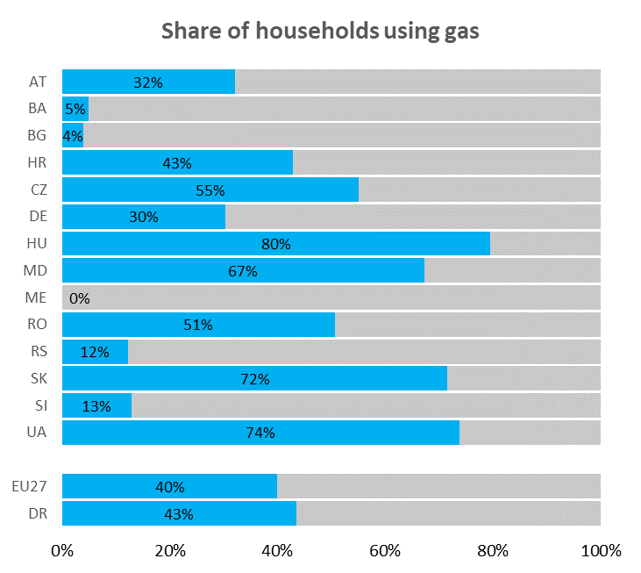
Household and building sector indicators
SHARE OF GAS IN BUILDING ENERGY CONSUMPTION
SHARE OF HOUSEHOLDS USING GAS
*CEER National Reporting 2019 https://www.ceer.eu/national-reporting-2020
** Eurostat 2019
Share of natural gas in final energy consumption of households
Includes not only heating and hot water but all enegy-related use of HHs (electricity for appliances, lighting)
Correlates well with share of HHs using gas
Proportion of households connected to the natural gas network
The indicator was calculated by dividing the number of household gas consumers* with the total number of households.**
Exceptionally high in HU, UA, SK, MD

Slide 40
Industry
Gas may be used as
Feedstock
Heat for building heating
Heat for industrial processes
DR and EU share is identical (28%)
DR industries use 20-33% gas, except for BA (9%), HR (47%)
SHARE OF GAS IN INDUSTRIAL ENERGY CONSUMPTION

Slide 41
Power&heat
EU and DR similar share
MD power sector highly dependent on gas
Well-interconnected ENTSO-E network allows for huge flexibility
SHARE OF GAS IN POWER&HEAT ENERGY CONSUMPTION

Slide 42
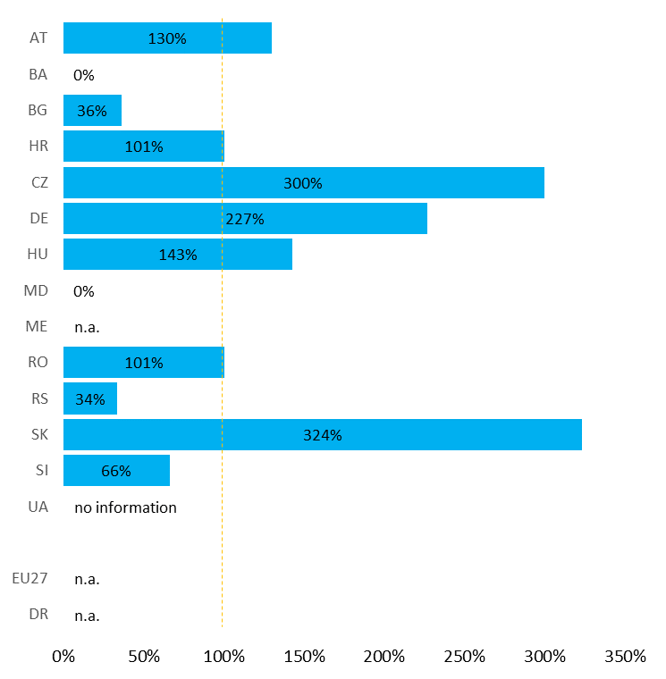
Supply side and infrastructure
N-1 STANDARD
Listing alternative options of supply and quantifying how much they may account for the total consumption
N-1

