Slide 1





29th Steering Group meeting of the EUSDR Priority Area 2

Slide 2
Agenda

Slide 3
PAC Report – Joint progress since last SG Meeting
Tomas Vondra CZ PAC
Annamária Nádor HU PAC
Reporting
Participation at PAC meetings, Annual Forum in Vienna in June
Strategic meeting – September 3
Continuous discussion

Slide 4
Progress on Hungarian side
Update of the Flagships (based on comments from 28th SG)
LoR-s (DATAsight - Data driven ML solutions for reliable building data quality, insight and efficiency –LIFE-CET Call), LIFE enerGISE – Energy Communities effective guidance, advise, innovative support – LIFE-CET)
Update of PA2 webpage (projects, news)
Participation at Danube Region Programme – post 2027 consultation survey
Follow up of supported projects (participation online workshops of the NRGCOM project, participation at project meeting of StoreMore (Fuchstal, Germany)
Participation at the Danube Region Business Forum (November 6, Vienna)
Organisation of project financing workshop (national) (November 11, Budapest)

Slide 5
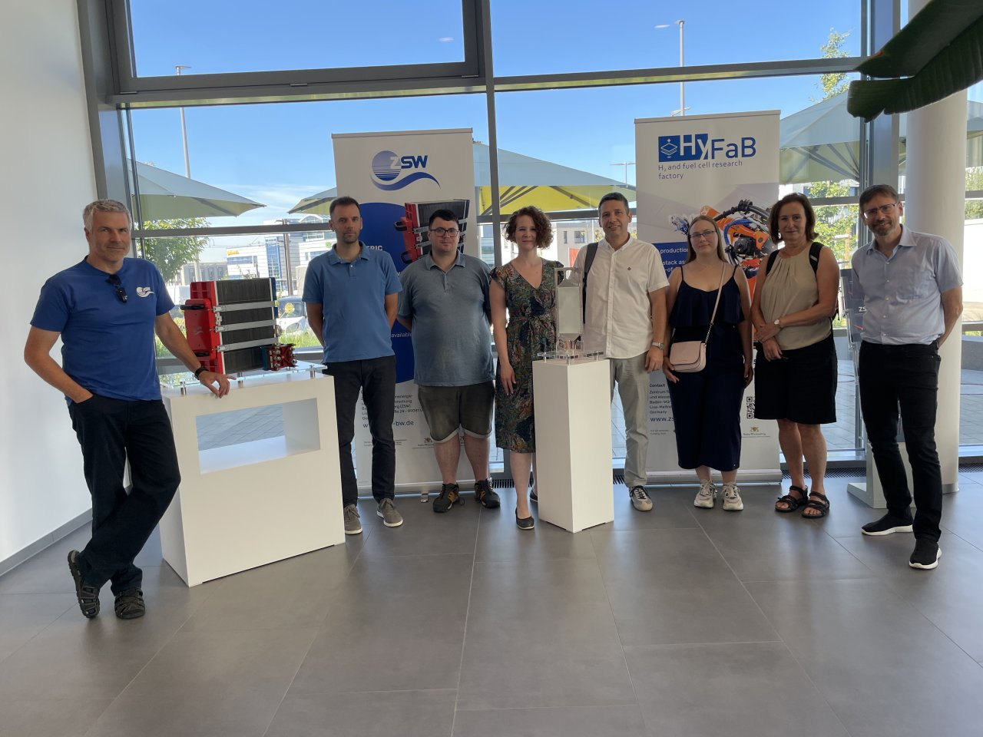
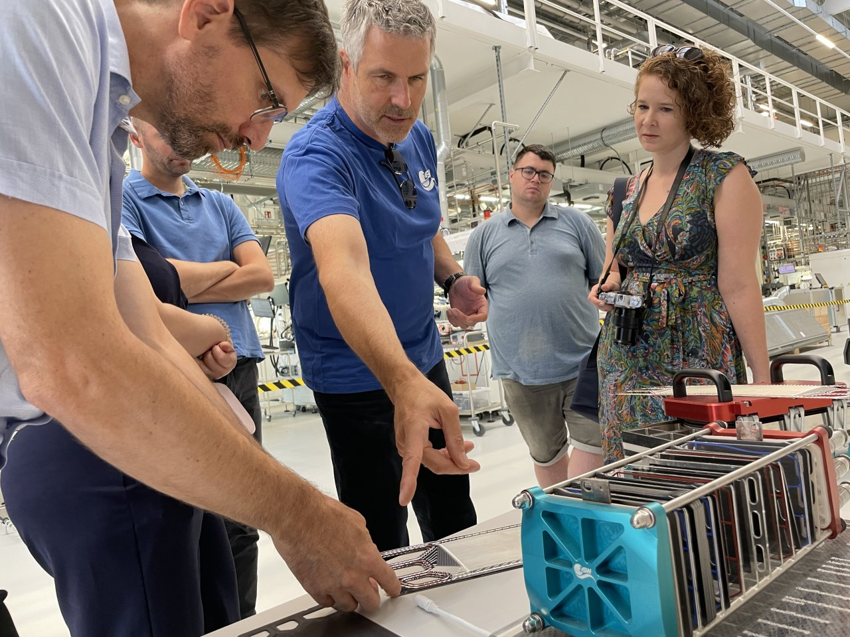
Progress on Hungarian side
Participation at Ulm Danube Day (July 8) – Thematic session „Economic Cooperation and Hydrogen Supply Chains along the Danube”
Hydrogen related site visit near Ulm (for HU experts)
Research Institute for Fuel Cell technology and batteries
University of Applied Sciences Ulm
Site visit of „H2-Aspen” project at Schwäbisch Gmünd
Site visit of RAG underground hydrogen storage (Austria)
Special thanks to our SG member from Baden-Württemberg Johanna Bamberger for her help in the organisation and contacts

Slide 6
Progress on Czech side

Slide 7
Introduction to the Bavarian Renewable Strategy
Andreas Erhard, Bavarian State Ministry of Economic Affairs, Regional Development and Energy

Slide 8
Roundtable discussion of SG Members
State of art of Renewable Energy Strategies and policy developments in EUSDR countries

Slide 9
Coffee break
Enjoy your refreshments

Slide 10
Energy Efficiency in Industry study
Léon Kamenický, Senior Consultant, GATUM

Slide 11
Introduction on the first results of the study: State -of-art - hydrogen economy in the Danube Region
Géza Losonczy, KPMG

Slide 12
Lunch break
Enjoy your food and drinks

Slide 13
State of play, European Commission
Johan Magnusson, DG Regio

Slide 14
Current and future activities of DSP
Katharina Lenz, Pillar Officer, Danube Strategy Point

Slide 15
Introduction of the Danube Youth Council Members

Slide 16
Introduction of the winner projects supported by PA2
DRP 2nd Call: StoreMore, GeHeCo, Danbe Indeet, NRGCOM
SMF: H2Scale, StoreMoreWarmth, EE heritage, Danbe Energy, energy.eu
Central Europe: HyEfre, Transgeo

Slide 17
Closing words
Annamária Nádor, HU PAC
Tomas Vondra, CZ PAC

