Slide 1




Danube Indeet
State-of-play and project activities
29th Steering Group Meeting of the Priority Area 2
20.11.2024
Budapest, Hungary
Balázs Kiss
kiss.balazs@paksbusz.hu

Slide 2
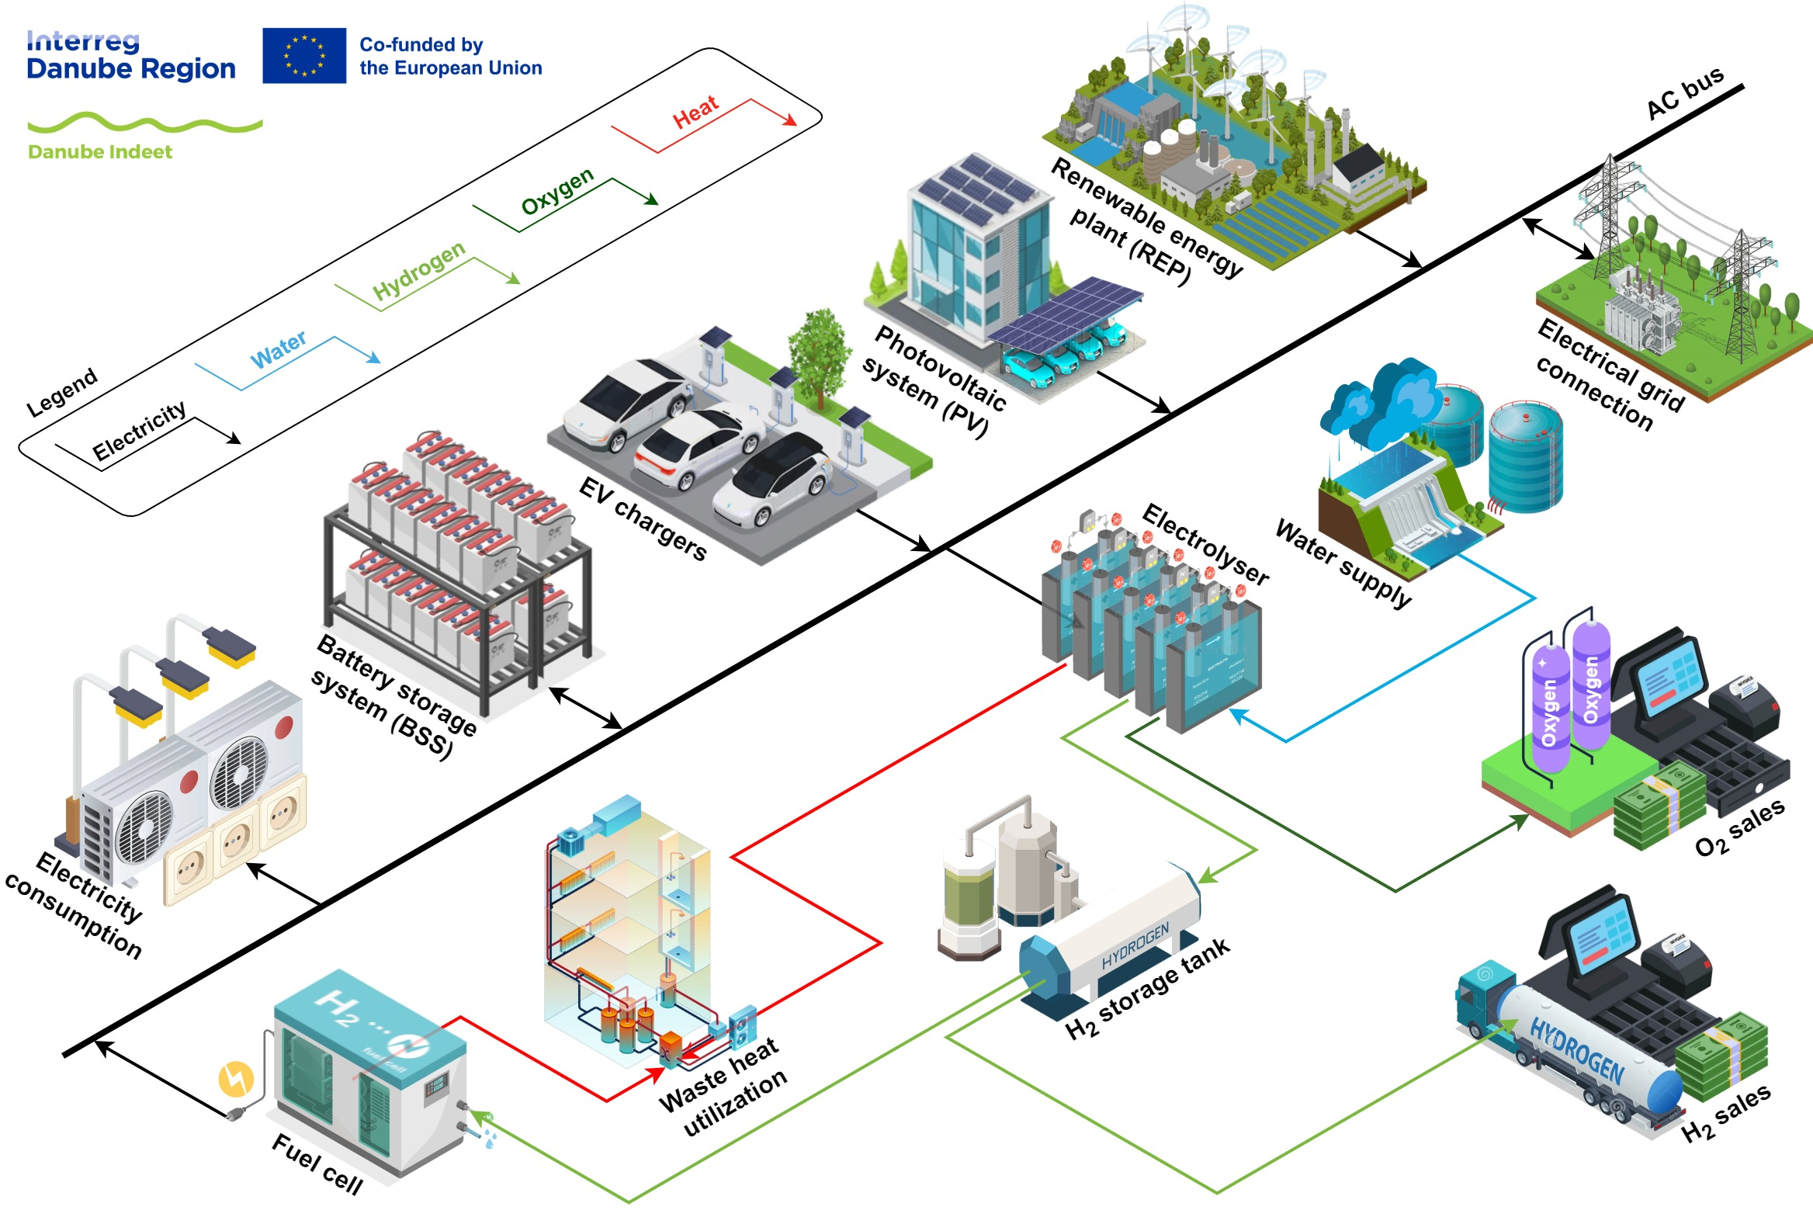
Short summary of Danube Indeet
Integrated and decentralized energy and transport systems
decision-support in investment and operation of integrated e-mobility and hydrogen production in a local community under specified infrastructure and market conditions and mobility needs
Strategy for an integrated energy and mobility concept
Anchorage of the developed model and strategy

Slide 3
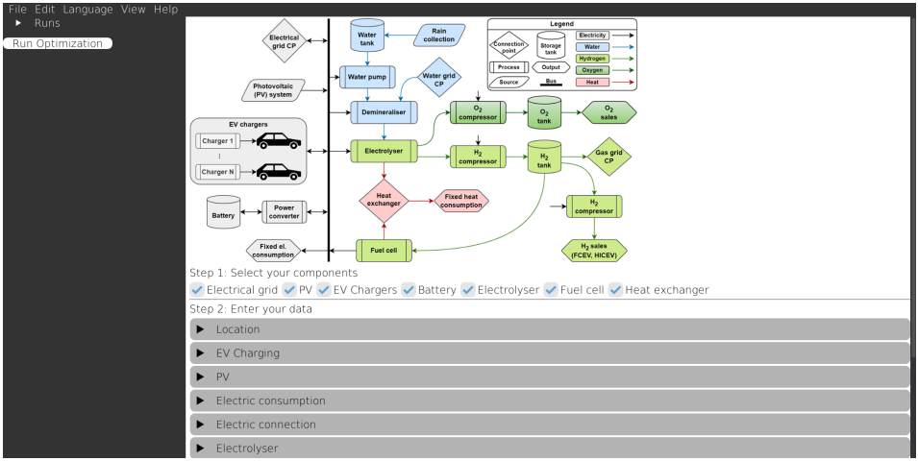
Results of the 1st year
Created a database template for the Danube Indeet Model inputs collecting data on charging infrastructure and charging behaviouor data, electrical grid and supply, RES-capacities, hydrogen and oxygen demand
Finalized the Danube Indeet Model – interface developed, functions being added
Testing phase early next year
Preliminary interface screenshot (from PP10 UNIGZFER)

Slide 4
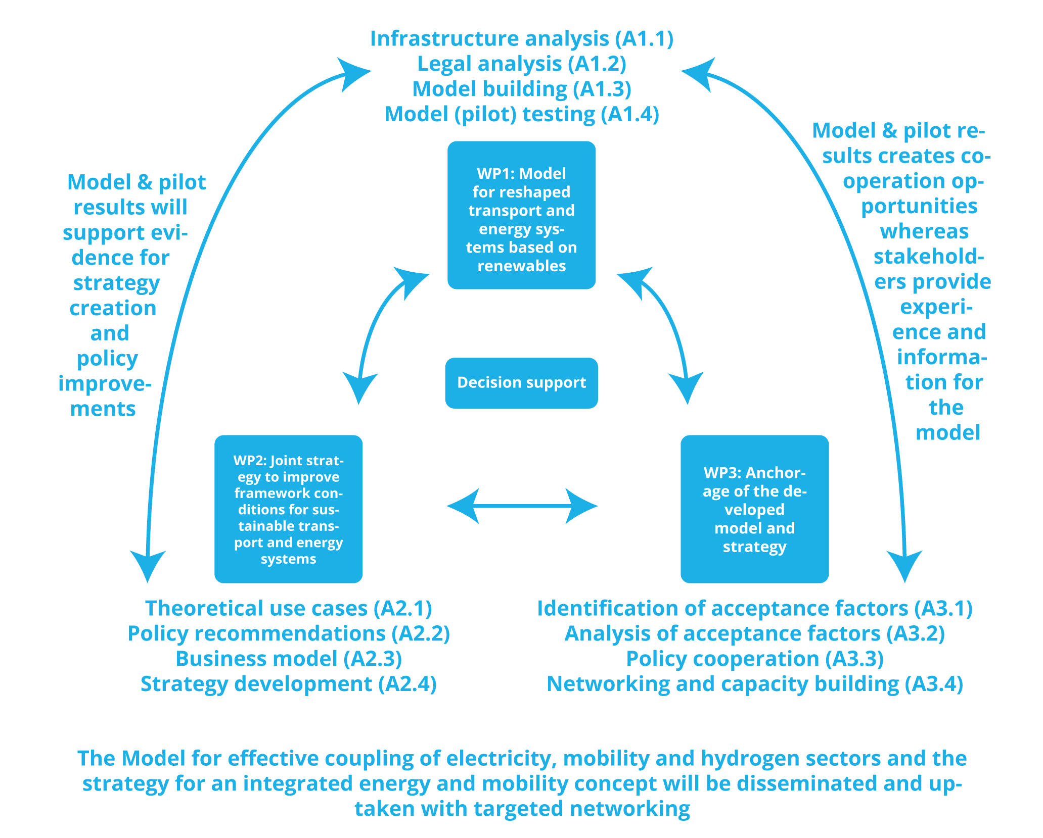
Results of the 1st year and further planned activities
A1.2 Legal Analysis
A2.3 Business Model is a deep-dive into one particular case in each country and will be – work started
Strategy for an integrated energy and mobility concept
Contains results from the model testing (A1.4), the scenario modelling (A2.1), the legal guidelines (A1.2), policy recommendations (A2.2) and the business model development (A2.3)
Danube Indeet intervention logic

Slide 5
Results of the 1st year and further planned activities
Anchorage of the developed model and strategy:
Analysis of acceptance factors started
By understanding the perception of our stakeholders we can drive further interactions to boost support
Public bodies and decision-makers are the main focus of these dissemination efforts

Slide 6
Thank you for your attention!
https://interreg-danube.eu/projects/danube-indeet
Balázs Kiss
Astrid Heindel
kiss.balazs@paksbusz.net
astrid.heindel@haw-landshut.de
https://linktr.ee/danubeindeet

