Slide 1
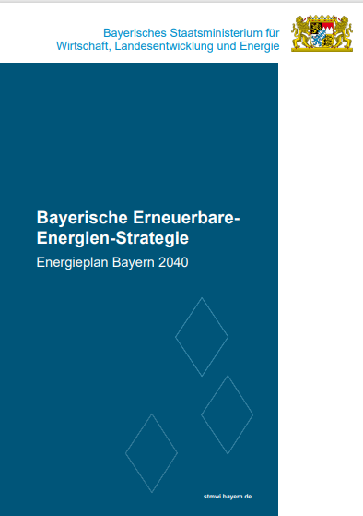
Bavarian Renewable Energy Strategy Energy Plan Bavaria 2040

Slide 2
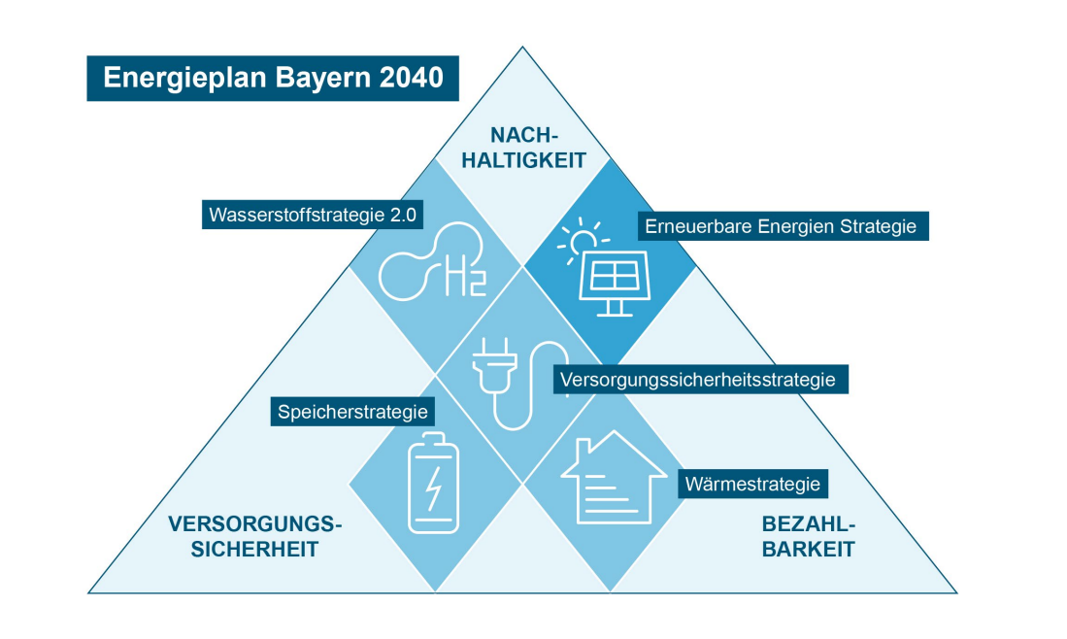
Sustainability
Hydrogen Strategy 2.0
Renewable Energy Strategy
Secured Supply Strategy
Storage Strategy
Heating Strategy
Secured Supply
Affordability
Notes:
Bavaria has according toBavarian Climate Protection Act the goal of being climate neutral by 2040.
TheEnergy Plan Bavaria 2040is the associated implementation concept, which is based on the scientific findings from the “Energy System Analysis Bavaria Climate Neutral“ shows a concrete and feasible way of achieving climate neutrality in the energy sector by 2040.
Presented so far:EE strategy, storage strategy (to be presented later) and hydrogen strategy.

Slide 3
Renewable Energy Strategy
Where are we?
LENK
acceptance
Team Energiewende Bayern
bioenergy
plant extension
EAB
wind energy
system integration
power grids
PV
hydropower
geo-thermics
memory
Notes:
Animated slide! Gray boxes appear each time you say something to the blue circles.
Three fields of action:
Plant expansion/ expanding Bavaria's leading position
AtphotovoltaicsBavaria has been the undisputed leader for years. There are around 1.1 million PV systems in operation here with an installed solar capacity of around 25.0 GW.
At thehydropowerBavaria is by far the leader with an installed capacity of around 2.4 GW and the generation of around 60 percent of Germany's total hydroelectric power.
In addition, the Free State is in thebioenergywith around 1.9 GW in first place nationwide.
And last but not least, thewind powera clear trend reversal with plans and initiatives for the construction of 500 new wind turbines. The pipeline is well filled with 143 wind turbines applied for but not yet approved and an additional 66 approved but not yet operational.
system integration/Expansion of the electricity grid infrastructure and storage play an important role
Close integration with thesecurity of supply strategyand thestorage strategy(today on the TO)
In order to integrate the many decentralized generation plants and to use renewable electricity as efficiently as possible, the power grids in Bavaria are being adapted to meet demand at all voltage levels.
Bavaria's further aim is to increase the contribution potential of storage to security of supply and system stability.
In terms of cumulative performance and capacities, Bavaria is the leading federal state in the field ofinstalled battery storageleading and home to a total of around22 percent of the total battery storage capacity and 22 percent of the total battery storage capacity in Germany.
In the areapumped storageThere are also around10 percent of Germany's pumped storage capacity and 9 percent of Germany's pumped storage capacityin Bavaria.
Continue takingrenewable gasessuch as biomethane play an important role as energy storage.
Acceptance/ Central to the success of the energy transition
With the initiative"Team Energiewende Bayern"we offer citizens, municipalities and companies in Bavaria aobjective and trustworthy guidancearound energy topics.
Through variousparticipation opportunities, variousevent formatsThrough events such as the Bavarian Energy Days and information campaigns, the Energy Transition Bavaria team increases understanding of the complex interrelationships in the energy sector and motivates people, particularly through positive examples.
Ascompetence and advisory centerThe Bavarian State Government supports theState Agency for Energy and Climate Protection (LENK)the implementation of the energy transition and the Bavarian climate protection offensive. The wind care workers, coordinated by LENK, advise and support municipalities with wind energy projects.
LENK’s support services in the Energy Transition Bavaria team on issues relating to municipal heat planning are also being continuously expanded.
In theEnergy Atlas BavariaAs the central internet portal of the Bavarian State Government on the energy transition, extensive documents for citizens, municipalities, companies and planners are made available in the text and map sections

Slide 4

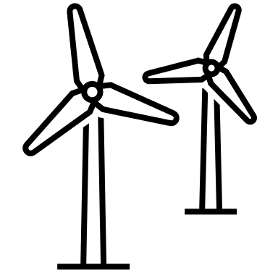


Ambitious goals
increase electricity production from biomass by 15%
by 2030
1,000 new wind turbines by 2030; then continuing annual expansion
By 2030, heat output from deep geothermal energy will be tripled and by 2050 it will cover up to 25% of heat demand in buildings
80 to 100 GW
installed capacity
by 2040
Increase annual hydroelectric power generation by 1 TWH
Notes:
We focus our activities on allsensibleliftablePotentials for the expansion of renewable energiesand retain thesystem compatibilityof expansion. A balanced combination of solar and wind energy expansion with simultaneous use of bioenergy, hydropower and geothermal energy is required
At thePVAn installed capacity of 80 to 100 GW is to be achieved by 2040.
At thewind energyThe aim is to add 1,000 new plants by 2030 and to continue the high annual increase achieved then.
By 2030, the installed capacity for electricity generation frombiomassby 15 percent and then the potential will be consistently exploited further.
The annual electricity production fromhydropowerIn the long term, the total energy consumption is to be increased by one TWh and the potential ofpumped storageof around 11 GW.
By 2030, the current heat output is to be tripled by thedeep geothermal energyachieved and by 2050 in Bavaria even up to 25 percent of the heat demand in the building sector can be covered by geothermal energy.

Slide 5
Important fields of action
Identifiying and removing obstacles
Support services and funding programs
Acceptance
BioMeth (BioMethane) and BioWärme (BioHeat) Bavaria
program for small hydropower plants
distribution grid initiative
activities of the State Agency for Energy and Climate Protection
Windkümmerer program
campaign „Bayern macht Wind“
Bavarian Energy Days
mandatory community and citizen participation
Notes:
Bavaria’s goals are very ambitious.
In particular, the energy department isfederal governmentcalled for the removal of remaining obstacles to the expansion of all renewable energies.
We have launched a broad range of measures within our own area of ​​responsibility.
Exchange and networking/identify and remove obstacles
professional exchange
the distribution network initiative
the activities of the State Agency for Energy and Climate Protection.
support offers and funding programs
Wind Caretaker Program
BioMethBavaria andBioHeatBavaria
program for small hydropower plants
acceptance
Mandatory citizen and community participation
campaign "Bavaria makes wind"
Bavarian Energy Days

Slide 6
Bavarian demands to the federal government
Balancing priority of renewable energies in the specific laws
Potentials of energy sharing
Adjustments in renewable energies/ innovation calls
mobilization of private capital
changes in tax law
wind energy and military
facilitation of transport
ending disadvantage of solid biomass
Notes:
balancing priorityof renewable energies must be included in all relevant specialist laws (including theFederal Nature Conservation Act, BauGB).
Potentials of Energy Sharingand renewable energy communities in the sense ofEU lawmust finally be exploited and the EU legal requirements implemented.
In order to further advance the integration of storage in renewable energy projects, theThe framework conditions for EEG innovation tenders should be comprehensively revised, including by increasing the maximum value and tender volumes and adjusting the requirements for storage use
Further adjustments EEG:
At thebiomassThe Federal Government must make various adjustments to the EEG tender design.
For thehydropowerThe development of a suitable electricity market design is necessary, which ensures appropriate remuneration for system services provided. In addition, further adjustments to the EEG are necessary (abolishing degression, remuneration level for small hydropower).
Given the largefinancial needsThe Federal Government must present convincing concepts for the energy transition, such asprivate capital for this major task in the coming yearscan be.
PV: floating PV: urgent revision of the restrictions according to Section 36 of the Water Resources Act required; in particular with regard to inheritance and property tax as well as further simplifications for PV systems for commercial enterprises
wind: Compatibility of wind energy development and military aviation; improvements in transport
In the area ofsolid biomassthe disadvantages and limitations of the energetic use of wood in federal funding programs must be removed

