Slide 1

EU Strategy for the Baltic Sea Region– PA Energy Dr. oec. Olga BOGDANOVA, PA Energy Coordinator
5th July, 2017, Brussels

Slide 2
BEMIP/ EUSBSR: Policy Area Energy
Reform of optimising regional cooperation formats in Energy:
June2015
Memorandum of Understanding on the Reinforced Baltic Energy Market Interconnection Plan 'BEMIP‘
Joint Action Plan for BEMIP and EU Strategy for the Baltic Sea Region (EUSBSR)
EUSBSR documents: Action Plan and Flagship Annex

Slide 3
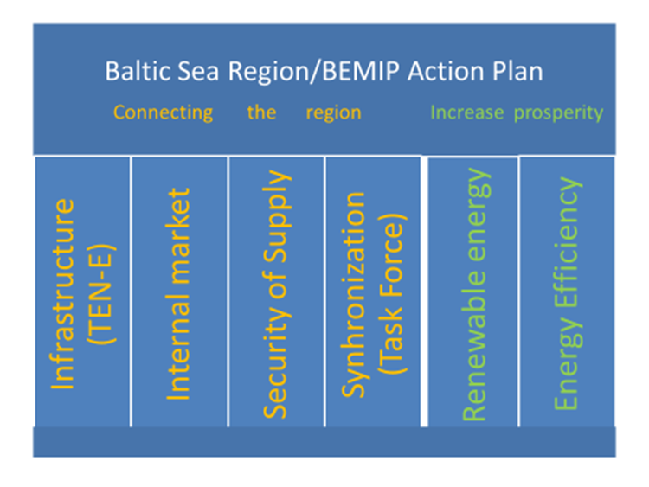
BEMIP & EUSBSR PA Energy

Slide 4
PA Energy coordination
PA Energy coordinators LV&LT:
Ministry of Economics of Latvia
Ministry of Foreign Affairs together with Ministry of Energy of the Republic of Lithuania
PA Energy coordinators work closely with the BEMIP group members and BEMIP HLG
BEMIP group acting as the Steering committee of the EUSBSR PA Energy

Slide 5
BEMIP/EUSBSR PA Energy objectives in the action plan
Better interconnected electricity market;
Level playing field for market participants;
Baltic States integrated to the EU internal electricity market;
Interconnected gas grid;
Fuel switching in heating/ Increased use of Renewable Energy Sources (RES) in heating;
Promotion of the development of sustainable energy;
Promotion of energy efficiency (EE).

Slide 6
Flagship projects and their purpose
Projects that help to reach the EU and regionally set targets:
Has a clear macro-regional dimension (at least 3 BSR countries involved)
Is mature for implementation
Policy impact
Types of Flagships in the EUSBSR
One project
Project chain
A process

Slide 7

Process of receiving Flagship staturs
PA Energy coordinator (LT)
National Coordinators
PA Energy coordinator (LV)
BEMIP group members
DG Regio
3.
2.
1.
4.

Slide 8
Projects receiving PA Energy support when applying for funding
 | Seed Money Projects |  | Regular Projects
Year | 2015 | 2016/2017 | 2016/2017
Projects applied to PA Energy for support | 7 | 5 | 10
Projects supported by the PA Energy | 2 | 3 | 6
Projects Financed by Interreg BSR | 1 | 1 | 2

Slide 9

CURRENT FLAGSHIPS
BALTIC INTEGRID - Integrated Baltic offshore wind electricity grid development
USE-LBM-BioPro - Use of liquefied biogas from waste (LBM) as gasoline substitute including side product utilization for Biopolymer production
EFFECT4buildings - Effective Financing Tools for implementing Energy Efficiency in Buildings
ACT NOW - Action for Energy Efficiency in Baltic Cities
BALTFLEX - Development of flexibility services for energy market
CO-ENERGY - Establishment and operation of cooperatives to generate energy
COPREMM - Conceiving and Piloting Resources Efficiency Management Measures for carbon-free heating in rural BSR communities
URBAN BIOGAS HUBS - Enhancing the use of biogas for urban transport

Slide 10
CURRENT FLAGSHIP
1. BALTIC INTEGRID - Integrated Baltic offshore wind electricity grid development
The aim of the project is to contribute to sustainable local electricity generation, further integration of the regional electricity market and enhancing security of supply around the Baltic Sea.
The Baltic InteGrid will provide a professional network for expertise exchange and interdisciplinary research on the optimization potential of offshore wind energy in the Baltic Sea region.
The project is a step towards the creation of a fully interconnected and integrated regional energy marked.
Lead Partner: Germany.
Project partners: Poland, Germany, Denmark, Sweden, Latvia, Finland, Estonia, Lithuania.
Estimated duration and deadline: 2016-2019.

Slide 11
CURRENT FLAGSHIP
2. USE-LBM-BioPro - Use of liquefied biogas from waste (LBM) as gasoline substitute including side product utilization for Biopolymer production.
The project aim is to use various types of bio-waste liquid (LBM) as fuel in private, public and professional transportation that would decrease the greenhouse gas emissions and increase the use of renewable energy.
The project is focused at improving the circular economy through reusing bio-waste as a basis for new products.
Lead Partner: Estonia.
Project partners: Germany, Finland.
Estimated duration and deadline:
February 2016 – September 2016.

Slide 12
CURRENT FLAGSHIP
3. EFFECT4buildings - Effective Financing Tools for implementing Energy Efficiency in Buildings
The aims are:
developing and improving institutional and financial measures,
promoting energy efficient technological solutions to increase energy efficiency in buildings,
developing and implementing training schemes for professionals and anchoring them in the daily practice of the target group.
Lead Partner: Sweden.
Project partners: Finland, Norway, Latvia, Denmark,
Estonia, Poland.
Estimated duration: 36 months.

Slide 13
CURRENT FLAGSHIP
4. ACT NOW - Action for Energy Efficiency in Baltic Cities
The objective is to increase energy efficiency based on enhanced capacity of public and private actors involved in energy planning.
The project will show how local “Sustainable Energy Action Plans (SEAPs)” can be turned to concrete measures reducing energy consumption in buildings. .
The project focusses on strengthening the capacities of municipalities in the field of energy management, definition and funding of investment projects and addressing private investors like housing companies or landlords to stimulate their investments in energy efficiency.
Lead Partner: Germany
Project partners: Germany, Sweden, Poland, Finland, Denmark, Lithuania, Latvia, Estonia
Estimated duration: 36 months.

Slide 14
CURRENT FLAGSHIP
5. BALTFLEX - Development of flexibility services for energy market
The project's goal is to tackle the electricity flexibility market development issues regionally and to create an effectively operating energy market with flexibility services.
Through creating a report with description of regional market design for flexibility services and implementing 1-3 ICT pilot projects on flexibility services project partners seek:
to build up institutionalized knowledge and competence of stakeholders and thus creating a basis for development of appropriate regulatory framework for flexibility services;
to create a technical (IT) solution for flexibility services in Baltic-Nordic region and thus enable more efficient use of human and technical resources.
Lead Partner: Estonia.
Project partners: Latvia, Lithuania, Finland.
Estimated duration: 36 months.

Slide 15
CURRENT FLAGSHIP
6. CO-ENERGY - Establishment and operation of cooperatives to generate energy
Main project goals:
- implementation of best practices for energy co-operatives;
- setup of 12-15 power generating co-operatives by 90 SMEs;
- completion of at least one pilot co-operative;
- setup of regional power innovation clusters and development of regional strategies;
- tested trainings and concepts of counselling.
The project will contribute to bridging the gap between regional pioneers, t.i., Denmark, Finland and to some extent in Germany, and other BSR countries.
Lead Partner: Germany
Project partners: Poland, Lithuania, Latvia, Finland,
Denmark, Germany.
Estimated duration: 36 months.

Slide 16
CURRENT FLAGSHIP
7. COPREMM - Conceiving and Piloting Resources Efficiency Management Measures for carbon free heating in rural BSR communities
The project promotes a more efficient use of climate-friendly resources by sharing best practices and testing adequate heating technologies.
It focuses on administrative bodies of small rural municipalities which intend to develop emission neutral regions.
Experienced municipalities will form a group of coaches which will be established as Baltic Sea Region competence center and train also future local coaches.
Lead Partner: Germany
Project partners: Germany, Denmark, Finland,
Latvia, Poland.
Estimated duration: 36 months.

Slide 17
CURRENT FLAGSHIP
8. URBAN BIOGAS HUBS - Enhancing the use of biogas for urban transport
The project aims to demonstrate for politicians and private sector directors that biogas is a competitive alternative from the financial, environment, climate and health aspects with the benefit of local/regional fuel supply and production.
The project focuses on developing the security of fuel supply and regional substrates collection capacity; researching the relative economic and environmental performance of modern biogas buses as compared to traditional diesel and other fuel buses; as well as elaborating and implementing solution-wide ‘holistic’ business models, that include an innovative approach to green public procurement and financial setup.
The project will address a technology that reduces external costs, including mitigation and adaptation to climate change, in the areas of freight and/or passenger transport.
Lead Partner: Sweden
Project partners: Sweden, Poland, Estonia, Denmark,
Finland
Estimated duration: 36 months.

Slide 18
EUSBSR Annual fora
Since 2010 a yearly forum has been organised to support the EUSBSR.
Participants from governments, international organisations, NGOs, universities, local and regional administrations and business discussed a broad range of issues relevant for the Baltic Sea Region.
EUSBSR 9th Annual Forum is planned in Tallinn, Estonia on 4-5 June 2018 in Kultuurikatel.
Main theme: After 2020- EUSBSR and future of EU policies especially cohesion policy, funds and programmes

Slide 19
Thank you!
Ministry of Economics of the Republic of Latvia
Address: Brīvības iela 55, Rīga, LV-1519, Latvia
Phone: +371 67013100
Fax: +371 67280882
E-mail: pasts@em.gov.lv
Home page: www.em.gov.lv
Twitter: @EM_gov_lv, @siltinam
Youtube: http://www.youtube.com/ekonomikasministrija
Facebook: http://www.facebook.com/atbalstsuznemejiem

