Slide 1
Danube Region Energy Efficiency Concept for Public Buildings
6th Steering Group Meeting of the Priority Area 2
Budapest, 13th June, 2013
Szilárd Árvay
Ministry of Foreign Affairs of Hungary

Slide 2
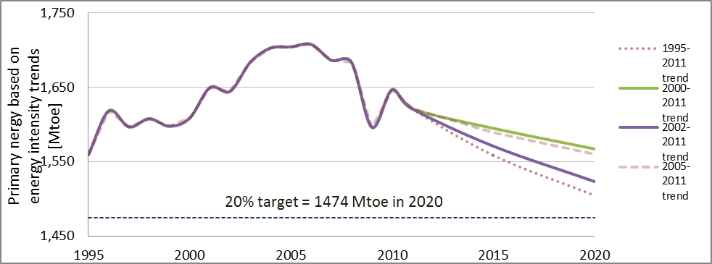
PA 2 supports achieving EU-targets
Europe 2020 Strategy - saving 20% (368 Mtoe) of the Union’s primary energy consumption by 2020 compared to projections made in 2007.
Continent is not on track to reach its 2020 energy efficiency goals - Recent estimate of COM: primary energy consumption in 2020 will be reduced by only about 17%!!!
EU Energy Efficiency Directive - COM shall assess progress achieved by 30 June 2014 AND Member States shall establish a long-term strategy for the renovation of buildings, 1st version to be published by 30 April 2014.
Priority Area 2 to provide a useful input to such analyses and to promote best practice.
1528Mtoe ⇨ 17% saving

Slide 3

Public buildings have a great impact
Buildings represent 40% of the EU final energy consumption (and 36% of greenhouse gas emissions).
Publicly owned or occupied buildings represent about 12% by area of the EU building stock and have a high visibility in public life.
Public spending accounts for 17% of EU GDP ⇨ important driver to market transformation towards more efficient products, buildings and services + triggers behavioural changes in energy consumption.
Public bodies fulfil an exemplary role regarding energy efficiency + decreasing consumption could free up public resources for other purposes.

Slide 4
Actions are needed in energy efficiency
In the Action Plan of the DRS PA2, there are two Actions, which directly target energy-efficiency of buildings (EEB):
  Action 14. - “To promote energy efficiency and use of renewable energy in buildings and heating systems including by renovating district heating and combined heat and power facilities as required by Energy Performance of the Buildings Directive and Renewable Energy Directive”.
  Action 17. - “To provide local authorities, businesses and citizens in the Danube Region consultative support with issues relating to mitigation of climate change and energy efficiency”.
Latest consultation of the EU regarding energy efficiency in buildings (February 2012) resulted in a lack of feedback from the new member states, in spite of the fact that there is great potential for energy efficiency investments in these countries.

Slide 5
Good opportunity to decrease energy intensity
Energy intensity (energy consumed compared to the GDP produced) is still considerably higher in the Eastern part of the Danube Region than in Western Europe ⇨ Still much room for improvement.
Improving energy intensity could be a major contribution to the achievement of the 2020 targets.
The public buildings provide ideal conditions for energy efficiency investments:
  few well defined stakeholders,
  responsible decision makers are easy to access,
  energy consumption data are available,
  guarantees from the state,
  building pool is ideal to initiate large scale projects
  Public buildings (not residential, big consumer) ⇨ usually exposed to market conditions (not subsidised).
Source: IEA

Slide 6
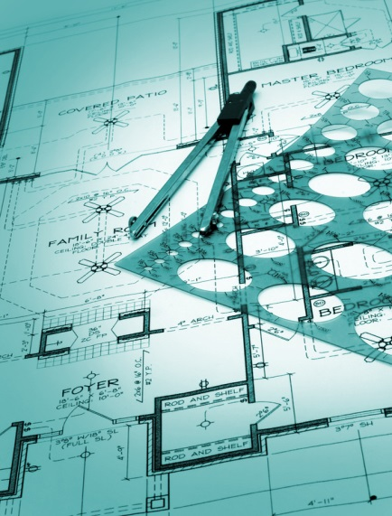
Eliminating obstacles to bank financing
EEB projects are usually financed by
  state/EU grants ⇨ The magnitude of EU or state support for EE is basically a political decision.
  private funds (owners, ESCO-s) & bank loans ⇨ Mobilisation of capital from private sources basically influenced by the business environment.
ESCO concept is thoroughly analyzed, several initiatives to provide favourable environment, in comparison, bank financing schemes are not in the limelight.
In the consultation paper of the European Commission (February 2012), identified main barriers to initiating energy efficiency projects in buildings are of market, financial or regulatory in nature.
Many of these obstacles could be eliminated more effectively on a regional level ⇨ the study shall investigate the current structure of financing energy efficiency investment of public building in the DRS countries by
  taking into account currently existing local and regional studies in the same topic and
  using input through the steering group members from the various DRS countries.
The aim is to
  identify the main barriers to successful bank financing of such projects to highlight common challenges and
  provide for possible ways to deal with them by sharing best practices in the region.

Slide 7
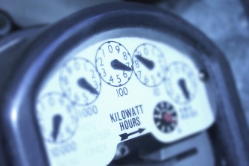
Results could bring multiple benefits
The outcome would be
  policy recommendations for decision makers to improve the environment of public building renovation projects and enable financing institutions to increase investment in this area.
This would
  decrease energy costs for the public institutions,
  bring growth and employment opportunities in the construction sector, in the production of construction products and professional activities such as architecture or engineering.
  have a positive effect on job creation (or retention),
  generate additional tax revenues and social security contributions,
  reduce unemployment costs.

Slide 8
Addressing problems on regional level
The study should
  provide a retrospective analysis on the financing structure of energy-efficiency projects in public buildings (EU, state or municipal grants, loans, ESCO-s, ETS revenues, etc.) by analysing the energy-efficiency investments made in the DRS countries in the last 3 years, focusing on the financing mechanism and the financing sources.
  describe the state-of-play of bank financing in the region with the aim to identify and list main barriers to success.
  describe the success factors in terms of financing model, organizational and legal framework by collecting practices of the Member States on public building renovation finance schemes with proven track record.
  provide suggestions to policy makers on how to improve the environment for bank financing of EEB projects.

Slide 9
Results possible by early 2014
The study would invite
  State organisations, such as ministries and institutions responsible for energy efficiency;
  Banks and financial institutions;
  Scientific institutions, e.g. universities.
Concept would bring results by the beginning of 2014.
The Concept could provide a regional perspective to promote energy efficiency projects by addressing common challenges and enabling knowledge transfer among the member countries.

Slide 10
For more information please visit: http://danube-region.eu/
Thank you for your attention! szilard.arvay@mfa.gov.hu

