Slide 1

Scientific Support to the Danube Strategy The Danube Bio-Energy Nexus Nicolae Scarlat, Renewable Energy Unit
13 June 2013 Budapest

Slide 2
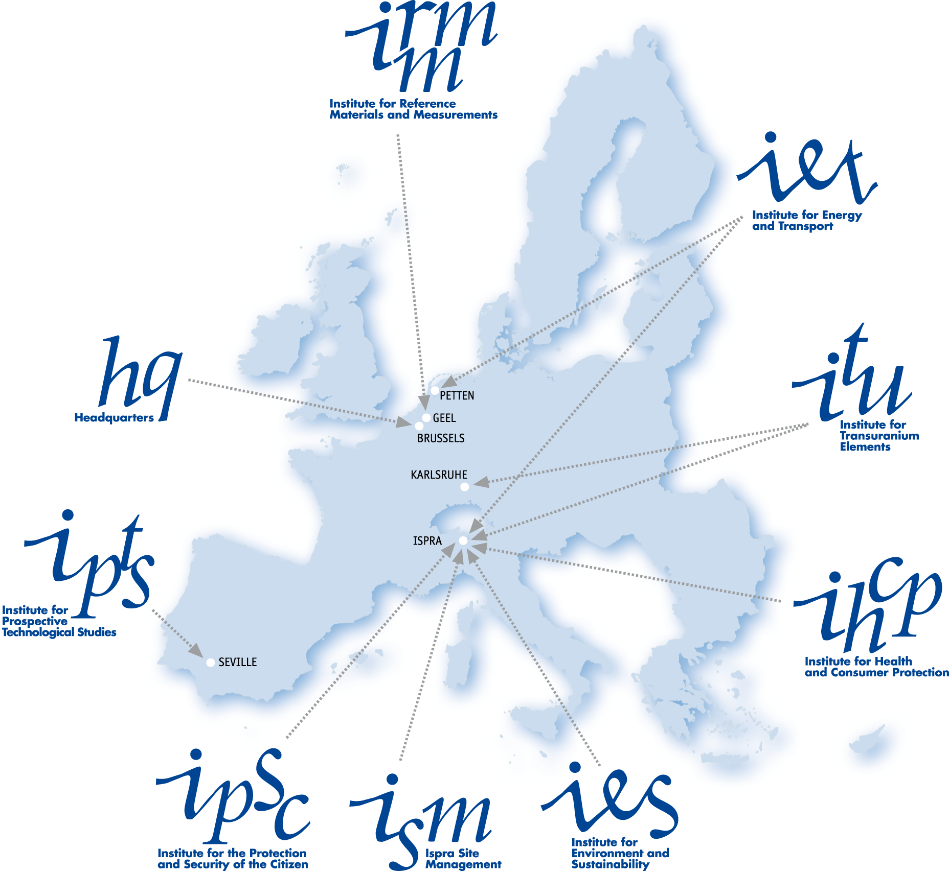
Who are we?
Institute for Energy and Transport
1 of the 7 scientific institutes of the JRC.
Our mission: “provide support to Community policies and technology innovation to ensure sustainable, safe, secure and efficient energy production, distribution and use and to foster sustainable and efficient transport in Europe”
Main activities:
Renewable energies
Sustainable transport
Sustainable & safe nuclear energy
Energy techno/economic assessment
Bioenergy including biofuels
Hydrogen and fuel cells
Clean fossil fuel
Energy efficiency
Security of energy supply
JRC: the European Commission's
in-house science service
As a Directorate-General of the European Commission, the JRC provides customer driven scientific and technical support for the conception, development, implementation and monitoring of European Union policies.
2

Slide 3
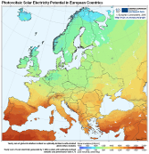
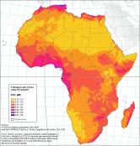
Renewable Energy Mapping & Monitoring in Europe and Africa
Activities
Monitor the implementation of the RES Directive 2009/28/EC
Support Commission evaluation process for Member State reports
Assess resource use and potential: biomass, biofuels, solar, wind, geothermal
Technology assessment

Slide 4
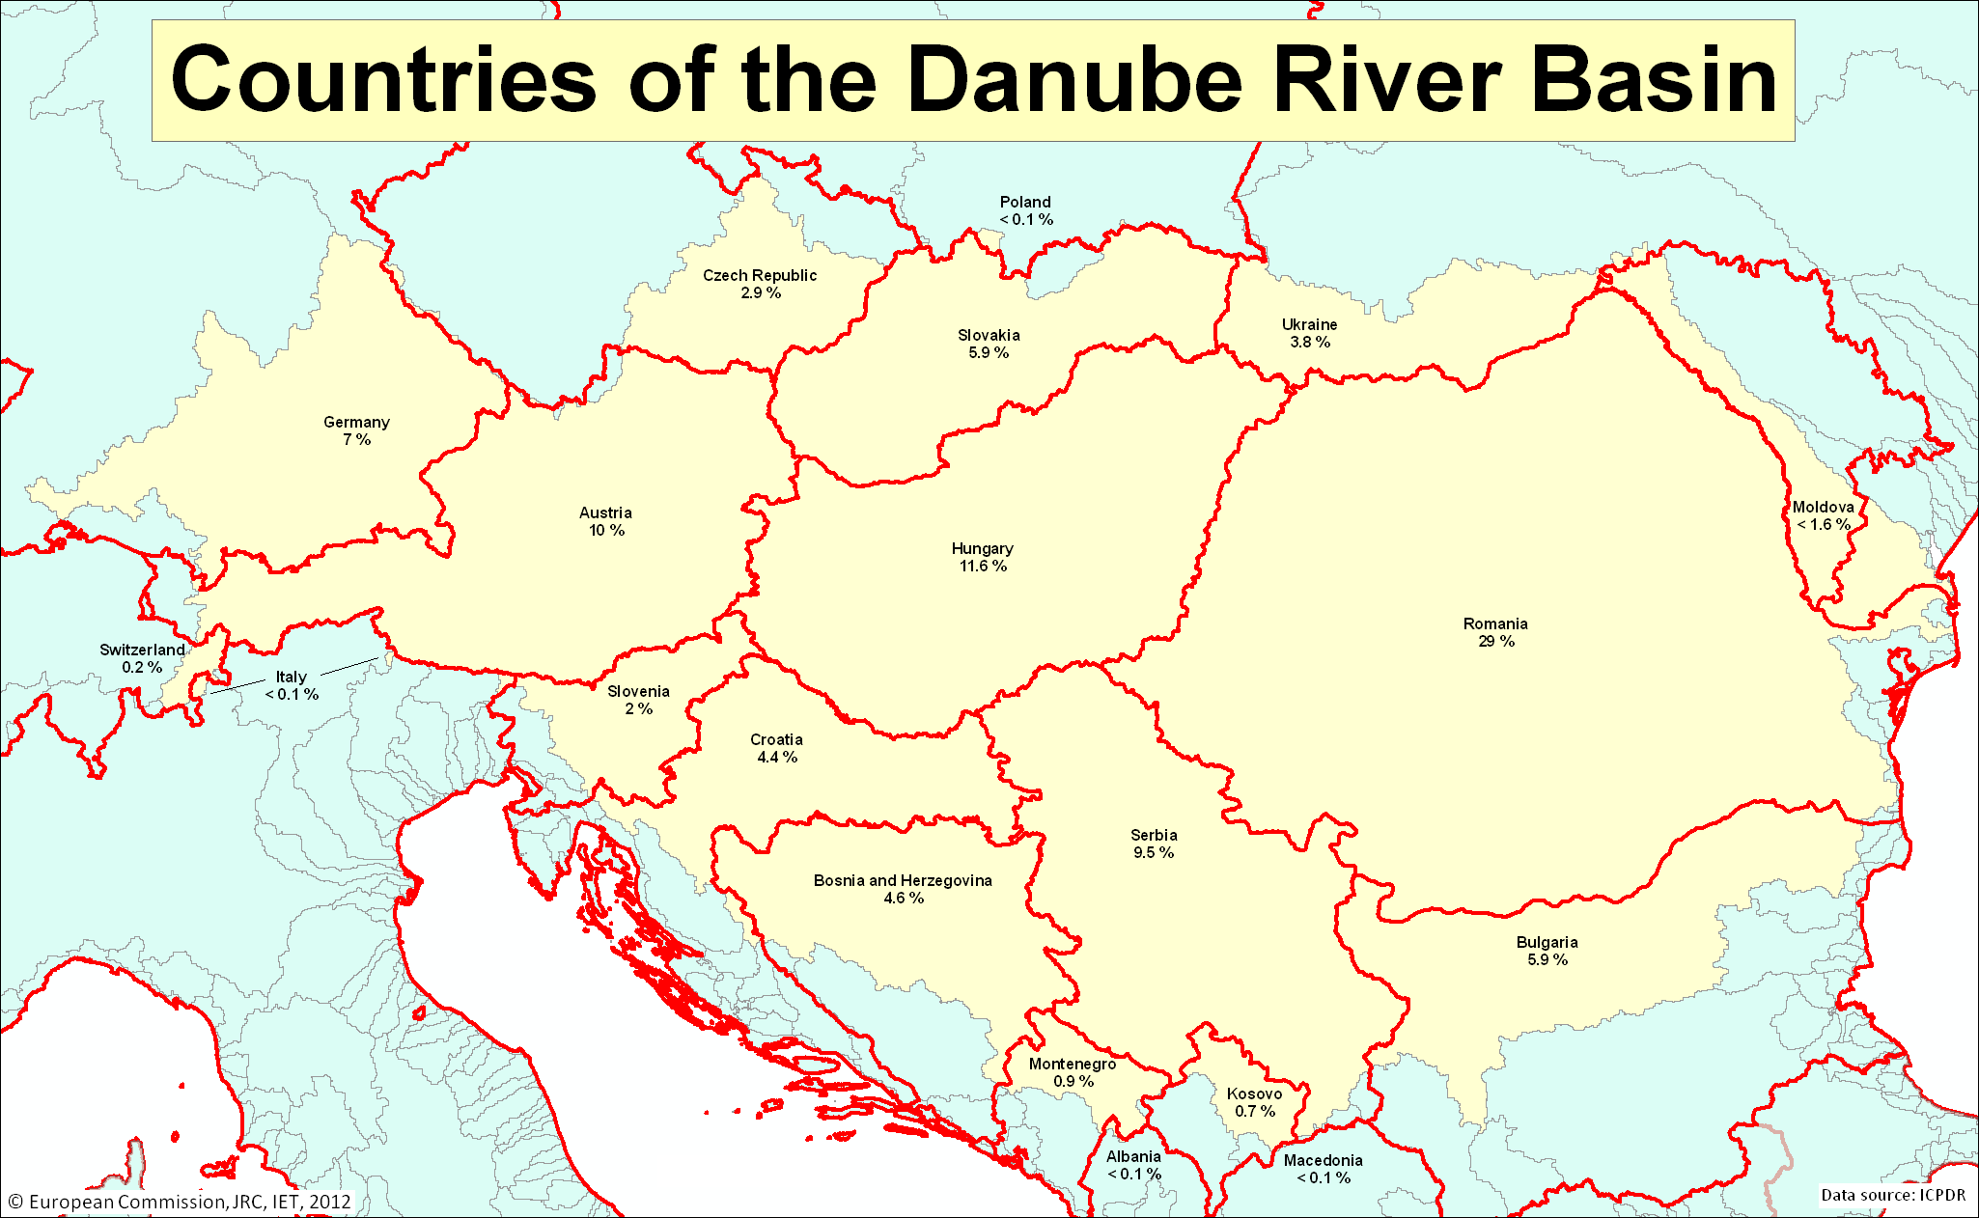
Bio Energy Nexus
Relevance:
Renewable Resources for Energy Production
Agricultural Development
Environment Protection
Renewable Energy Policy:
20% Renewable Energy by 2020
Bio Energy (60%)
Wind
Solar
Hydro

Slide 5
Bio Energy Cluster: Priorities
National Renewable Energy Action Plans - NREAPs
Focus: Bioenergy
Mapping the potential
Technology Options
Impacts on Agriculture, Soil and Biodiversity and Water use
Energy systems/economics – Resource Efficiency
Transport of biomass-feedstock on the Danube River
Sustainability

Slide 6
Bio Energy Cluster: Opportunities
Integration between EU-Member States, Candidate/Accession countries and neighbourhood countries to address challenges of
Environment
Renewable Energy
Economic Growth
Innovation
Exploiting a rich potential
Common Opportunities for Agriculture
Trade opportunities
Statistical transfers between Member States , joint projects between Member States and with third countries
Innovation for advanced conversion systems

Slide 7
Bio-Energy: Complexity
agriculture
forestry
domestic & industrial waste
solid biomass
crop residues
SRF & grasses
wood residues & waste
wet biomass
manure
organic waste
resource
oil crops
rape, sunflower
sugar & starch crops
cereals, sugar beet, sorghum
hydrolysis/ fermentation
anaerobic fermentation
conversion technology
esterification
pyrolysis
gasification
combustion
liquid biofuels for transport (ethanol, FAME, DME, etc.)
Electricity
heat
steam
mode of use
cogeneration

Slide 8
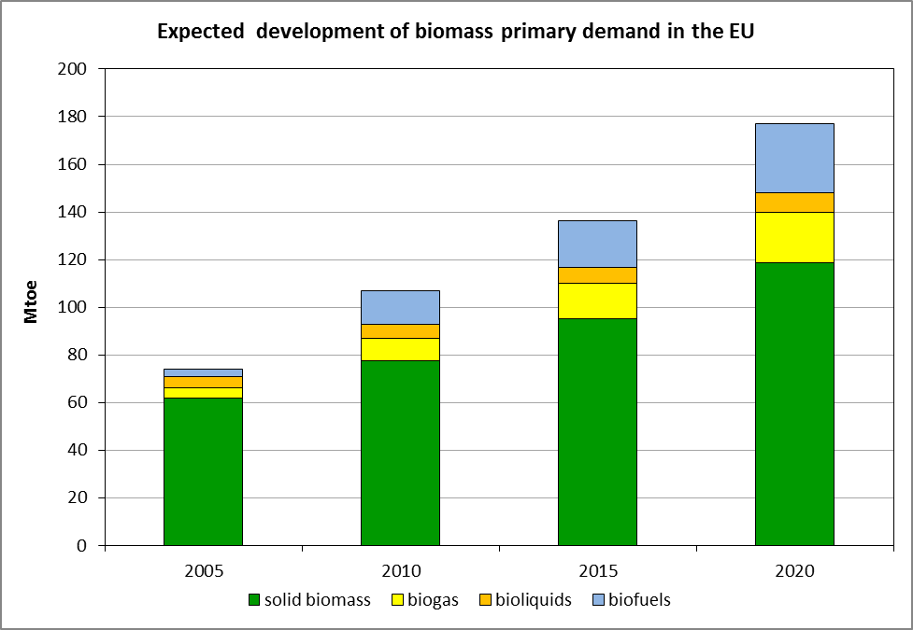
National Renewable Energy Action Plans Biomass domestic supply
Is there enough biomass
to reach these targets?
-better mobilisation
-energy crops
-imports from abroad

Slide 9
National Renewable Energy Action Plans Domestic Biomass Supply +46%
N/A: BA, ME, MD, UA

Slide 10
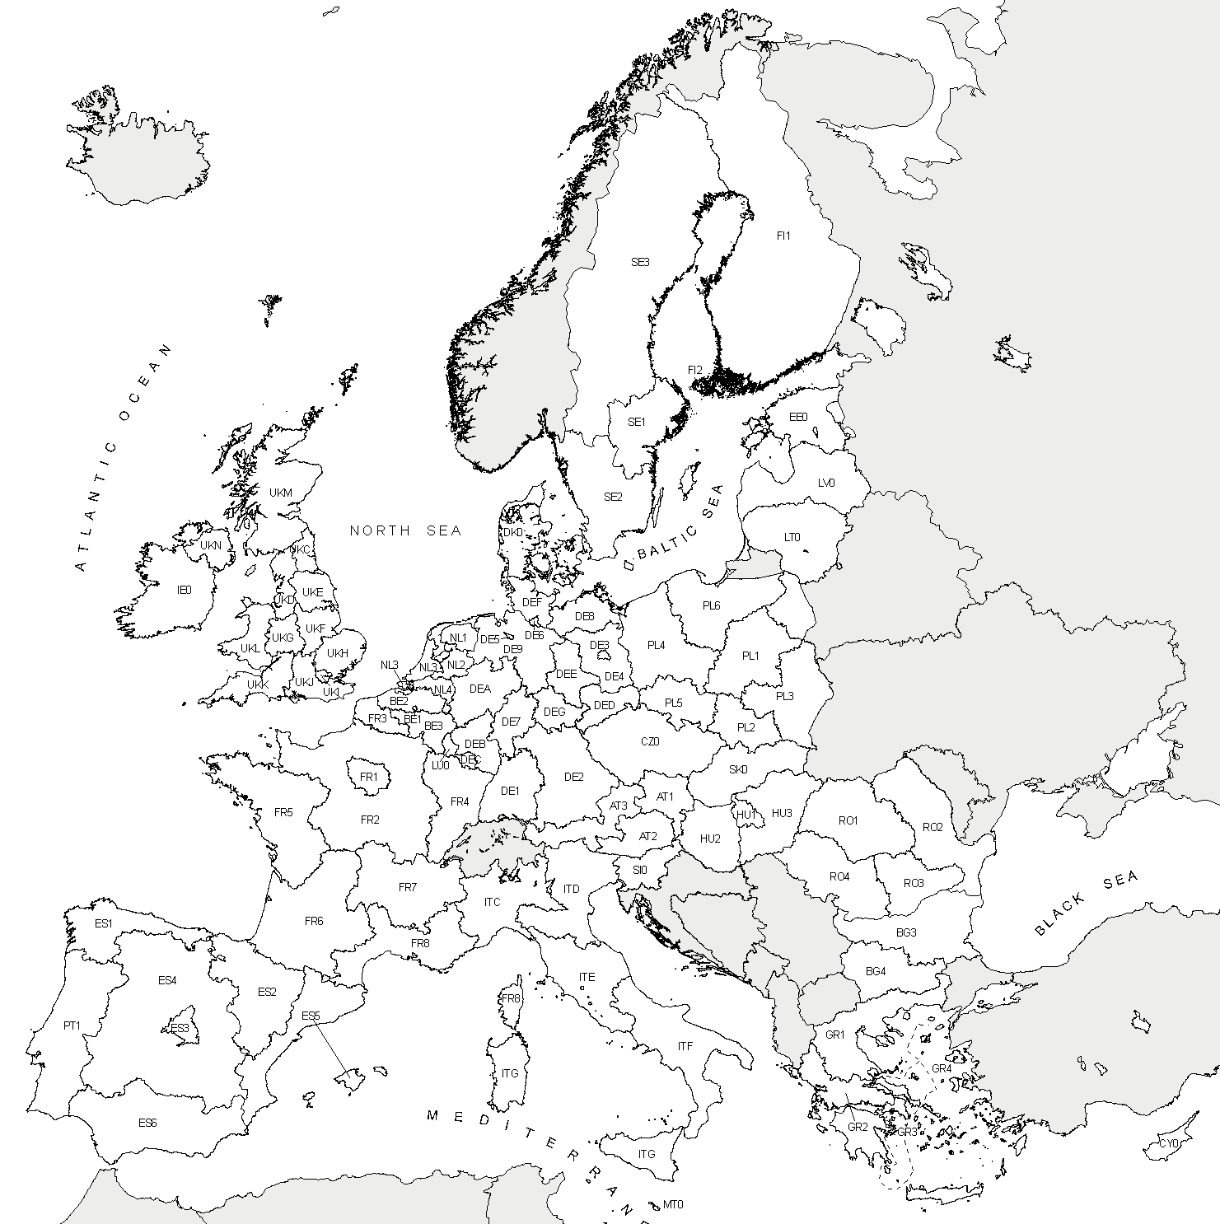
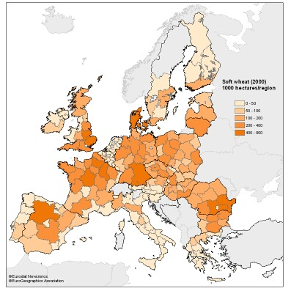
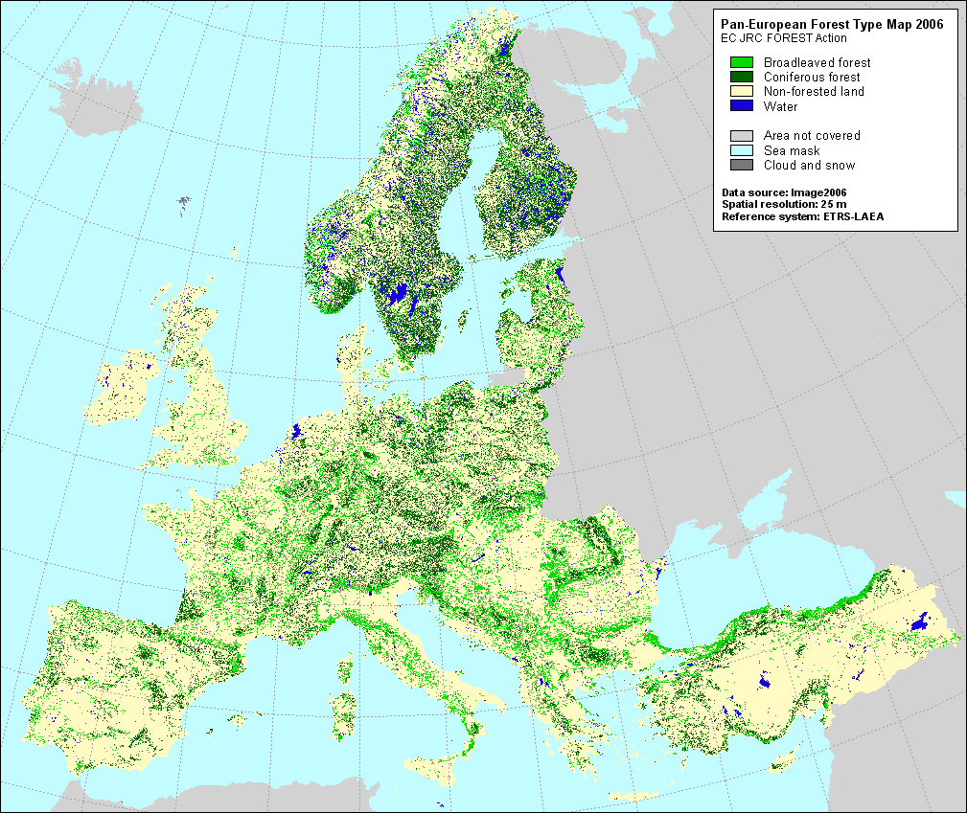
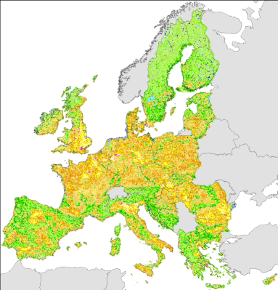
GIS-based assessment of biomass resources
Because Renewable Energies sources are mostly SPARSE and/or IRREGULAR, a careful potential evaluation should be geographically based.
Statistical databases (regional level)
agricultural crops: area, yield, production
forest data: forest area, growing stock, annual increment
land use
Spatial datasets
CORINE Land Cover 2000
forest map
soil maps
terrain map
road map
Geographical Information System (GIS)
Notes:
Availability of biomass feedstock is critical for the development of bioenergy

Slide 11
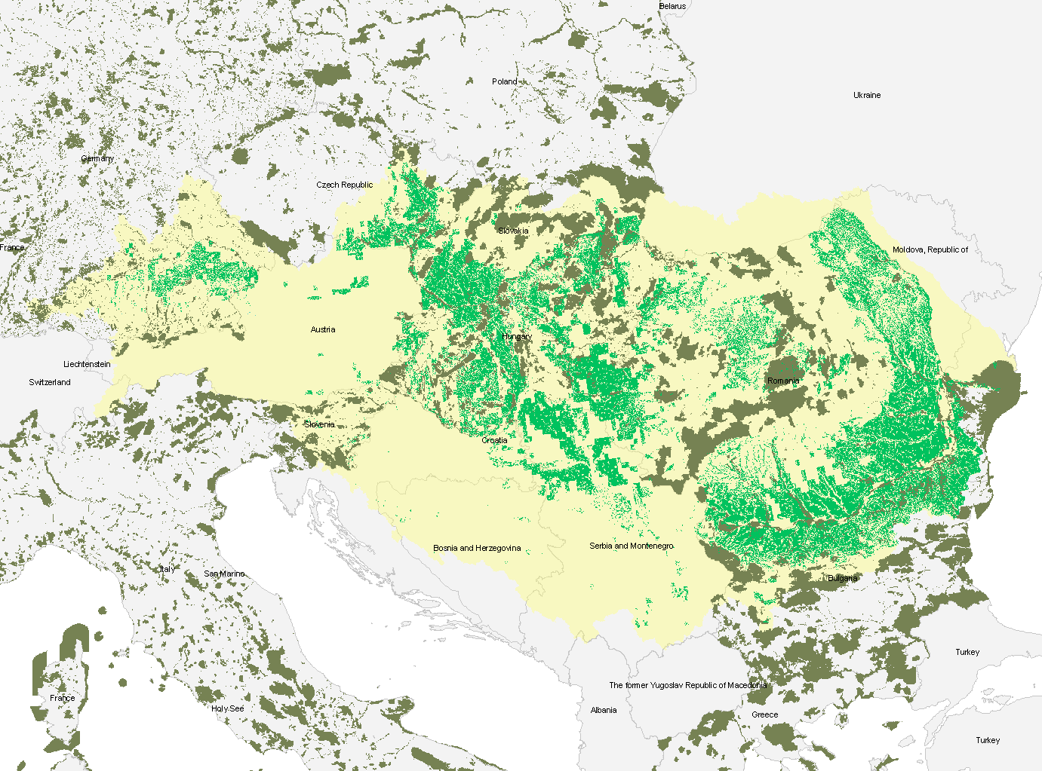
Example: How to assess resources?
Legend
Arable land with no or slight soil constraints
Natura 2000
13 June 2013
11

Slide 12
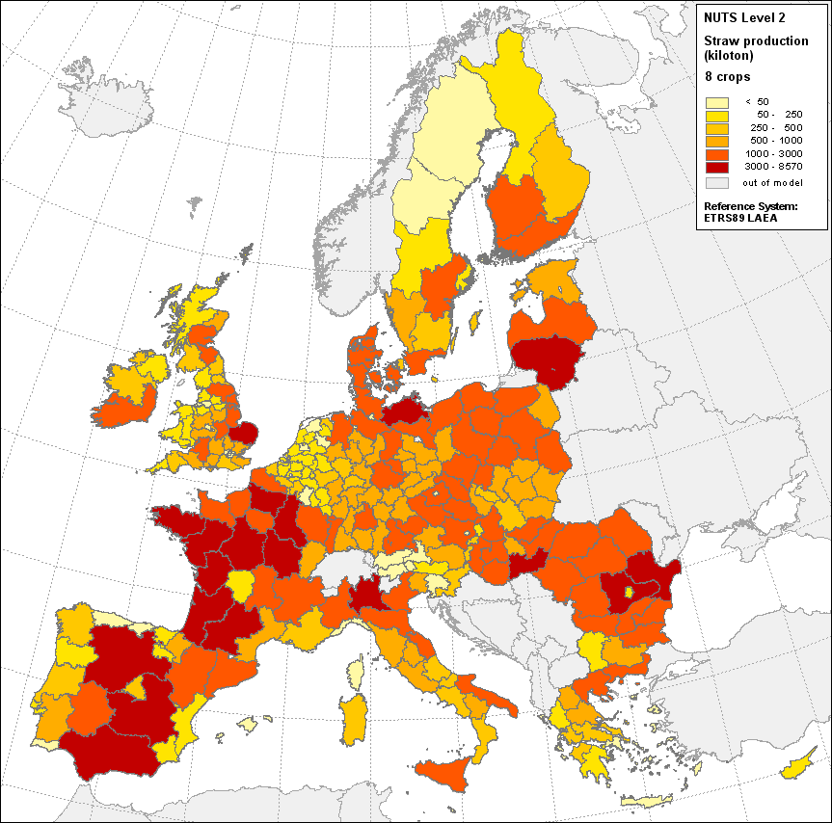
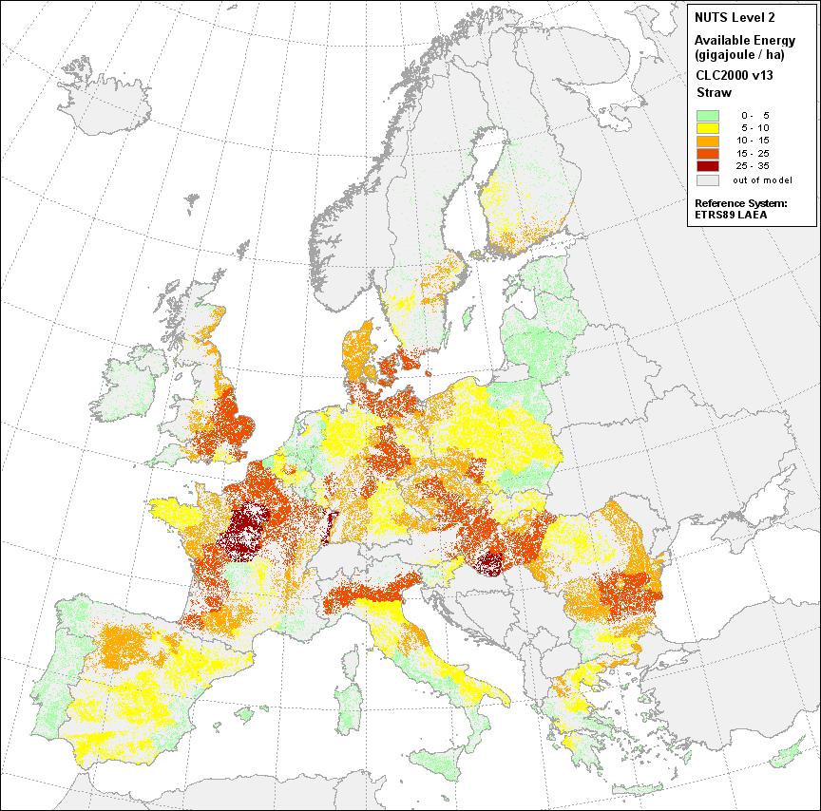
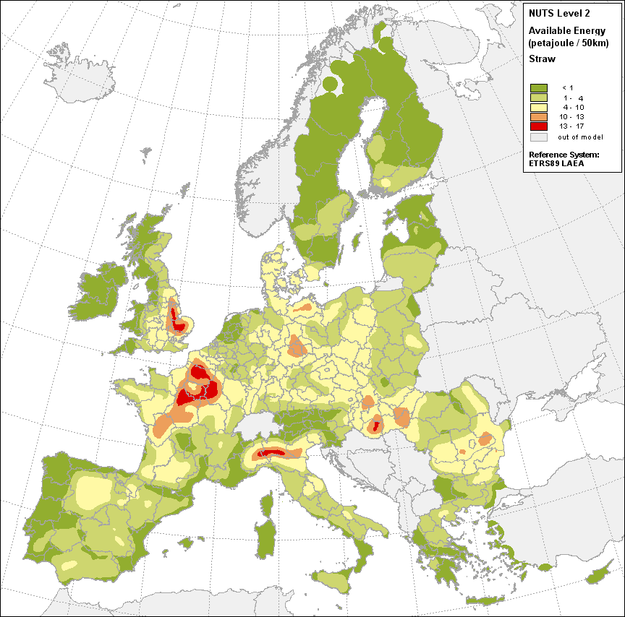
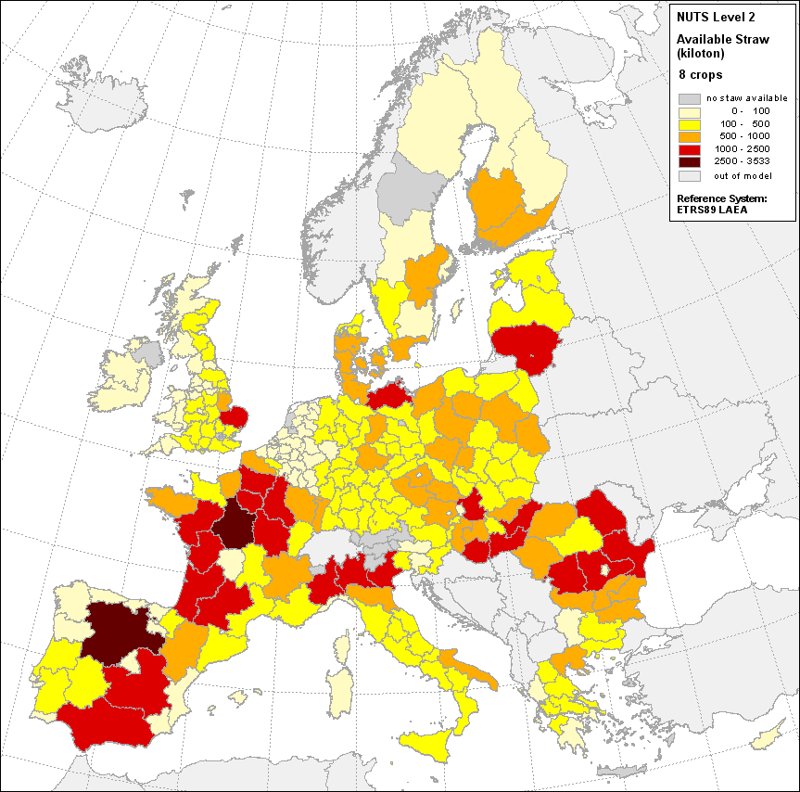
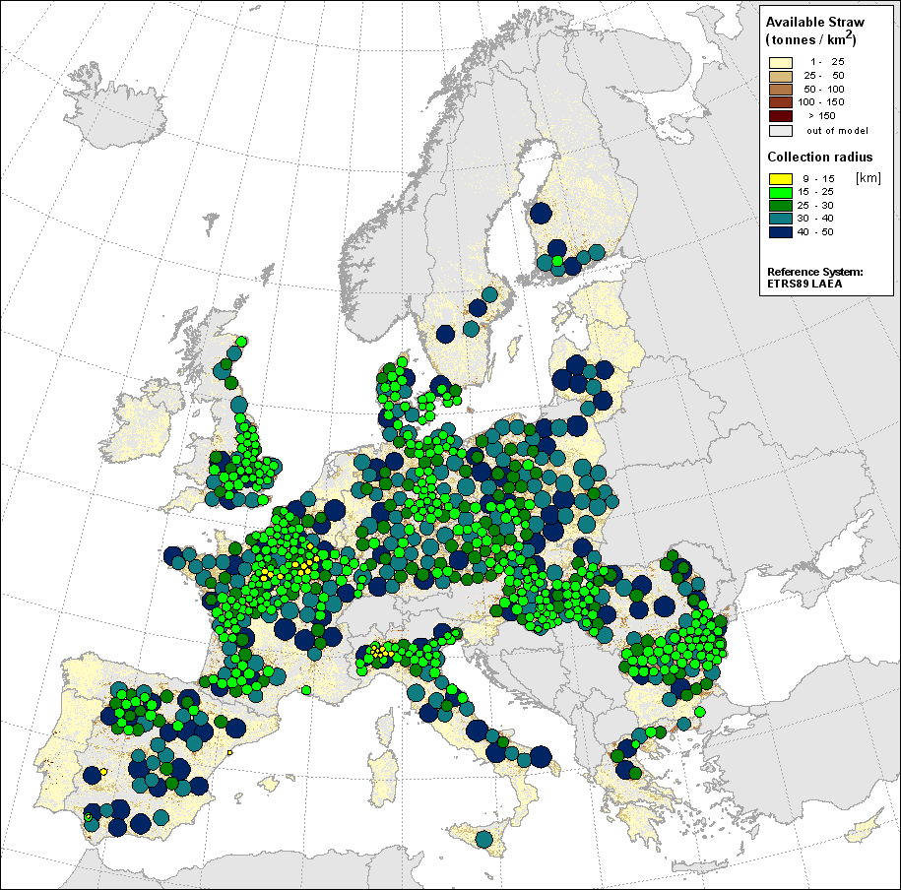
GIS-based assessment of EU crop residues
Straw production
Straw available for energy
Suitability map for power plants
Collectable straw
Optimized allocation
808 plants – 100 kt straw/year
81.7% straw used
Actual production
crop production, area and yields
residue to yield ratios
Environmental constraints
organic matter content
>> sustainable removal rates
Competitive use
Straw available for energy production
Looks for the most dense straw areas
and exploits them in decreasing density order

Slide 13
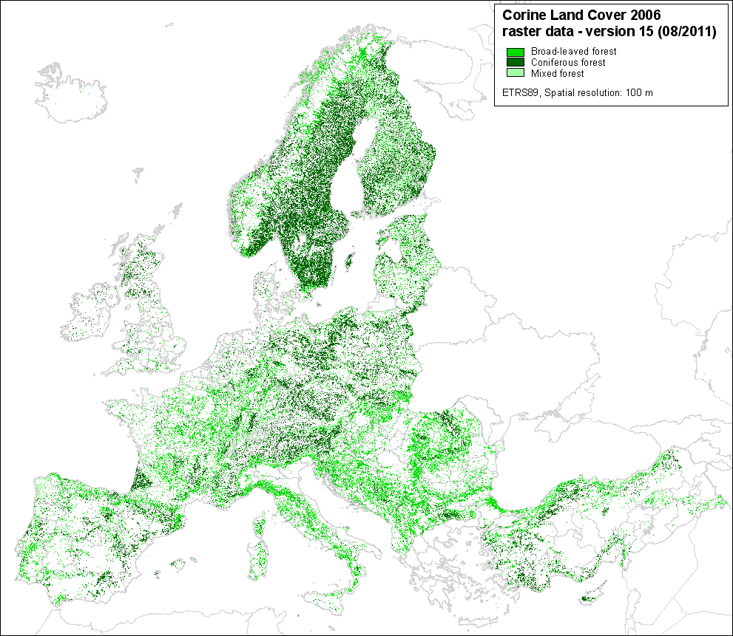
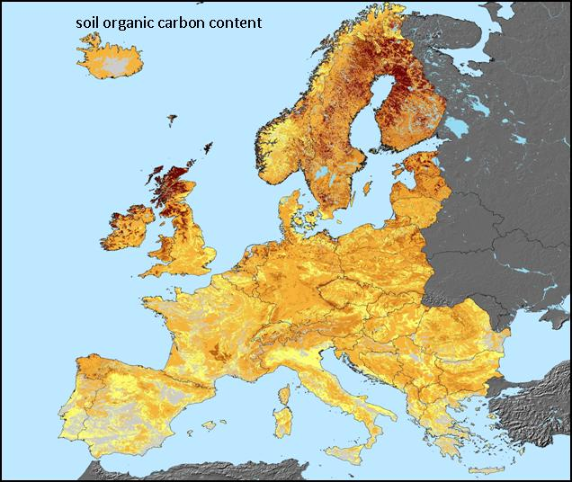
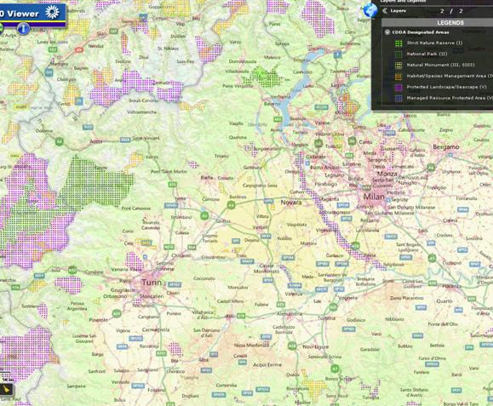
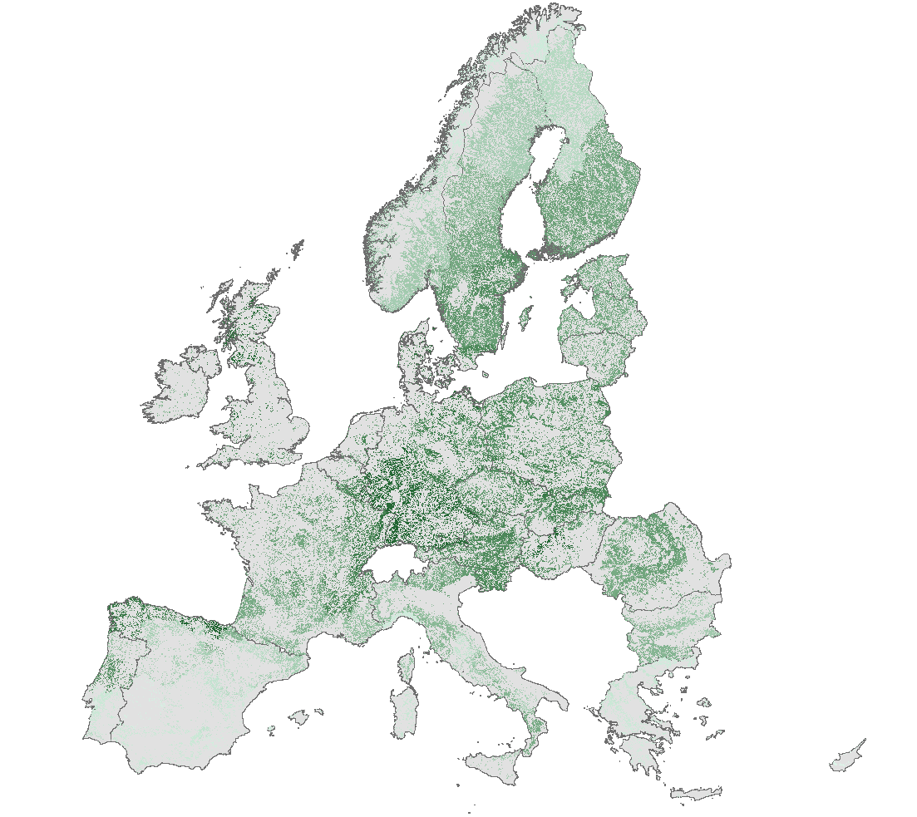
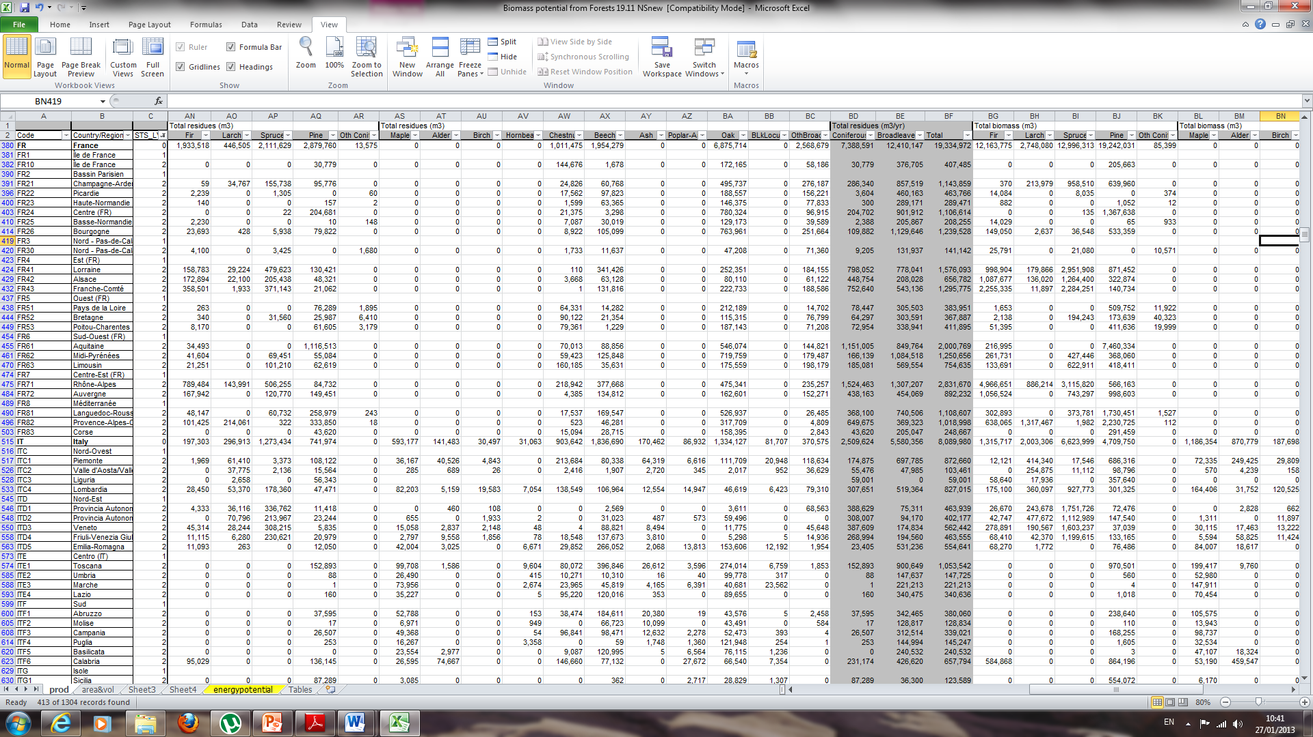
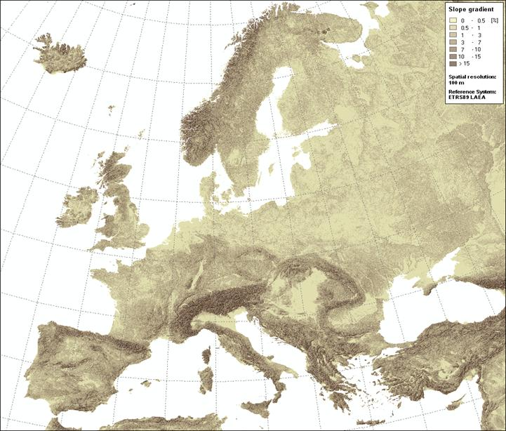
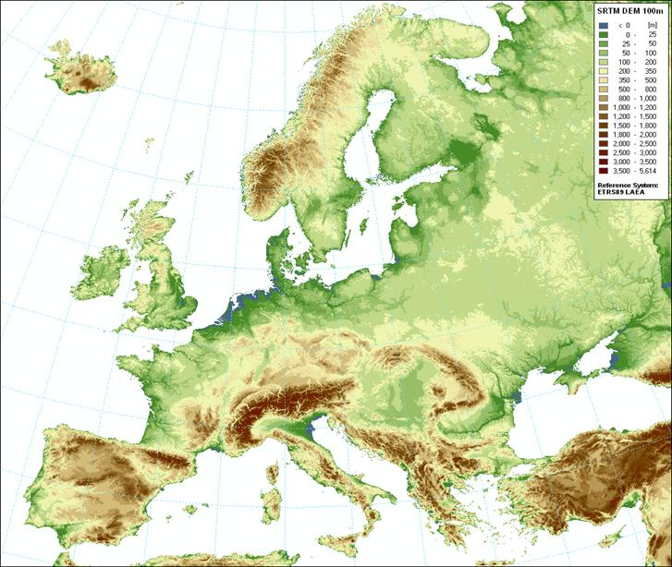
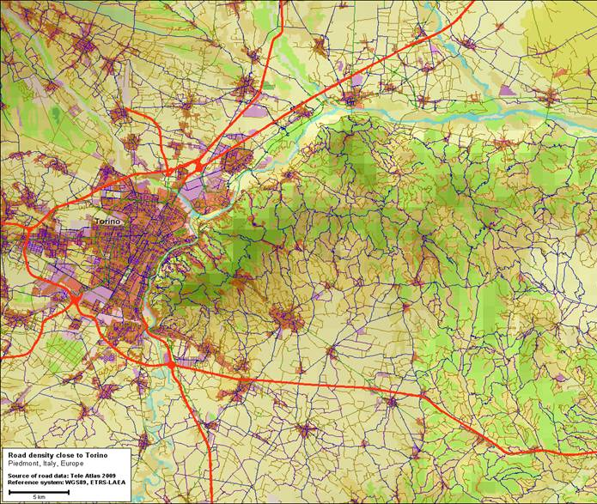
Spatial distribution of forest biomass
Corine Land Cover (EEA)
Pan-European Forest Type - JRC
Protected areas - NATURA 2000
Slope gradient map
Digital Elevation Model
Roads in Europe Tele Atlas
13 June 2013
13

Slide 14
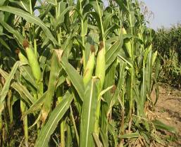
Agriculture = 4 Fs = Food, Feed, Fuel, Fiber
+ Bio-materials and green chemistry
Food, Feed = Large quantities, low profit margins
Green chemistry = Low quantities, high profit margins but high technology
Bioenergy = Large quantities, low profit margins
How much land do we need ?
Which land shall we use ?
Competition for land / resources ?

Slide 15
Wish-list Items, by Work-package
Resources
Forestry / Agricultural crops residues / Waste streams
Energy crops / Short Rotation Forest / Coppice
Technologies
Consistency with local feedstock
Mapping of the existing infrastructures + demonstration plants
Use of Danube river as transport route of biomass-feedstock
Energy systems/economics
Financial feasibility, stability of the value chain
Heat & Cooling demand – where it is?
Mobilization of end user market… Incentives?
Competing end products, e.g. plywood, paper, pellets
Environmental Impacts
Feedstock environmental assessment (e.g., water, pesticides, fertilizers).
Preservation of soil fertility - sustainable removal rates (w. soil nexus)

Slide 16
Contribution to / from participants
Extension of NREAP database to non-EU countries of DRB
Mapping the potential
Assessing different sustainability aspects of bioenergy
Data analysis, progress monitoring
Understanding local opportunities
Filling the gaps
………………
………………

Slide 17
Do not forget:
++ Build on the knowledge from existing projects.
++ Deep involvement of all actors – industrial players
++ Policy coherency and stability
++ “what are the rules of the games??” – NREAPS + Progress Reports
++ Citizen involvement: What’s in the pocket for them..

Slide 18

Thank you on your attention!
13 June 2013
18

