Slide 1

BUDAPEST DANUBE CONTACT POINT: an innovative tool to support the implementation of the Danube Strategy
David Pelech
Budapest Danube Contact Point
6th Steering Group Meeting of Priority Area 2, 13 June 2013

Slide 2
Budapest Danube Contact Point:
Smart Tool for Facilitating DRS Projects
Innovative initiative of the European Investment Bank (EIB) and Hungary to support feasible and financeable projects for the Region
Starting off: June 2012
Support for the Danube Strategy on the project level:
    free advisory services
    „reality check” for projects
    aiming to improve quality and speed up preparation
    team of international experts

Slide 3
Organization
BDCP
2 Experts by HU
1 Expert
by EIB
2 Experts
by DRS Members
Supported by:
EIB (technical, financial)
JASPERS
Location, infrastructure: MFA, HU
SERVICING: EUSDR Steering Groups, National Contact Points, Project Promoters
NETWORKING: EC, consultants, sectorial experts, local ministries, authorities

Slide 4
Focusing on Projects with
Macro-regional Relevance
BDCP supports selected DRS projects and concepts
with focus on transport, energy, environment and water management
carried out in a transnational context
with high added value for the Region

Slide 5
Services Offered for
Steering Groups / Project Promoters
HOW TO STRUCTURE?
Supporting selected transnational projects with high added value via:
      Project identification
      Project prioritization and selection
      Reality check and needs assessment
      Using EIB/JASPERS technical support
      Involving stakeholders
      Planning the financing of selected actions
      Promoting the macro-regional approach

Slide 6
Services Offered for
Steering Groups / Project Promoters (2)
HOW TO FUND?
Helping to assign optimal financing structure via
      In-debth knowledge of available grant / financing instruments
      „In-house” EIB support

Slide 7
Services Offered for
Steering Groups / Project Promoters (3)
HOW TO CREATE MACRO-REGIONAL ADDED-VALUE?
Promoting and supporting macro-regional concepts (i.e. strategic feasibility studies)
      Geographically: functional region affecting multiple countries
      Methodology: multi-sectorial, integrated approach
      SOLID BASIS FOR SUSTAINABLE REGIONAL DEVELOPMENTS

Slide 8
Project Example: Integrated Transport Concept
CONTENT Geographically concerned: AT, HU, SK (CR, SI) Integrated Transport Concept for Burgenland – Western Hungary Deriving transport measures from existing and planned strategies and projects of all relevant sectors Output: transport measures (infrastructure, organization, operation) optimized for the Region, solid basis for sustainable and financeable transport projects for 2014 - 2020 CONTRIBUTION OF BDCP Involve and coordinate relevant stakeholders Make stakeholders understand the added-value of the Concept Preparing major principles of the feasibility study

Slide 9
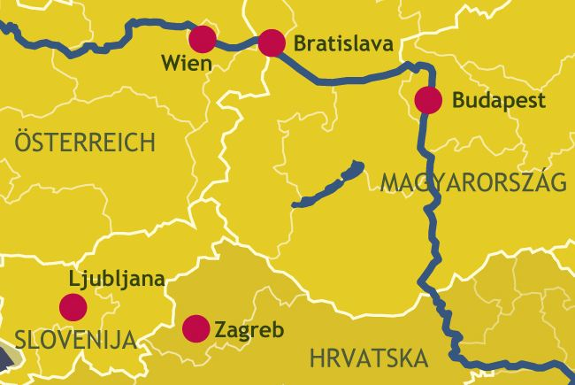
Individual Project Development
1
2
3
4
5
6
7
8

Slide 10
Integrated & Optimized Project Development
1 + 2
3
4
5
6
6
7 + 8

Slide 11
IN THE PIPELINE…
Supporting PA2’s initiative on examining opportunities and barriers of public building energy efficiency projects
Expecting 2 experts from Moldova to work on energy / environmental projects
Danube Investment Fund: Fund of funds to support fundraising and growth of SMEs in the Region
EIB Technical Assistance Facility: to fund feasibility studies of large scale infrastructure projects

Slide 12
THANK YOU FOR YOUR KIND ATTENTION!
BUDAPEST DANUBE CONTACT POINT
Bem rkp. 47, 1027 Budapest
Ministry of Foreign Affairs of Hungary
Tel: +36 1 458 1722
email: bdcp@mfa.gov.hu

