Slide 1



Challenges and opportunities of natural gas sector in the Danube Region
Mgr. Martin Jirušek, PhD
Assistant Professor, Faculty of Social Studies, Masaryk University
International Institute of Political Science, Masaryk University

Slide 2
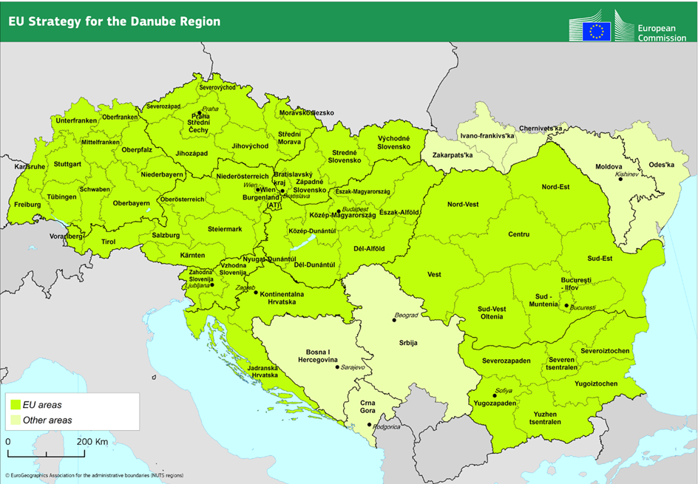
Challenges and opportunities of natural gas sector in the Danube Region
2

Slide 3
The Danube Region – main characteristics
The Danube Region is characterized by uneven development
Western part of the region (GER, AUT) - established and interconnected gas markets
Central Europe (CE) – relatively successful transformation, catching up with the West
South-eastern Europe (SEE) - serious obstacles to market development and integration
THEREFORE: The main issues hindering the development are related to the SE part of the region
The SEE states are typical for higher share of the industrial sector in the economy and higher energy intensity
Natural gas is a crucial commodity for industrial sector and households (heating)
Supply curtailments may have severe impact despite relatively lower gas utilization
THEREFORE: Outages and supply cuts pose a serious threat due to their potential impact on industry and on sensitive sectors

Slide 4
Issue 1: Lack of will to cooperate, diverging interests and country-specific hindering issues
Interests of individual countries/market players as hindering factors for integration
Diverging policies and discourses even within micro-regions of the Danube region
CE countries differ in foreign policy discourses, which influences their energy policies
CZ focuses on close cooperation with the western European markets (Gazelle)
Slovakia generally focuses on maintaining the country´s transit role (Eastring)
Hungary focuses on securing its position; also takes a different foreign policy path in number of areas
SEE countries differ in terms of sectoral goals
Romania - still an isolated ‘island’ only slowly progressing in terms of interconnections for internal reasons, despite the potential for improving the situation in the region,
Slovenia – a wholly different situation compared to the rest of former Yugoslavia; does not feel the urge to highlight the regional integration
Number of states struggle with the very basics (Moldova, BiH, Montenegro,…)
4

Slide 5
Issue 1: Lack of will to cooperate, diverging interests and country-specific hindering issues
Factors undermining market integration can be found also on the level of inner-state administration
Deep ethnic cleavages - Bosnia & Herzegovina
Ambiguity on the country's FP discourse and relations – Serbia
Territorial issues hindering reforms and investments – Moldova
Supply deals often influenced by corruption & non-transparency (non-transparent intermediaries - e.g. Serbia, Romania...)
Politicization of infrastructural projects (Bulgaria – South Stream)

Slide 6
Issue 2: Lack of strong, clearly formulated sectoral policies
Lack of strong, clearly formulated sectoral policies is harmful especially for states whose natural gas sectors are underdeveloped
Missing policies undermines development particularly in underdeveloped and dependent countries
Sector development requires long-term policies for predictability and stability for investment decisions
No gudelines mean no goals and inability to procure reforms
Lack of focus causes failure in addressing one of the most imminent threats of the region - energy poverty

Slide 7
Issue 3: Lagging harmonization of pertinent legislation
Majority of SEE states struggle with implementing the IEM rules ranging from minor issues within the current legislation and its enforcement to entire missing acts
Most notable examples: BiH, Moldova, Serbia
IEM principles (as defined in the 3rd Energy Package) are levelling the playing field, effectively eliminating the advantage of outsize incumbents active on these markets (Gazprom and its subsidiaries)
The EU’s IEM rules are the crucial factor in pulling the laggard countries towards a functional energy market, partly substituting lacking visions and clear policies, providing the countries with a purpose for the development

Slide 8
Issue 4: Insufficient infrastructure
East-West-oriented supply infrastructure with little flexibility
In SEE the infrastructure is sparser compared to the CE (not mentioning WE)
The infrastructure is East-West oriented, overly dependent on a single supplier (Russia)
The situation is changing only slowly
Inadequate intra-state infrastructure and mutual interconnectivity
1/3 of the post-communist countries in the Danube Region are 100% dependent on Russian supplies with no viable alternative: Bulgaria, Serbia, Bosnia and Herzegovina, and Moldova
States in SEE are often dependent on a single supplier and often also on a single supply route (i.e. weakened supply security), e.g.:
Bulgaria – crisis of 2009
Moldova – high politicization of supplies influencing both energy security and political stability
Serbia & Bosnia and Herzegovina - threats of cutting off supplies due to the accumulated debt
The network in SEE lacks interconnectivity, source & route diversification, and flexibility
8

Slide 9
Issue 4: Low natural gas utilization and sector development
Anchor loads for large-scale projects are higher than current demand (IAP, EC Gas Ring)
Lacking incentives for large-scale infrastructural as well as intra-state projects
Lack of indigenous resources
insufficient domestic resources
unclear potential of reserves (Black Sea – conventional/unconventional, Adriatic Sea)
Bulgaria – potentially large deposits (up to ca. 480 bcm) – moratorium imposed after public protests in 2012, confirmed in 2015
Romania – prospective offshore fields in the Black Sea (related: Crimea annexation);
shale gas reserves up to 1,5 tcm – questionable economic viability
Croatia – potential gas fields in the Adriatic Sea facing environmental concerns
Montenegro – potential gas fields in the Adriatic Sea
9

Slide 10
Issue 4: Low natural gas utilization and sector development
Low natural gas utilization
Large-scale projects need solid economic rationale
The rationale is missing due to low utilization
The utilization will not increase without additional supply
No investor is willing to make the decision due to missing incentives

Slide 11
Issue 5: Lack of reliable information sources
Lack of necessary information hinders cooperation and advising
Poor information coverage of SEE countries
Internal issues hinder information services
Bosnia & Herzegovina, Moldova
Information may be kept secret as a result of the state´s or main stakeholder´s policy
Diverging policy goals may (again) be the obstacle
Cooperating on information exchange is crucial for developing the functioning market and also supporting programs
Energy Community does an important job in providing interconnecting EU and non-EU members

Slide 12
Conclusion & Recommendations for SEE countries
The main obstacles to the development of the natural gas market in the Danube Region are related to the countries located in south-eastern part of the region
Implement and enforce the IEM rules
The IEM rules level the playfield and introduce market-based measures
Increase transparency within the sector
Increase interconnectivity and work on source and route diversification
Implement and conduct clear and focused sectoral policies to enhance the stability and predictability of the sector
Improve information services and exchange of information and data

Slide 13
Opportunities
New sources of natural gas (conventional & unconventional)
Black Sea, Adriatic Sea
Infrastructural projects with a region-wide impact
Turkish Stream + Tesla Pipeline
Eastring
EC Gas Ring
IAP
Adria LNG + related infrastructure
SE part of the Danube Region may become an important crossroad of infrastructural projects, increasing its importance for natural gas supplies within and even beyond the Danube Region

Slide 14
Thank you for your attention!
http://energy.fss.muni.cz/
jirusek.martin@mail.muni.cz

