Slide 1
Future perspectives for underground energy storage in slovakia
Underground Energy Storage IN THE DANUBE REGION
Ladislav Barkoci

Slide 2
Agenda
Demand for energy storage
Underground energy storage activities in Slovakia
Future challenges

Slide 3
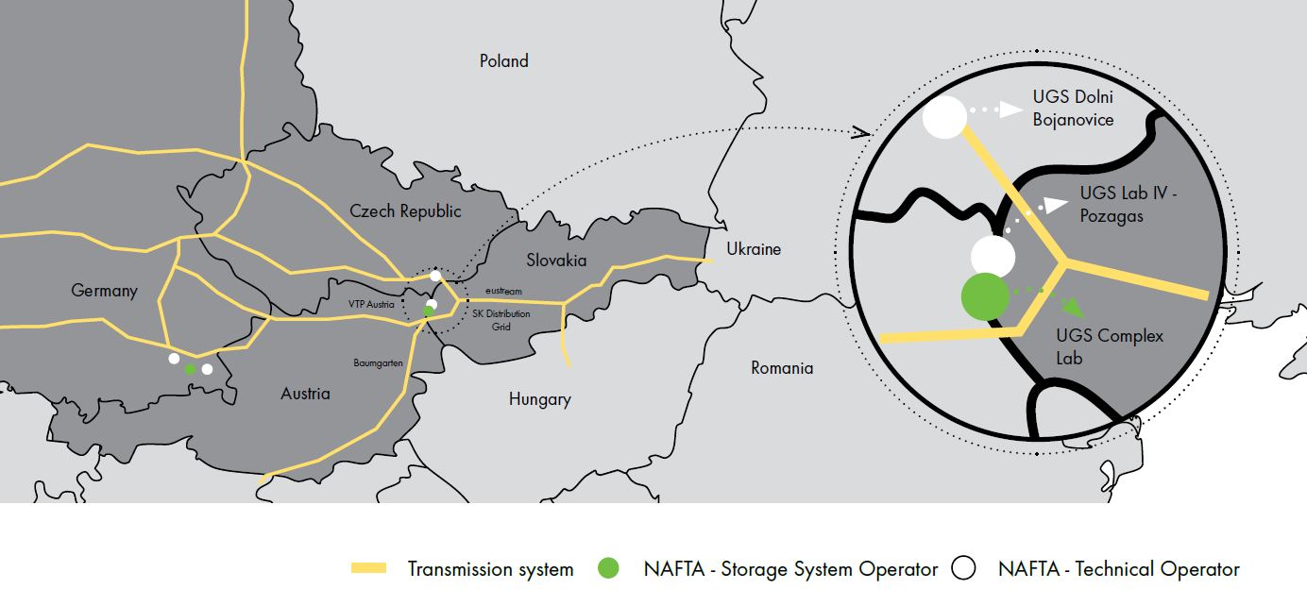
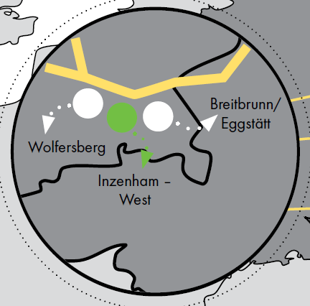
NAFTA STORAGE OPERATIONS ACROSS EUROPE
40.7 TWh
Stogit
Storengy
NAM
Uniper
RAG
NAFTA
20 TWh
1
2
183
121
6
67.0
60.7
3
4
5
76.4
68.2

Slide 4
Demand for Energy Storage

Slide 5
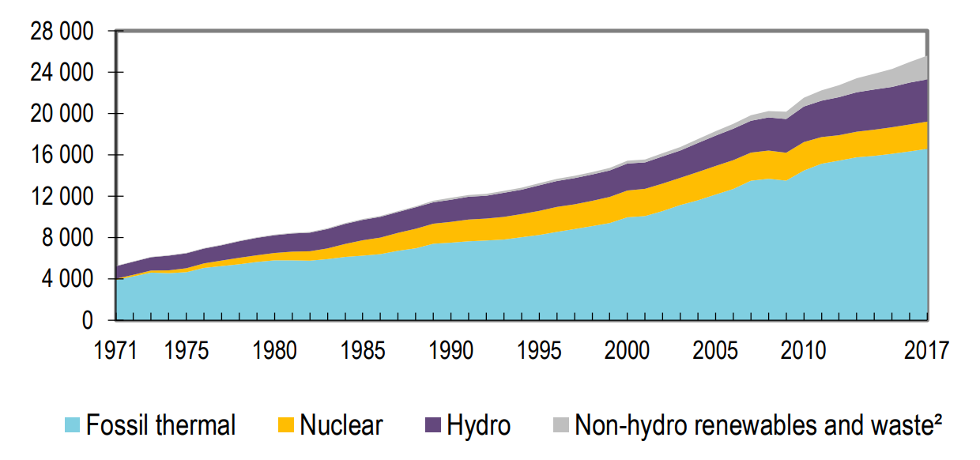
Why we need more energy storage?
World electricity generation from 1971 to 2017 by fuel (TWh)
65%
Source: IEA Statistics, www.iea.org
First intuitive answer – we need more energy storage in the future to cover flexibility of supply when replacing dispatchable fossil sources of electricity by intermittent renewable electricity sources
...but this is not a whole picture...

Slide 6
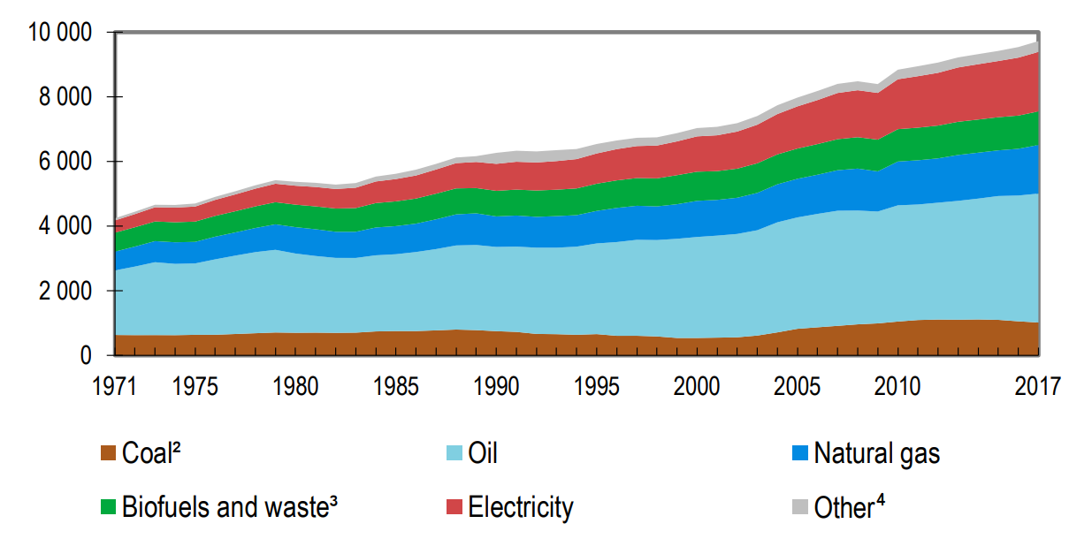
Future energy storage need – full perspective
World total final energy consumption by source from 1971 to 2017 by fuel (Mtoe)
Electricity currently accounts for less than 20% of worlds final consumption of energy.
Source: IEA Statistics, www.iea.org
If the share of electricity in energy mix is increased then covering the intermittency of renewable electricity sources is even more acute.
Moreover, fossil fuels currently cover majority of seasonal energy demand. This seasonality needs to be addressed as well.

Slide 7
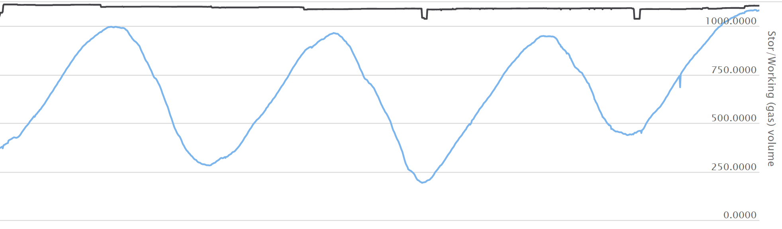
European seasonal natural gas demand
8%
31%
Source: IEA Statistics, www.iea.org
Europe UGS working gas level (TWh)
Source: GIE AGSI Storage Data, https://agsi.gie.eu/#/
Underground natural gas storages store significant part of energy consumed in EU and are actively used to balance seasonality of energy demand

Slide 8
02
Underground energy storage activities in Slovakia

Slide 9
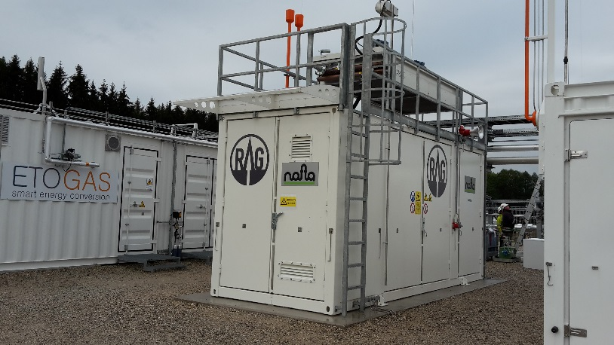
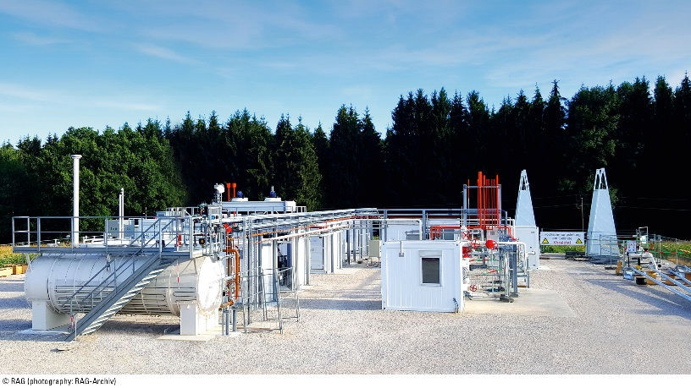
Sun Storage – first lesson
Pilot project
Storing of energy in form of H₂ in the mixture with natural gas – 10% vol. H₂
Laboratory research
Results
1
2
3
Pilot plant
Laboratory research confirmed that 10% of H₂ should not cause issues in the reservoir
Some chemical / microbial reaction was expected
NAFTA specified and delivered compressor unit
Pilot operation confirmed technical feasibility of the concept
No H₂S production
Microbial reaction occurred
H₂ mixed with cushion gas
Source of picture: RAG

Slide 10
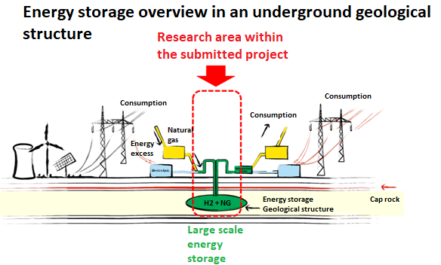

Research of the large-scale energy storage in the form of hydrogen in the geological structures
Project goals:
Identifying, laboratory testing and modelling of the suitable geological objects in Slovakia for hydrogen storage, depending on specific geological conditions as well as the amount of hydrogen mixed with the natural gas
Developing of the methodology to guide candidates interested in field of the energy storage in the form of hydrogen. The methodology should answer which tests needs to be done to allow real physical storage

Slide 11










Research of the large-scale energy storage in the form of hydrogen in the geological structures
Main activities
Research of H₂ impact to the geochemical, mineralogical and geological properties of the reservoir
Monitoring of microbial impacts
Modelling of the selected structure
Project structure
1
Project partners
Consortium of three academic institutes of SAV
Main universities in Slovakia: STU Bratislava, UK Bratislava, UPJŠ Kosice
Industrial partner - NAFTA
2
3
The project applied for financial support from the call of long-term strategic research of the Ministry of Education of the Slovak Republic

Slide 12
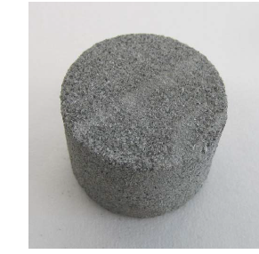
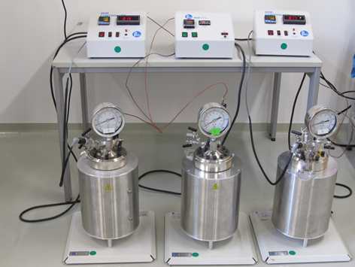
Research of the large-scale energy storage in the form of hydrogen in the geological structures
Hydrogen impact to the geological integrity as well as to the cap rock
Research of possible H₂ reactions with the abiotic parts of the reservoir
Complex analysis of macro components of the reservoir, their properties (porosity, permeability, structure, etc.) and micro components of the reservoir (minerals, gases, sedimentary organic matter, etc.)
Characterization of chemical processes of the reservoirs
Monitoring of potential changes in rocks, structures due to the influence of H₂
Individual experiments will be carried out in the reactor, simulating real reservoirs conditions (temperature, pressure ...)
Source of pictures: DBI Leipzig 2014; BOKU IFA Tulln 2014

Slide 13
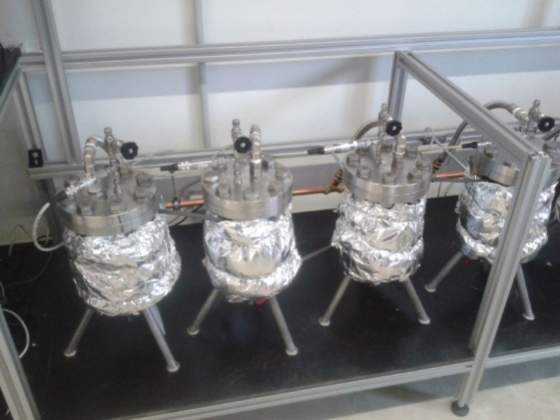
Research of the large-scale energy storage in the form of hydrogen in the geological structures
Research of microbial activity in pressure reactor simulating real reservoirs conditions
Analysis of microbial activities that can potentially take place under real conditions
Monitoring the impact of hydrogen for a change in microbial activities, with an impact on the resulting products
Analysis of the microbiome composition of the underground hydrogen reservoir
Each deposit (except salt caverns) contains a microbial community
Understanding it may help to eliminate inappropriate microbial reactions, or to eliminate microbial reactions or may indicate that the reservoir is not suitable for storing the mixture under given conditions
Source of pictures: DBI Leipzig 2014; BOKU IFA Tulln 2014

Slide 14
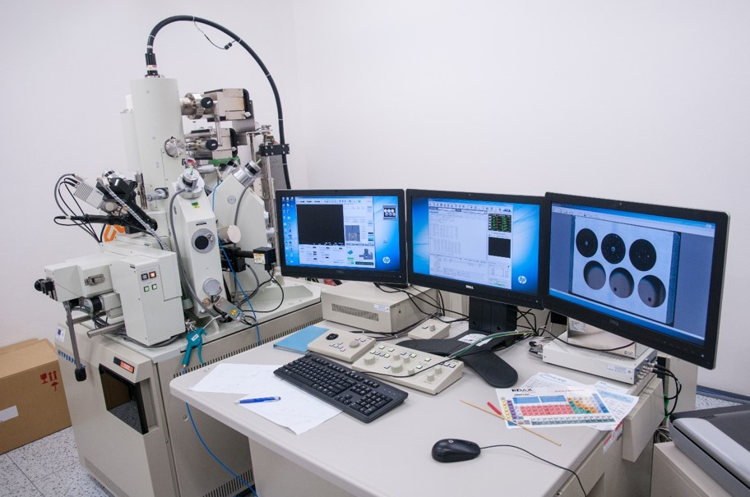
Research of the large-scale energy storage in the form of hydrogen in the geological structures
Analysis and modeling of thermo-hydro mechanical behavior of rocks and construction materials
Investigation of thermo-hydromechanical properties of reservoir layer and cap rock
Testing the impact of H₂ on materials used in selected natural gas storages – focus on sealing materials, rubbers and cement

Slide 15
03
Future challenges

Slide 16
Future Challenges
Establish sound regulation on hydrogen content in the gas grid
Develop sustainable technology of hydrogen storage in porous rock storages
Align time frame of research with application of the climate policy
Research cooperation within Europe
Climate policy coordination within whole world
„The secret of change is to focus all of your energy, not on fighting the old, but on building the new“
Socrates

