Slide 1
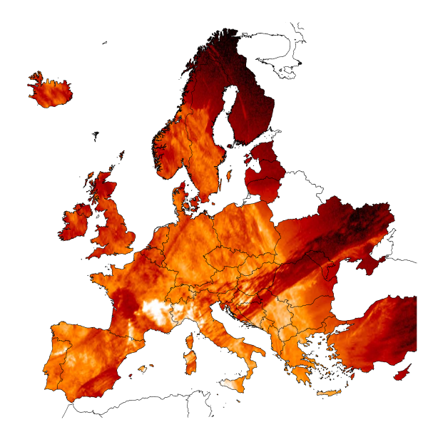
E S T M A P
Energy Storage Mapping And Planning
Results of the ESTMAP project – first pan-European assessment of underground energy storage potential
Vit Hladik (Czech Geological Survey)
Serge van Gessel (TNO)
Underground energy storage in the Danube Region – possibilities and European perspective
Budapest, 4 December 2019

Slide 2
E S T M A P
Energy Storage Mapping And Planning
Project information
Horizon 2020 project based on tender by EC/DG Energy
2 years duration, completed in 2016
leader TNO, 5 consortium partners, 24 sub-contractors

Slide 3




























Slide 4
E S T M A P
Energy Storage Mapping And Planning
Project objectives
Collect key knowledge and information on European energy storage potential
Create a European spatial energy storage database for electricity, gas and heat technologies
Demonstrate the utilizability and usefulness of collected data for European energy systems analysis and planning (by a case demonstration)

Slide 5
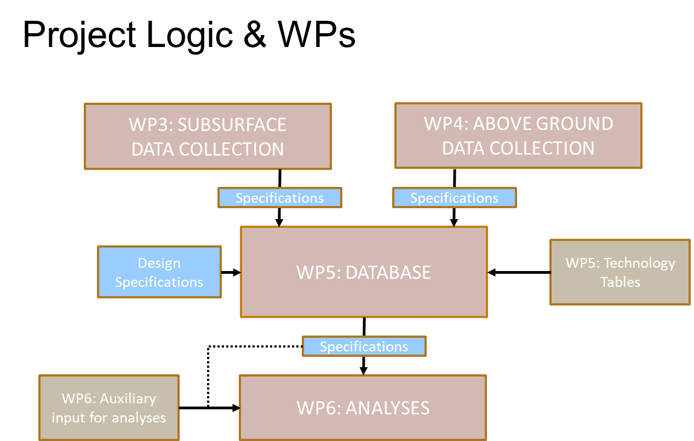

Slide 6
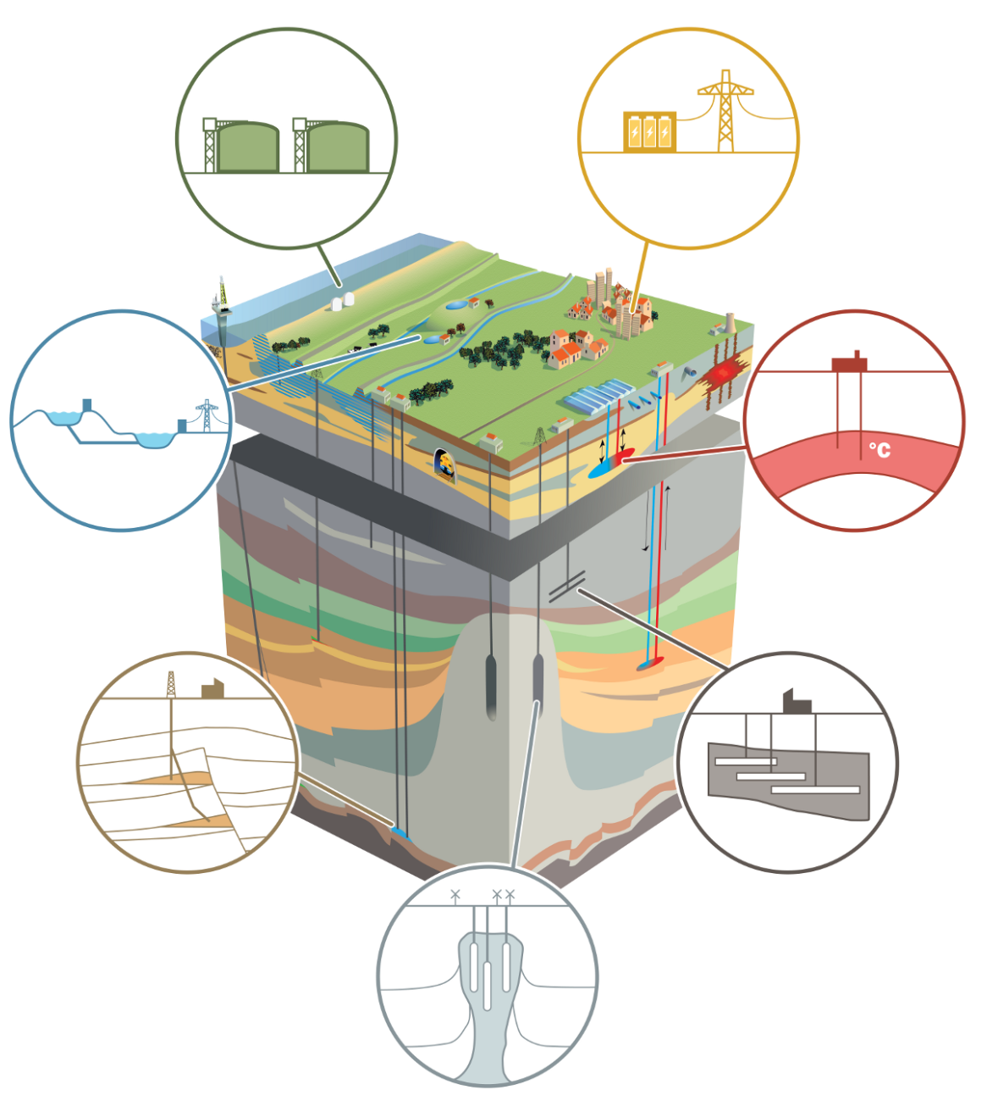
ESTMAP DATA SCOPE
Reservoirs
Technologies
Subsurface / Above ground
Existing / Potential
Electricity, Gas, Heat
BATTERIES
FLYWHEEL
CAPACITATORS
LNG
HYDROGEN STORAGE
TANKS
MODULAR
LAKES
AQUIFERS
PUMPED
HYDRO STORAGE
UNDERGROUND
THERMAL ENERGY STORAGE
HOST ROCK FORMATIONS
RESERVOIRS
NATURAL GAS STORAGE
THERMAL ENERGY STORAGE
COMPRESSED AIR ENERGY STORAGE
UNDERGROUND PUMPED HYDRO STORAGE
NATURAL GAS STORAGE
HYDROGEN STORAGE
HYDROGEN STORAGE
NATURAL GAS STORAGE
COMPRESSED AIR ENERGY STORAGE
SALT

Slide 7
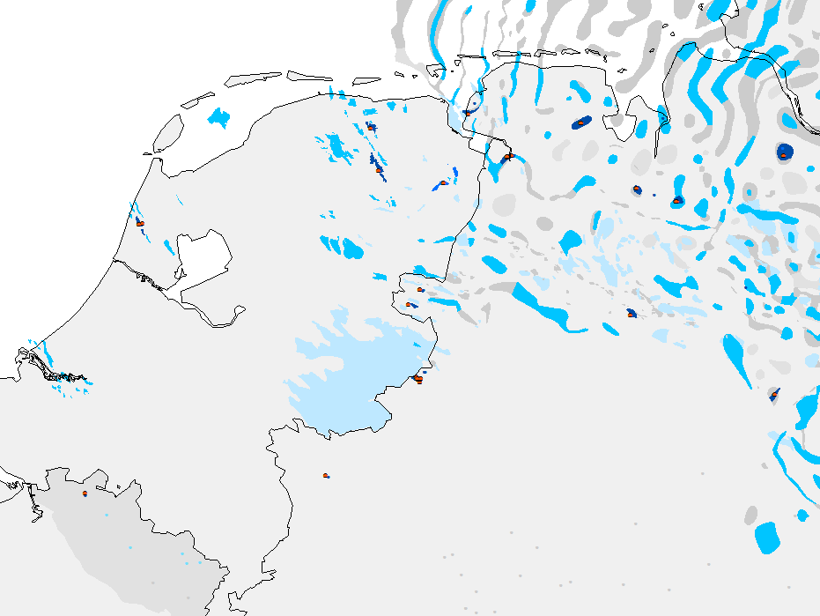
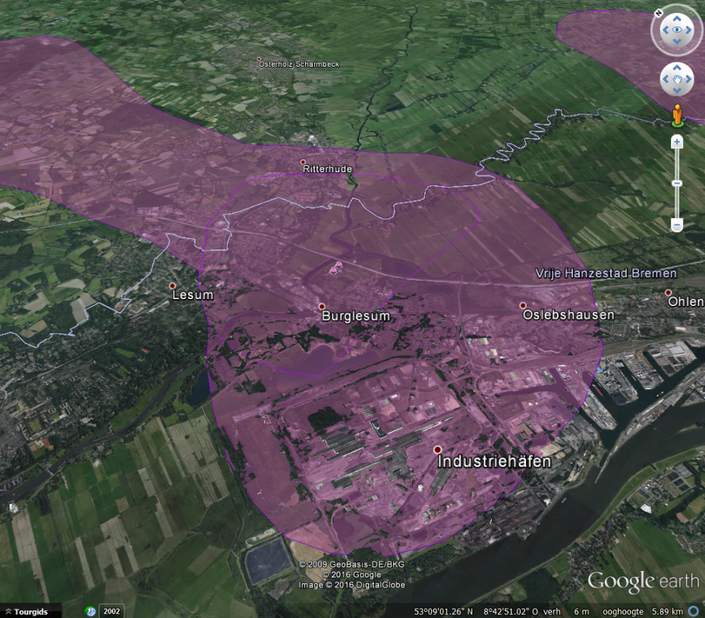
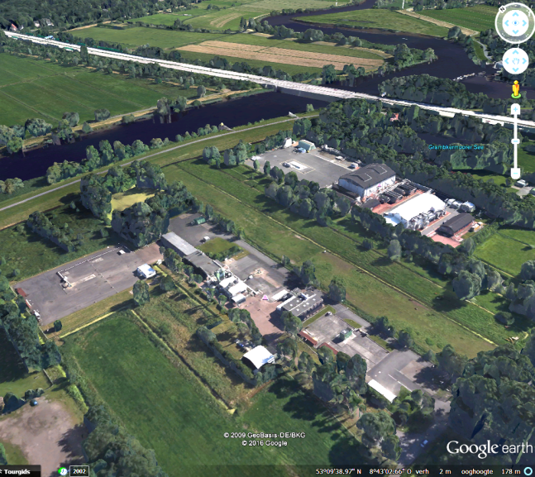
Reservoirs
Facilities
Location
Geometry
Characterization
Physical properties
Development
Feasibility assessment
Maturity
Reliability quality
Spatial relations
Source references
Location
Characterization
Performance attributes
Cost attributes
Operations and grid
Data quality
Source references

Slide 8
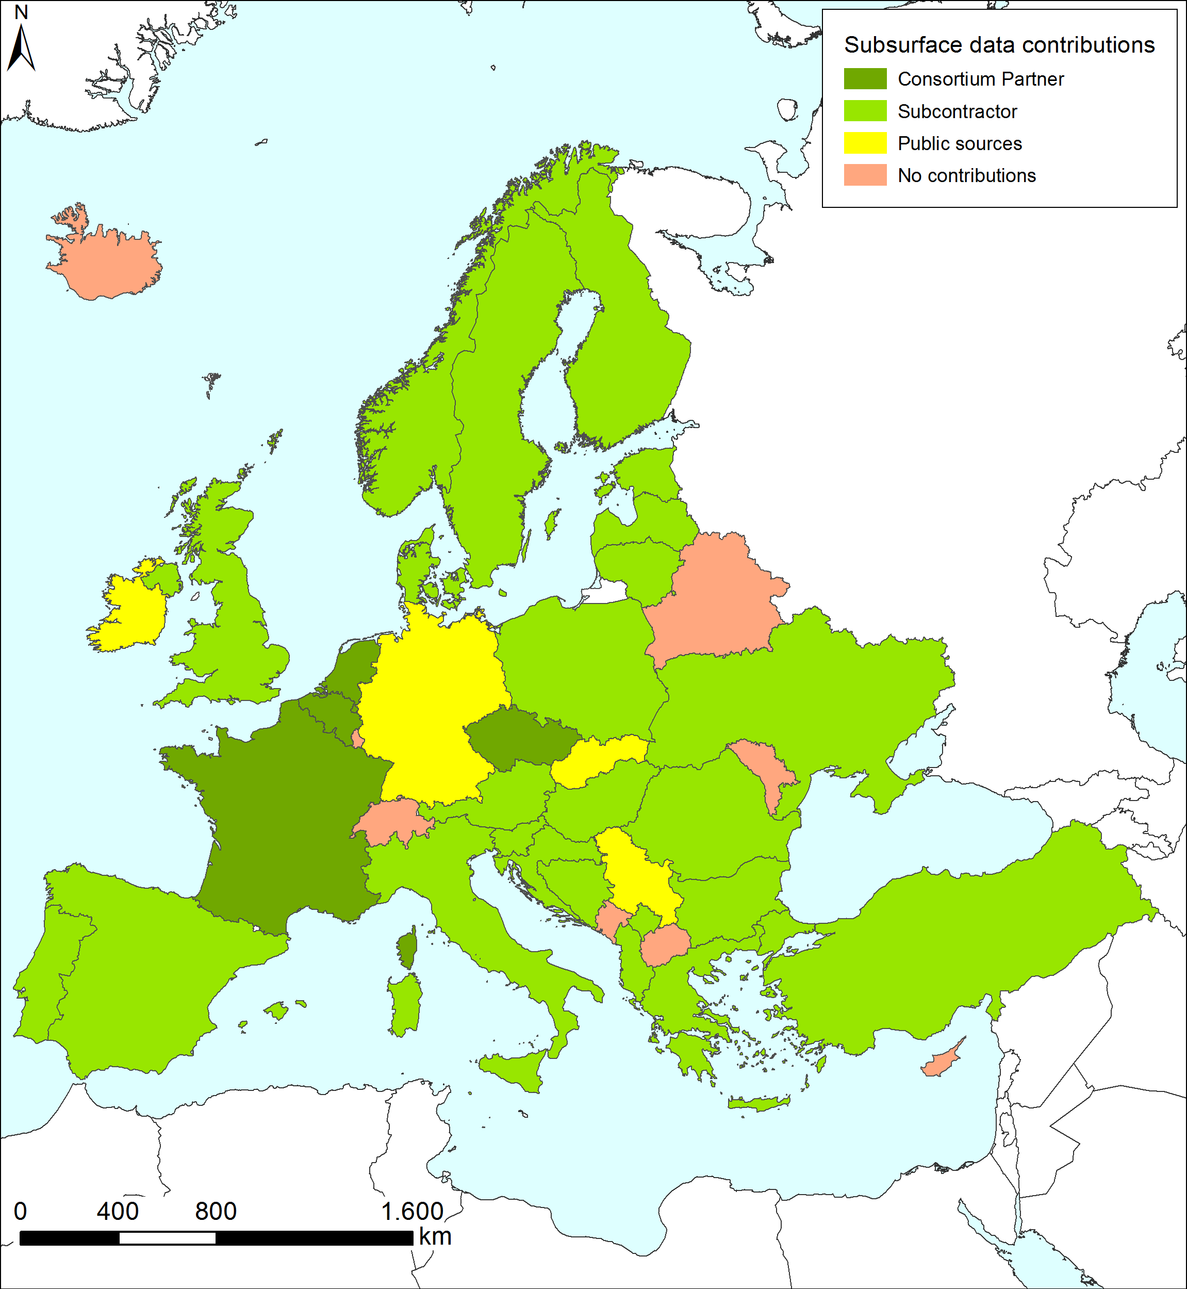

Subsurface data collection

Slide 9
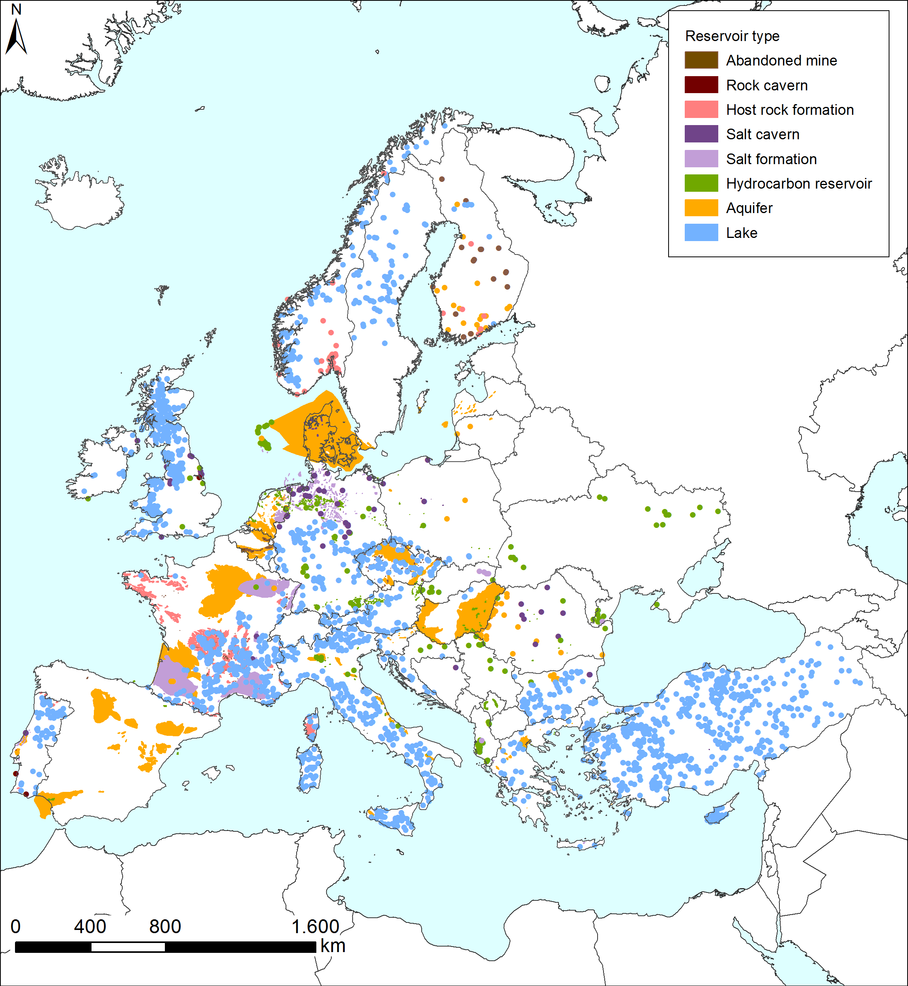
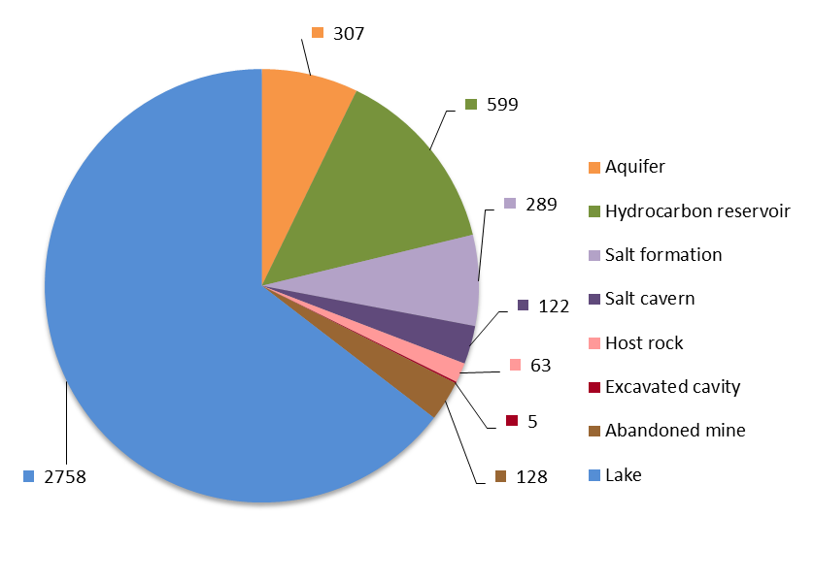
Geographical energy storage database
> 4200 potential and proven natural energy storage capacities
> 700 planned and developed energy storage facilities
Number of potential storage sites
Web-GIS version available
at www.estmap.eu

Slide 10
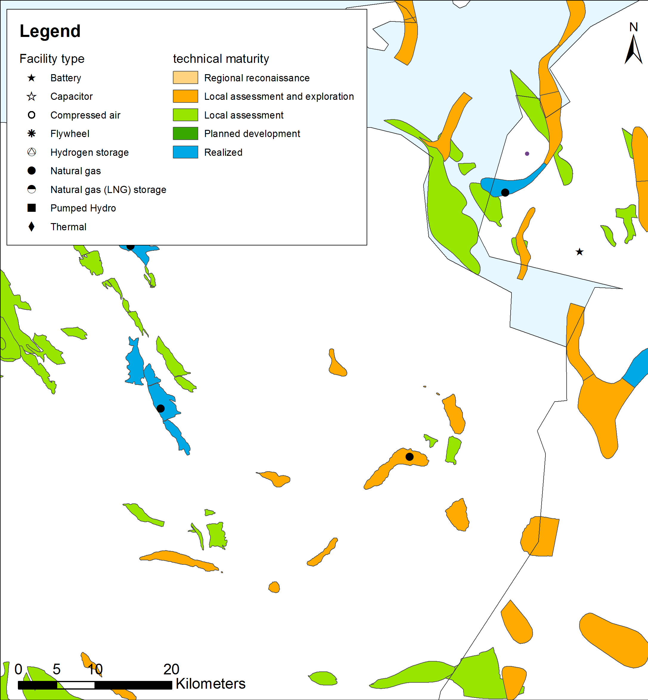
Example Site Characterization
Parameter | Value
ID: NAME: GEOLOGY: LITOLOGY: SEAL: FILL: DEVELOP: OPERATOR: LICENCE: NATURA2000: ALT USE: INFRA: | NL-F-RES-060 Eleveld gas field Slochteren Formation Sandstone Salt Gas Producing NAM B.V. Drenthe IIIb Overlap CO2 storage Gas Grid and Production
Parameter | Value
DEPTH: AREA: THICKNESS: GIIP: P_MIN: P_MAX: ESTOR ASSESS: UGS: UGS WV: H2: CAES: THERM: UPHS: | 3170 m 7 km2 100m 12 bcm 20 bar 377 bar Local evaluation Possible 1 bcm Theoretically Unlikely Unlikely Unsuitable

Slide 11
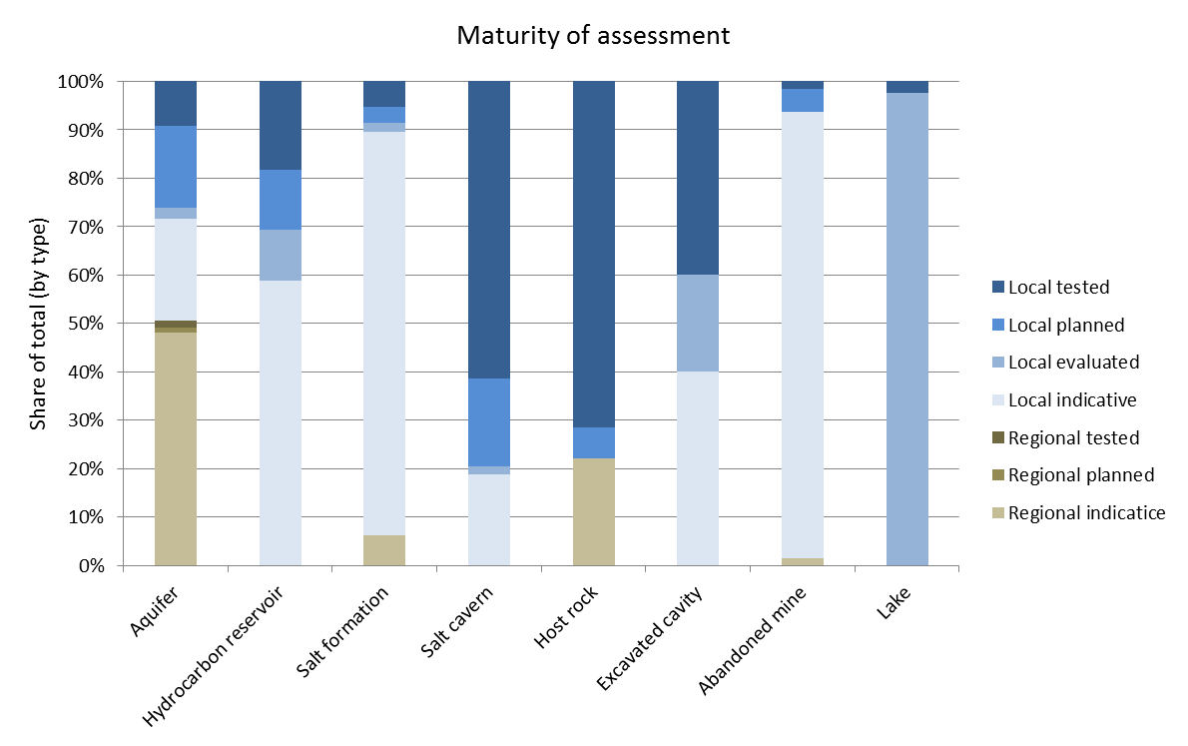
EU summary of collected sites: Maturity of Assessment

Slide 12
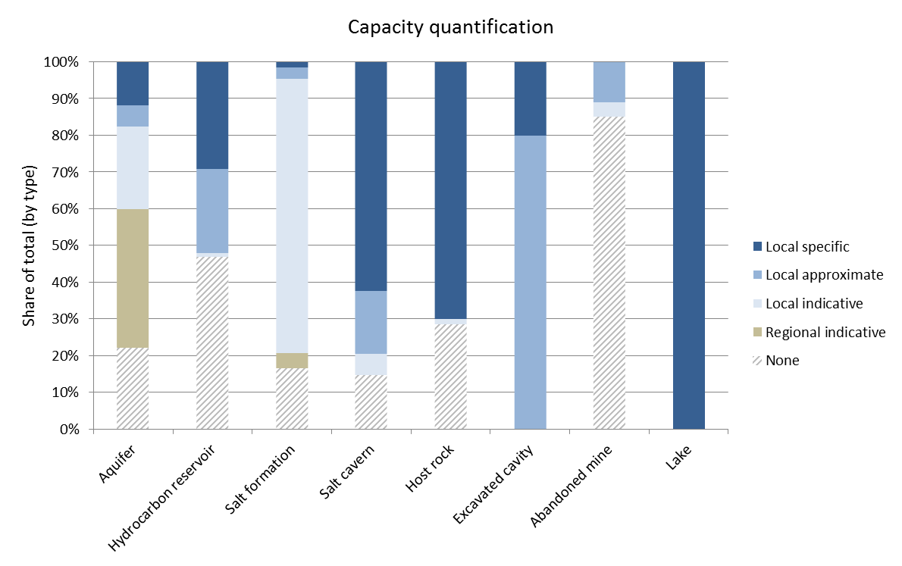
EU summary of collected sites: Quality of Capacity Determination
Working gas volumes
Total gas volumes
Bulk volumes
No data

Slide 13
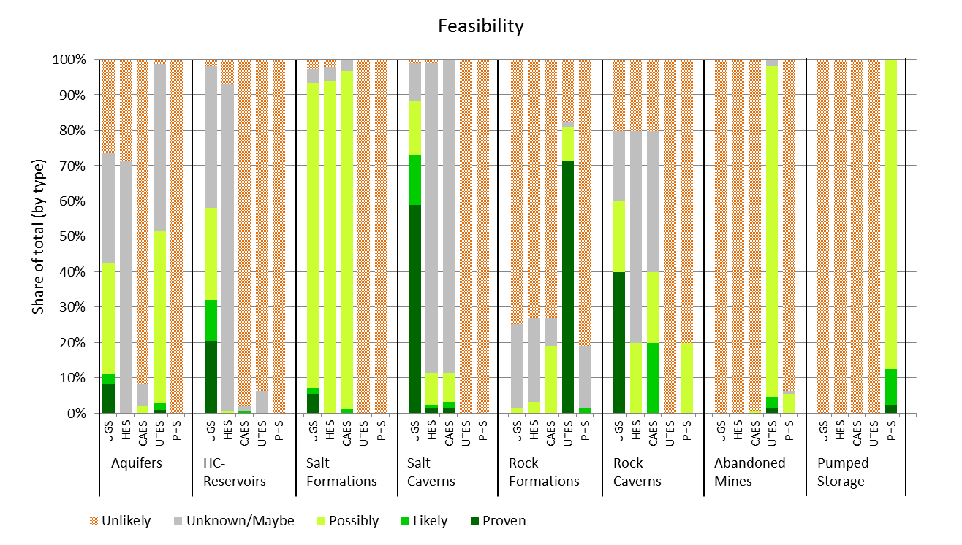
EU summary of collected sites: Feasibility

Slide 14
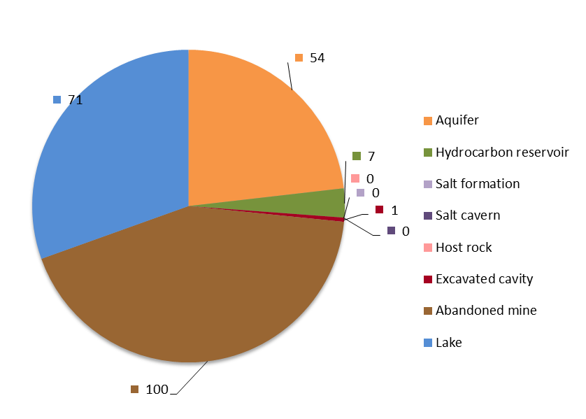
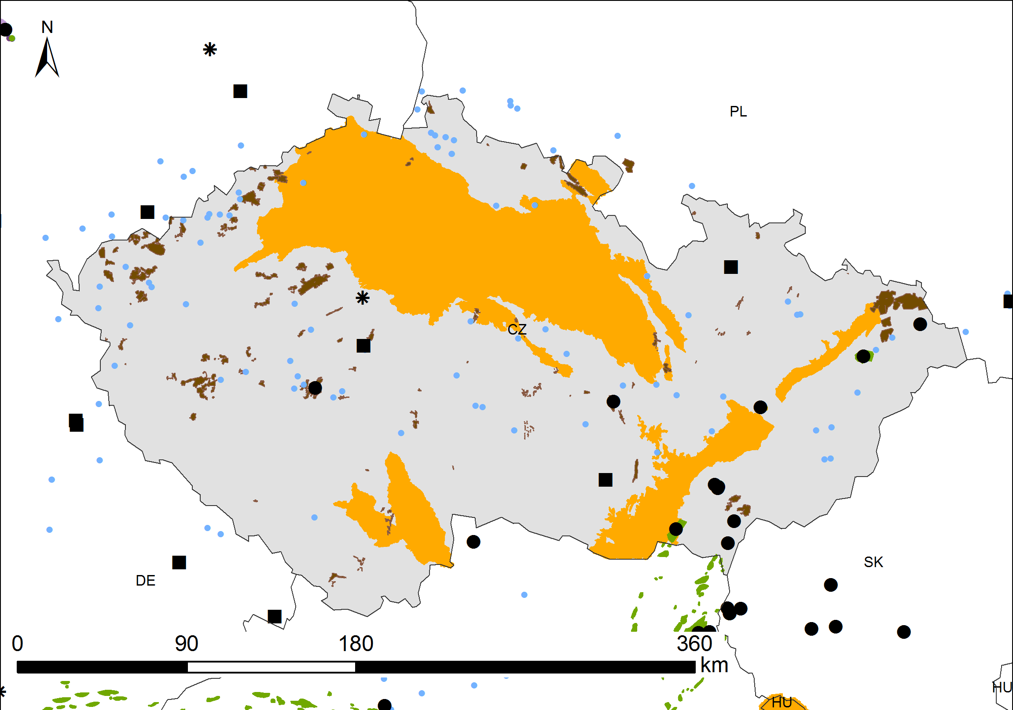
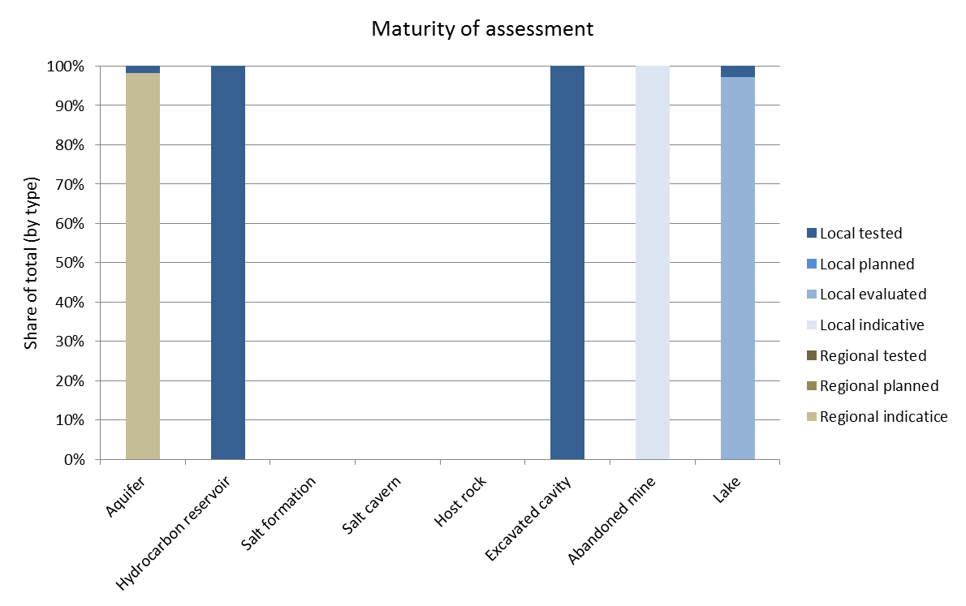
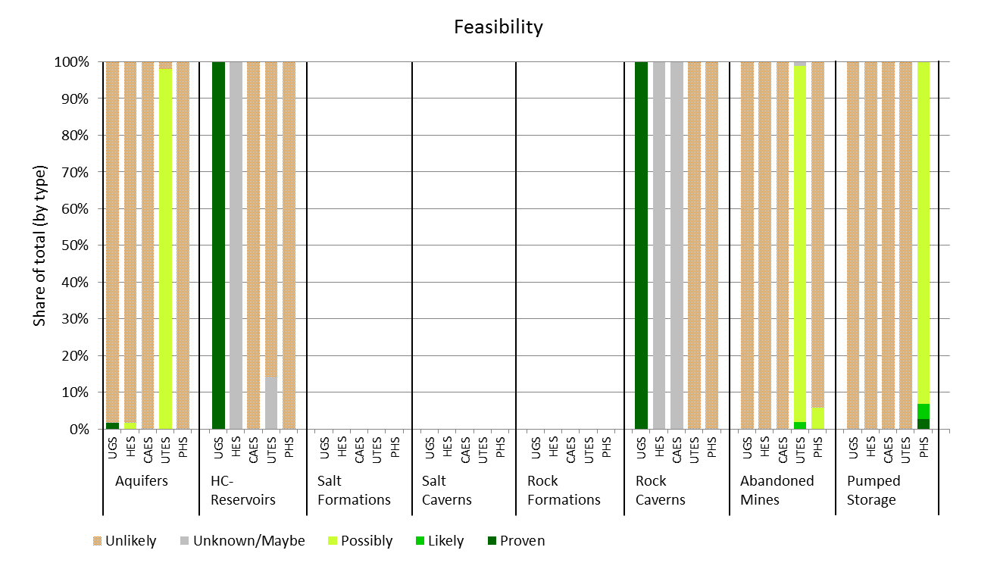
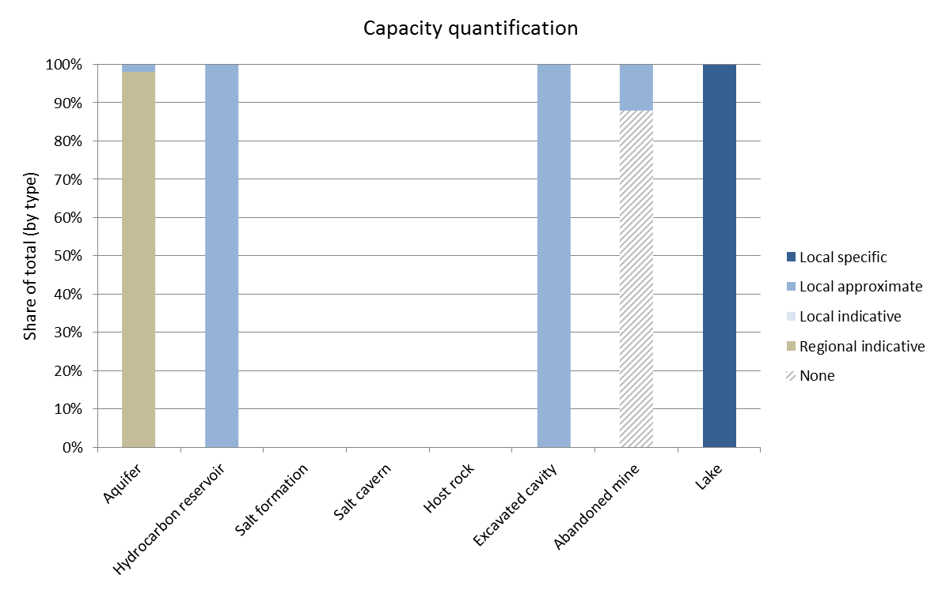
Per country data reviews (example Czech Republic)

Slide 15
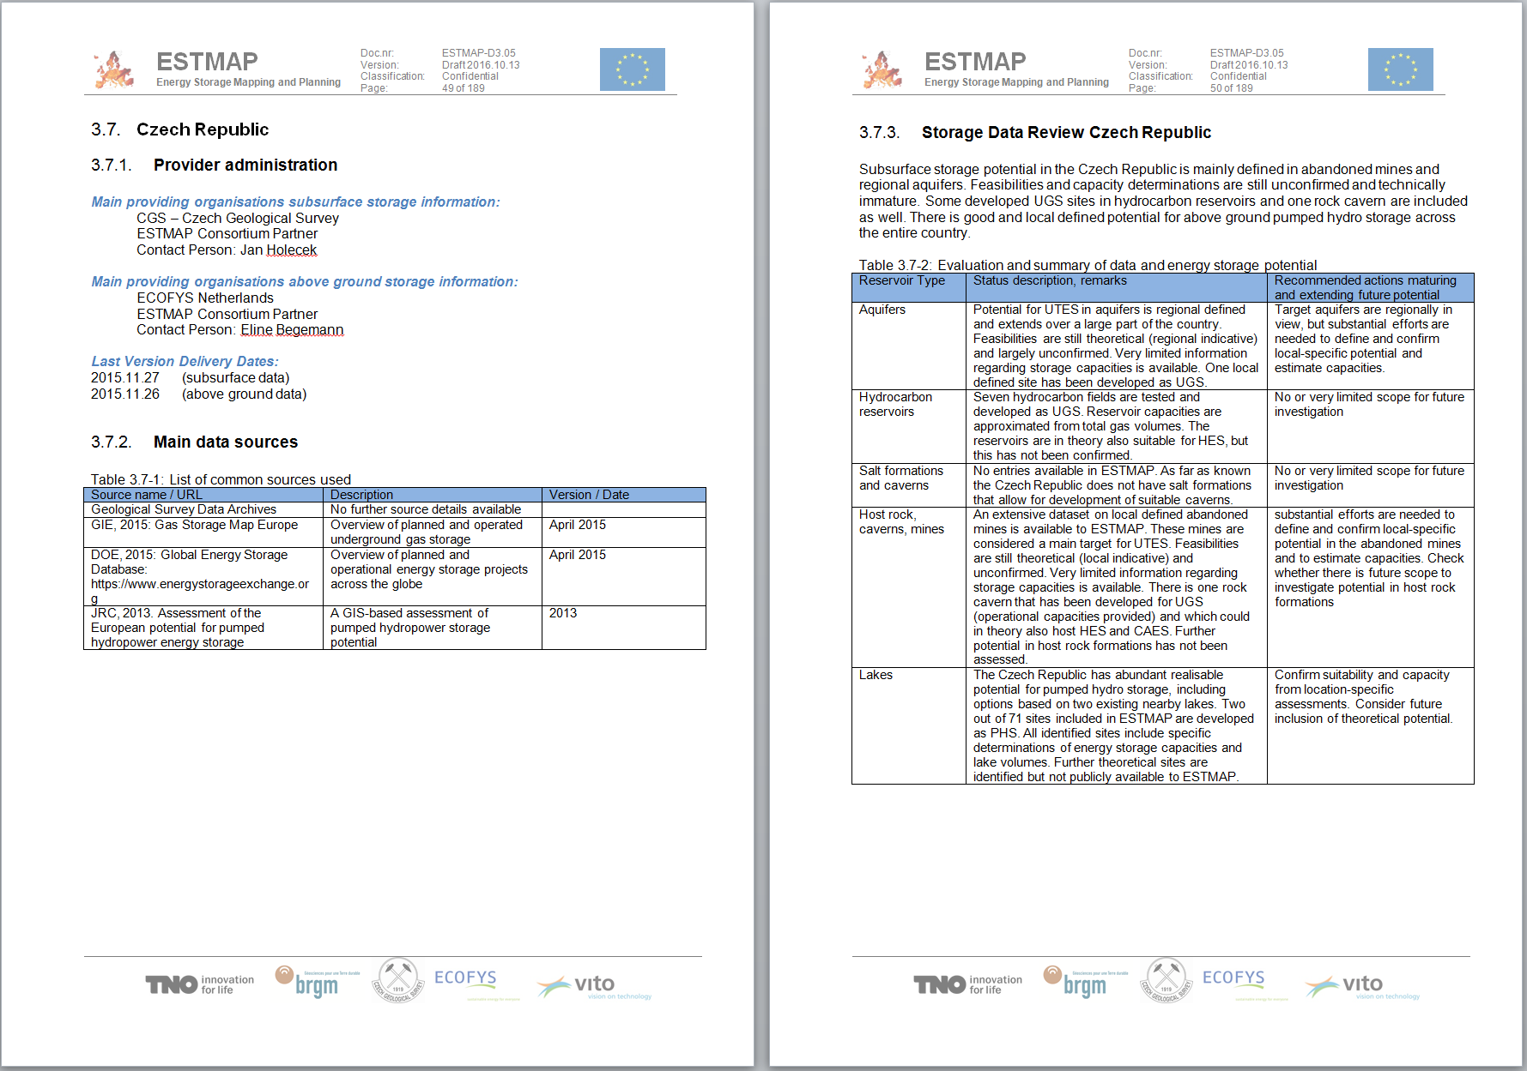
Per country data reviews (example Czech Republic)

Slide 16
GIS, TIMES and PowerFys have been combined to demonstrate potential analysis on ESTMAP database
 | Database |  | GIS mapping |  | TIMES model |  | PowerFys model
Description | Compile a database with existing and future potential energy storage Integrate contributions from geological and technical institutes and open source information EU |  | Calculate connection costs for future storage facilities Develop storage maps depicting analysis results, after TIMES and PowerFys model runs |  | TIMES PanEU: Optimize configuration of storage sites & power plants Time resolution of day, night and peak time slices EU-28, NO, CH 2010 – 2050 TIMES regional: Time resolution of 2- and 3-hourly time slices DE, BE & NL |  | Optimize operation of energy storage and power generation assets Optimize storage use Assess cross-border electricity flow & congestion Calculate marginal energy costs Hourly resolution DE, BE and NL 2050
Outcomes | Storage locations Storage specifications |  | Storage connection costs |  | Optimal config. of storage sites and power plants |  | Hourly storage use Generation mix Marginal costs
Combining the TIMES and PowerFys model allows for both optimizing the configuration of storage sites and power plants and optimizing the operation of these facilities

Slide 17
Conclusions and recommendations regarding subsurface
storage potential assessment
Necessity for large scale energy storage development is expected (in mid- and long-term)
Now is the time to invest in developing the key knowledge:
Long lead times on development
Technological breakthrough needed for certain technologies
Benefit from synergies with other research areas (geothermal, CCS)
Make use of key E&P technical knowledge while they are still active (Joint Industry Projects)
Subsurface is key to developing flexible, large-scale storage solutions for Electricity, Gas and Heat related energy sources

Slide 18
Recommendations regarding subsurface assessment
Harmonize and extend geological mapping and characterization of subsurface reservoirs that are considered suitable for energy storage. Complete parameter definitions;
Establish harmonized methodology to assess energy storage capacities and performance indicators for different subsurface technologies. Include stochastic approaches to assess uncertainties and confidence levels;
Further explore and confirm site-specific potential for multiple storage options and uniformly rank these options on the basis of technical, economic and environmental criteria;
Select and develop sites that are primary targets for potential energy storage demonstration projects;
Set up the appropriate procedures and means to maintain and regularly update the uderground storage potential database with new contributions from third parties (industry) and national research!

Slide 19
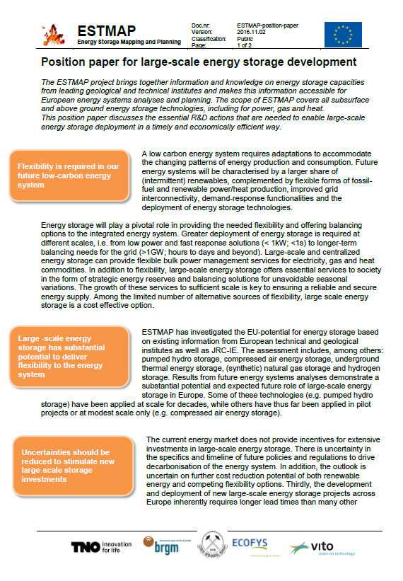
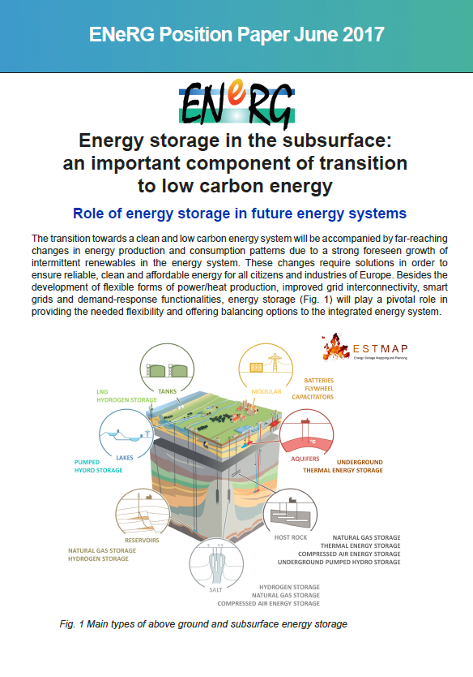
Position papers

Slide 20
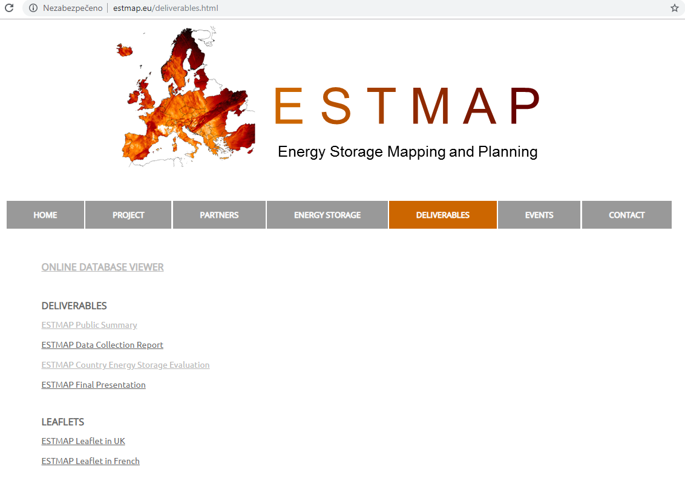
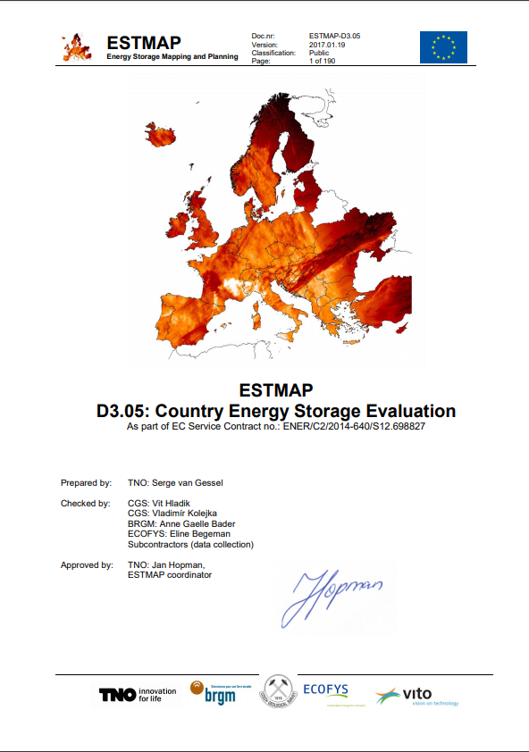
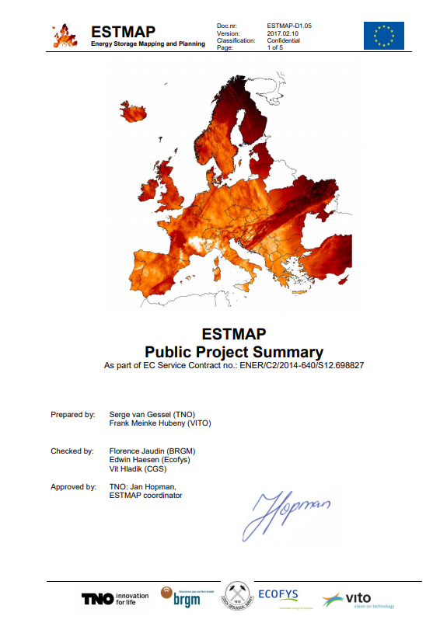
Project website – www.estmap.eu

Slide 21
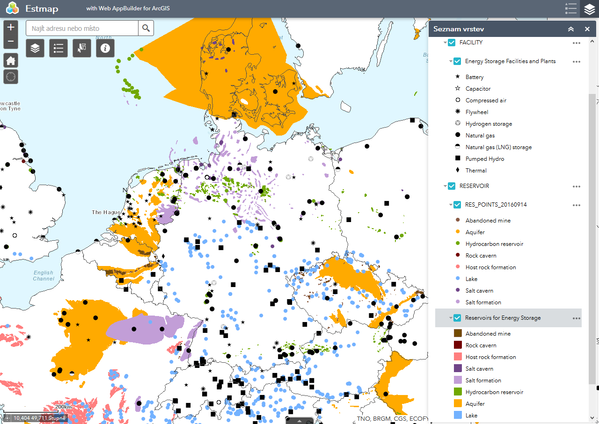
Project website – www.estmap.eu

Slide 22
E S T M A P
Energy Storage Mapping And Planning
The ESTMAP project results preseted here have been produced within a contract with the European Union, Service Contract Number ENER/C2/2014-640/S12.698827.
The opinions expressed are those of the contractor only and do not represent the contracting authority’s official position.

