Slide 1

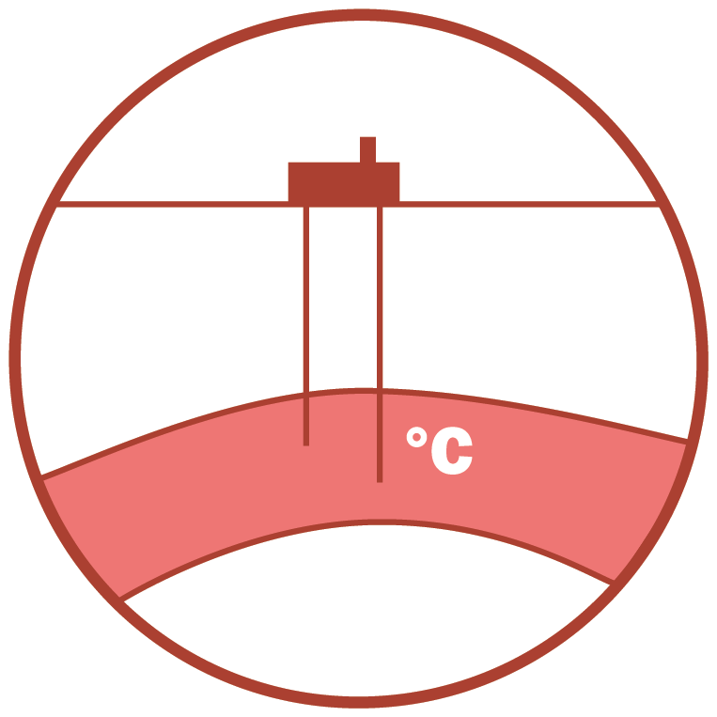






Introduction to Underground Energy Storage
European Research and Technology Perspective
Serge van Gessel
Senior Advisor Economic Affairs, TNO
Chairman Geo-Energy Expert Group EuroGeoSurveys
Serge van Gessel
Underground energy storage, Danube Region – possibilities and European perspective, Budapest, 2019.12.04

Slide 2
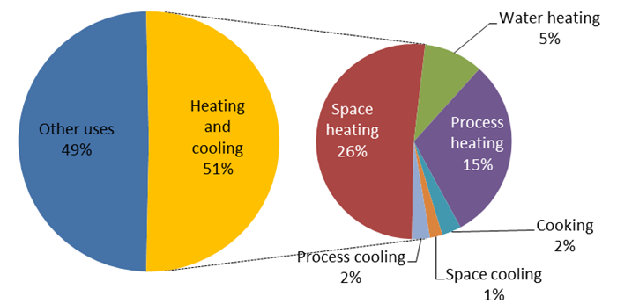
Challenge: Decarbonizing heating (and cooling) sector:
Half of all final energy consumed in Europe is used for heating/cooling
Heat demand continues to follow a seasonal pattern
Heat demand primarily fulfilled by fossil (85%) incl. underground gas storage
Serge van Gessel
European Workshop on Underground Energy Storage, Paris, 2019.11.07

Slide 3
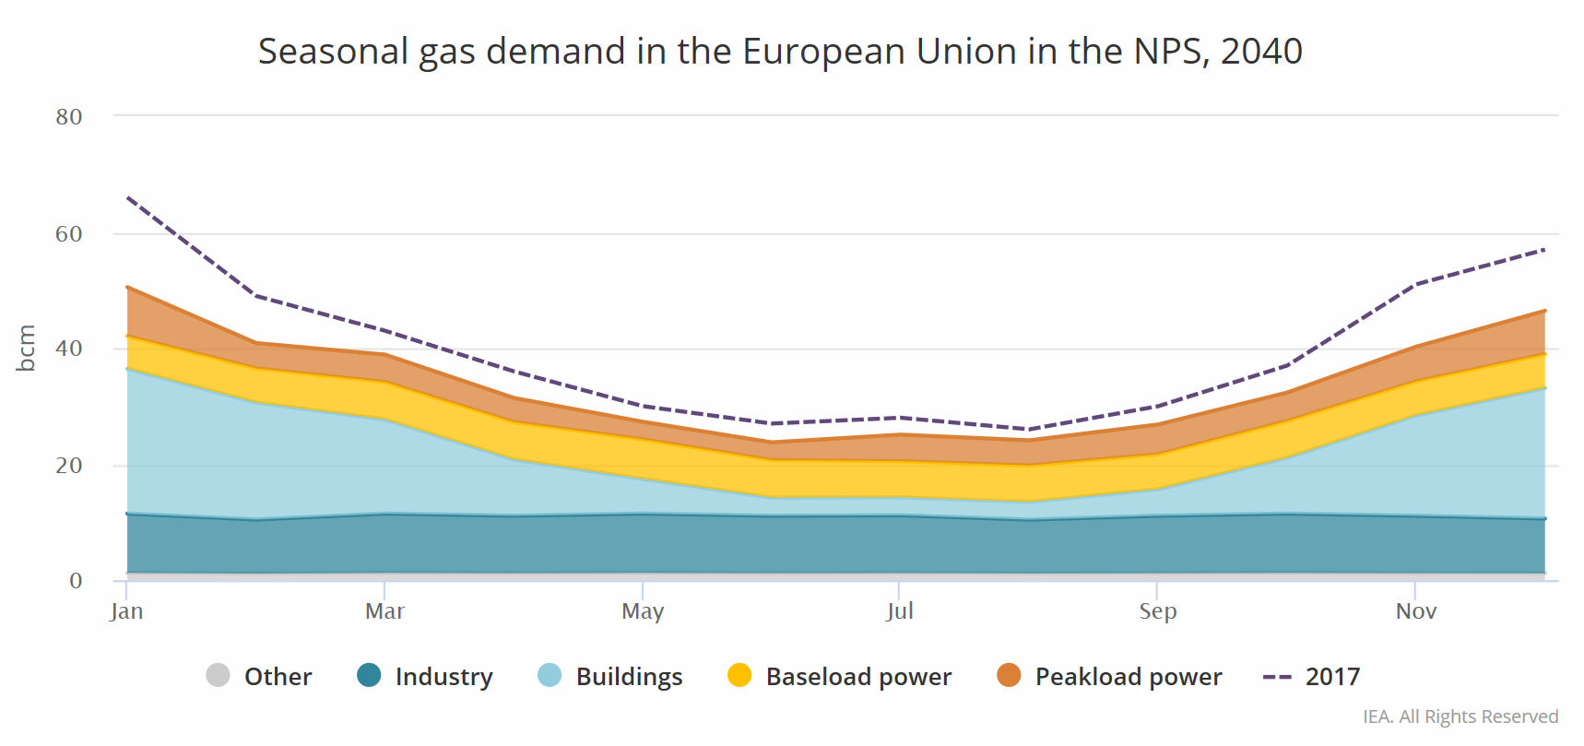
Seasonal fluctuation gas demand (heating)
(EIA 2019)

Slide 4
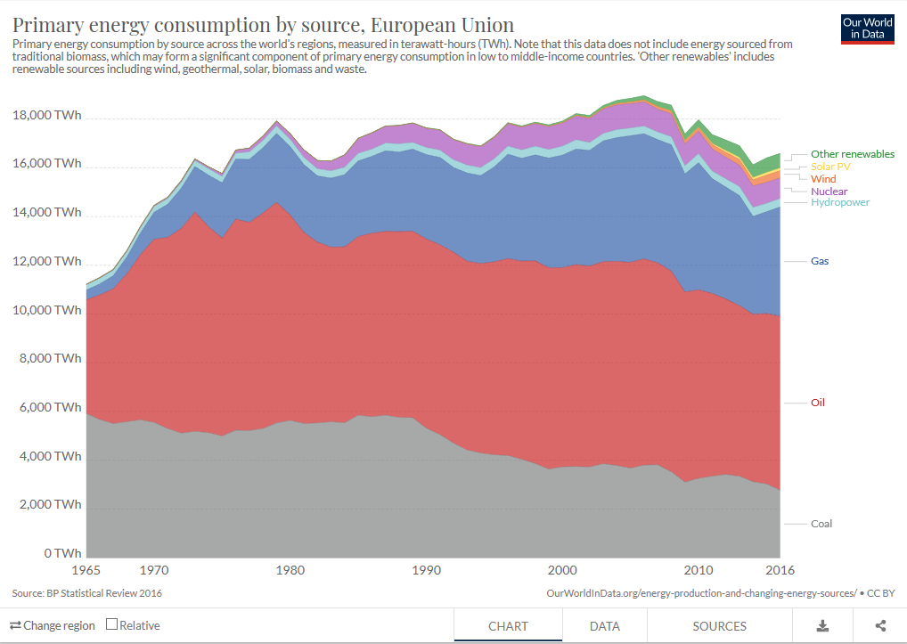
Share of UGS Capacity vs Primary Energy Consumption
(downloaded from ourworldindata.org, 2019, GIE-2019)
EU gas storage volume
  ca. 1132 TWh
  156 operational sites
EU primary energy consumption 2016
ca. 16.400 TWh
UGS ~ 7%
EU primary gas consumption 2016
  ca. 4.200 TWh
  UGS ~ 27%
nuclear
gas
oil
coal

Slide 5
Challenge: Integrate renewable electricity generation:
Intermittent renewable capacity expected to grow drastically towards 2050
Fossil flexibility (e.g. power plants) transforming or phasing out (coal)
High shares of intermittent renewables will require flexibility beyond the capacity of surface electrical storage options

Slide 6
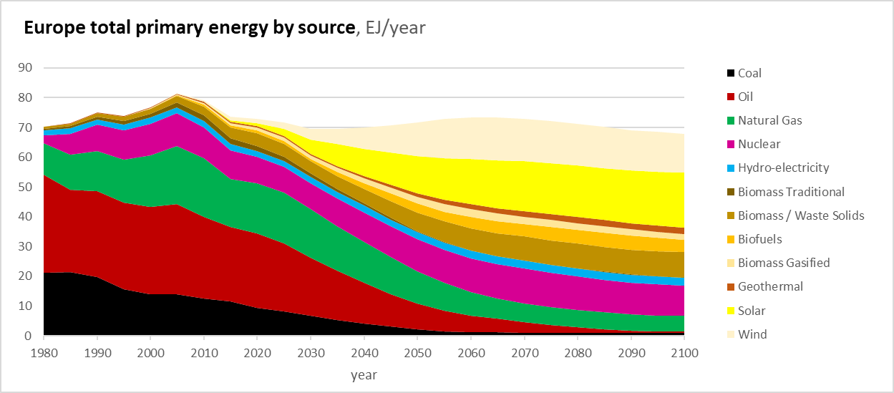
Strong increase of intermittent RE (EU and Globally)
(Shell Sky Scenario, 2019)
RE-Int
RE
bas
RE
intermittent
Base
RE-intermittent
RE
base
Base
RE-base
Fossi flexible
Fossi flex
Base
Fos

Slide 7
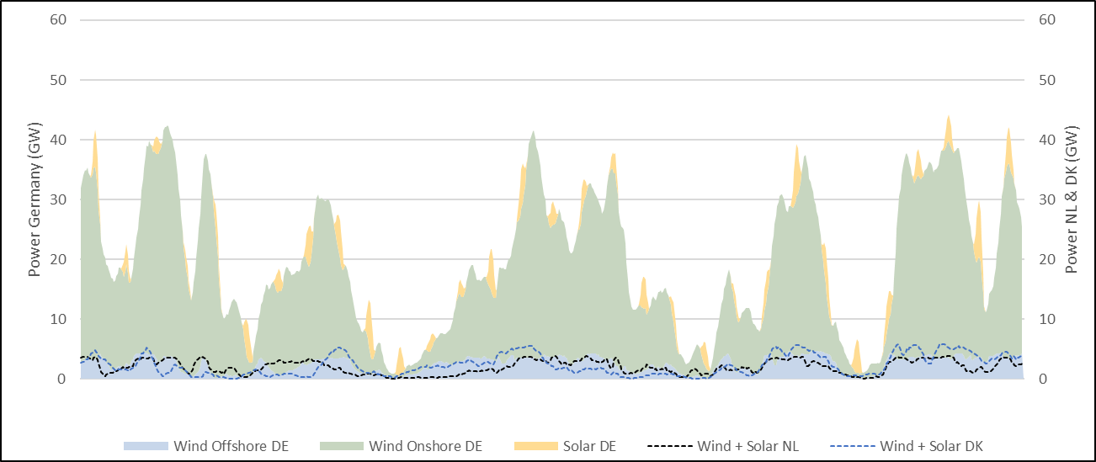
Wind and Solar production, DE-NL-DK, January 2018
(Energy-charts.de, Frauenhofer 2019, ENTSOE, www.energidataservice.dk)
35 GW
ca. 4 days
1 Jan
31 Jan
Germany: ca. 60 GW installed capacity (comparable to Dutch renewable ambitions in 2050)
ca. 30.000 wind turbines

Slide 8
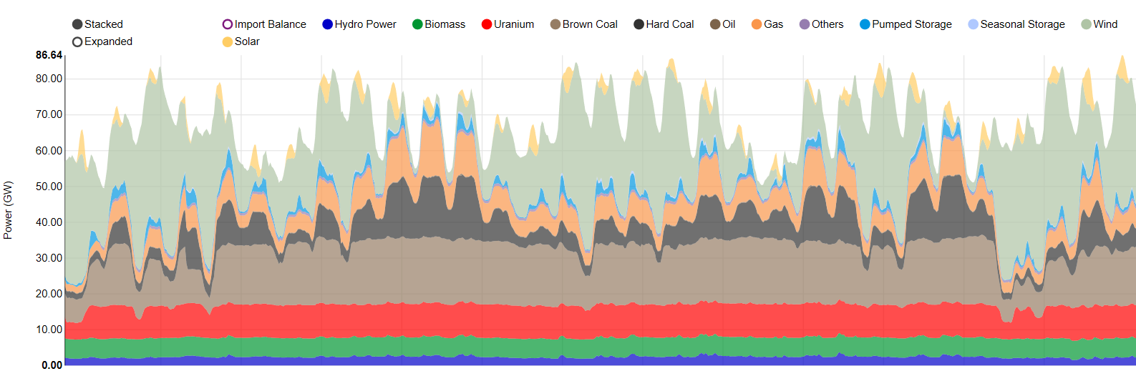
Electricity production Germany, January 2018
(Energy-charts.de , Frauenhofer, 2019)
Wind
(variable)
Fossil
(flex)
Base load
1 Jan
31 Jan
Fossil fuels mainly used as balancing capacity.

Slide 9
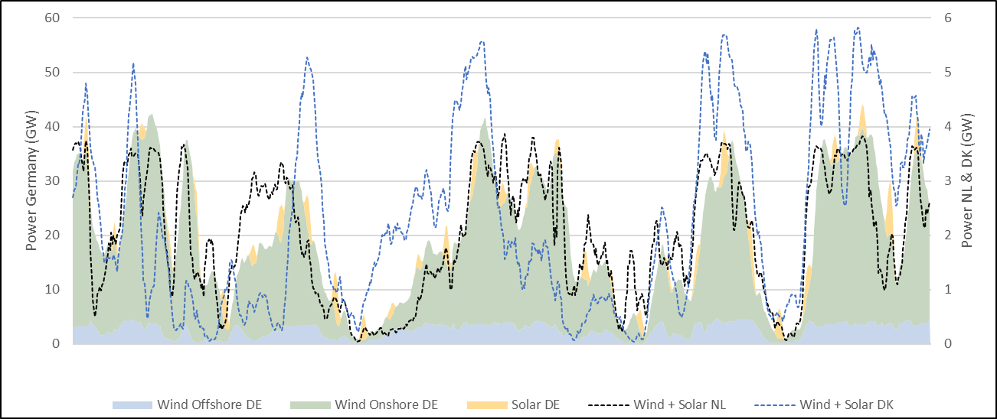
Wind and Solar production, DE-NL-DK, January 2018
(Energy-charts.de, Frauenhofer 2019, ENTSOE, www.energidataservice.dk)
1 Jan
31 Jan
Regional weather patterns: wind peaks and gaps are largely overlapping
(NL and DK scaled to German wind capacity)

Slide 10
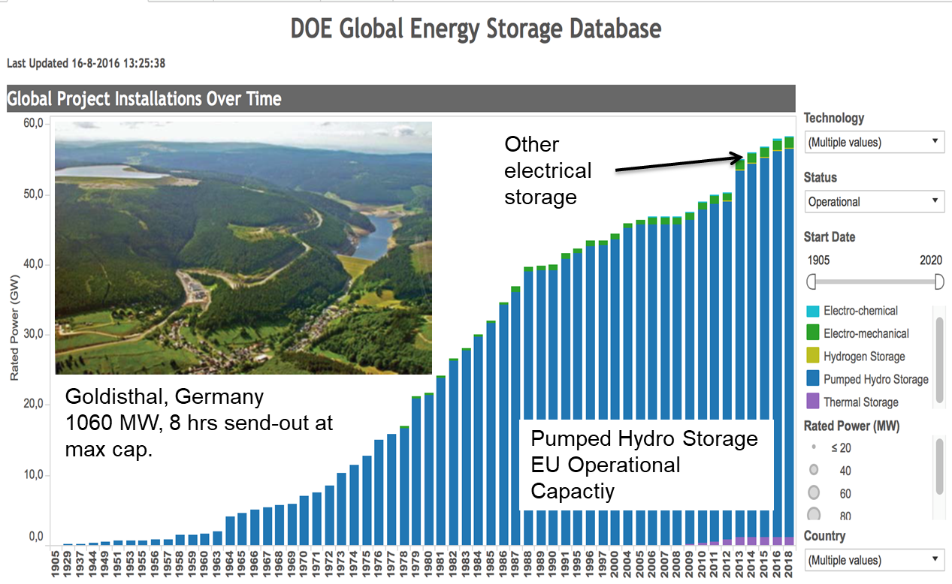
Pumped Hydro Storage and Surface Electrical
(DOE Global Energy Storage Database)
Total PHS EU: ~ 0,5 – 1,0 TWh assuming 8 - 16 hrs average duration (0,1% of current UGS capacity)

Slide 11
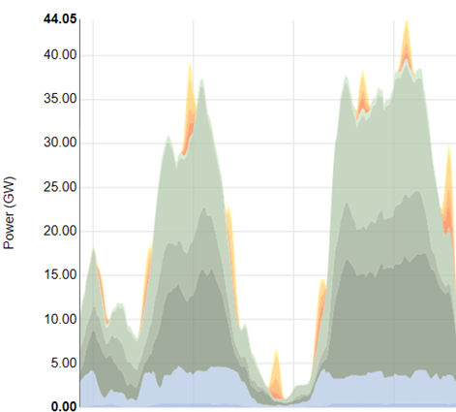
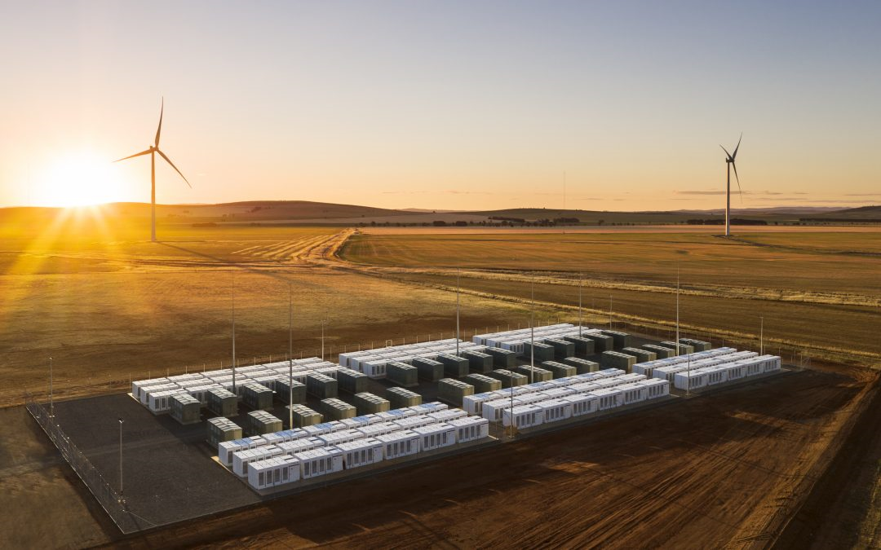
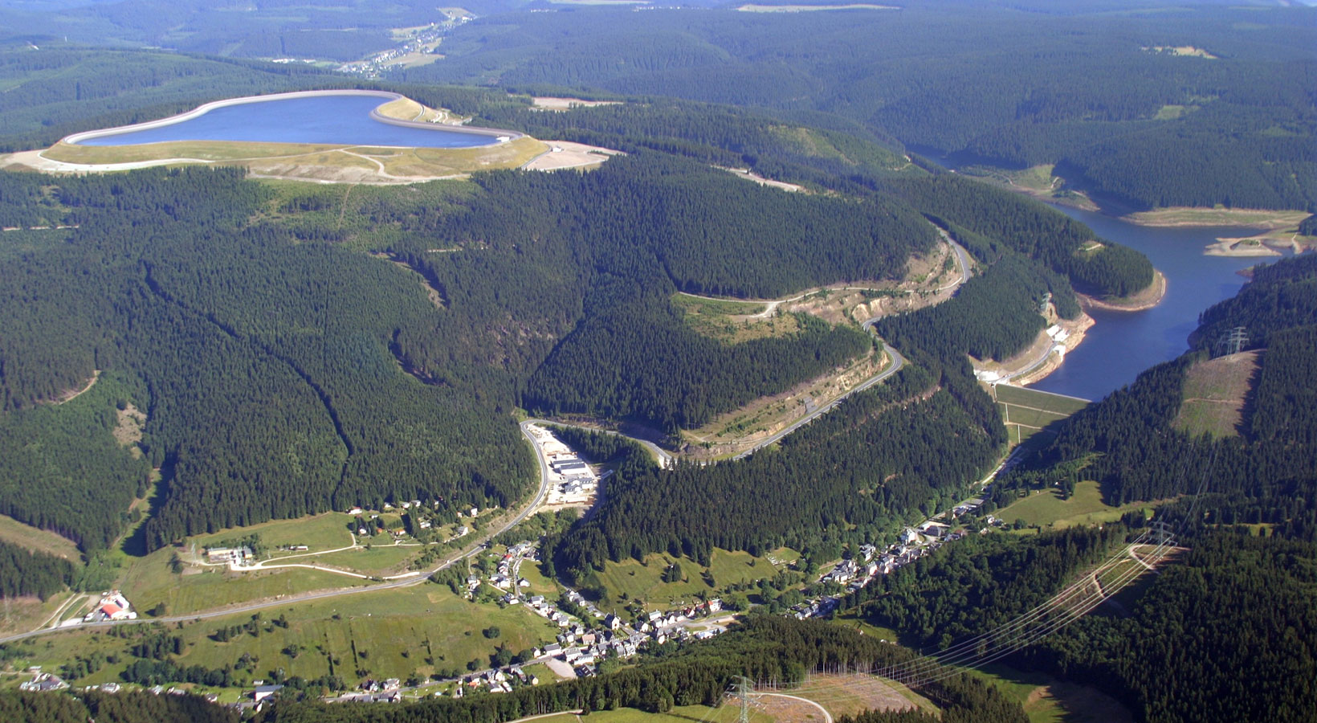
Compensate 1 day of wind in Germany with E-storage
(A back-of-the-envelope calculation …)
Tesla Battery Australia: 129 MWh
35 GW
PHS Goldisthal: 8.480 MWh
1 day: 35 GW x 24 hours = 840 GWh
>> 4 days = ca. 3 TWh
or 100 PHS lakes
1 day ~ 8.000 batteries

Slide 12
Large-scale Underground Energy Storage supports Europe’s ambitions for clean, secure and affordable energy:
Scalable low-carbon or zero-carbon flexibility solutions, proven
Applies to direct heat, gases and electricity
Conversion (e.g. Power-to-gas) > sectorial integration
Integrated with other (surface) flexibility options

Slide 13

Flexibility Options
1.
Regulated
Production
2.
Demand
Response
3.
Energy Import & Export
4.
Energy
Storage
+ Conversion

Slide 14
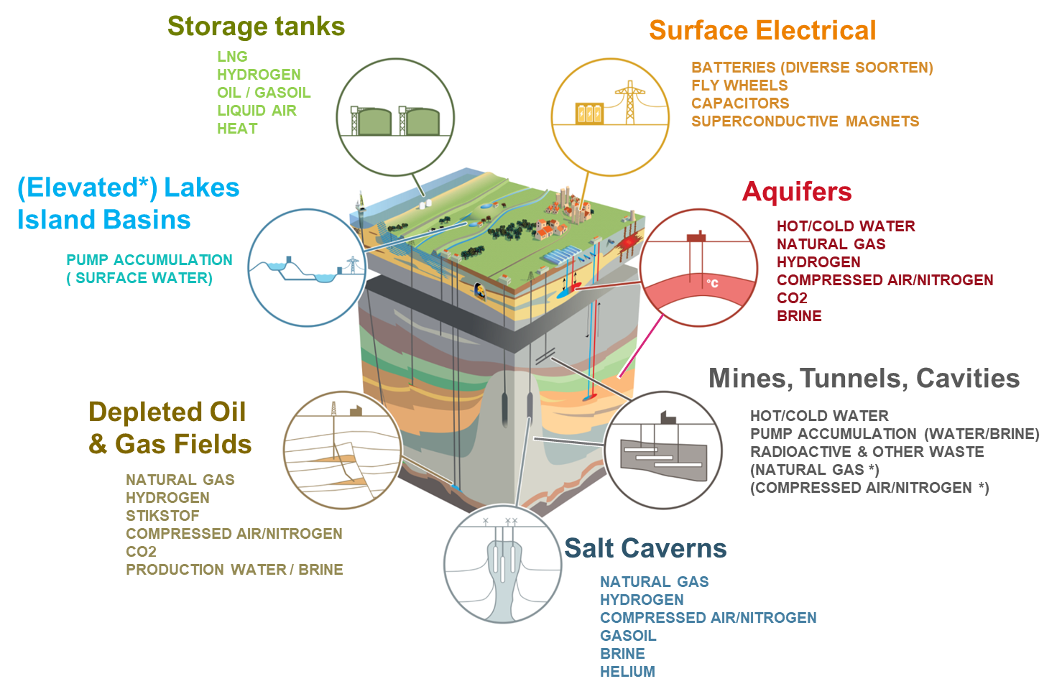
Family of Energy Storage Technologies

Slide 15
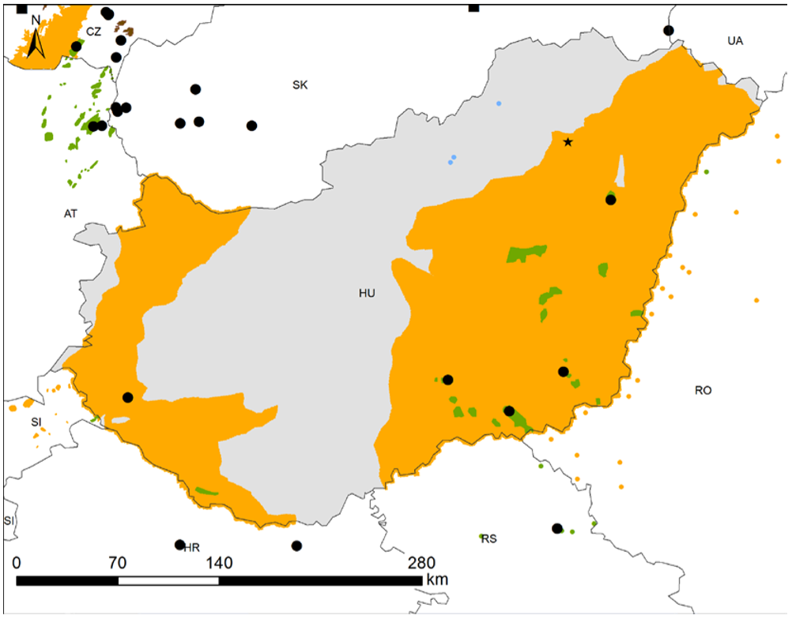
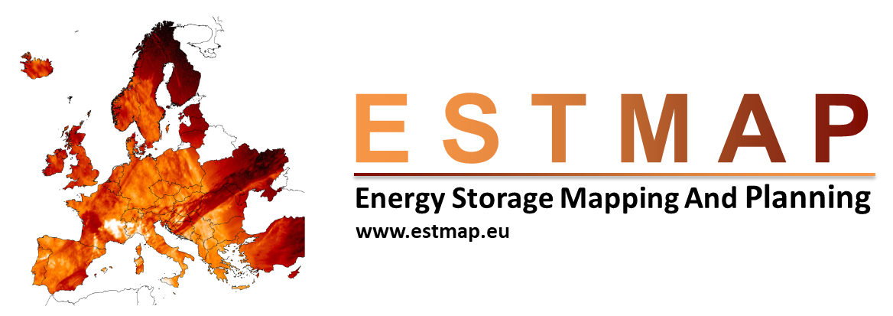
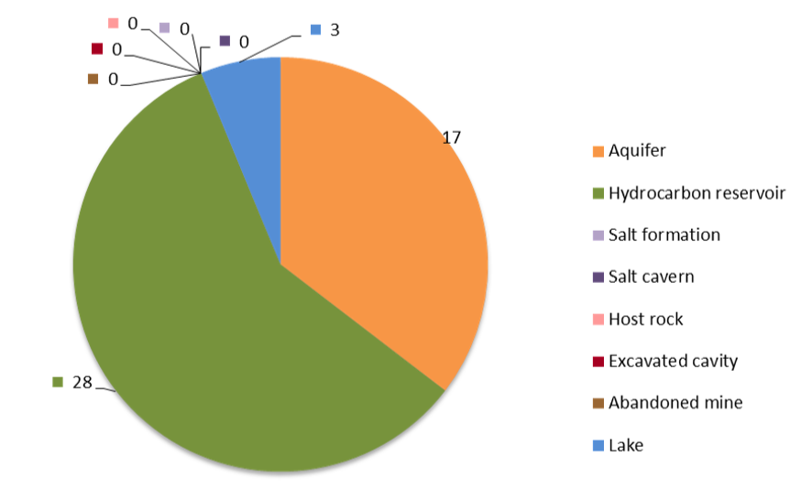
Underground Energy Storage Potential Hungary
(ESTMAP 2016, www.estmap.eu)
5 UGS sites (•), potential for heat storage (aquifers), no potential for salt cavern storage

Slide 16
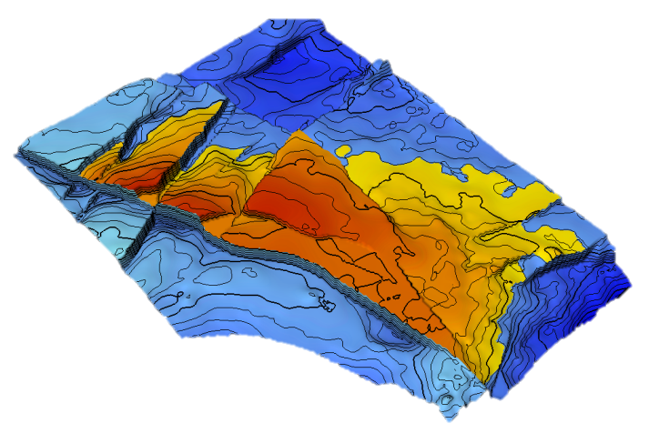
Deep Porous Storage (fossil/renewable gases)
(depleted gas fields, deep aquifers, typically >1000m)
Natural gas (NG), bio-methane, syn-gas
Proven, Mature
Typically 4 – 40 TWh per asset
Typically seasonal (heat)
Hydrogen
Under investigation (e.g. RAG Austria)
Energy content ca. 25% compared to NG
Typically seasonal (heat), maybe electricity?
Containment, fluid-matrix reactions, purity, economy?

Slide 17
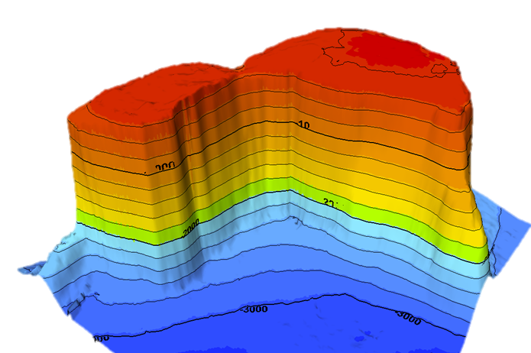
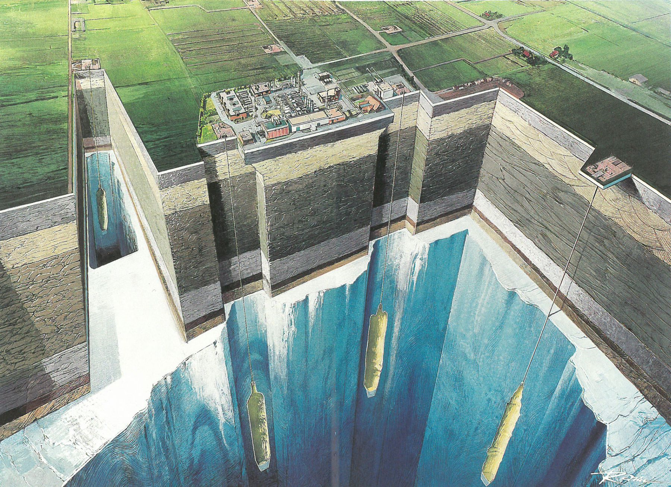
Salt Cavern Storage (fossil/renewable gases)
(salt formations / pillars ca. 1000 – 1500 m)
Natural gas (NG), bio-methane, syn-gas
Proven, Mature
Typically 0,5 – 1 TWh per cavern
Typically peak to seasonal (heat, electricity)
Hydrogen
Proven, not mature (e.g. US)
Typically 100 – 250 GWh per cavern
Typically peak (electricity, heat, feedstock)
Compressed Air
Proven, not mature (e.g. Germany)
Typically 1 – 3 GWh per cavern
Typically peak (electricity)
Manage compression heat losses (e.g. ALACAES)

Slide 18
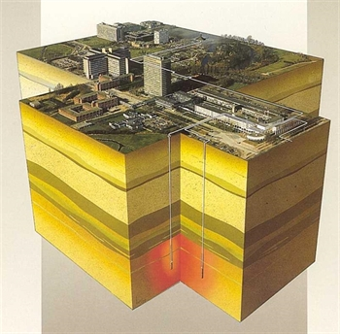
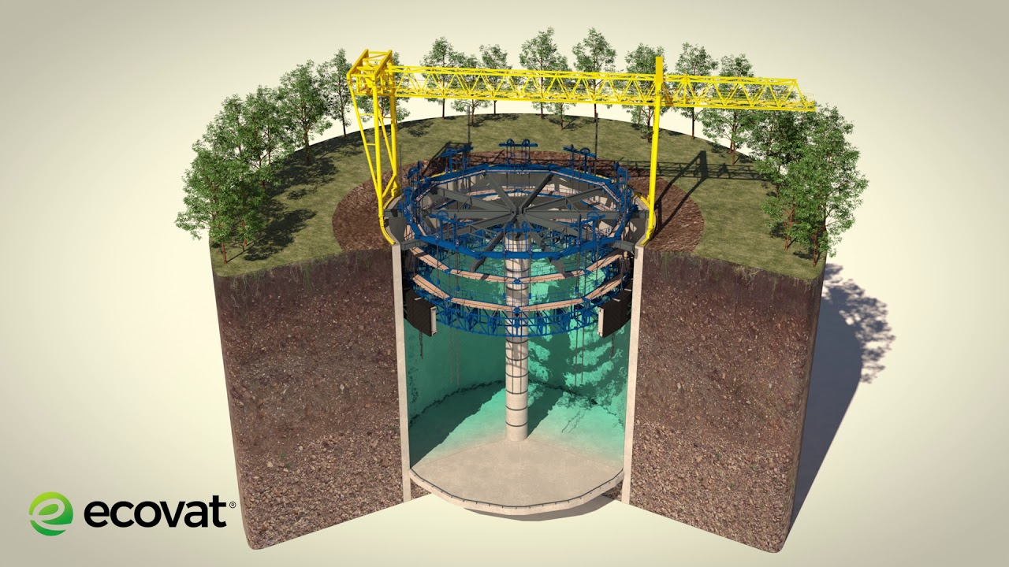
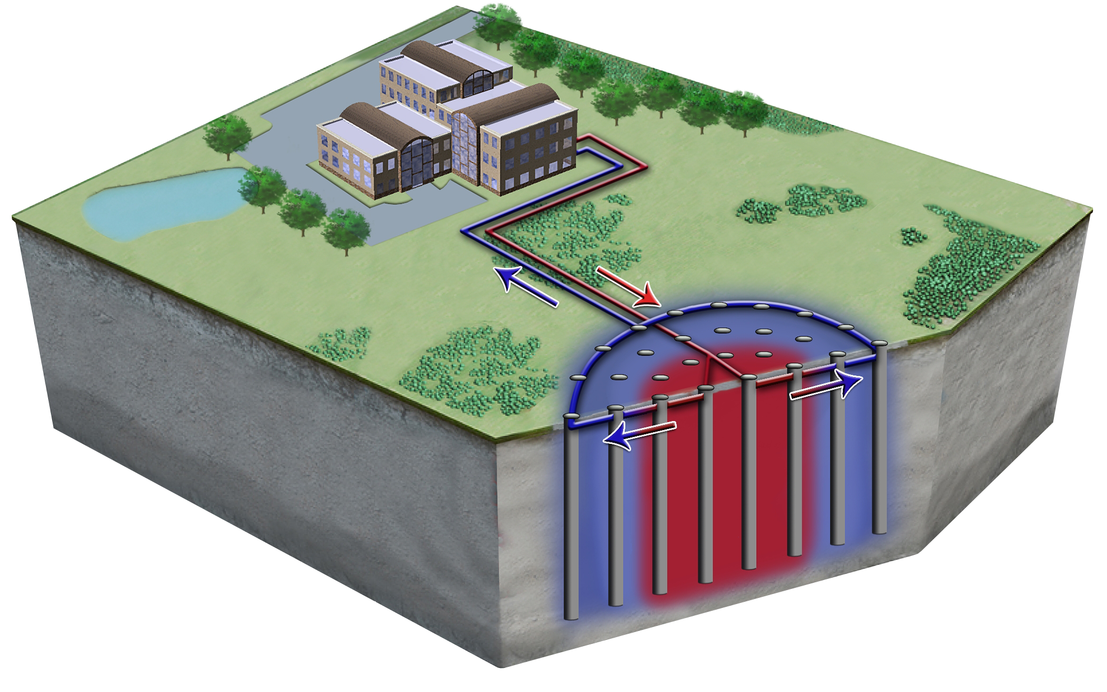
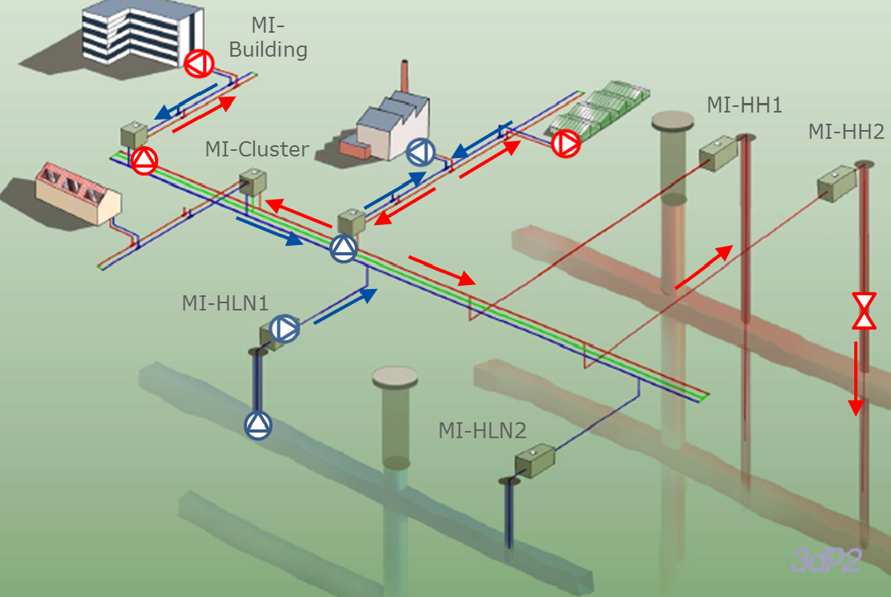
Mid-High Temperature Heat Storage (sensible)
(shallow subsurface: ca. 0 – 500 m)
Proven, not mature
40 - 120°C
0.1 – 25 GWh
Monthly to Seasonal
Integrated with district heating systems, waste heat, geothermal and agriculture heating
Large potential to manage seasonal heat demand at local level
Open (aquifer)
Lined cavity
Closed (borehole)
Flooded mines

Slide 19
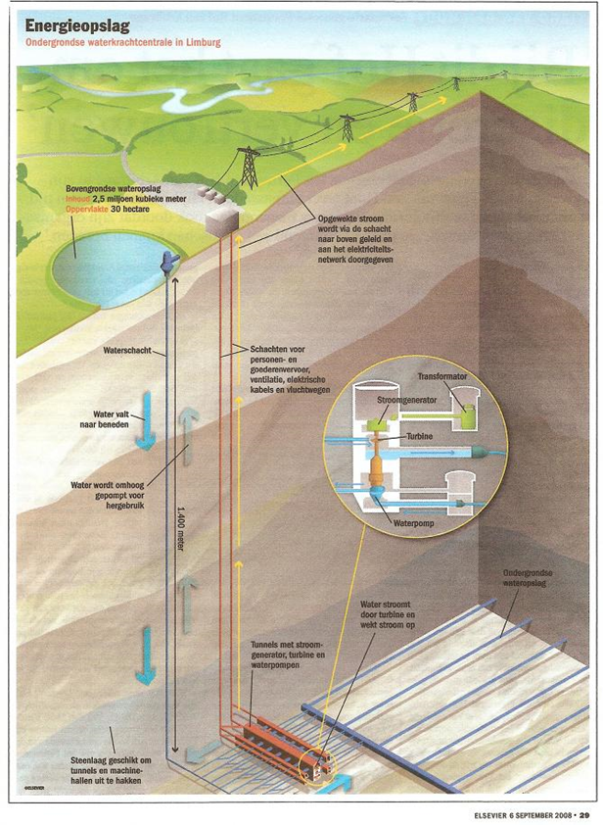
Underground Pumped Hydro
(ca. 500 – 1500 m)
Conceptual, Pilots
Typically 1 - 4 GWh
Peak / Daily (electricity)
Alternative to Surface Pumped Hydro
Cost?

Slide 20
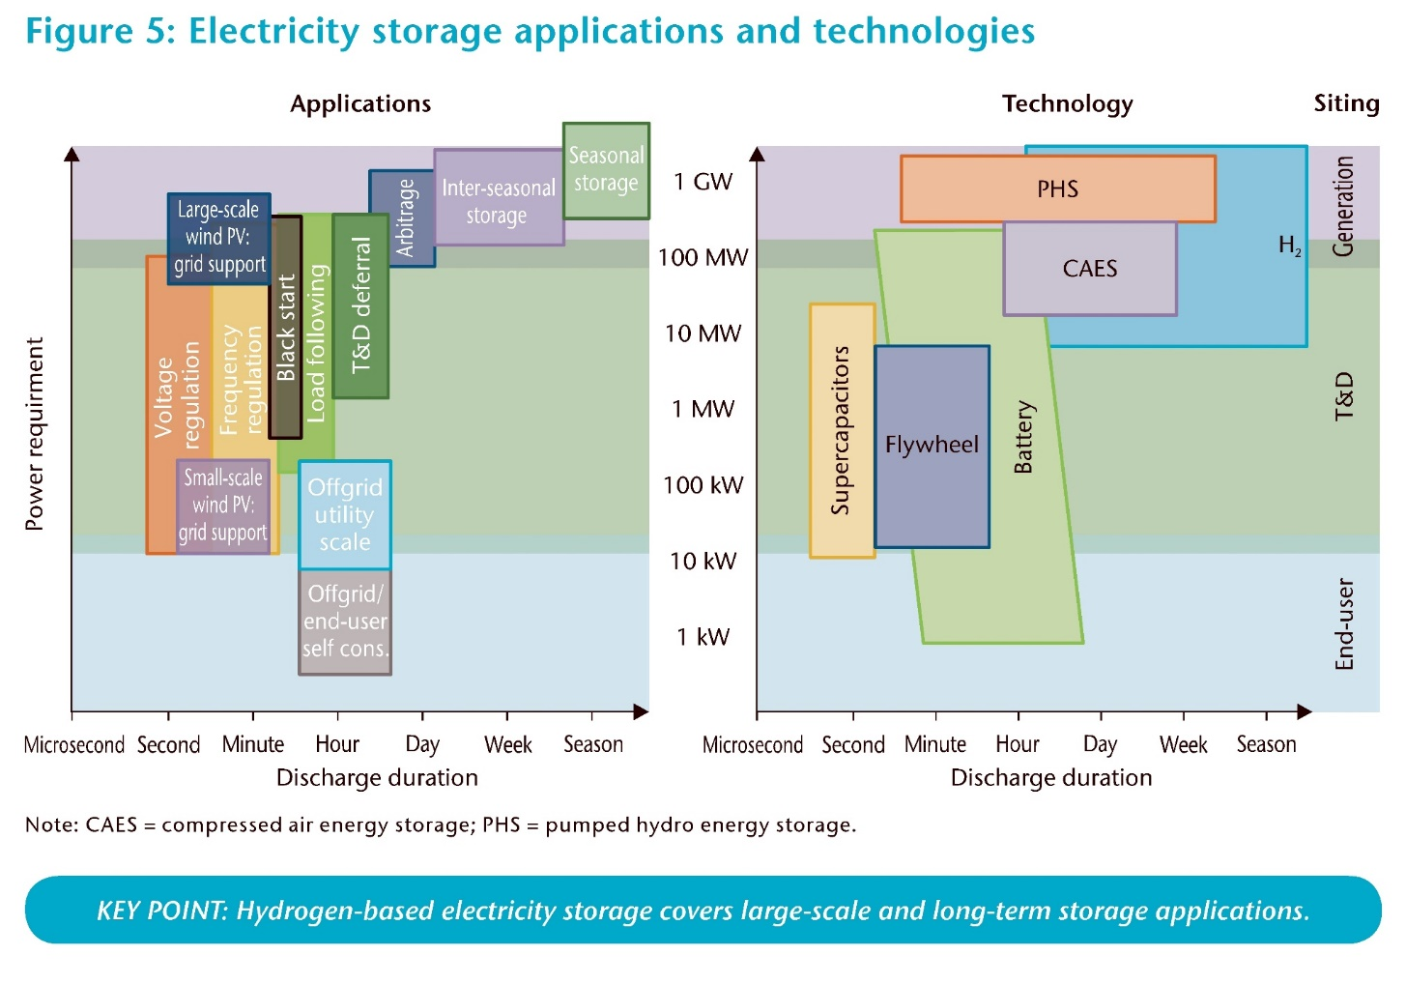
Family of Energy System Services
UGS
Source: 2015 - IEA - Technology Roadmap

Slide 21
Family of Energy System Services
Underground
Centralized Heating and Grid Services
UGS
Underground
District/Greenhouse
Heat Balancing
UTES
Source: 2015 - IEA - Technology Roadmap

Slide 22
European Energy Storage Mapping and Planning
EC Service Contract no.: ENER/C2/2014-640/S12.698827 (www.estmap.eu)
Mapping of Energy Storage Sites
Above ground / Subsurface
Existing and Future Potential
Standardized Technology KPI’s
Application in EU systems models

Slide 23
Effective valorization and implementation of large-scale underground energy storage:
Raise TRL of clean storage technologies (industry pilots, business cases, upscaling and energy-market integration)
Portfolio management: national assessments, plug & play datasets (standardized KPI’s) for energy systems modelling
Social license to operate (cost vs benefits, transparency, participation, regulatory)
Timely action (long lead times)
Serge van Gessel
Underground energy storage, Danube Region – possibilities and European perspective, Budapest, 2019.12.04

Slide 24
Introduction to Underground Energy Storage
European Research and Technology Perspective
Serge van Gessel
Senior Advisor Economic Affairs, TNO
Chairman Geo-Energy Expert Group EuroGeoSurveys
Thank you for your attention
Serge van Gessel
Underground energy storage, Danube Region – possibilities and European perspective, Budapest, 2019.12.04

