Slide 1





Switching the district heating of Szeged to Geothermal
This project was supported as part of Sustainable Energy, an Interreg Danube Region Programme project co-funded by the European Union (ERDF fund) with the financial contribution of partner states and institutions.

Slide 2
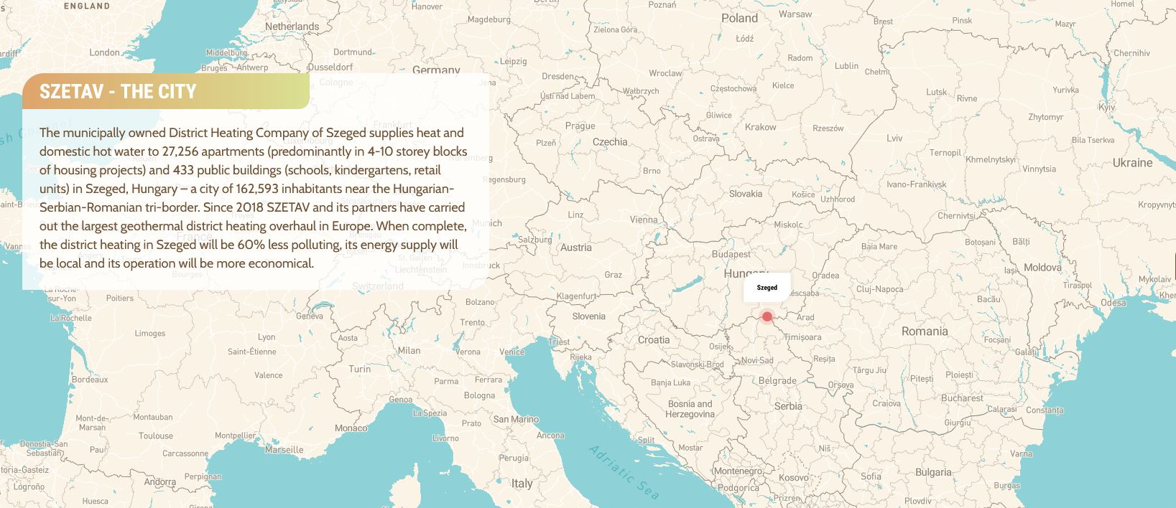
This project was supported as part of Sustainable Energy, an Interreg Danube Region Programme project co-funded by the European Union (ERDF fund) with the financial contribution of partner states and institutions.

Slide 3
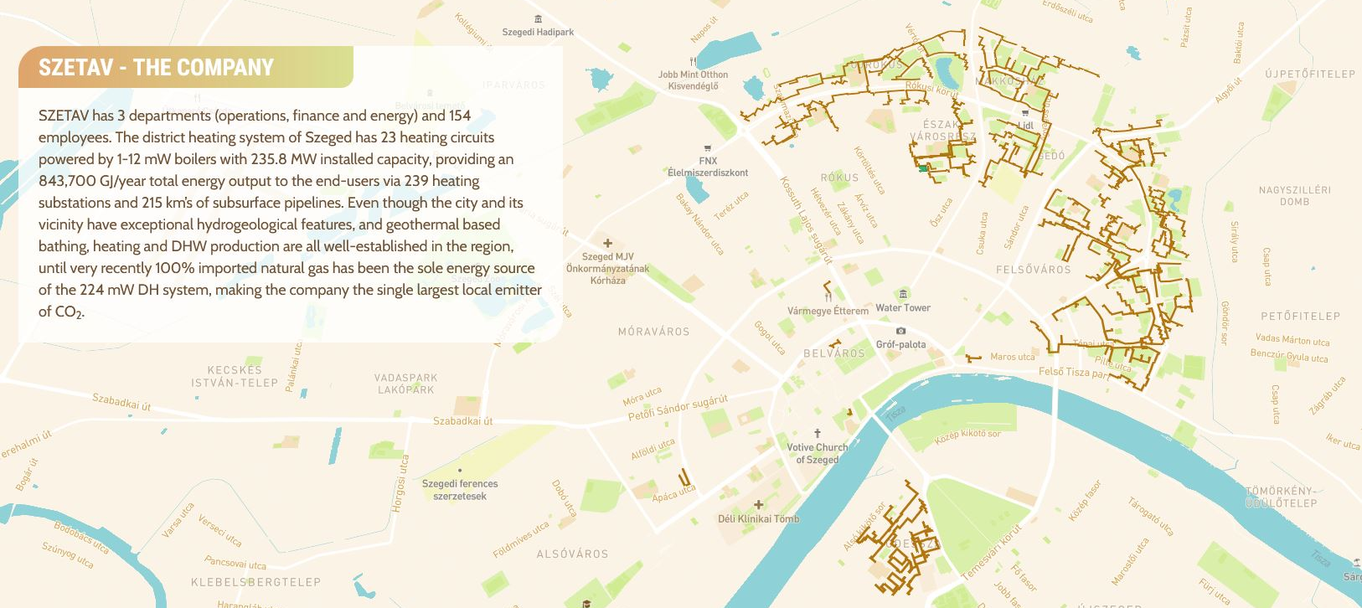
This project was supported as part of Sustainable Energy, an Interreg Danube Region Programme project co-funded by the European Union (ERDF fund) with the financial contribution of partner states and institutions.

Slide 4
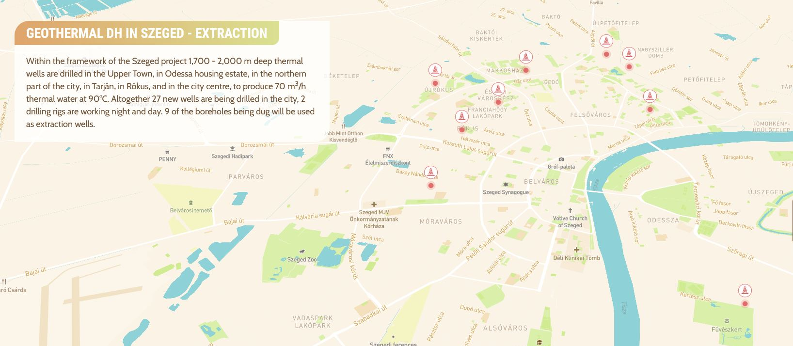
This project was supported as part of Sustainable Energy, an Interreg Danube Region Programme project co-funded by the European Union (ERDF fund) with the financial contribution of partner states and institutions.

Slide 5
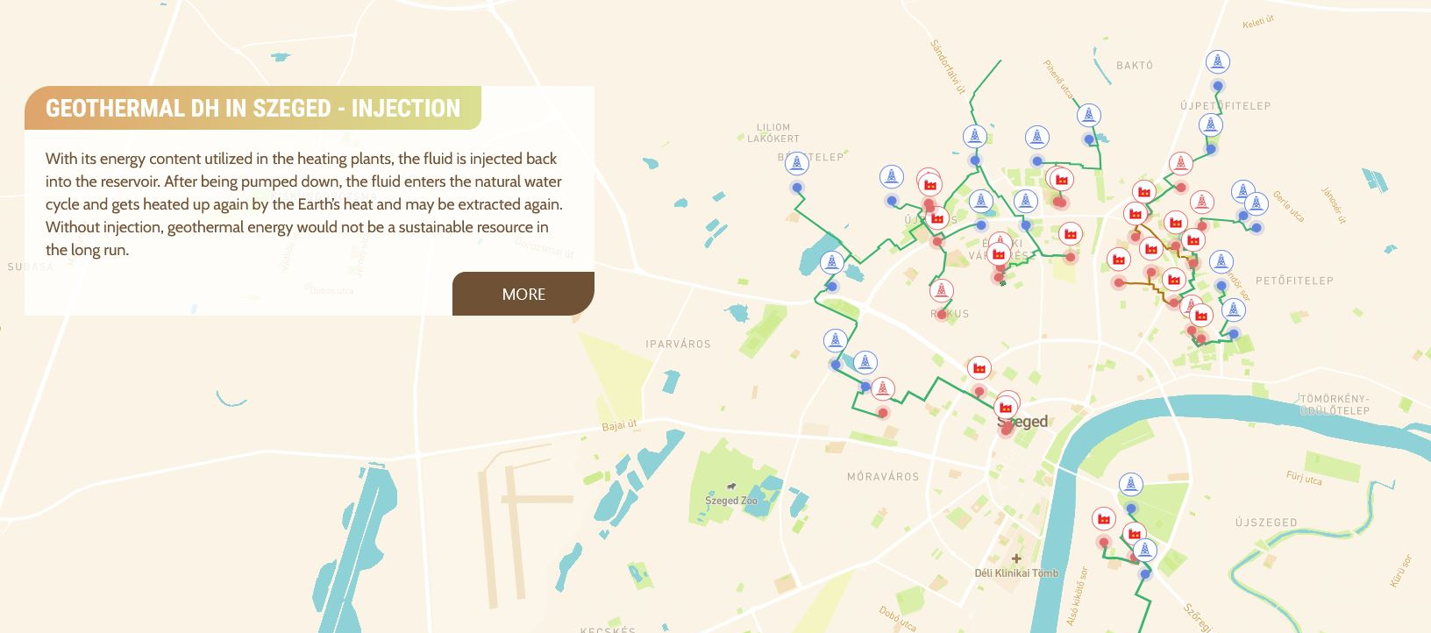
This project was supported as part of Sustainable Energy, an Interreg Danube Region Programme project co-funded by the European Union (ERDF fund) with the financial contribution of partner states and institutions.

Slide 6
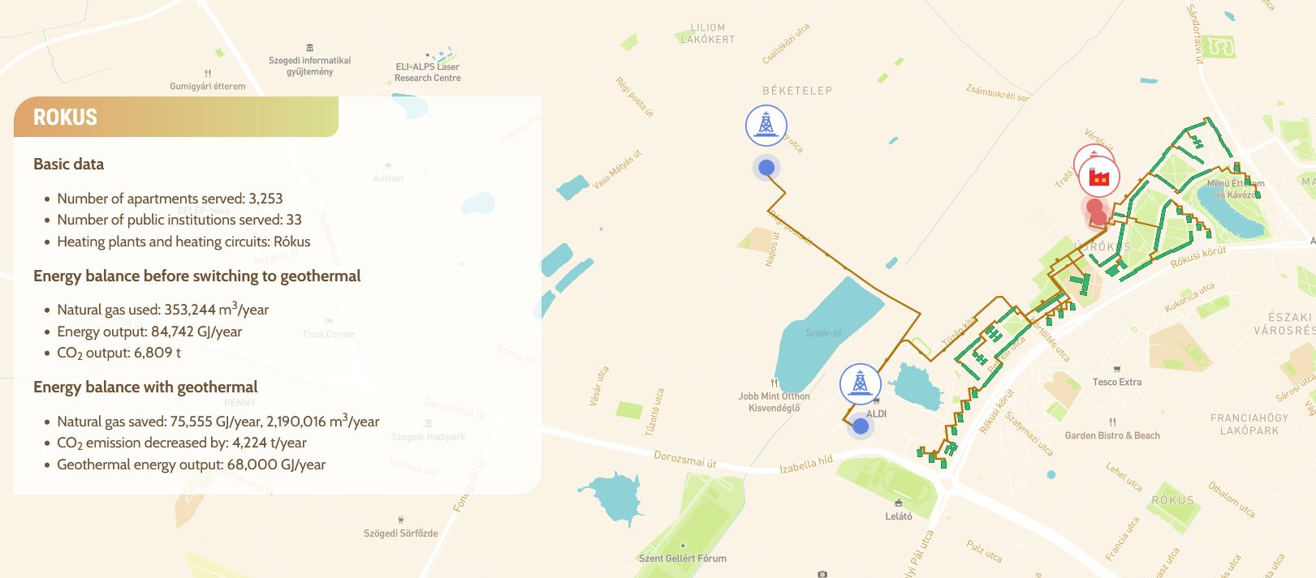
This project was supported as part of Sustainable Energy, an Interreg Danube Region Programme project co-funded by the European Union (ERDF fund) with the financial contribution of partner states and institutions.

Slide 7
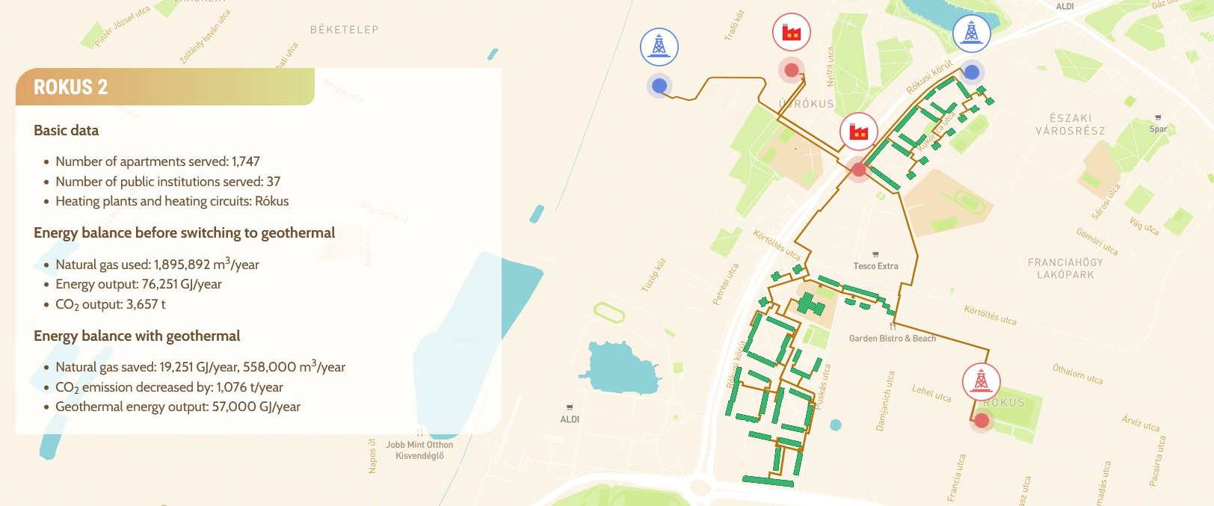
This project was supported as part of Sustainable Energy, an Interreg Danube Region Programme project co-funded by the European Union (ERDF fund) with the financial contribution of partner states and institutions.

Slide 8
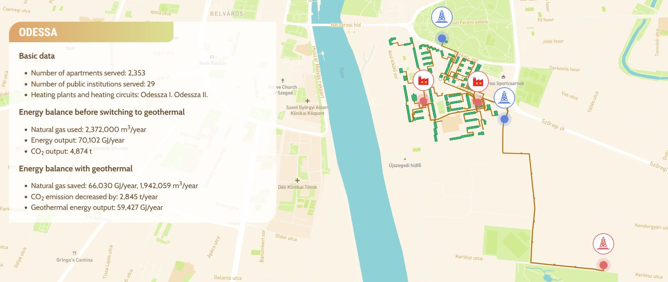
This project was supported as part of Sustainable Energy, an Interreg Danube Region Programme project co-funded by the European Union (ERDF fund) with the financial contribution of partner states and institutions.

Slide 9
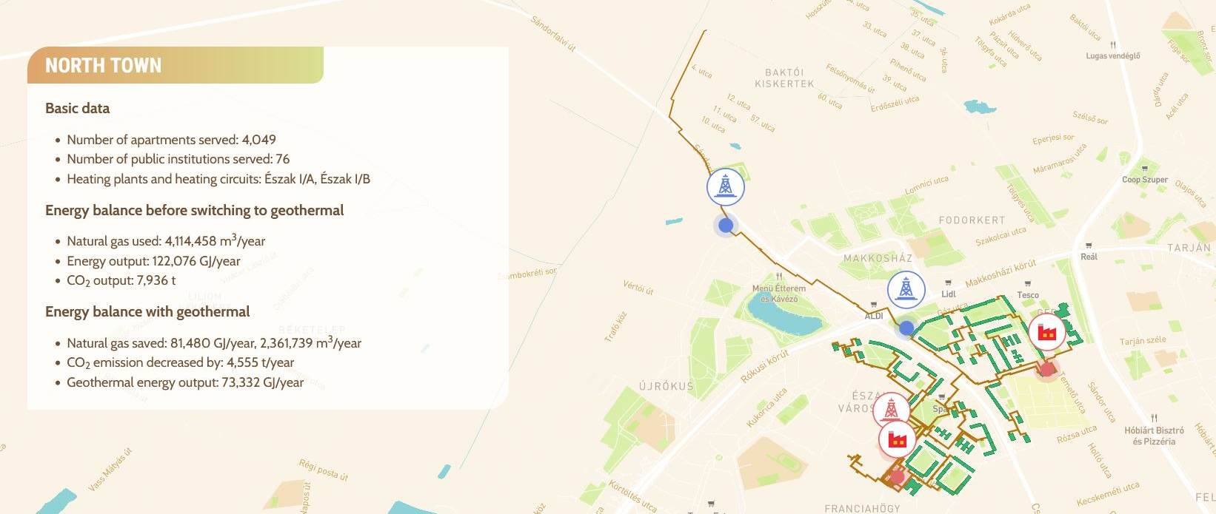
This project was supported as part of Sustainable Energy, an Interreg Danube Region Programme project co-funded by the European Union (ERDF fund) with the financial contribution of partner states and institutions.

Slide 10
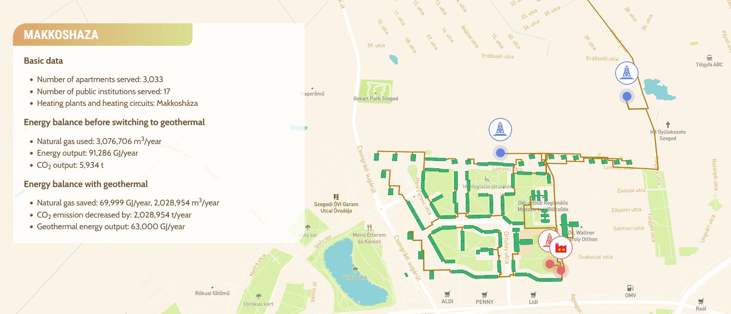
This project was supported as part of Sustainable Energy, an Interreg Danube Region Programme project co-funded by the European Union (ERDF fund) with the financial contribution of partner states and institutions.

Slide 11
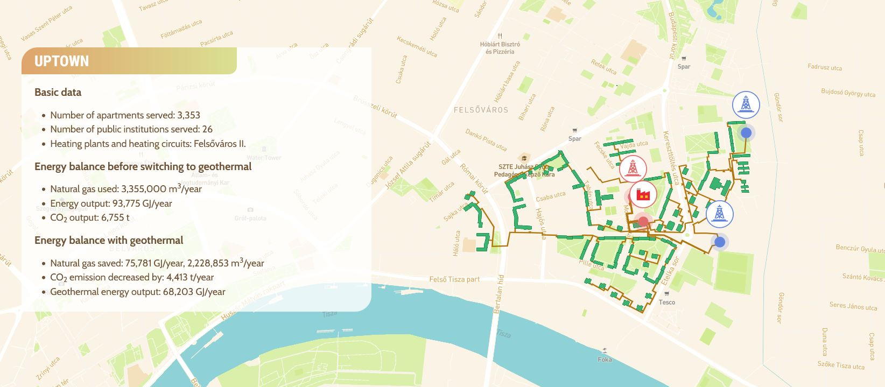
This project was supported as part of Sustainable Energy, an Interreg Danube Region Programme project co-funded by the European Union (ERDF fund) with the financial contribution of partner states and institutions.

Slide 12
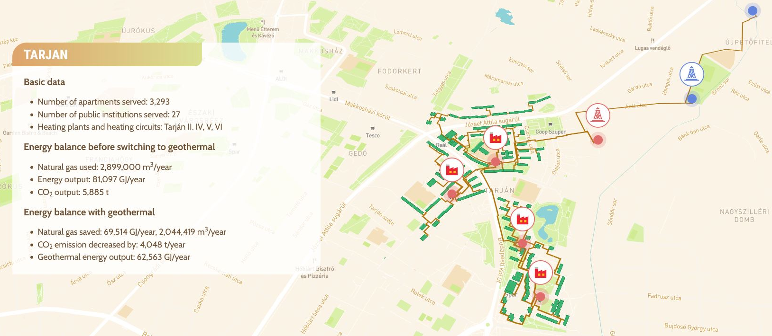
This project was supported as part of Sustainable Energy, an Interreg Danube Region Programme project co-funded by the European Union (ERDF fund) with the financial contribution of partner states and institutions.

Slide 13
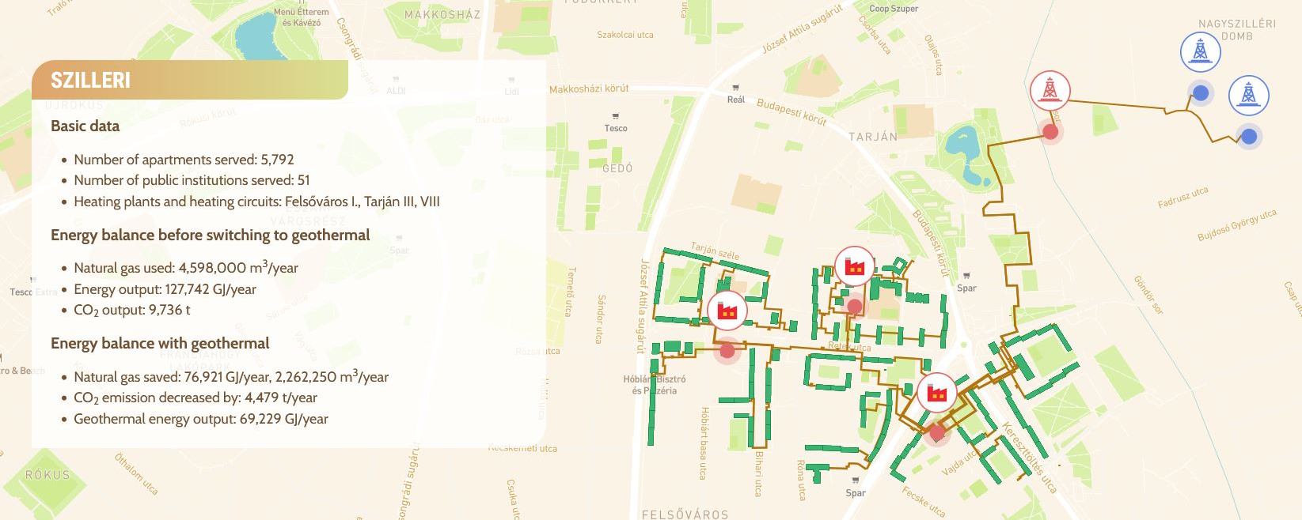
This project was supported as part of Sustainable Energy, an Interreg Danube Region Programme project co-funded by the European Union (ERDF fund) with the financial contribution of partner states and institutions.

Slide 14
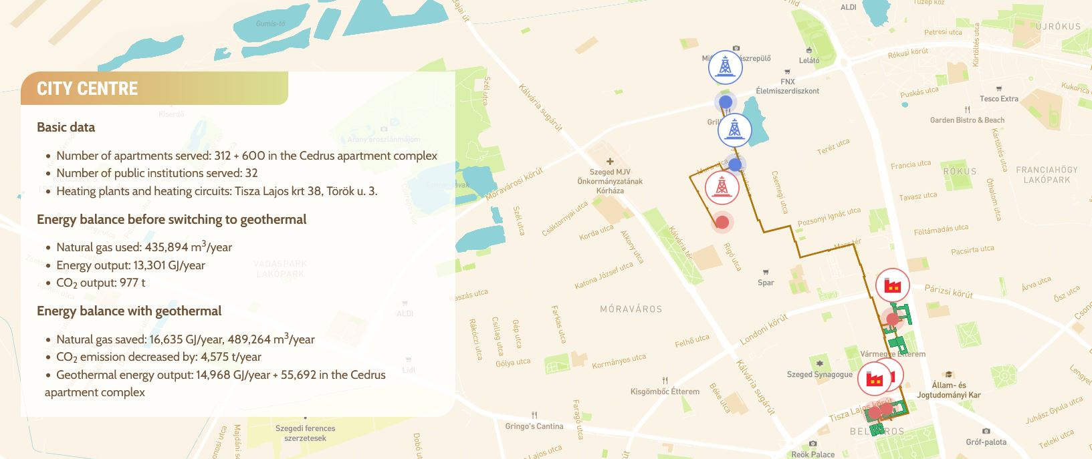
This project was supported as part of Sustainable Energy, an Interreg Danube Region Programme project co-funded by the European Union (ERDF fund) with the financial contribution of partner states and institutions.

Slide 15
This project was supported as part of Sustainable Energy, an Interreg Danube Region Programme project co-funded by the European Union (ERDF fund) with the financial contribution of partner states and institutions.

Slide 16
This project was supported as part of Sustainable Energy, an Interreg Danube Region Programme project co-funded by the European Union (ERDF fund) with the financial contribution of partner states and institutions.

Slide 17
Thank you for your attention!
More about the geothermal project of Szeged: https://geotherm.szetav.hu/
This project was supported as part of Sustainable Energy, an Interreg Danube Region Programme project co-funded by the European Union (ERDF fund) with the financial contribution of partner states and institutions.

