Slide 1





Project financing opportunities – international applications / tenders
Annamária Nádor
Ministry of Foreign Affairs and Trade
How to develop geothermal district heating systems? Tuzla, 20203. october 12
This project was supported as part of Sustainable Energy, an Interreg Danube Region Programme project co-funded by the European Union (ERDF fund) with the financial contribution of partner states and institutions.

Slide 2
Bosnia and Herzegovina was granted EU candidate status in December 2022 → eligible for certain EU funds
Instrument for pre-accession fund (IPA-III)
Western Balkan Investment Framework (WBIF)
Interreg-B (Danube program)
Horizon Europe
COST
LIFE-CET
This project was supported as part of Sustainable Energy, an Interreg Danube Region Programme project co-funded by the European Union (ERDF fund) with the financial contribution of partner states and institutions.

Slide 3
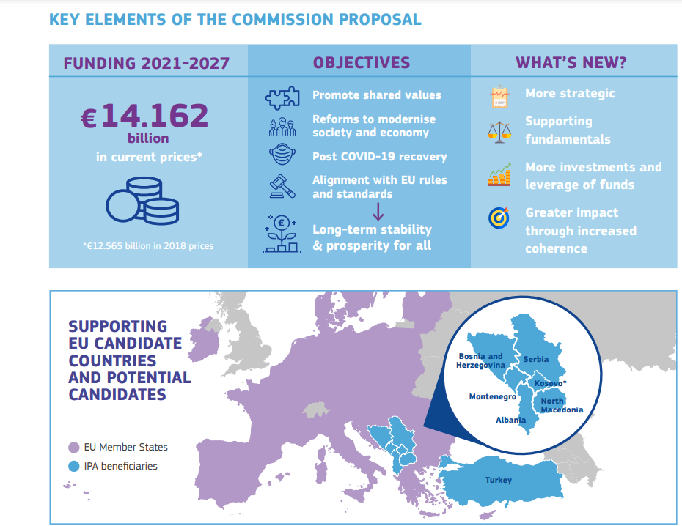
Instrument for pre-accession fund (IPA-III)
https://neighbourhood-enlargement.ec.europa
EU support in the enlargement region with financial and technical assistance to implement the necessary political and economic reforms
This project was supported as part of Sustainable Energy, an Interreg Danube Region Programme project co-funded by the European Union (ERDF fund) with the financial contribution of partner states and institutions.

Slide 4
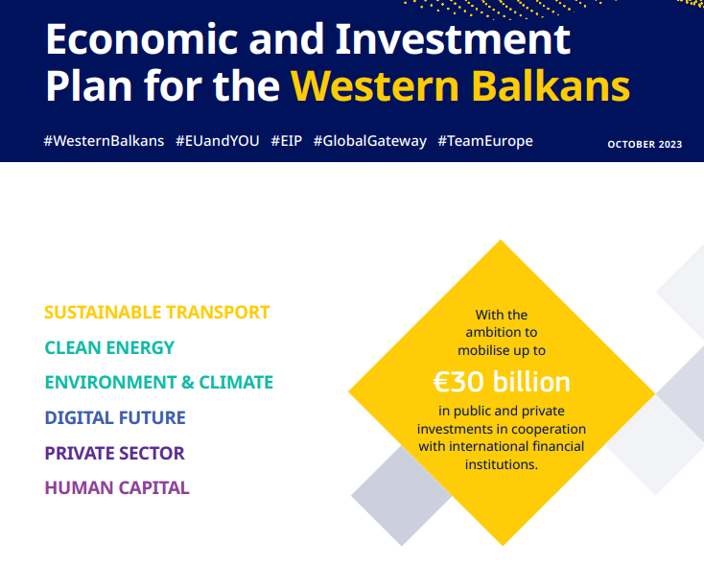
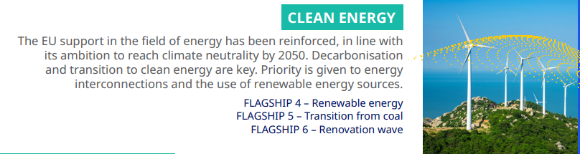
This project was supported as part of Sustainable Energy, an Interreg Danube Region Programme project co-funded by the European Union (ERDF fund) with the financial contribution of partner states and institutions.

Slide 5
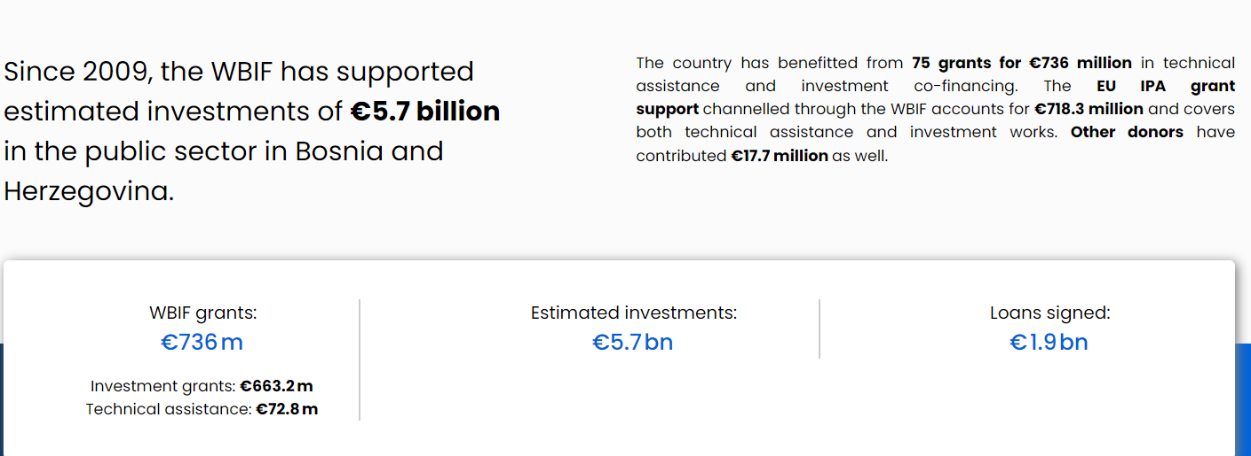
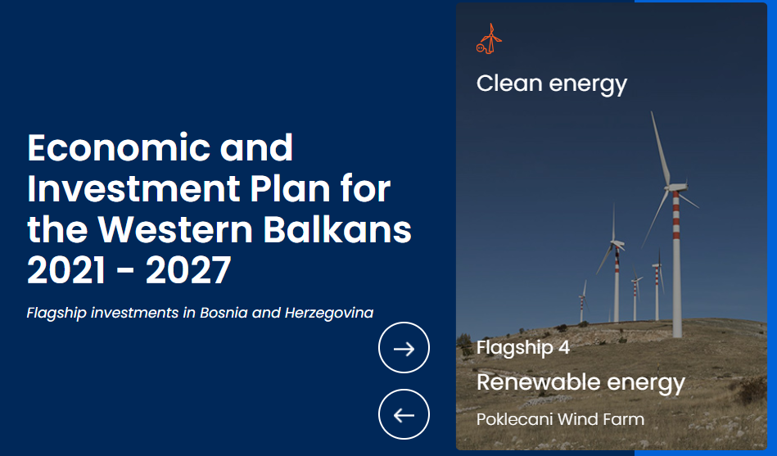
Western Balkan Investment Framework (WBIF)
https://www.wbif.eu/sectors/energy, https://www.wbif.eu/beneficiaries/bosnia-and-herzegovina
This project was supported as part of Sustainable Energy, an Interreg Danube Region Programme project co-funded by the European Union (ERDF fund) with the financial contribution of partner states and institutions.

Slide 6
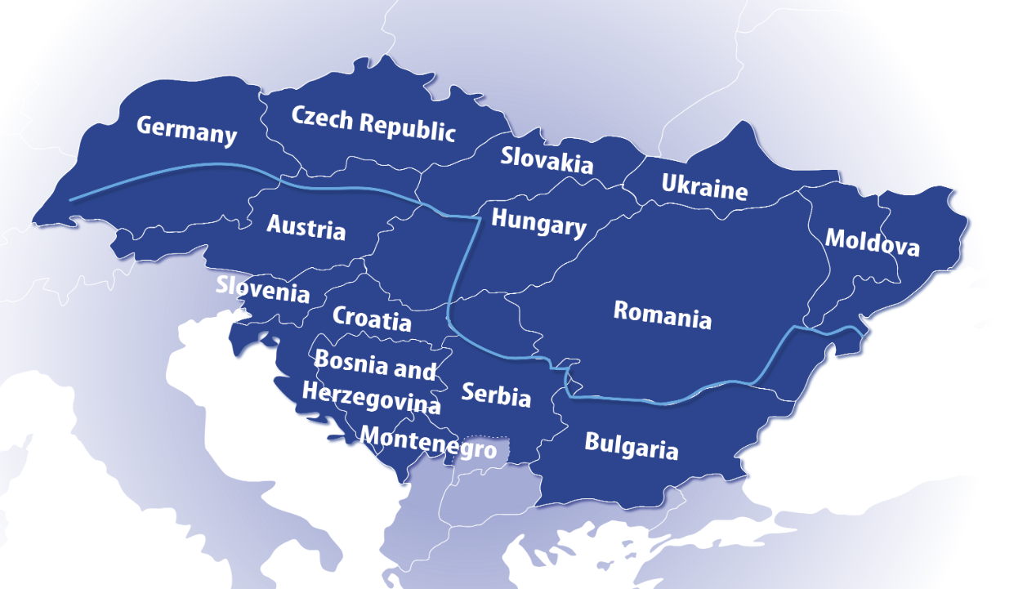
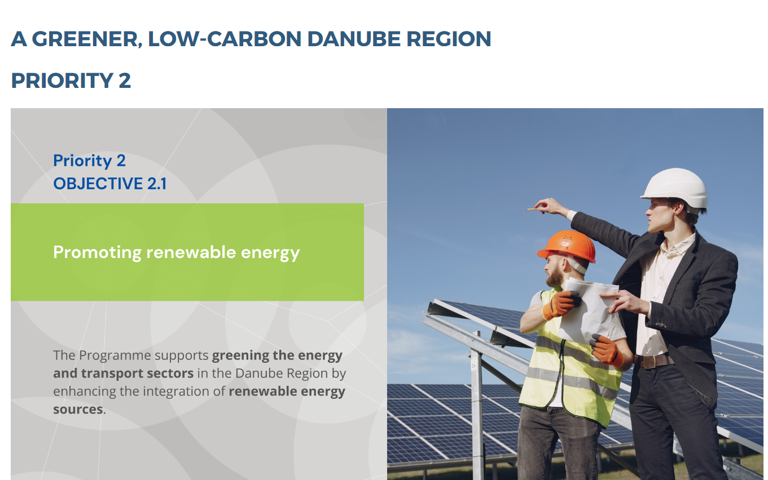
ERDF Interreg programs
https://interreg.eu
https://www.interreg-danube.eu/dtp-archive/about-dtp/new-funding-2021-2027
Interreg B: Transnational cooperation
Territoral coopeartion
Enhance institutional capacity of public authorities and stakeholders to implement macro-regional strategies, no investments
Danube Program
2nd Call will be launched at the end of Oct 2023, submission: 2124 March
This project was supported as part of Sustainable Energy, an Interreg Danube Region Programme project co-funded by the European Union (ERDF fund) with the financial contribution of partner states and institutions.

Slide 7
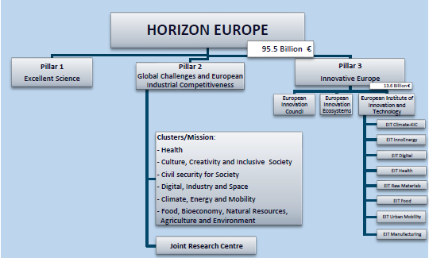
Horizon Europe
https://research-and-innovation.ec.europa.eu/funding/funding-opportunities/funding-programmes-and-open-calls/horizon-europe_en
Largest RI program in the world, supports research and innovation throughout the entire value chain, from frontier research to the market uptake of innovation
Innovation, market uptake
Fundamental research
Technological development from research to market
This project was supported as part of Sustainable Energy, an Interreg Danube Region Programme project co-funded by the European Union (ERDF fund) with the financial contribution of partner states and institutions.

Slide 8
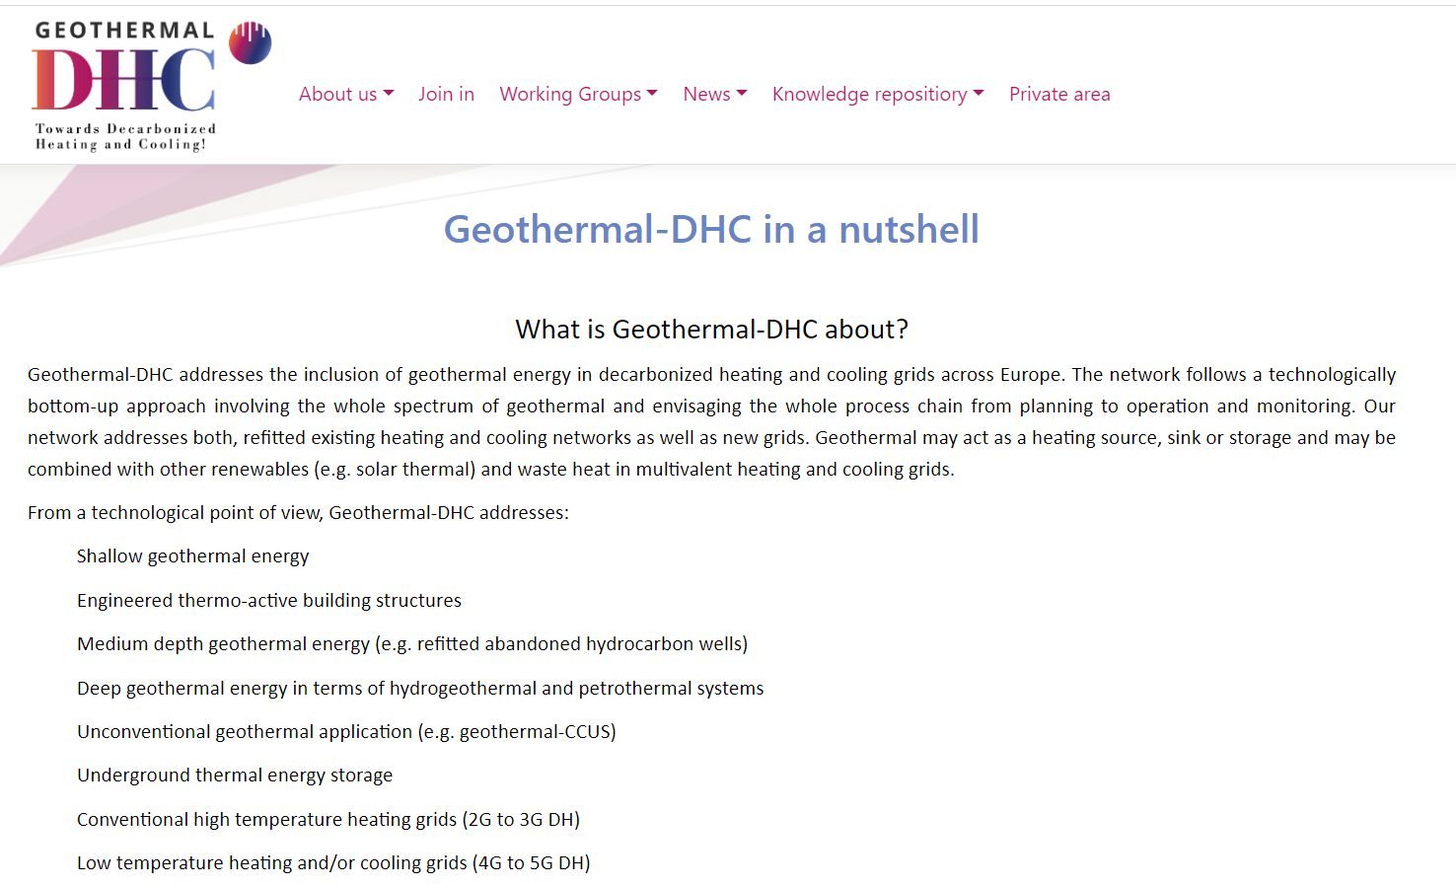
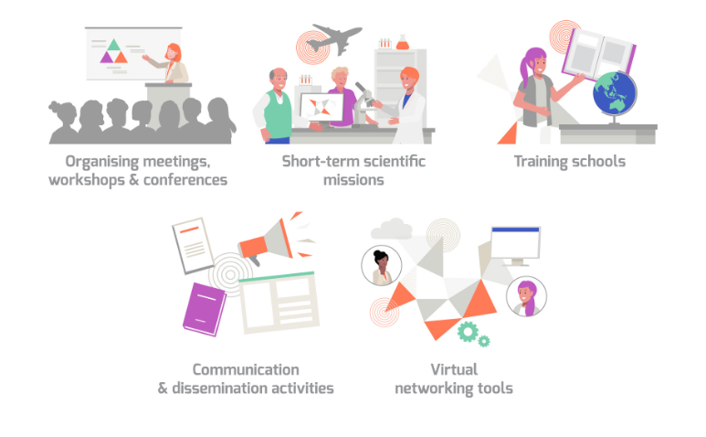
COST: European Cooperation in Science and Technology (600 million €)
https://www.cost.eu/
https://www.geothermal-dhc.eu
Funding for interdisciplinary networking activities for researchers (EU and beyond) to jointly develop their own ideas and new initiatives across all scientific and technological fields
This project was supported as part of Sustainable Energy, an Interreg Danube Region Programme project co-funded by the European Union (ERDF fund) with the financial contribution of partner states and institutions.

Slide 9
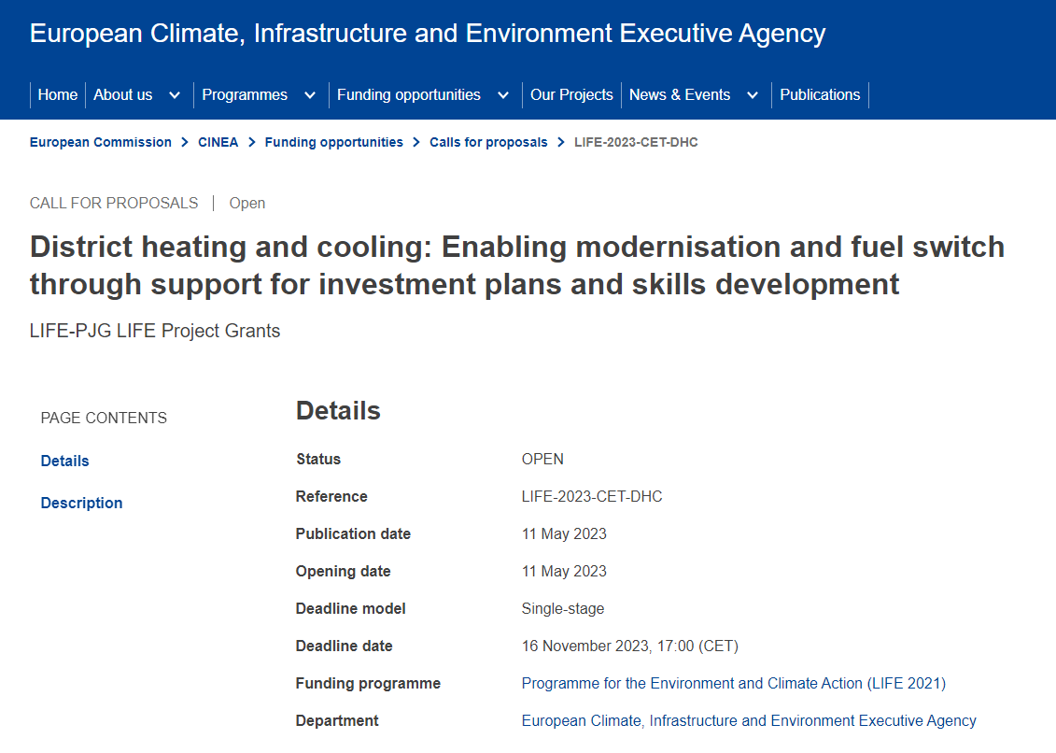
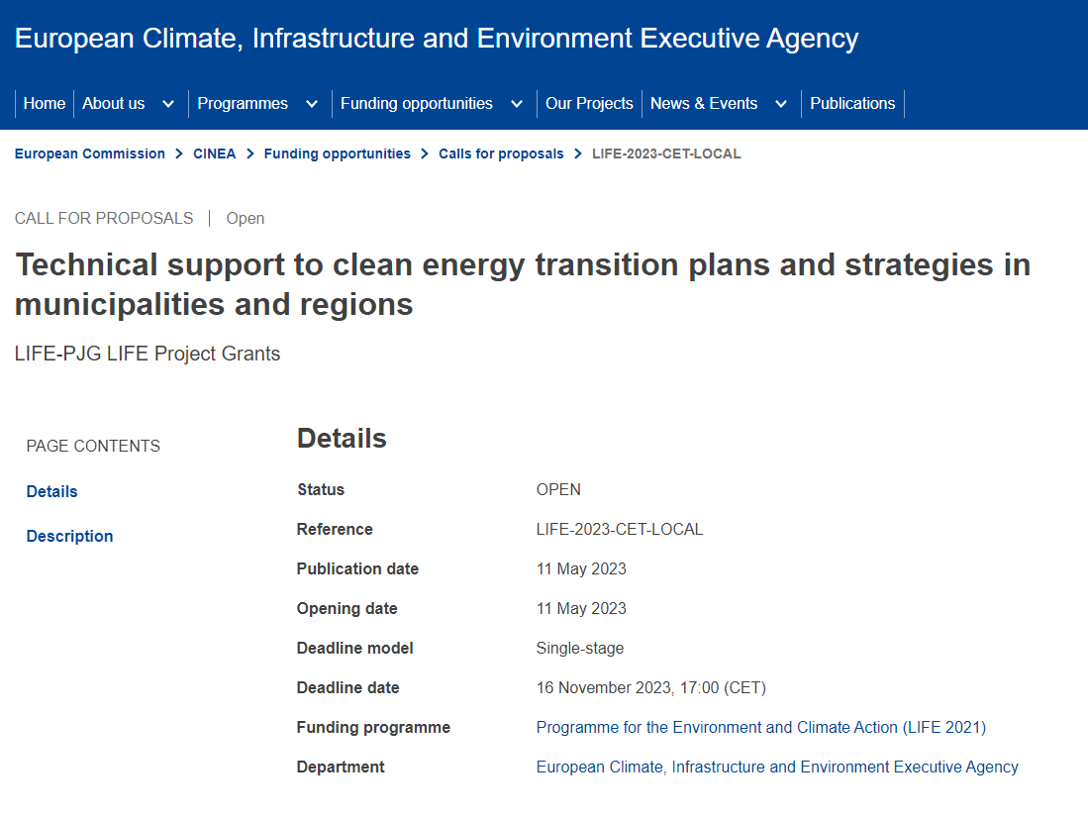
LIFE Clean Energy Transition sub-program
https://cinea.ec.europa.eu/programmes/life/clean-energy-transition_en
Overall aim: facilitating the transition towards an energy-efficient, renewable energy-based, climate-neutral economy by funding coordination and support actions
Areas of intervention: Supporting the development of local and regional investment projects;
Min 3 partners from 3 countries
6,5 billion euro
8 billion euro

Slide 10
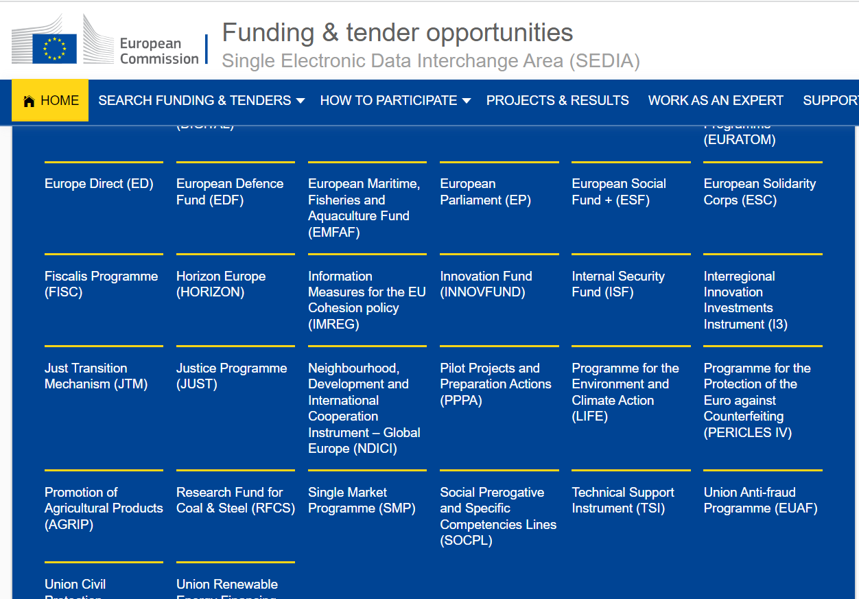
https://ec.europa.eu/info/funding-tenders/opportunities/portal/screen/home
This project was supported as part of Sustainable Energy, an Interreg Danube Region Programme project co-funded by the European Union (ERDF fund) with the financial contribution of partner states and institutions.

Slide 11
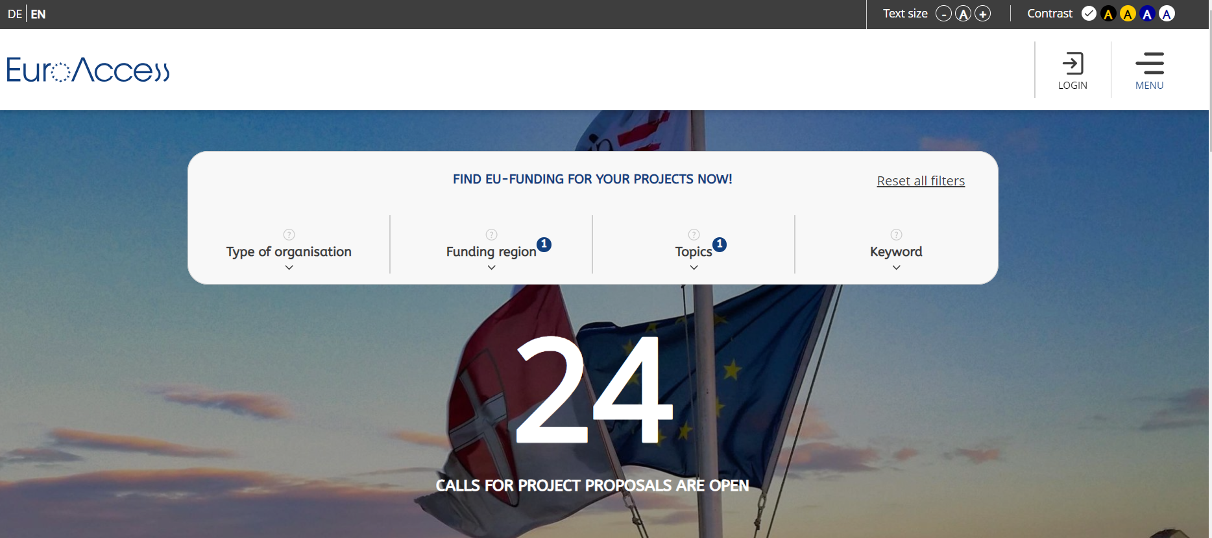
https://www.euro-access.eu/en
BH
ENERGY
This project was supported as part of Sustainable Energy, an Interreg Danube Region Programme project co-funded by the European Union (ERDF fund) with the financial contribution of partner states and institutions.

Slide 12

Good luck for finding your right financing instrument!
THANK YOU FOR YOUR ATTENTION
This project was supported as part of Sustainable Energy, an Interreg Danube Region Programme project co-funded by the European Union (ERDF fund) with the financial contribution of partner states and institutions.

