Slide 1

isoplus Budapest presentation
Tuzla BIH 12.10.2023

Slide 2
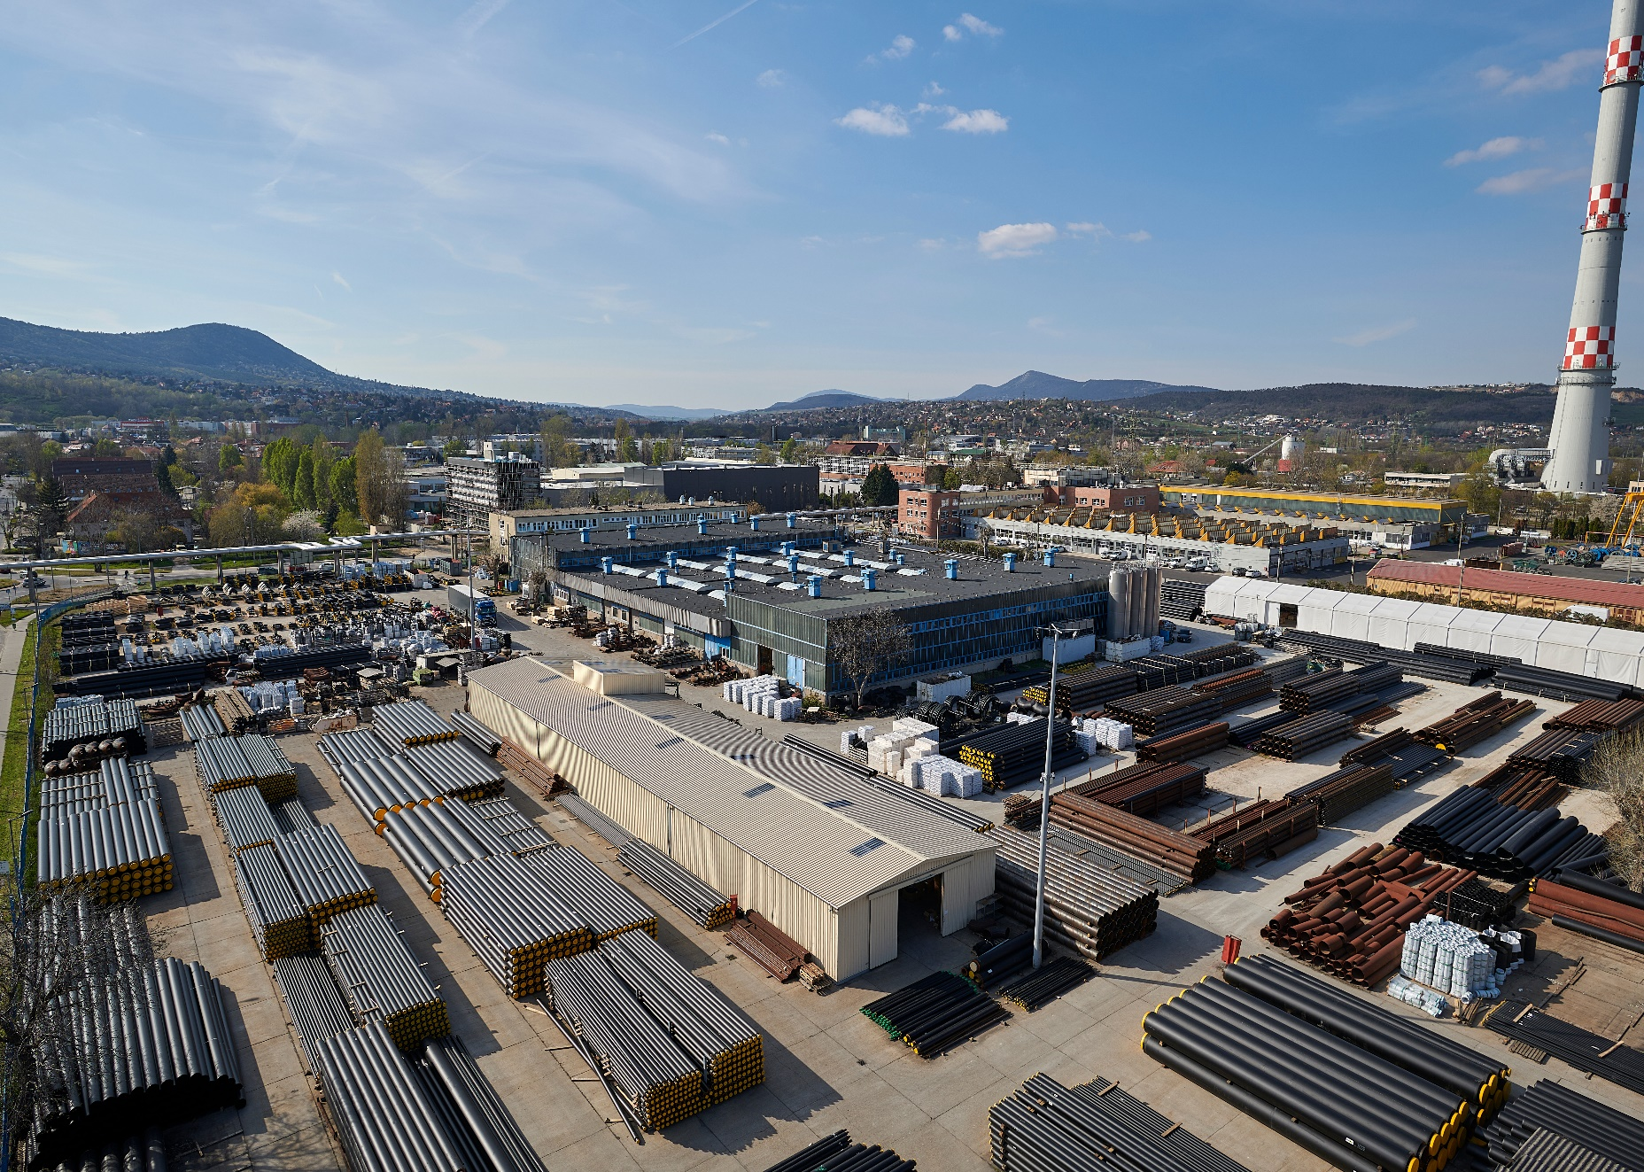

isoplus Hungary - location Budapest
foundation 1987.04.27
plant size
    total area 37.749 m²
    roofed area 8.280 m²
  number of employees (May 2023)
    white collar 27
    blue collar 41
    hired worker 21
  produced quantities in 2022
    pipes 164.634 m
    fittings 5.587 pcs
    others 986 pcs
    PE 346.515 m
Factory photo (ideally from the air)

Slide 3
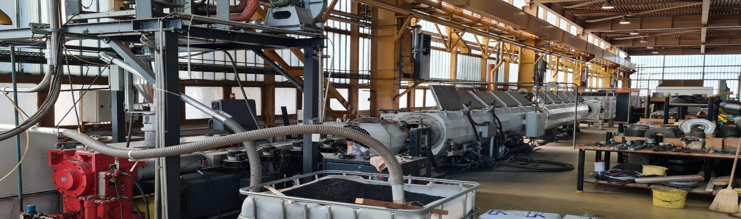
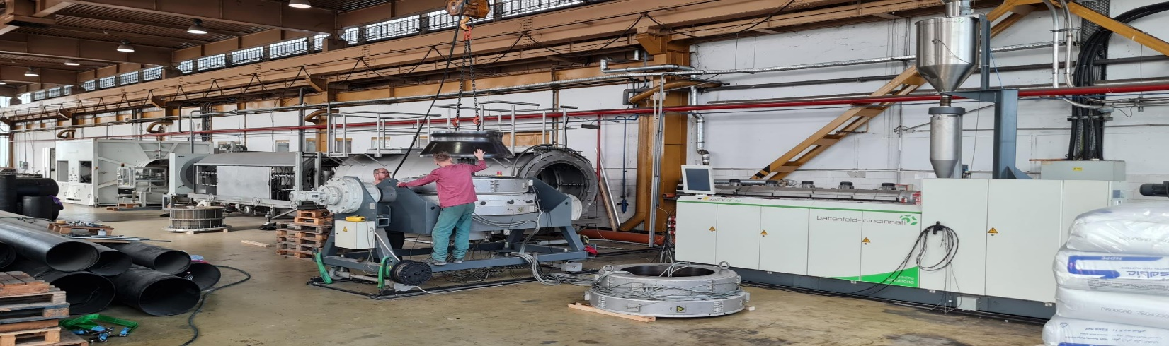
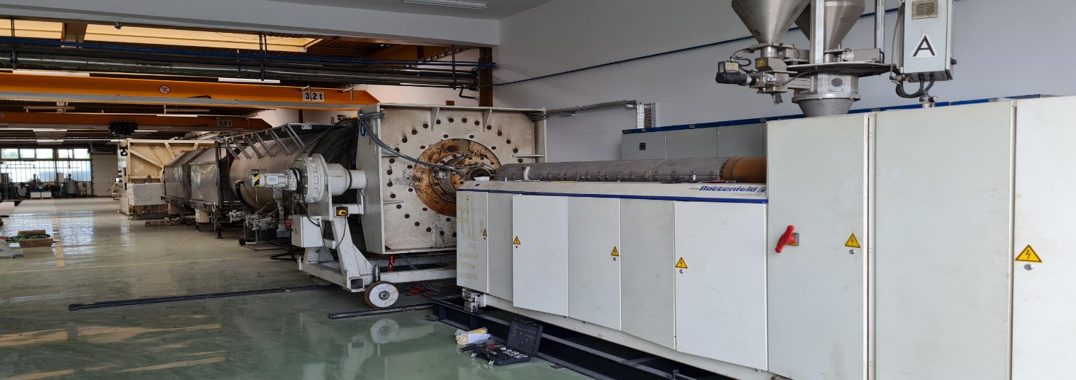

isoplus Budapest - production technology & capacity
extrusion lines
90 mm - 630 mm
670 mm - 1.000 mm
400 mm - 1.200 mm
  disconti-foaming tables
  6M, 12M, 16M
  fitting production
    steel pipe bending machine
    PE-welding machines
    90 mm – 800 mm (1.200 mm)
    steel welding boxes
Photos from each biggest
production machine

Slide 4
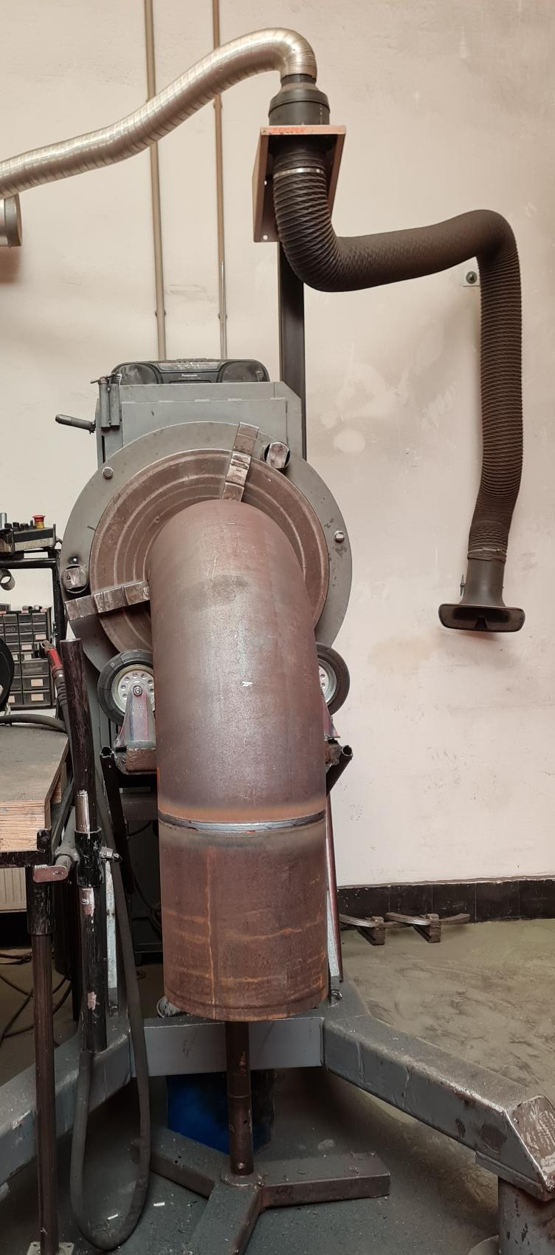
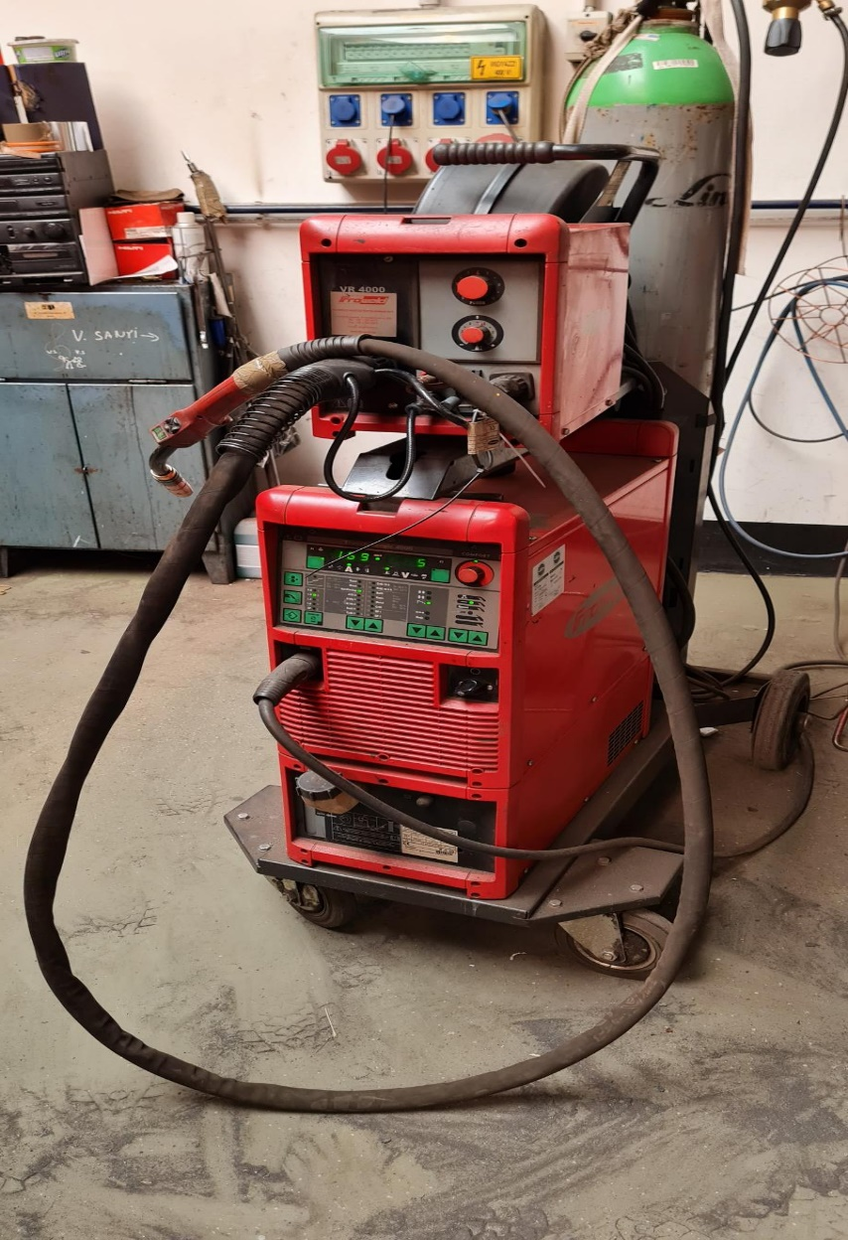
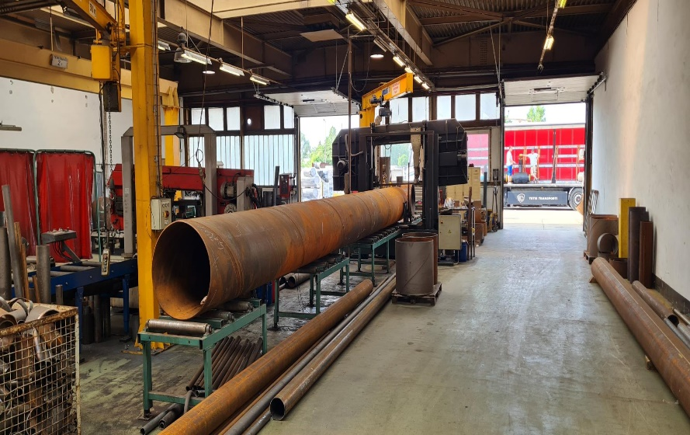
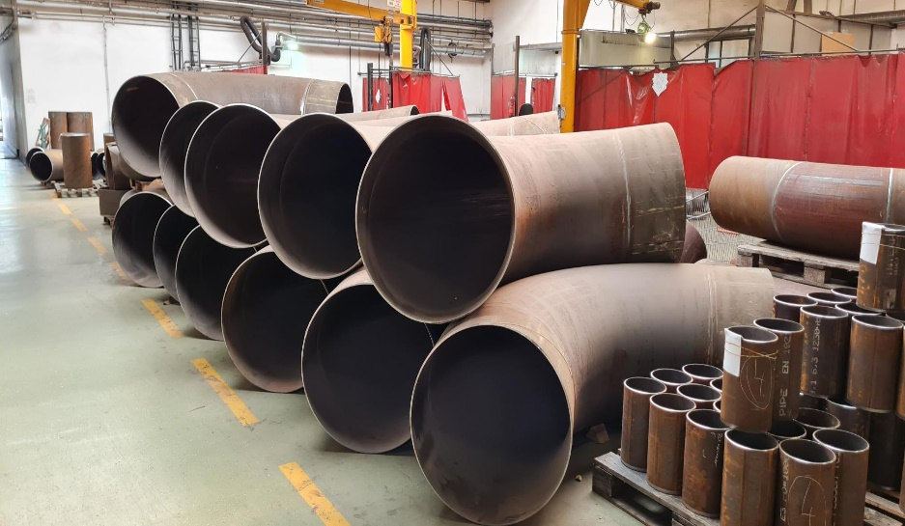
Production technologies
    steel welding machines

Slide 5
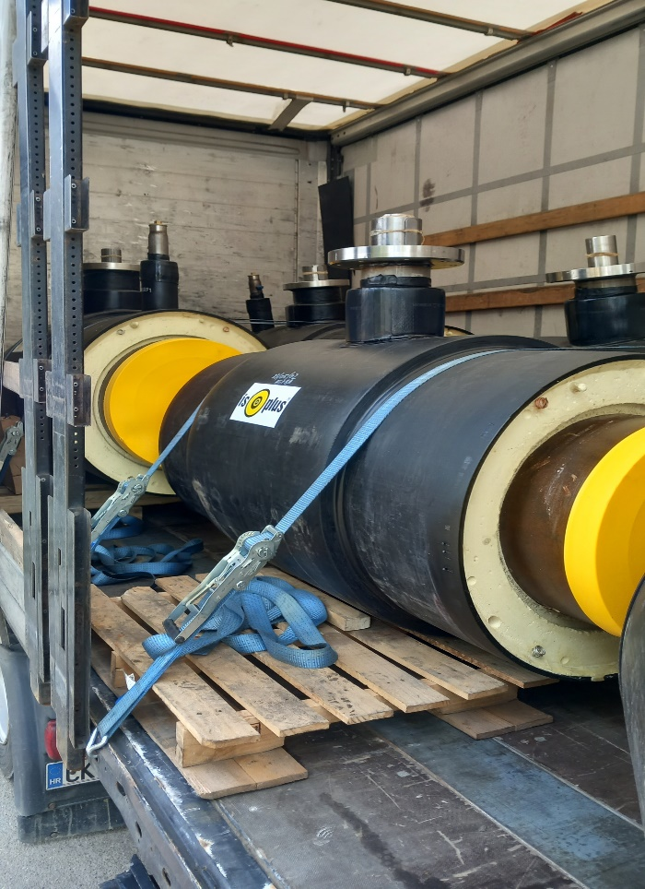
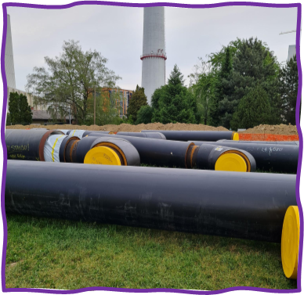
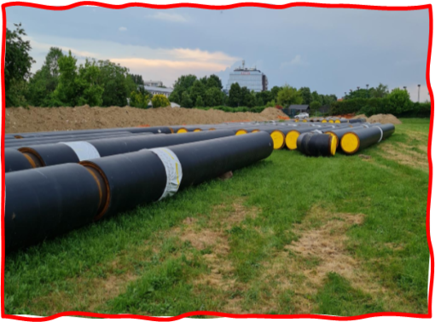
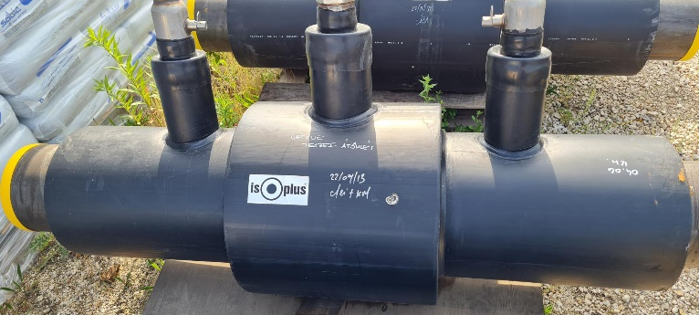
isoplus Budapest - product overview
pre-isolated pipes
    outside dimension PE-jackets [Da]
      single 90 – 1.200 mm
    pipe lengths 6, 12, 16 m
    steel pipe technology seamless, spiral, longitudinal,
    coated pipes
    alarm systems Nordic, Brandes
    curved pipes up to Da 400 mm/PEHD
  Fittings
    outside dimension PE-jackets [Da]
      single 90 – 1.200 mm
    bend technology forged and welded, cold bend

Slide 6
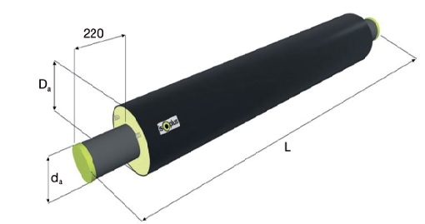
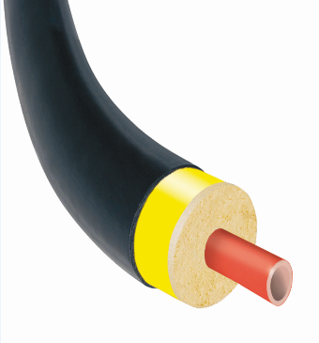
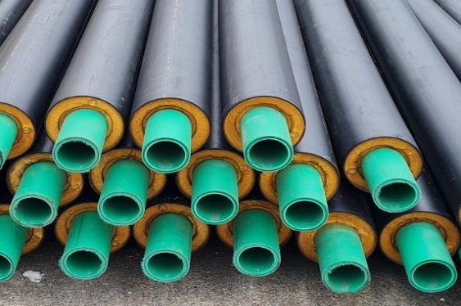

Geothermal Projects in Hungary
pre-isolated steel pipes
          Győr/AUDI DN400/560 10 188m
          Békéscsaba DN32-DN150/250 4 500m
          Miskolc Mályi DN200/315 2 004m
flexible compound systems PEX, 6 bar end 10 bar
          Földes isopex® H-40-H-110/10 6 000m
          Létavértes isopex® H-25-H-125/180 3 000m
pre-isolated PP pipes, SDR 11,17, etc.
          Mórahalom PP - DN200/315 3 996m
          Lenti PP – DN160/250 3 504m

Slide 7
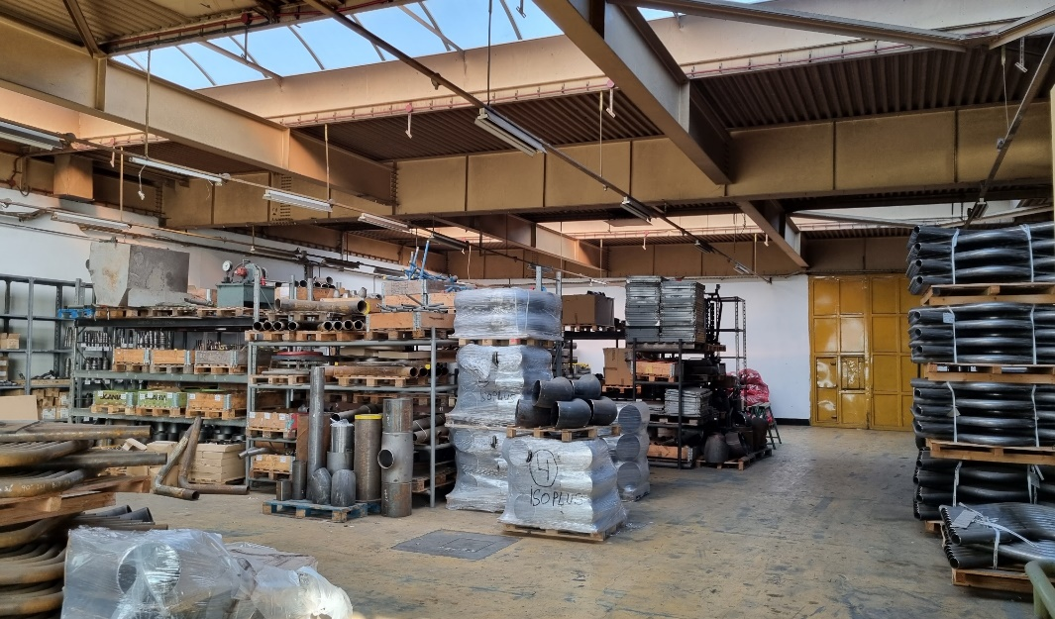
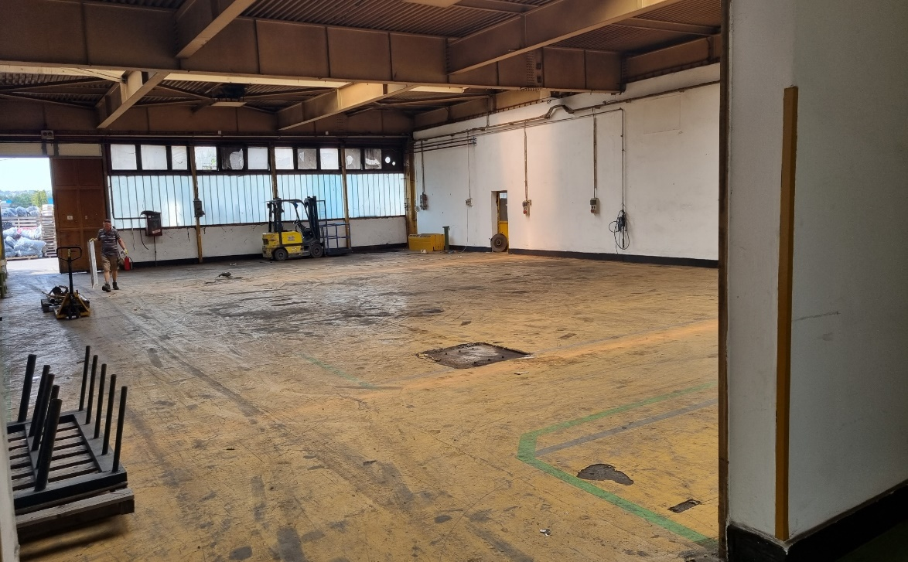
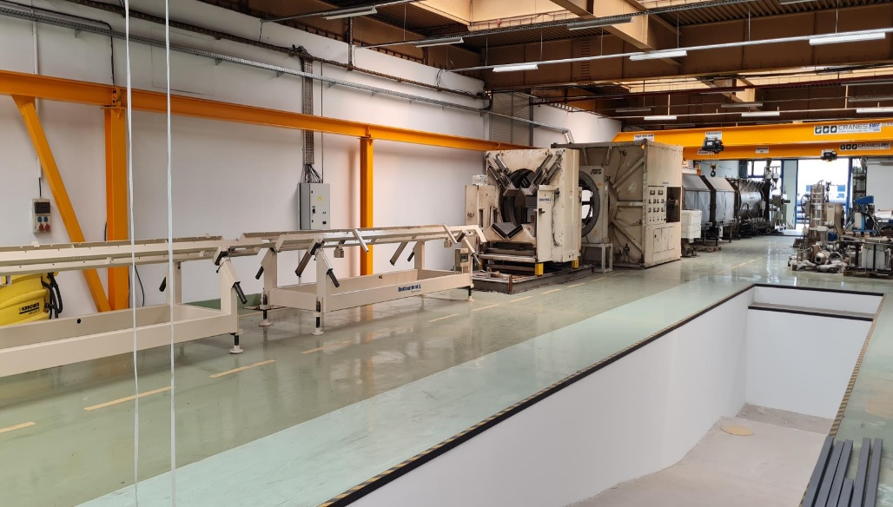
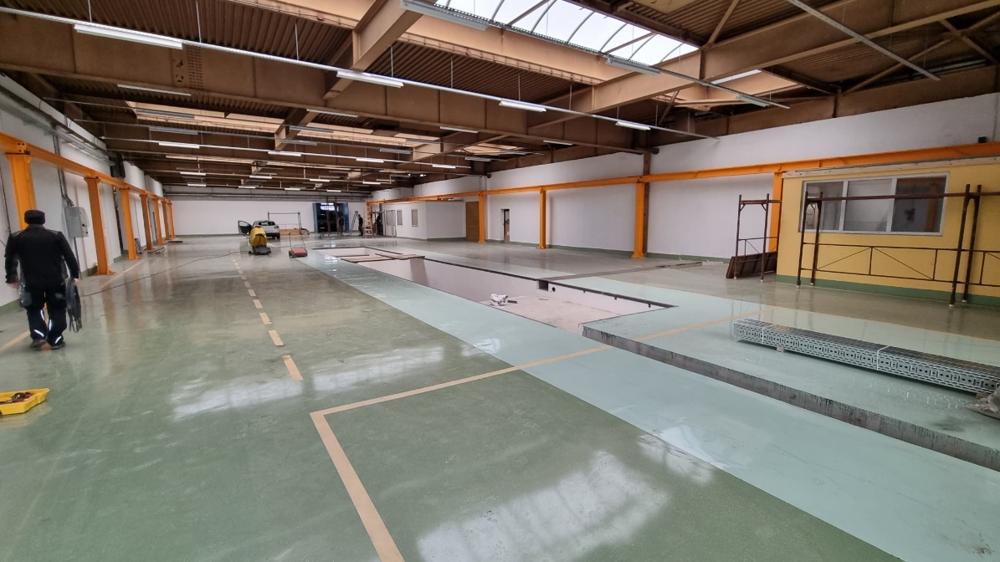
isoplus Budapest - plant project new production facility for 16m lenght DN1.000/1.200 mm
Presentation of the currently most important factory projects:
factory extension new 16 M pipe production line
capacity increase new extruder 1.200 mm
new foaming table 16 M, 2 x foaming machine

Slide 8
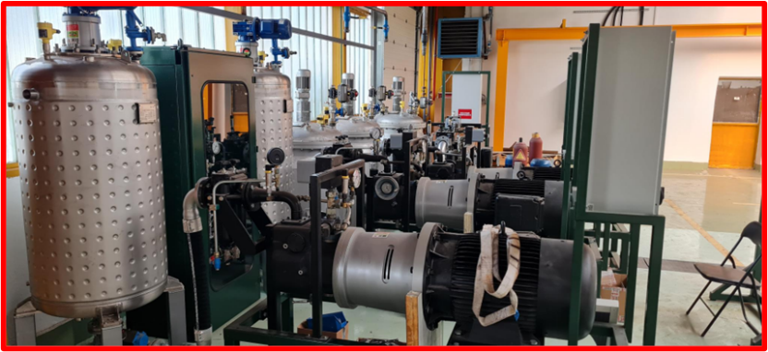
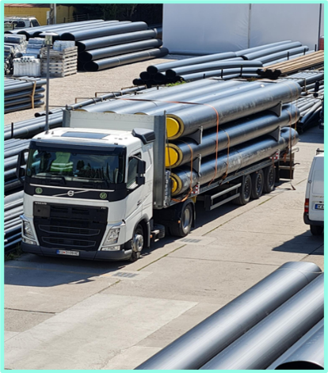
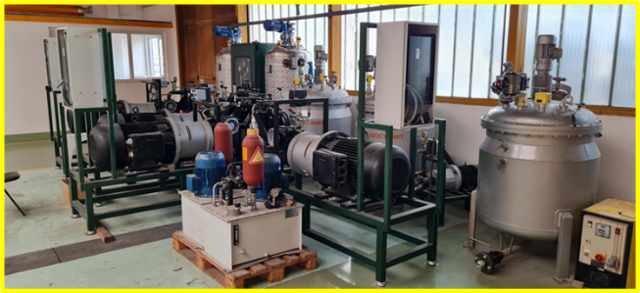
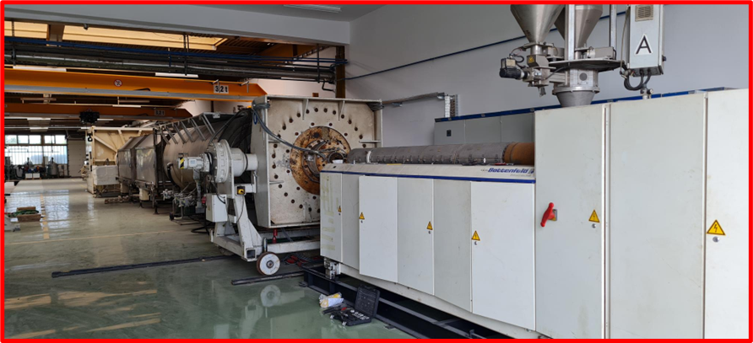
New production facility for 16M DN1.000/1.200 mm

Slide 9
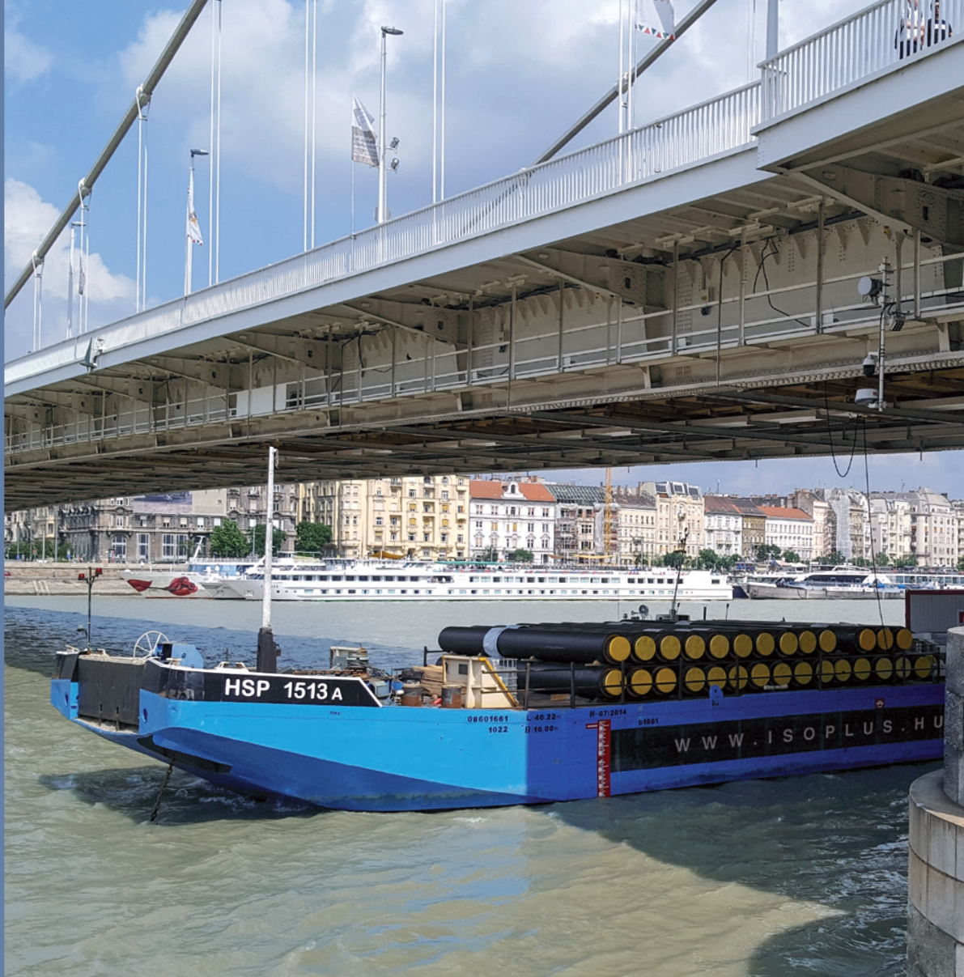
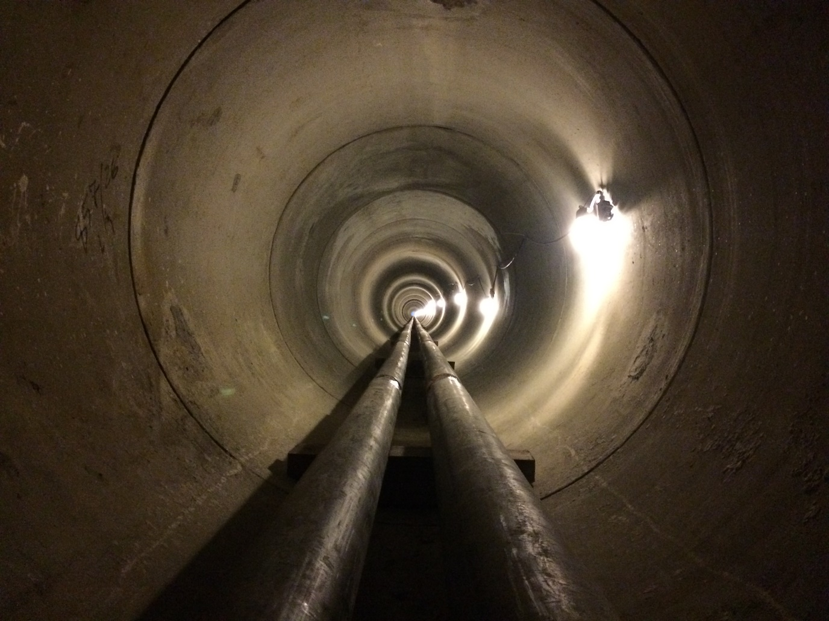
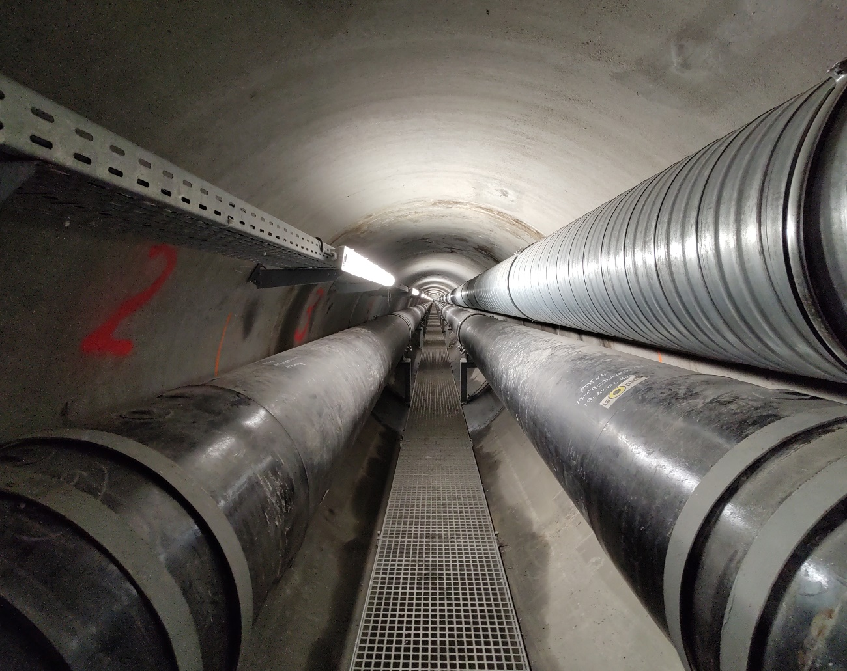
Extraordinary projects from the past
Budapest Hungary Erzsébet Bridge&Tunnel 2018-2019
2xDN 250- DN600

Slide 10
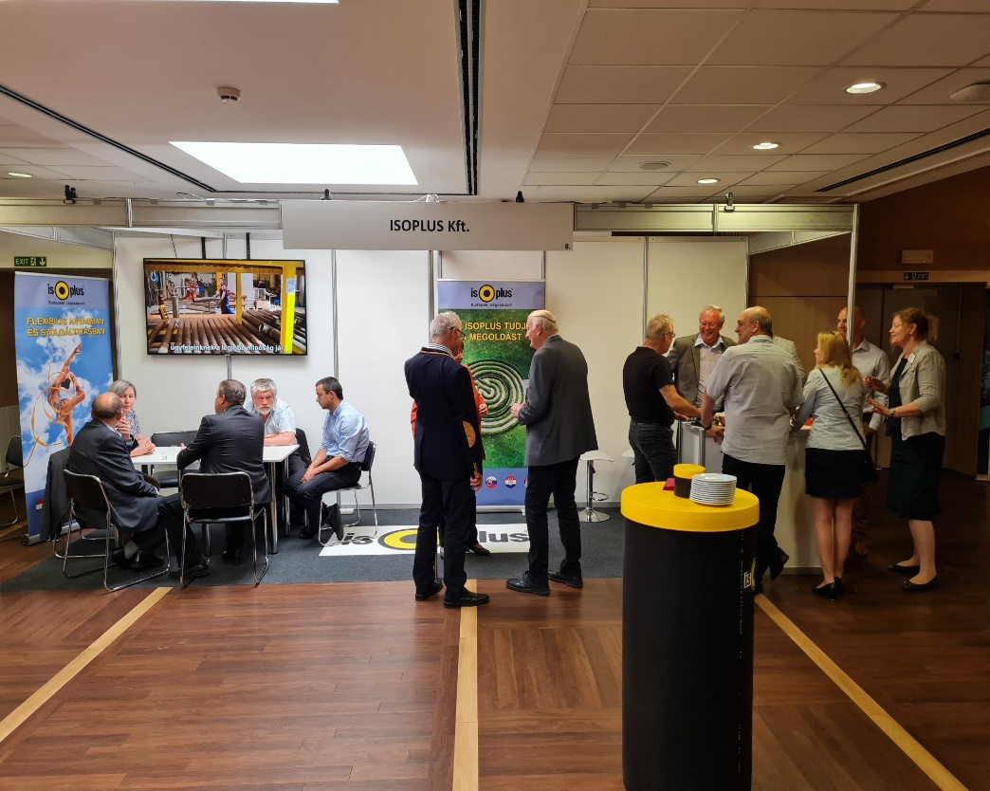
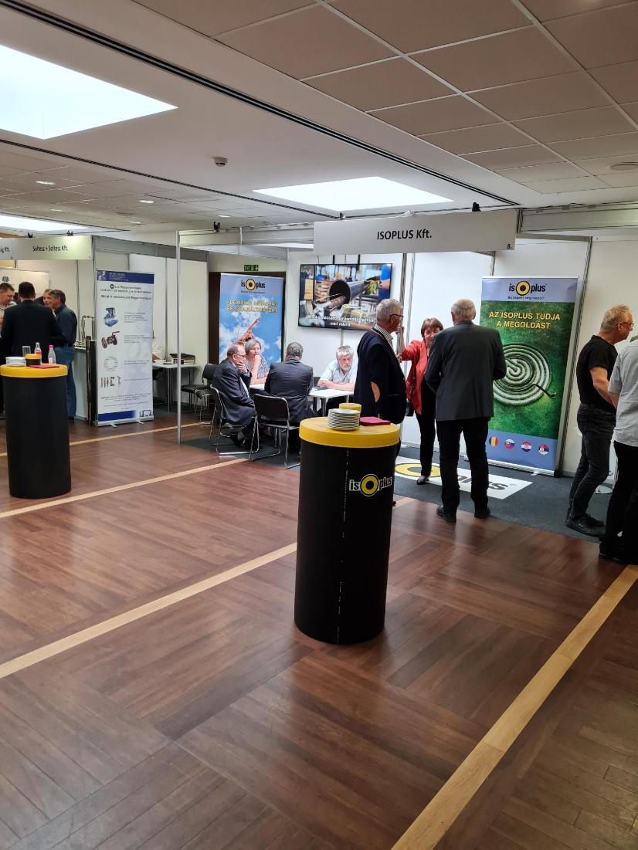
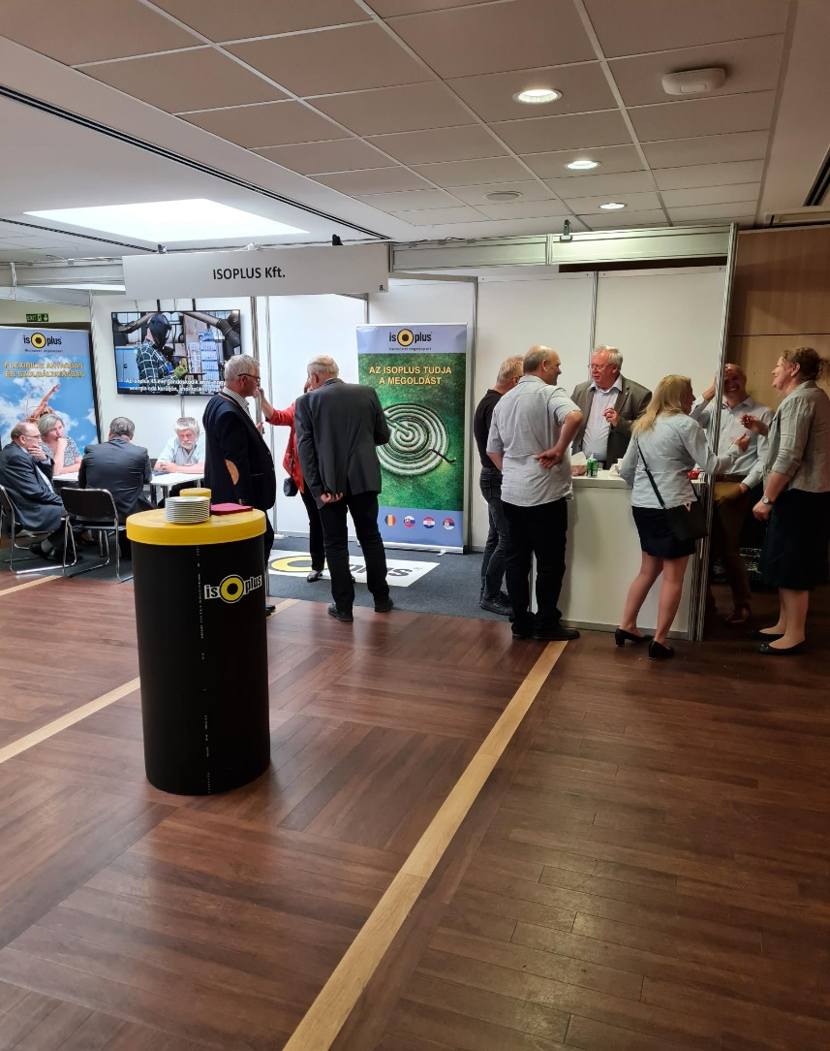
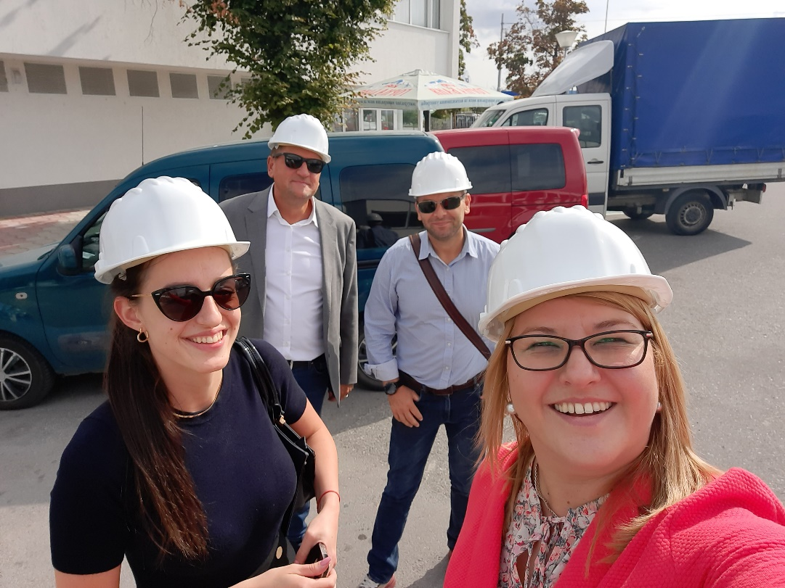
Events
Fair & Exhibition HDHA/Matászsz
Onsite visit Plovdiv/EVN/PEM

Slide 11

What makes the location to something very special
Environmentally friendly & safety by FOX

