Slide 1
14th SG MEETING OF PA2 INSTITUTE FOR FOREIGN AFFAIRS AND TRADE Budapest, 13 July 2017
THE centrope region
Gál Körmendy
Coordinator of Cluster and Economic Development
West-Pannon Nonprofit Ltd

Slide 2
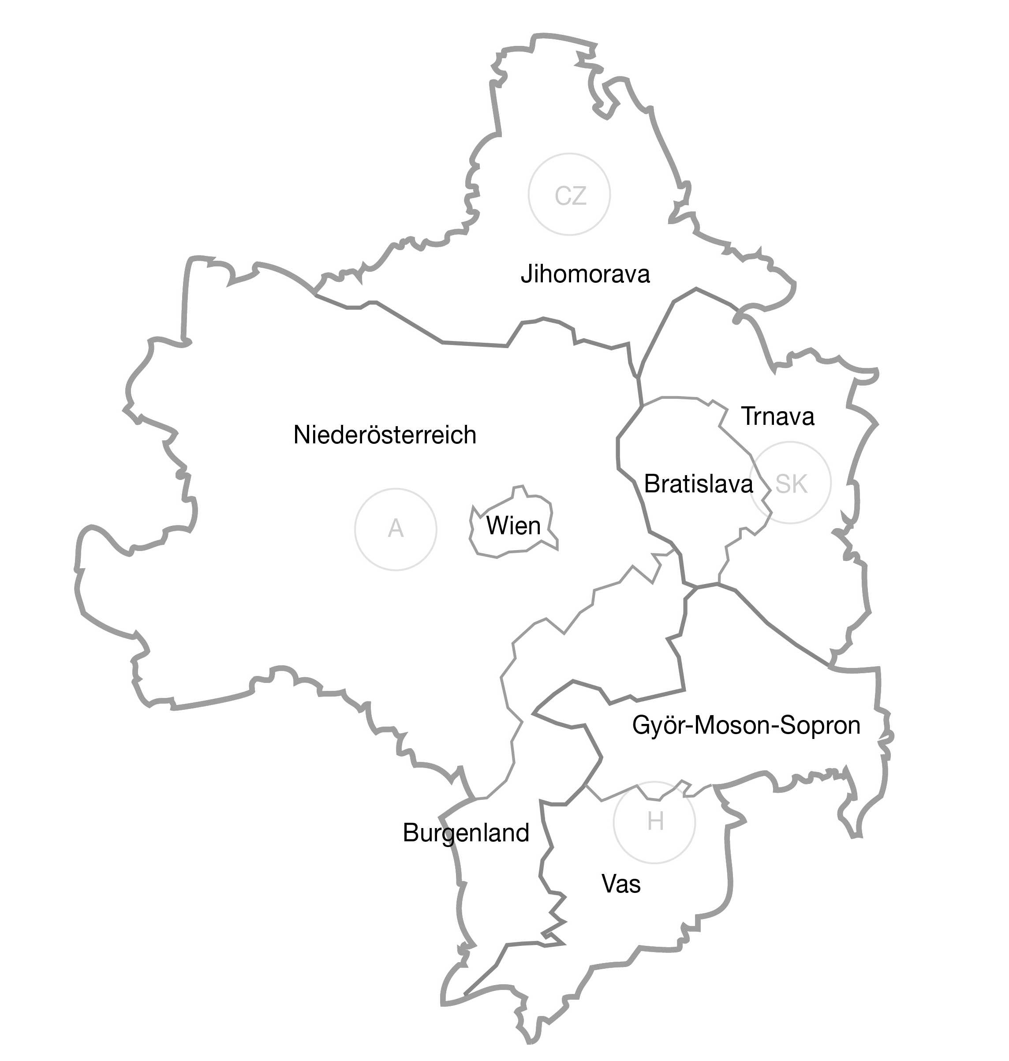
Region
4 countries – 7 regions – 7 cities:
Austria (Burgenland, Lower-Austria, Vienna)
Czechia (South Moravian Region, Brno)
Hungary (Győr-Moson-Sopron county, Vas County, Győr, Sopron, Szombathely)
Slovakia (Bratislava region, Trnava region, Bratislava, Trnava)
2

Slide 3
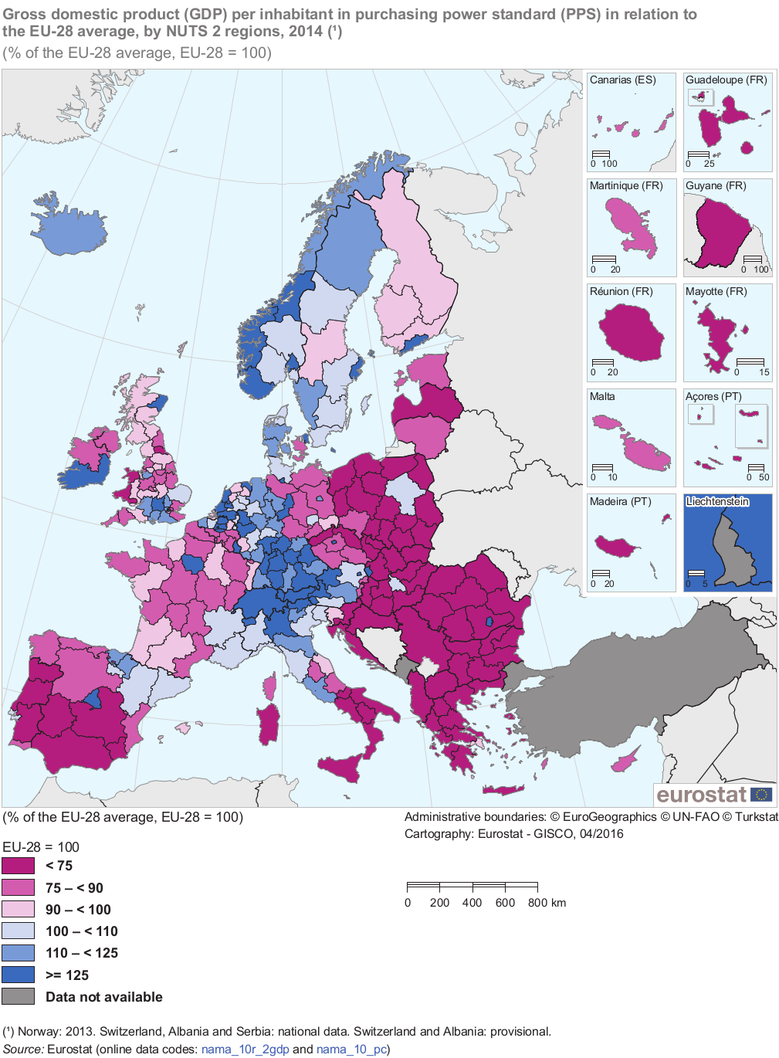
Facts
~7 million people
~210 billion EUR GDP
10 000+ monuments and heritage sites
Dynamic development
High quality of life
Macroregional centre of gravity for industry, innovation, heritage and culture
Long and complicated common history, two sides of the Iron Curtain
3

Slide 4
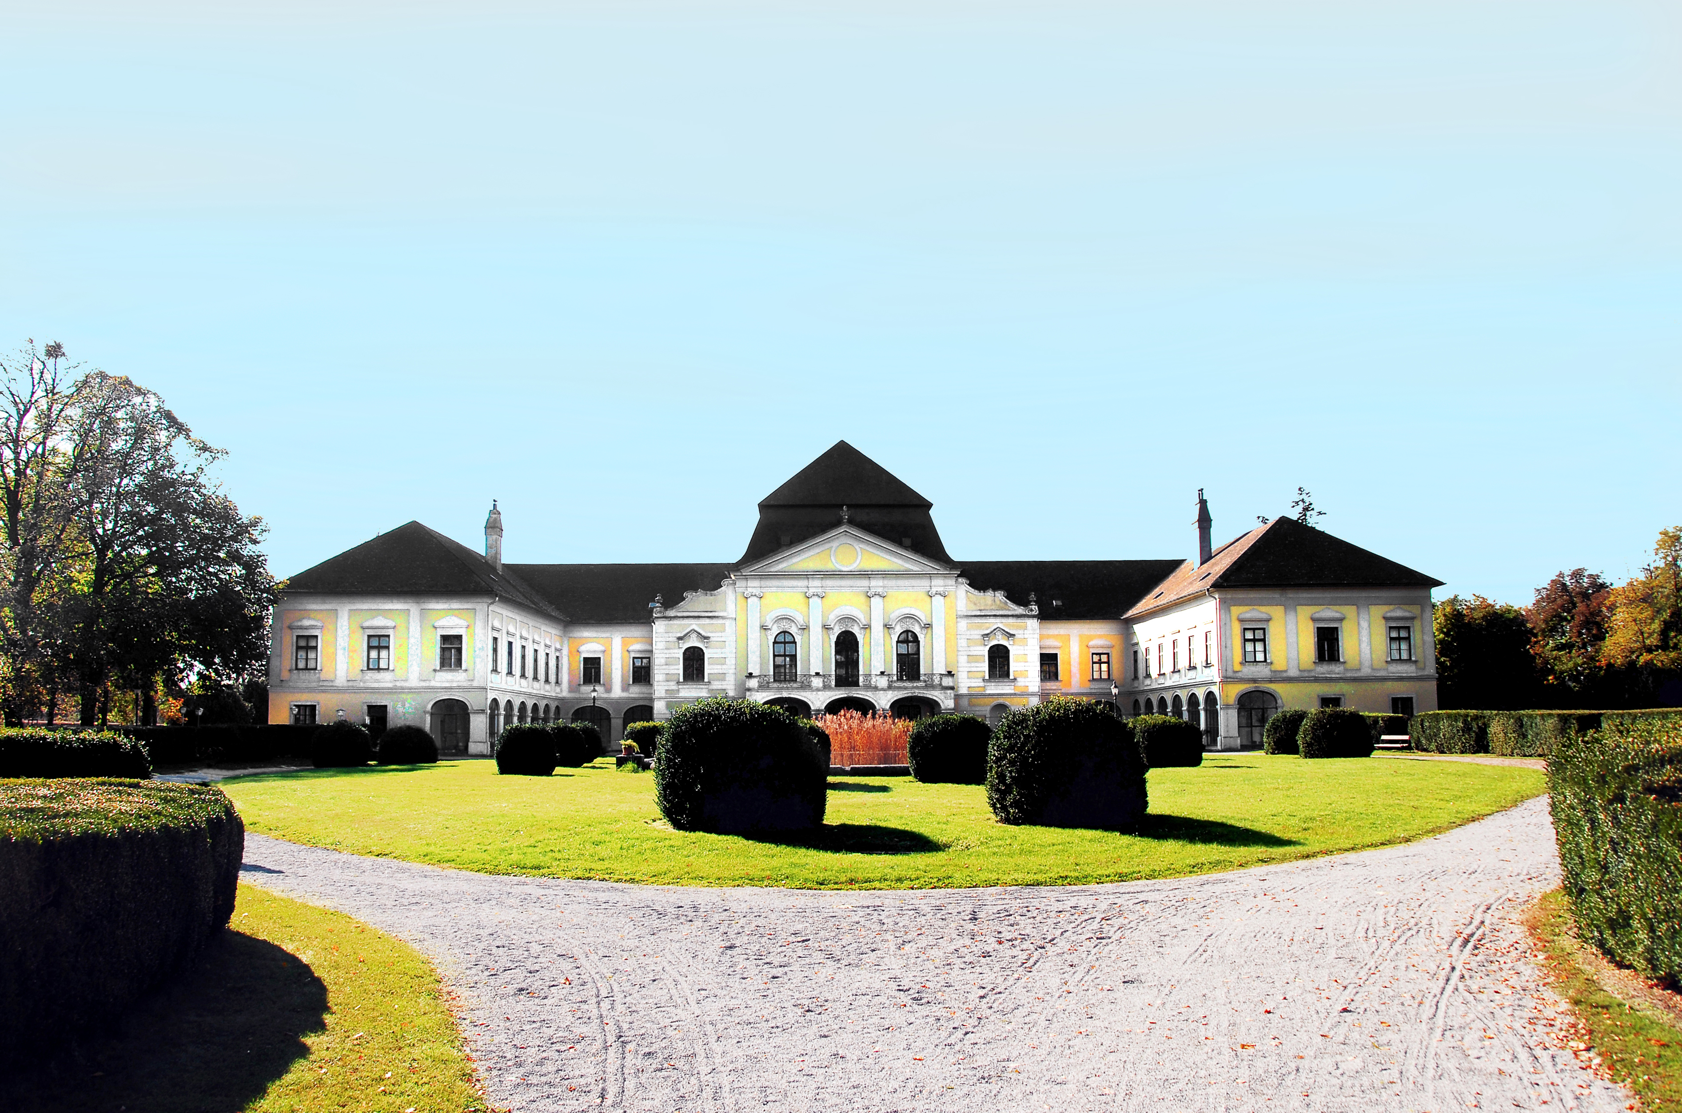
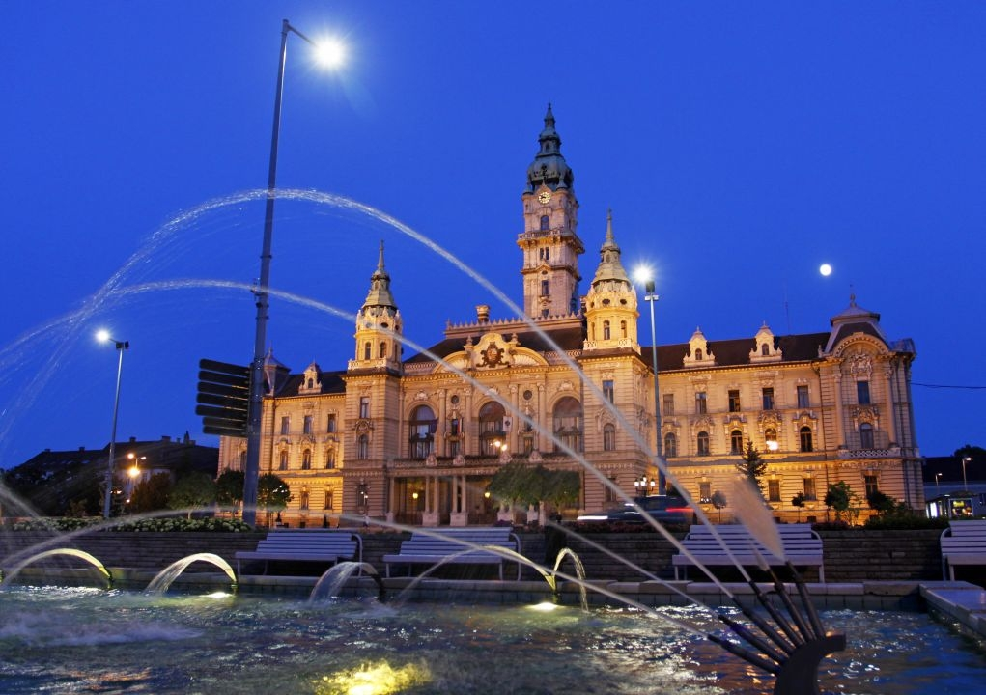
History
2003 – Kittsee Declaration
2004-2006 – CENTROPE project
CentropeMAP – CentropeSTATISTICS
Wide scope of cooperation
2007-2008 – the Lean Years
2009-2012 – Centrope Capacity project
Multiregional political → management consortia
Dedicated presence in all regions
More focused cooperation areas:
Knowledge region – innovation
Human Capital – higher educatuon, workforce migration
Spatial Integration – Transport and strategic planning
Culture and tourism
Tangible results, balanced participation
2013- - Rotated presidency
Maintained structures + Annual flagships
4

Slide 5
2017 – Hungarian Presidency
Cooperation of national-regional-local policy levels
Cooperation with EUSDR
Focus areas: transport + sustainability → e-mobility
Key university research area in Győr, active in partner regions too
Industry strategic direction (Audi, VW, Citroen…)
Smart City / Smart Region drive
Cooperation with the Hungarian E-Mobility Association and the e-mobility oriented Ányos Jedlik Cluster
Objectives
Network redevelopment
Branding and co-branding
Visibility
Cooperative projects
28 June – Workshop on Cross-border transport
26-27 September – Workshop on the future of city/regional transport
17 November – Political Board meeting, transfer of presidency
Győr-Moson-Sopron County Council
Ministy of Foriegn Affairs and Trade
GYSEV ZRt
West-Pannon Nonprofit Ltd
Hungarian Embassy in Austria
5

Slide 6
Benefits
Economic gravity
Opportunities for joint branding and cross-border attraction development
Seamless transport infrastructure/service linkages
Shared professional network
Policy coordination → representation up and down
European good practice
Controlled joint development of the bipolar Vienna-Bratislava metropolitan area
6

Slide 7
Thank you for your attention!
www.westpannon.hu
www.centrope.com
gal.kormendy@westpannon.hu

