Slide 1
Progress report of the Training Program of the PA2 in Moldova 6th Steering Group Meeting of the Priority Area 2 Budapest, 13 June, 2013
dr. Gábor Szörényi, General Secretary
Energy Regulators Regional Association (ERRA)

Slide 2
Fact Finding Mission to the Republic of Moldova
Chisinau, 16-18 January, 2013
The Energy Priority Area has selected a contractor, ERRA (Energy Regulators Regional Association), for this project which has deep knowledge in energy regulation, in the implementation of the 2nd and 3rd Energy Package and good cooperation with regulators and government officials in the region (especially in the Republic of Moldova, Romania, Hungary and Ukraine). The ERRA was deeply involved in some projects funded by the European Commission (like the European Union’s INOGATE Programme; “Capacity Building for Energy Regulators in Eastern Europe and Central Asia”) organising and performing knowledge transfer, training programs and workshops for these countries.
The Danube Region Strategy Energy Priority Area (represented by Ambassador Anita ORBÁN, Priority Area Coordinator and István JOÓ, Chief Advisor) agreed with the representative of the Ministry of Economy of the Republic of Moldova (Vadim CEBAN) on those general topics, which could have high relevance and importance during the transposition and implementation of the EU 3rd Energy Package:
General transposition and implementation issues (process, scope, management, schedule, involved stakeholders)
Unbundling requirements, designation and certification procedure
Independence of the NRA, duties and powers of Regulator (among others supporting competition, monitoring market, supporting cross border trade)
Consumers’ rights and protection (simplification of the process of changing suppliers’ process, last resort supplier, dispute settlement)

Slide 3
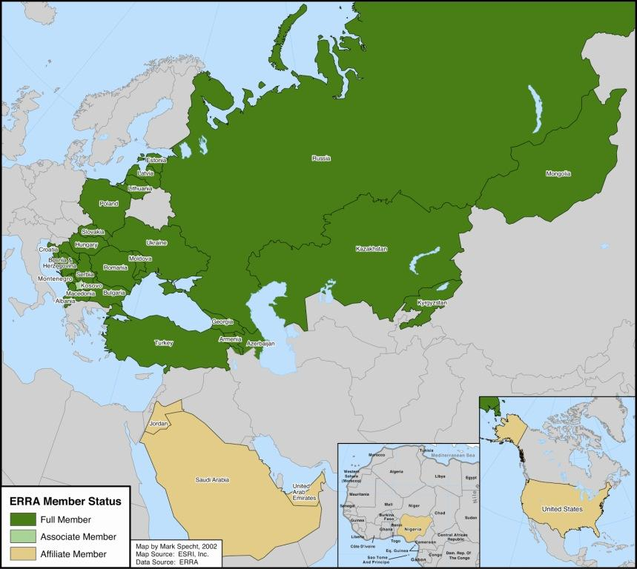
Energy Regulators Regional Association (ERRA)
Voluntary association of national energy regulators
Objectives:
Improve regulation
Strengthen Regulators with exchange of information, training, and research
Harmonized regulatory framework
Stable investment climate
34 member regulators
1700 trained participants
80 trained Commissioners
4 training Videos
4 textbooks
Several issue papers, case studies

Slide 4
Fact Finding Mission to the Republic of Moldova
Chisinau, 16-18 January, 2013
Before the Fact Finding Mission the Project members at ERRA side analysed all the available documents avoiding duplication (INOGATE Programme Report on Regulatory Peer Review at ANRE of Moldova; Energy Community Secretariat: Annual Report on the Implementation of the “Acquis”, 1 September, 2012; The Report on “Independent Regulatory Agencies in Moldova and their interaction with Parliament”, 2011 (in the framework of the “Support to the Parliamentary Development in Moldova” project, funded by DANIDA, SIDA and UNDP); Different energy laws of the Rep. of Moldova).
Based on the analysis of the above mentioned documents and the discussion with the Moldavian officials the Fact Finding Mission had a mixed view on the status of general legal and regulatory framework (especially on the implementation of them) and on the market structure and operational model constraints in Moldova.
The transposition process of the EU 2nd Energy Package has a lot of substantial results, but beside these developments in the field of implementation of the legal requirements into the real practice has some shortages as well.
The market structure (very concentrated “small” national market; limited chance to create regional market; lack of flexible electricity generation units for balancing; one dominant gas supplier) and the technical constraints (lack of synchronous operation with the electricity markets of EU Members before 2017, low utilisation factor of gas transit pipeline without congestion – the implementation of new congestion management methods could not bring immediate benefits) limit the possibility to create efficiently functioning wholesale and retail competition for the benefit of the economy, the end-users and the general social welfare even with the full implementation of some sophisticated methods and processes (like common coordinated congestion management method and procedure for allocation of capacity; market opening for all non-household customers).

Slide 5
Fact Finding Mission to the Republic of Moldova
Chisinau, 16-18 January, 2013
Based on the results of the Fact Finding Mission the following decisions were made:
The previously selected main issues, related to the transposition and implementation of the 3rd Package remain priority during the training sessions (but to be flexible and open for newly occurred issues as well as implementation questions related to the 2nd Package).
The planned four topical workshops should focus - beside the general transposition issues- on the practical implementation issues;
take into consideration the EU legal requirements and the limitations/constraints of the local market structure and operation model as well,
go into details of the practical implementation issues with possible case studies,
the form of training/knowledge transfer should be more discussion type, than presentation type→ to discover the unclear issues at the Moldovan side
incorporate government officials, regulators and industry representatives to the knowledge transfer team to demonstrate different aspects of each issues,
invite representatives of the Moldovan government, regulator and different segments of the energy industry (on the trainee side)

Slide 6
Workshops in the Republic of Moldova, Chisinau
Discussed topics (26-28 February; 26-28 March; 27-29 May 2013)
Independence, Tasks, Responsibilities and Necessary Statutory Powers of the Regulator
Regional Market Building Possibilities (Gas and Electricity)
Cross-Border Capacity Calculation and Congestion Management
Supporting Competition (Possible Regulatory Interactions in Concentrated Markets)
Unbundling, requirements on separation of activities, designation and certification procedure of TSOs (gas and electricity)
Practical examples on separation of activities, on Supervisory Body and on Compliance Monitoring
Requirements and practice of DSO unbundling
General customer protection related issues (gas and electricity) –legal/regulatory framework and regulatory procedures; the potential support for vulnerable customers; power/energy poverty; Last Resort Supplier’ concept
Service Quality Regulation – elements and international benchmark
End-user switching process (from one supplier to another) – elements of the switching process, responsibilities of DSOs, suppliers and customers, conditions
Exemption (from Third Party Access obligations) process – conditions of any TPA’ exemption; “Nabucco” exemption procedure as case study

Slide 7
Workshops in the Republic of Moldova, Chisinau
Lecturers and Trainees (26-28 February; 26-28 March; 27-29 May 2013)
Lecturers/Trainers/Consultants: Representatives of;
EC and EnC Secretariat,
Ministries (Hungary),
National Regulatory Authorities (NRAs) from Hungary, Poland and Romania,
Transmission System Operators (gas and electricity TSOs [OUSO, ISO, ITO]) from the Czech Rep. and Hungary (state and private owned),
Distribution System Operators (gas and electricity DSOs) from Hungary , Romania and Spain (private owned),
Suppliers (gas and electricity) from Hungary (private owned),
ERRA
Audience/Trainees at the side of Rep. of Moldova: Representatives of;
Ministry of Economy of Republic of Moldova
National Regulatory Authority (ANRE)
TSOs (gas and electricity) (state and private owned),
DSOs (gas and electricity DSOs) (state and private owned),
Suppliers (gas and electricity) (state and private owned)

Slide 8
Suggestions and advices during and after the workshops
Strengthen the autonomy of ANRE and create clear responsibilities and possibilities to operate efficiently;
Potential harm of regulatory independence in decision making
cross border issues,
legal expertise’ control of MoJ and free publication rights
the relevant Moldovan law on regulation of the entrepreneurial activity
Budget approval rules and practice (financial independence)
ANRE should have power to impose effective, proportionate and dissuasive penalties on energy undertakings and issue binding decisions (limiting the possibility to suspend the implementation of ANRE’ resolutions and decisions)
Supporting competition on concentrated markets (SMP)
Closer co-operation with neighbouring NRAs
Re-evaluating the division of responsibilities among ANRE and TSOs regarding network codes’ and market rules’ preparation.
Practical advices on;
TSO unbundling and certification process
Cross border capacity allocation issues
Unbundling requirements
Consumer protection issues
Service Quality Regulation related issues
Consumers’ switching process

Slide 9
Lesson learned (1)
Professional staff at ANRE with deep knowledge in the requirements of the 2nd and 3rd Package
Lack of practice in practical implementation of some of the 2nd Package’ requirements
Introducing all aspects (government, regulator, industry, consumer) of the different issues was useful and important
Moderated workshop was a good format of knowledge transfer and detailed discussion
Introducing new terminologies and abbreviations during presentation is important (e.g. FBMC, BCRP)

Slide 10
Lesson learned (2)
Detailed TOR (guidance) for lecturers and preparatory meetings and/or phone conversation with them before the workshop are useful
Follow up activity after the workshops are important:
report of findings and suggestions
delivering the documents requested during workshops
answering the follow up questions
Taking care on language barriers is important
Continuous support in the time-period preparing the draft bills transposing the 3rd Package’ requirements would be very useful.

Slide 11
Progress report of the Training Program of the PA2 in Moldova
Thank you for your kind attention!
Gabor. Szorenyi@erranet.org
www.erranet.org

