Slide 1




Funding programs for energy related topics, 2021-2027
Discussion on project genaration
Priority Area 2- EU Strategy for the Danube Region
Sustainable Energy
Annamária Nádor, PAC, Ministry of Foreign Affairs and Trade

Slide 2
Priority Area 2- EU Strategy for the Danube Region
Sustainable Energy
Background: Embedding EUSDR into EU Programmes
Embedding: a proper coordinaton among EUSDR and mainstream programmes to increase programmes’ impacts through better cooperation. Benefit from other programmes and funding instruments through a better compatibility of concrete actions and targets.
PA2 shortlist:
ACTION 1: To further explore the sustainable use of renewables (biomass, solar energy, geothermal, hydropower and wind power) to increase the energy independency and to promote and support multipurpose cross border RES utilization projects
ACTION 2: To promote energy efficiency and use of renewable energy in buildings and heating systems including district heating and cooling and combined heat and power facilities
ACTION 7: To explore new and innovative solutions of (subsurface) energy storage

Slide 3
Priority Area 2- EU Strategy for the Danube Region
Sustainable Energy
Identified funding sources - Overview
European Regional Development Fund (ERDF), Cohesion Fund (CF) → European Territorial Cooperation - Interreg Programs
  Interreg A: Cross-border Cooperation Programs (CBC) – 60 programs
  Interreg B: Transnational Programs – 15 programs (Danube Transnational Program (DTP), Central Europe Program (CE), Adriatic-Ionian (SI, HR, BiH, SRB, MNG), Alpine Space (AT, SI, D), Balcan-Mediterranean (BG), Mediterranean (SI, HR, BiH, MNG)
  Interreg C: Interregional (Interreg Europe Program)
Connecting Europe Facility (CEF) Program
Horizone Europe
LIFE Program
Visegrád Fund
European City Facilities

Slide 4
Priority Area 2- EU Strategy for the Danube Region
Sustainable Energy
Investment priorities of Cohesion Policy (policy objectives) for ERDF and CF
1) a Smarter Europe, through innovation, digitisation, economic transformation and support to small and medium-sized businesses;
2) a Greener, carbon free Europe, implementing the Paris Agreement and investing in energy transition, renewables and the fight against climate change;
3) a more Connected Europe, with strategic transport and digital networks;
4) a more Social Europe, delivering on the European Pillar of Social Rights and supporting quality employment, education, skills, social inclusion and equal access to healthcare;
5) a Europe closer to citizens, by supporting locally-led development strategies and sustainable urban development across the EU.

Slide 5
Priority Area 2- EU Strategy for the Danube Region
Sustainable Energy
European Territorial Cooperation - Interreg Programs – €8.43 billion
cross-border cooperation between adjacent regions to promote integrated regional development
transnational cooperation over larger transnational territories, involving national, regional and local programme partners in Member States, third countries to achieve a higher degree of territorial integration
outermost regions' cooperation among themselves and with their neighbouring third or partner countries to facilitate their regional integration in their neighbourhood
interregional cooperation to reinforce the effectiveness of cohesion policy
interregional innovation investments through the commercialisation and scaling up of interregional innovation projects having the potential to encourage the development of European value chains

Slide 6
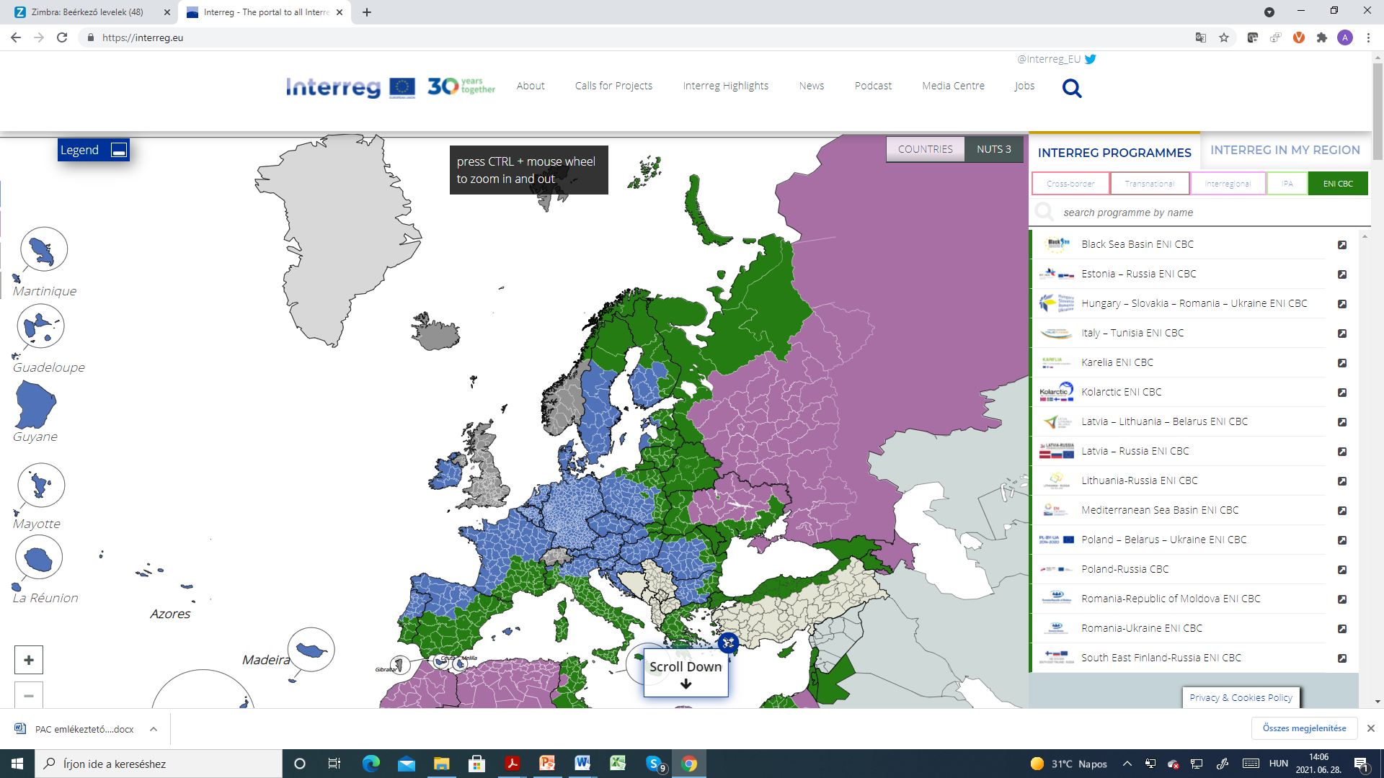
Priority Area 2- EU Strategy for the Danube Region
Sustainable Energy
https://interreg.eu/

Slide 7
Priority Area 2- EU Strategy for the Danube Region
Sustainable Energy
Interreg A: Cross-border Cooperation Programs (CBC)
60 programs
https://interreg.eu/strand-of-cooperation/interreg-a-cross-border-cooperation/
Interreg V-A – completed,
SI-AT, AT-CZ, SK-AT, AT/D-Bavaria, AT-HU, D/Bavaria-CZ, SK-CZ, SK-HU, SI-HU, HU-HR, RO-BG, HR-BiH-MNE, HR-RS, RO-RS, HU-RS, BG-RS,RO-MD, RO-UA, HUSKROUA, etc.
Planning of 2021-2027 period is at various stages at different program levels (selection of thematic priorities, SEA process, elaboration of program documents, etc.)
First calls to expected ~ Q3-Q4 2022

Slide 8
Priority Area 2- EU Strategy for the Danube Region
Sustainable Energy
Interreg B – Transnational Programs
Danube Transnational Program (DTP)
http://www.interreg-danube.eu/about-dtp/programming-period-2021-2027
The programme main (energy related) goal is to contribute to the reduction of region’s dependency on imported fossil fuels by facilitating a better integration of renewable energy sources and consequently greening the energy and transport sectors.
PO: Greener Europe
SO 2.2: Increasing the share of renewable energy in the Danube region
The embedding of other funding sources is crucial, and the proposed role of DTP 2021-2027 is to serve as a catalyst for ideas with a transnational added-value, an enabler and a policy driver (c.f. large investment in energy projects)
First calls expected in Q1 2022 ( 2 stage proposals)

Slide 9
Priority Area 2- EU Strategy for the Danube Region
Sustainable Energy
Types of Actions
Development of strategies and policies aimed at low-carbon energy production
Harmonised actions as regards to heating and cooling systems
Actions aimed at reducing GHG emissions in the transport sector
Joint planning of infrastructure for the utilisation of renewable energy sources
Development of incentive policies to encourage the renewable energy production based on available resources
Development of common orientations, frameworks and strategies in fields of transnational relevance
Preparation of transnational investments
Pilot activities including small-scale fixed investments
Development and practical implementation of transnational tools and services
Development and practical implementation of training and capacity building
Accompanying information, dissemination, capitalisation and publicity measures

Slide 10
Priority Area 2- EU Strategy for the Danube Region
Sustainable Energy
D
Interreg B – Transnational Programs
Central Europe Program (CE)
CZ
SK
AT
HU
https://www.interreg-central.eu/Content.Node/discover/InterregCE2021.html
SI
HR
Priority 2: Cooperating for a greener central Europe
SO 2.1 Supporting the energy transition to a climate-neutral central Europe
Potential fields to be addressed in transnational actions (non-exhaustive list):
• Smart integration of carbon-neutral solutions across sectors
• Renewable energy sources
• Energy efficiency of buildings and public infrastructures
• Reduction of greenhouse gas emissions from industry and other sectors
• Energy planning at local and regional levels
• Energy demand management and behavioural change
• Financing schemes for energy efficiency and renewable energy investments
• Energy poverty
First calls expected in Q4 2021 ( 1 stage proposal)

Slide 11
Priority Area 2- EU Strategy for the Danube Region
Sustainable Energy
Interreg C: Interregional Programs
Interreg Europe Program
https://www.interregeurope.eu/about-us/2021-2027/
First calls expected in Q1 2022 (1 stage proposal)

Slide 12
Priority Area 2- EU Strategy for the Danube Region
Sustainable Energy
Connecting Europe Facility (CEF) Program - €33.71 billion
https://ec.europa.eu/inea/en/news-events/newsroom/agreement-2021-2027-connecting-europe-facility
Supports trans-European networks and infrastructures in the sectors of transport, telecommunications and energy (large-scale investment projects)
1. Transport: €25.81 billion (including €11.29 billion for cohesion countries)
Shifting from a patchwork of national networks to a truly interconnected one by supporting the development and modernisation of railway, road, inland waterway and maritime infrastructure, as well as promoting safe and secure mobility. Priority will be given to further development of the trans-European transport networks (TEN-T)
2. Energy: €5.84 billion
Further integration of the European energy market, improving the interoperability of energy networks, facilitating decarbonisation, and ensuring security of supply. Funding will also be available for cross-border projects in the field of renewable energy generation. When defining award criteria, consistency with EU and national energy and climate plans, including the principle of 'energy efficiency first', will be taken into account.

Slide 13
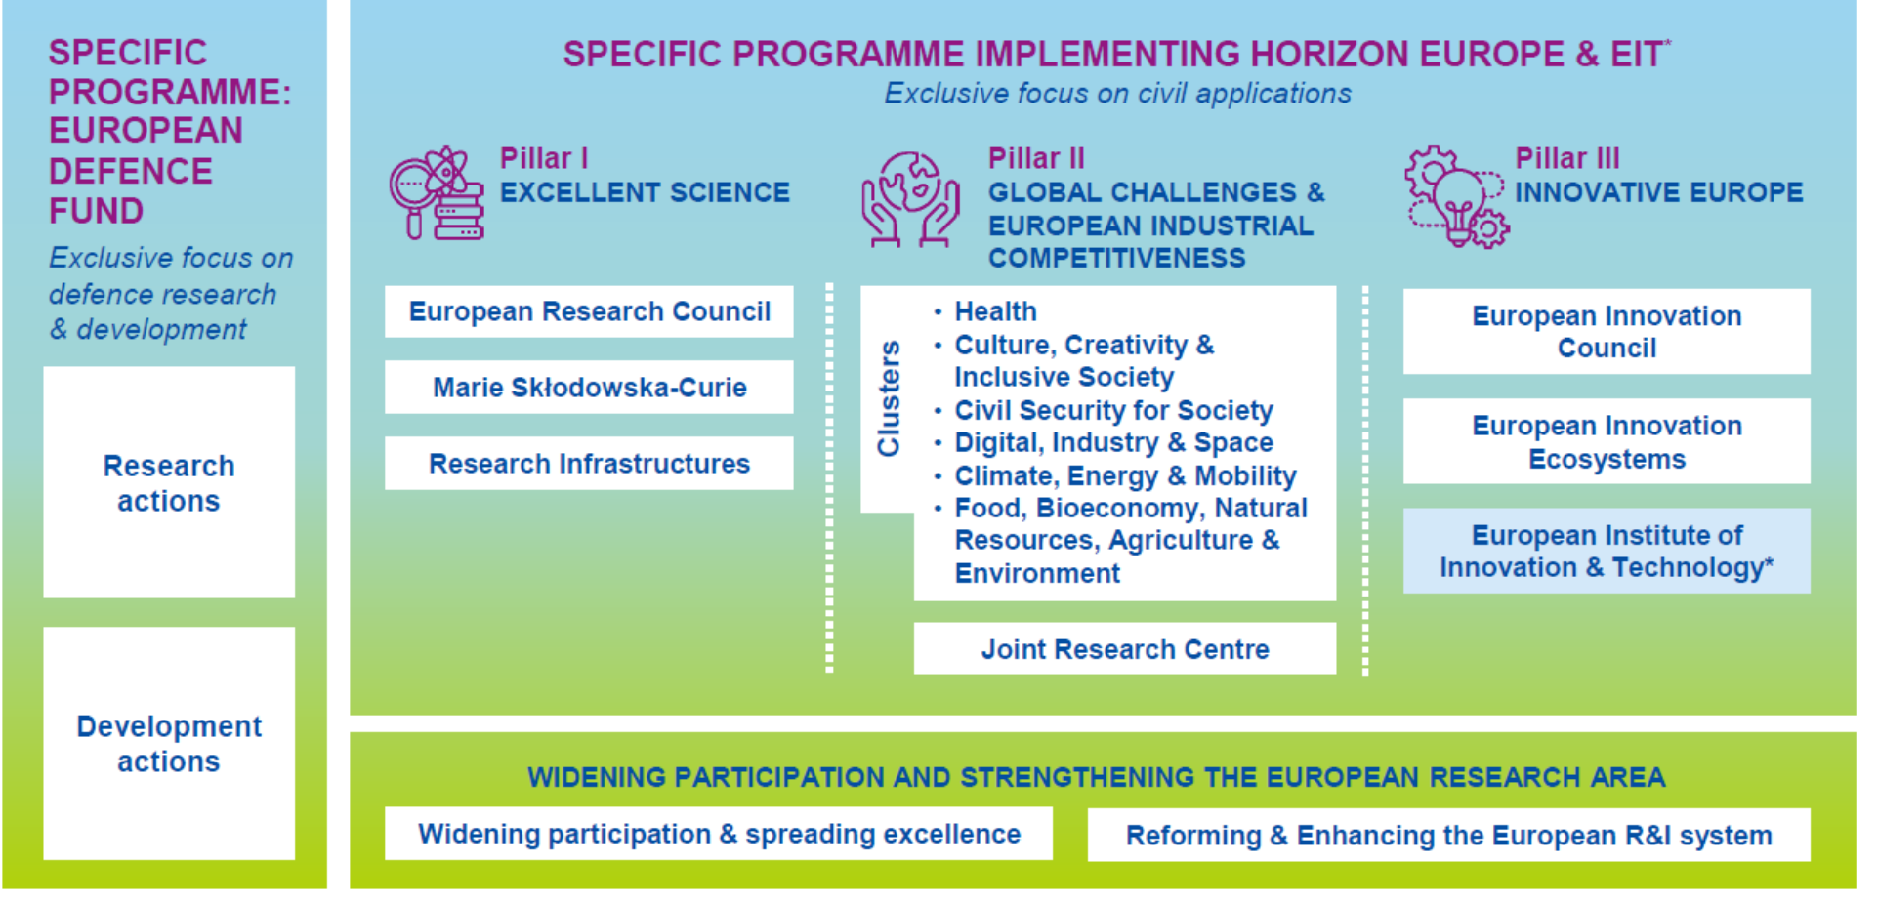
Priority Area 2- EU Strategy for the Danube Region
Sustainable Energy
Horizone Europe - €95.9 billion
https://ec.europa.eu/info/research-and-innovation/funding/funding-opportunities/funding-programmes-and-open-calls/horizon-europe_en
EU’s key funding programme for research and innovation

Slide 14
Priority Area 2- EU Strategy for the Danube Region
Sustainable Energy
Cluster Climate, Energy and Mobility - €15.123 billion
Intervention Areas:
climate science and solutions
energy supply
energy systems and grids
buildings and industrial facilities in energy transition
communities and cities
industrial competitiveness in transport
clean, safe and accessible transport and mobility
smart mobility
energy storage
Work Programme 2021-2022 available: https://ec.europa.eu/info/funding-tenders/opportunities/docs/2021-2027/horizon/wp-call/2021-2022/wp-8-climate-energy-and-mobility_horizon-2021-2022_en.pdf
Info days: https://www.horizon-europe-infodays2021.eu/
5 & 6 July - Climate, energy & mobility
First calls for proposals will open on the Commission's Funding and Tenders Portal on 22 June.

Slide 15
Priority Area 2- EU Strategy for the Danube Region
Sustainable Energy
LIFE Program
EU’s funding instrument for the environment and climate action
Climate Action - Sub-programme: Clean Energy Transition - € 1 billion
https://cinea.ec.europa.eu/life/clean-energy-transition_en
Intervention Areas:
Building a national, regional and local policy framework supporting the clean energy transition;
Accelerating technology roll-out, digitalisation, new services and business models and enhancement of the related professional skills on the market;
Attracting private finance for sustainable energy;
Supporting the development of local and regional investment projects;
Involving and empowering citizens in the clean energy transition.
The first LIFE multiannual work programme spans over a period of four years (2021-2024) and is under adaption

Slide 16
Priority Area 2- EU Strategy for the Danube Region
Sustainable Energy
Visegrad Fund
https://www.visegradfund.org/about-us/the-fund/
Established in 2000 by the governments of the Visegrad Group countries—Czechia, Hungary, Poland and Slovakia to promote regional cooperation in the Visegrad region (V4) as well as between the V4 region and other countries, especially in the Western Balkans and Eastern Partnership regions.
Visegrad Grants: at least 3 V4 countries
Visegrad+ Grants: at least 3 V4 countries and 1 entity from the EaP region or the Western Balkans countries
Projects must clearly address one of the objectives of the program (not clearly energy related topics)
Education and Capacity Building
Public Policy and Institutional Partnership
Regional Development, Environment and Tourism

Slide 17
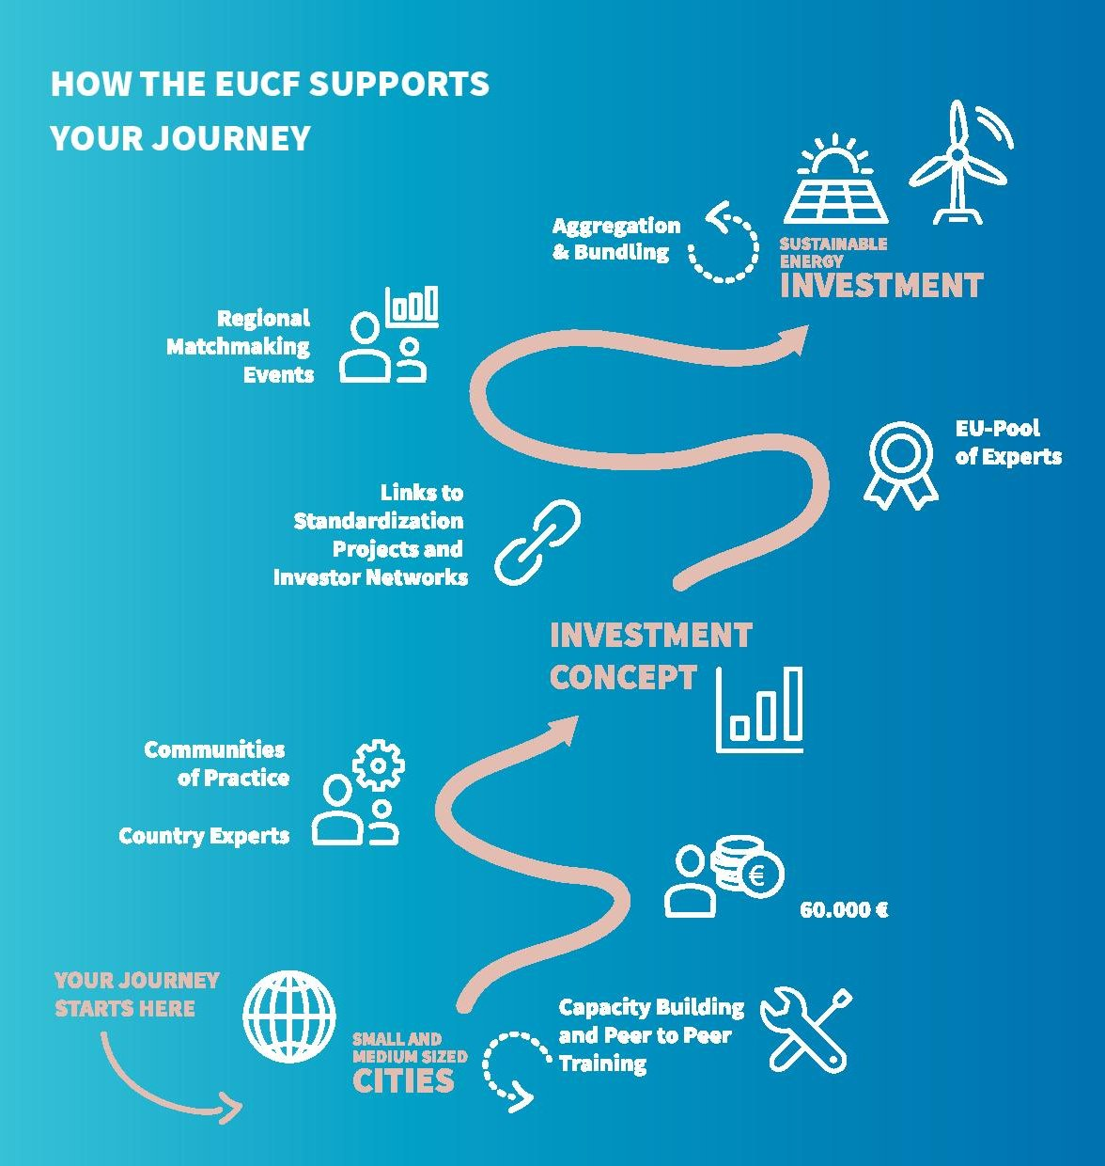
Priority Area 2- EU Strategy for the Danube Region
Sustainable Energy
European City Facilities
https://www.eucityfacility.eu/home.html
Supports municipalities, local authorities, their groupings and local public entities aggregating municipalities/local authorities in Europe with tailor-made, fast and simplified financial support (in the form of EUR 60,000 lump sums) to enable them to develop relevant investment concepts related to the implementation of actions identified in their climate and energy action plans.
3rd Call: Oct-Nov 2021
4th Call: May-June 2022

Slide 18
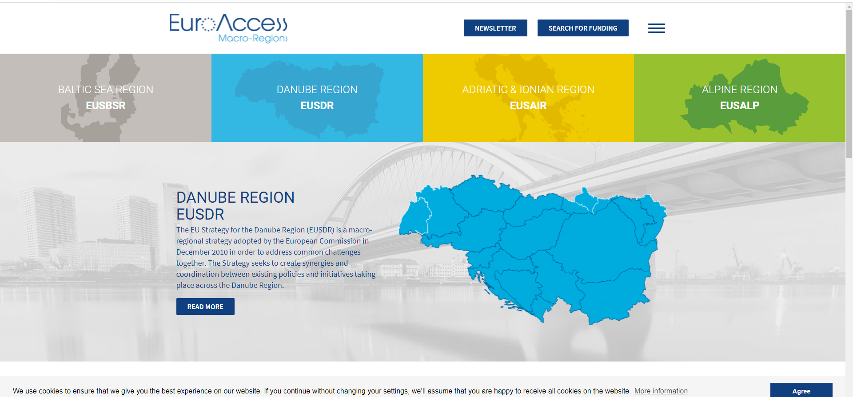
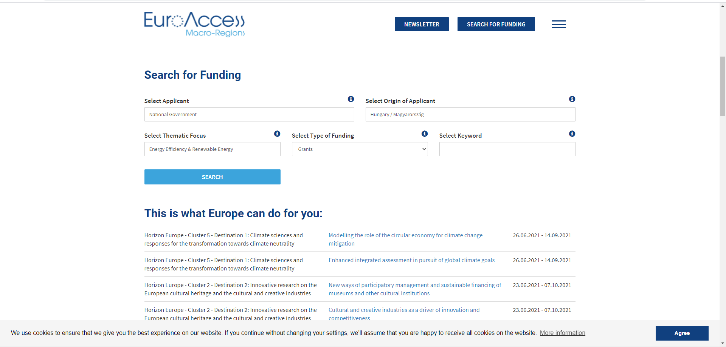
Priority Area 2- EU Strategy for the Danube Region
Sustainable Energy
https://www.euro-access.eu/

